Slide 1
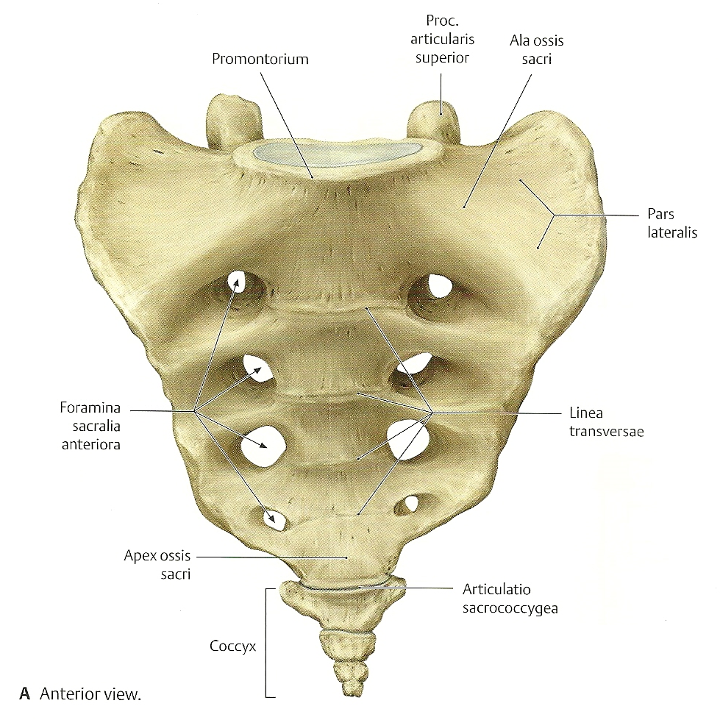
Ala ossis sacri

Slide 2
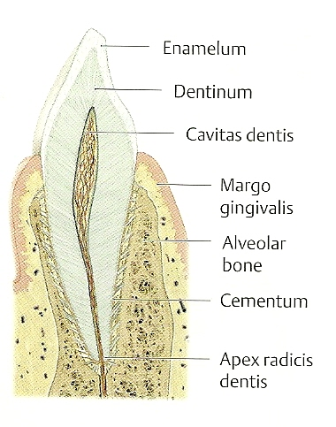
Apex radicis dentis

Slide 3
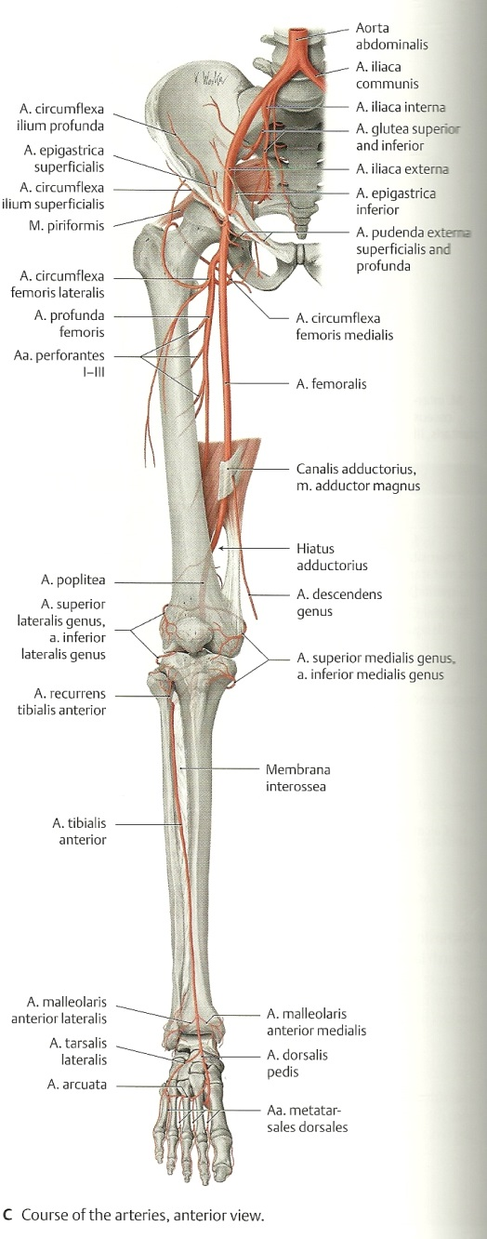
Arteria profunda femoris

Slide 4
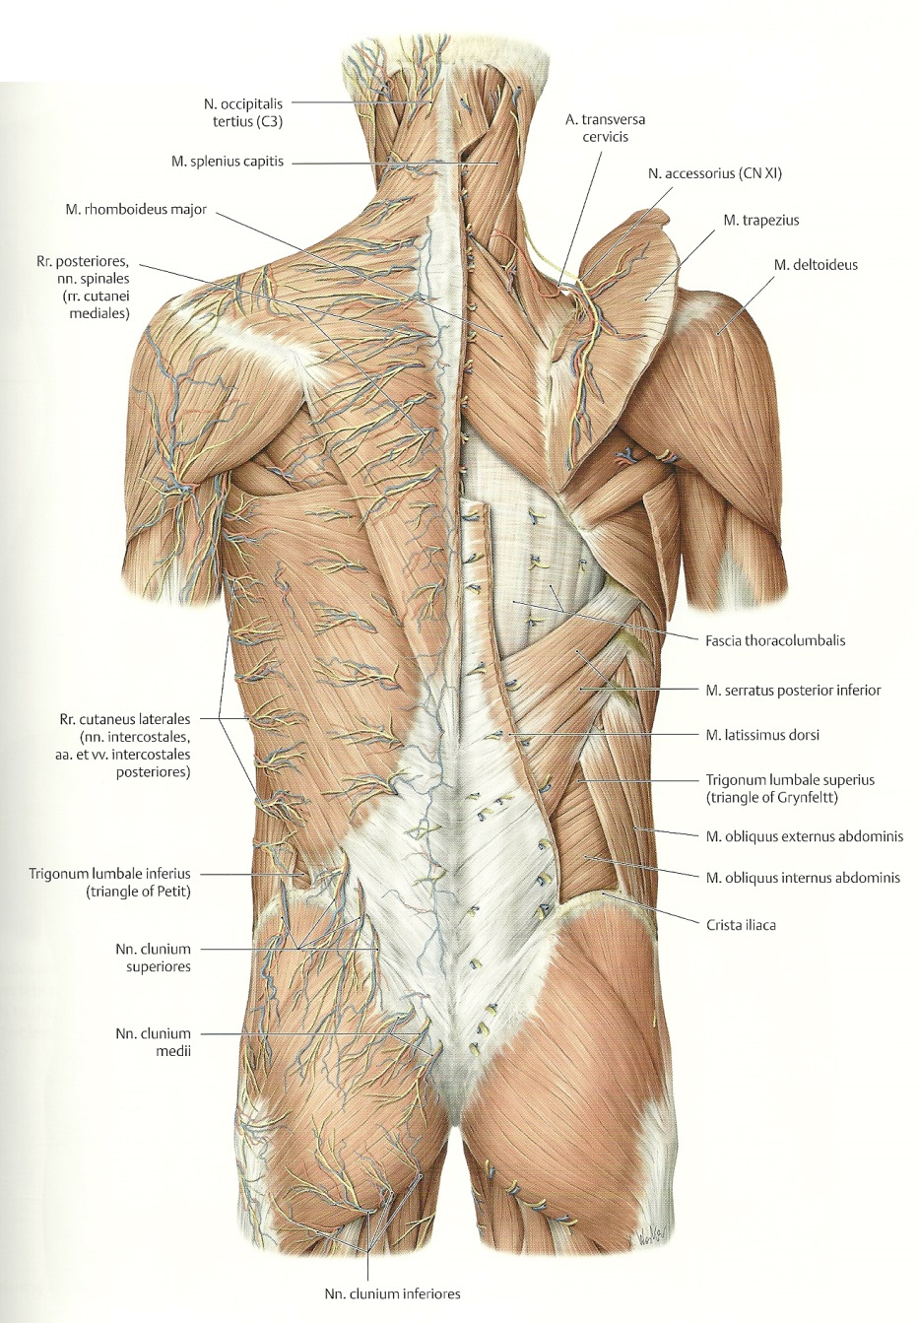
Arteria transversa cervicis

Slide 5
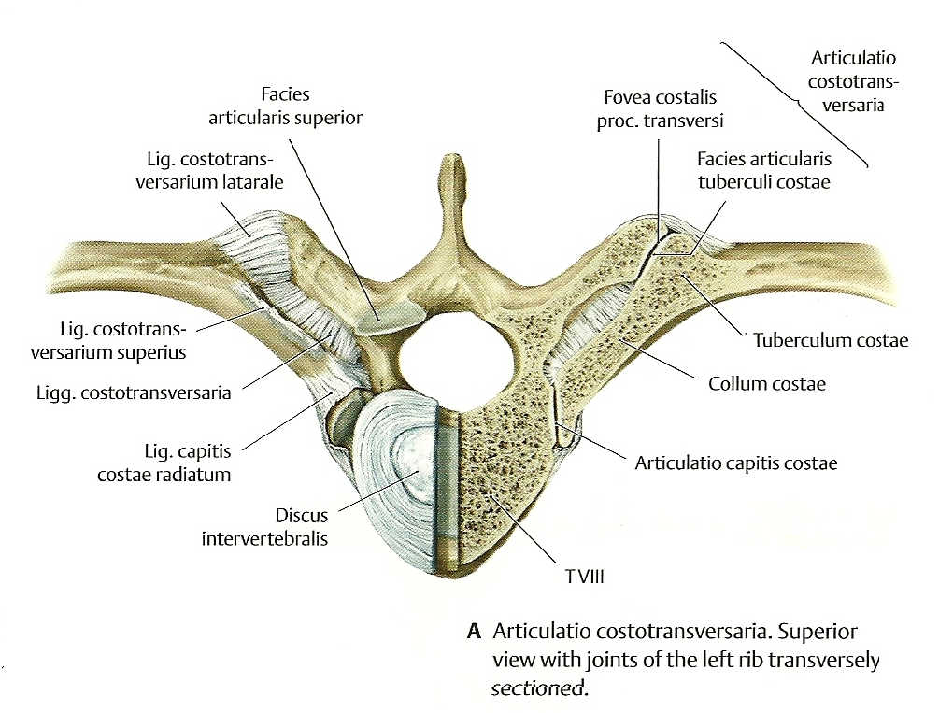
Articulatio capitis costae

Slide 6
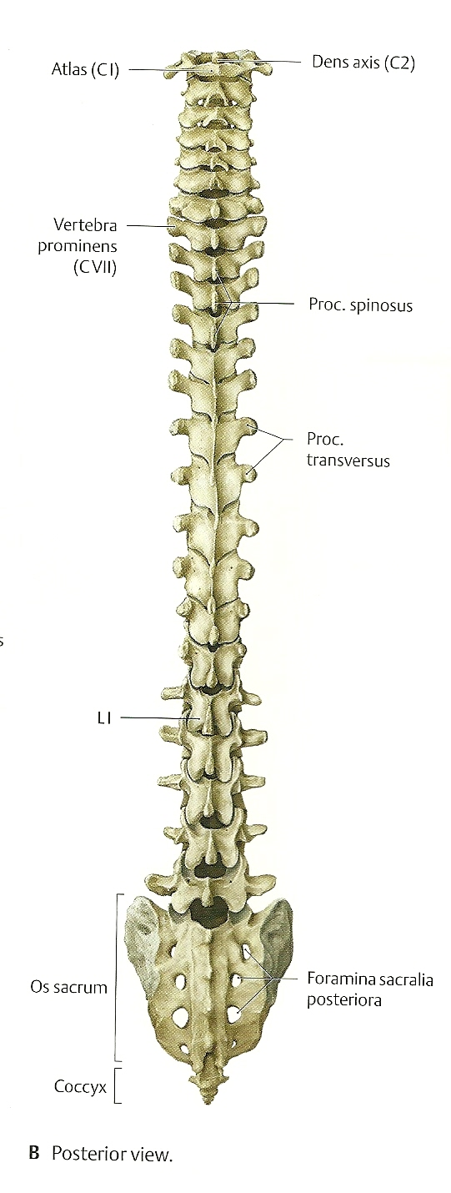
Dens axis

Slide 7
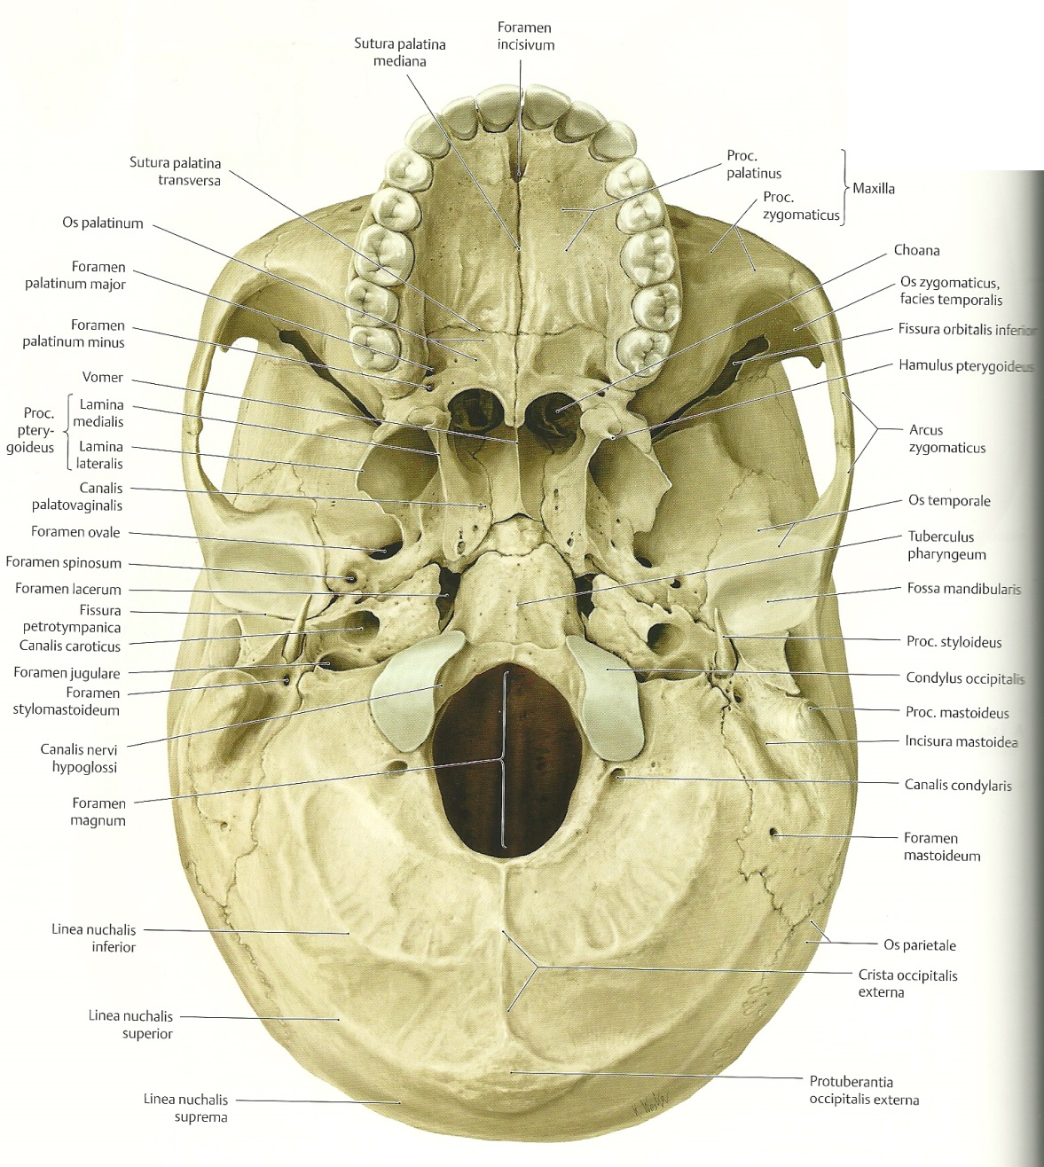
Basis cranii

Slide 8
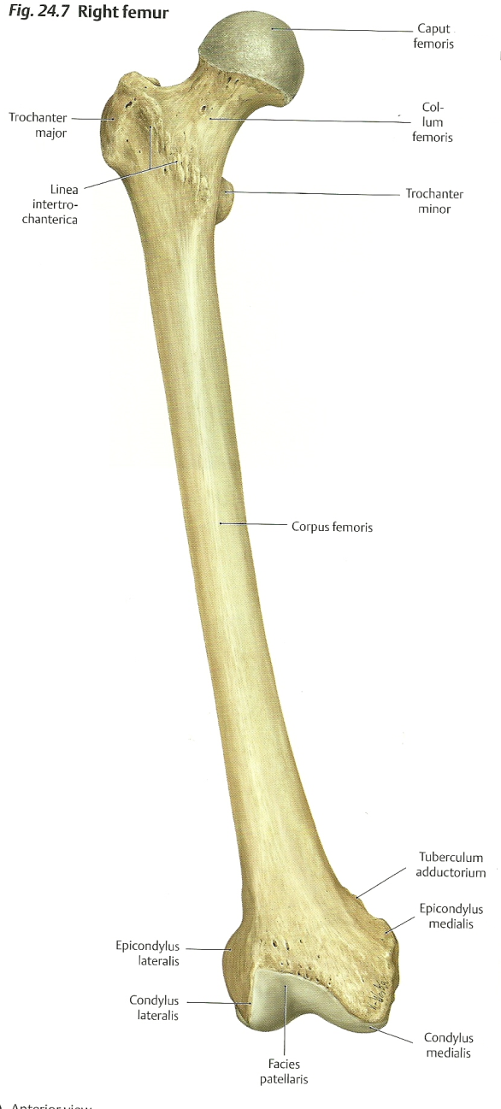
Caput femoris, collum femoris

Slide 9
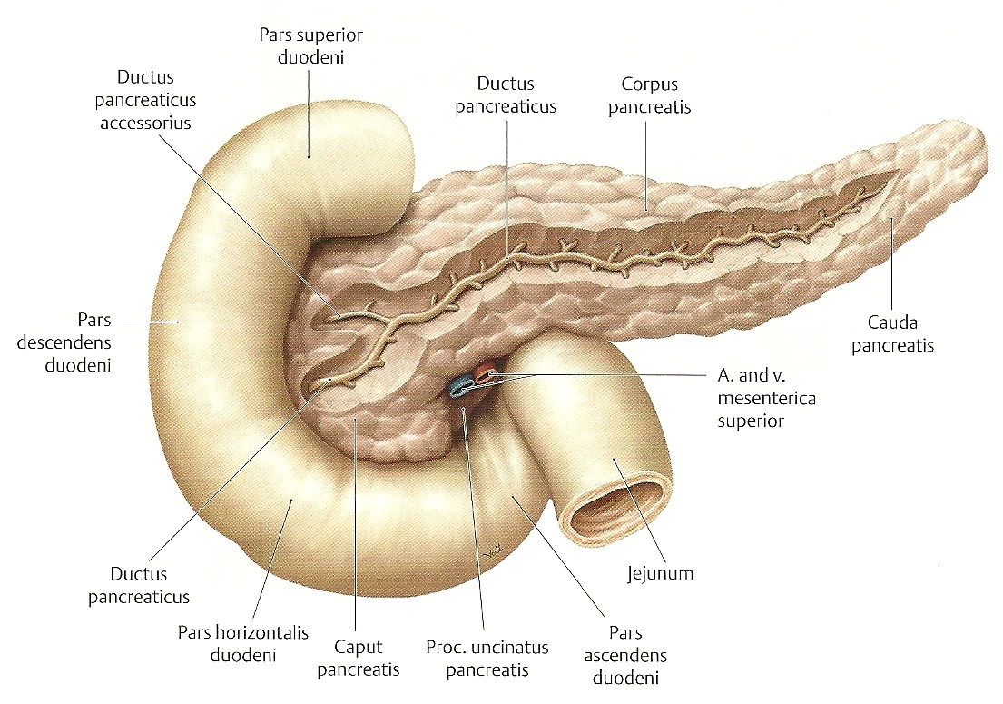
Caput pancreatis

Slide 10
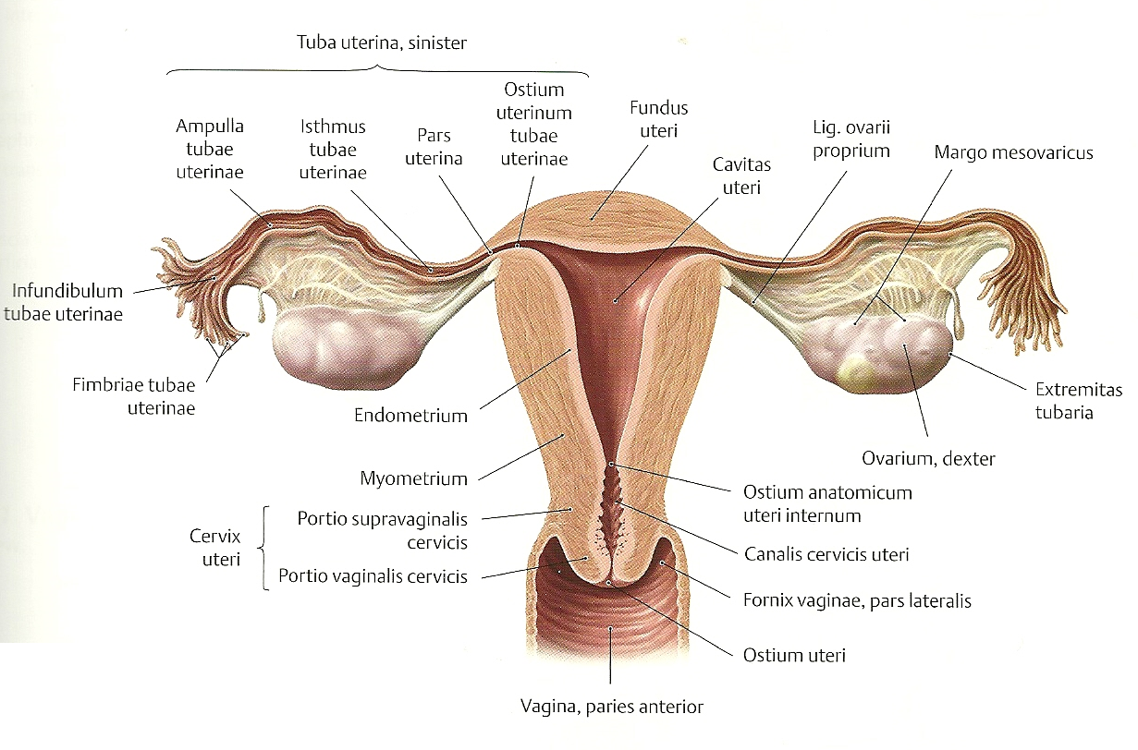
Cervix uteri

Slide 11
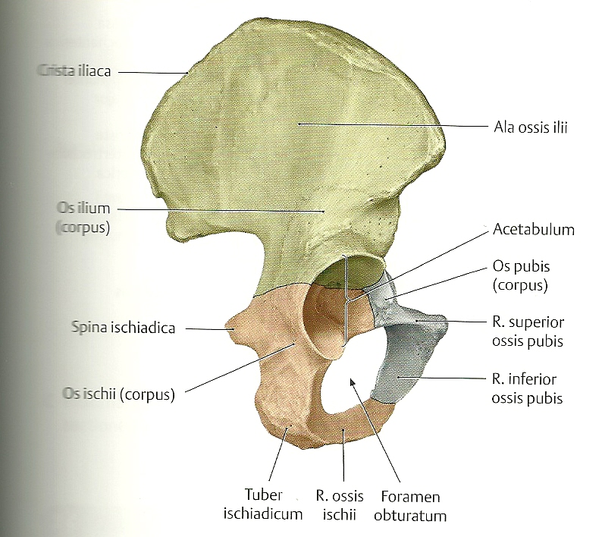
Corpus ossis ischii

Slide 12
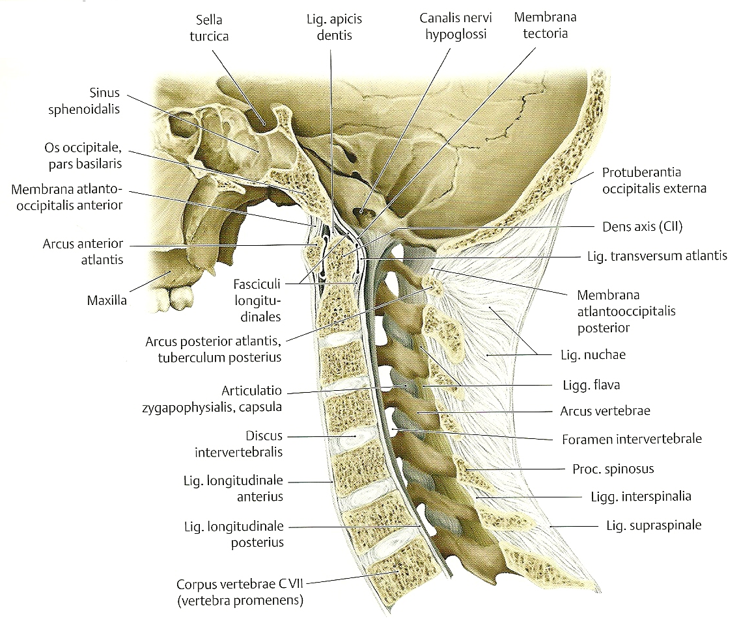
Ligamentum transversum atlantis

Slide 13
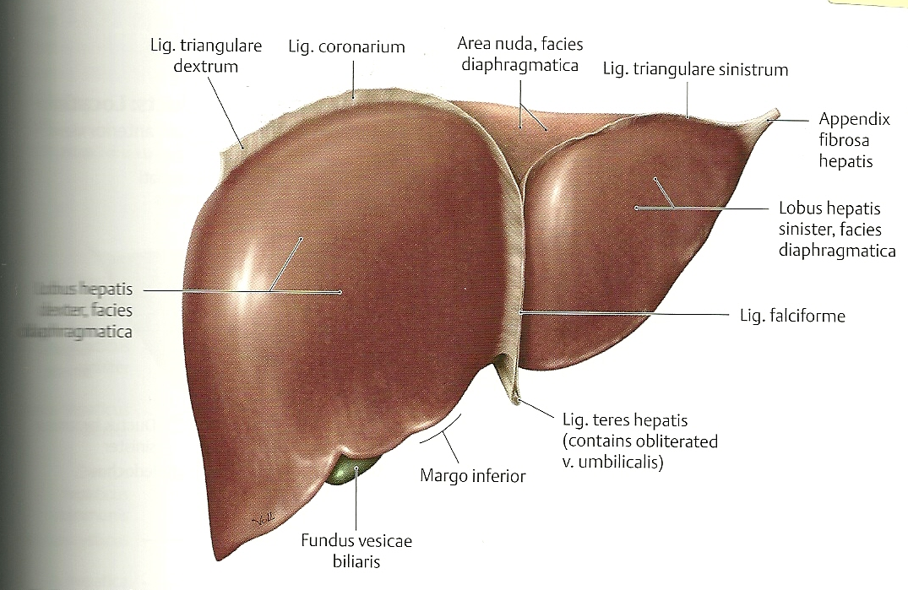
Lobus hepatis dexter, sinister

Slide 14
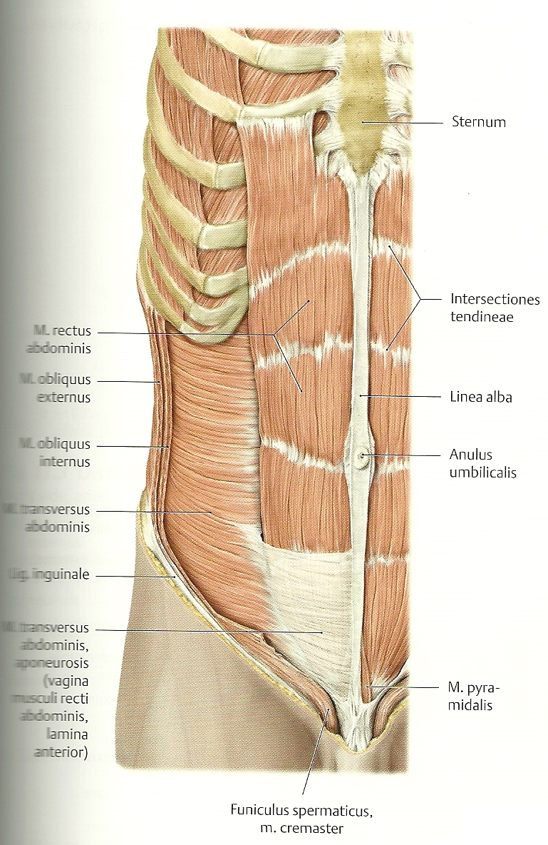
Musculus rectus, transversus abdominis

Slide 15
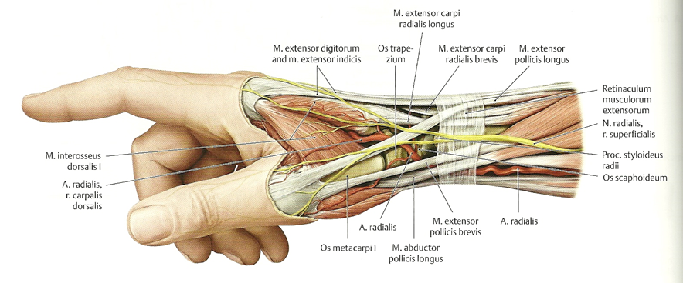
Musculus abductor pollicis longus

Slide 16
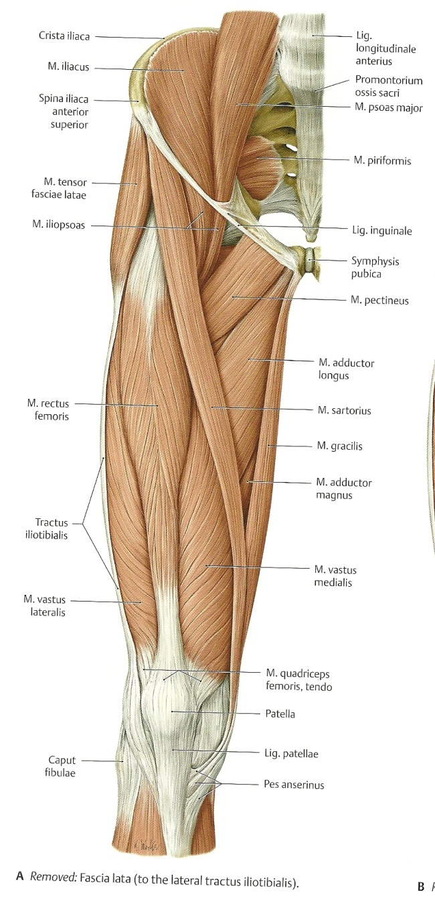
Musculus tensor fasciae latae

Slide 17
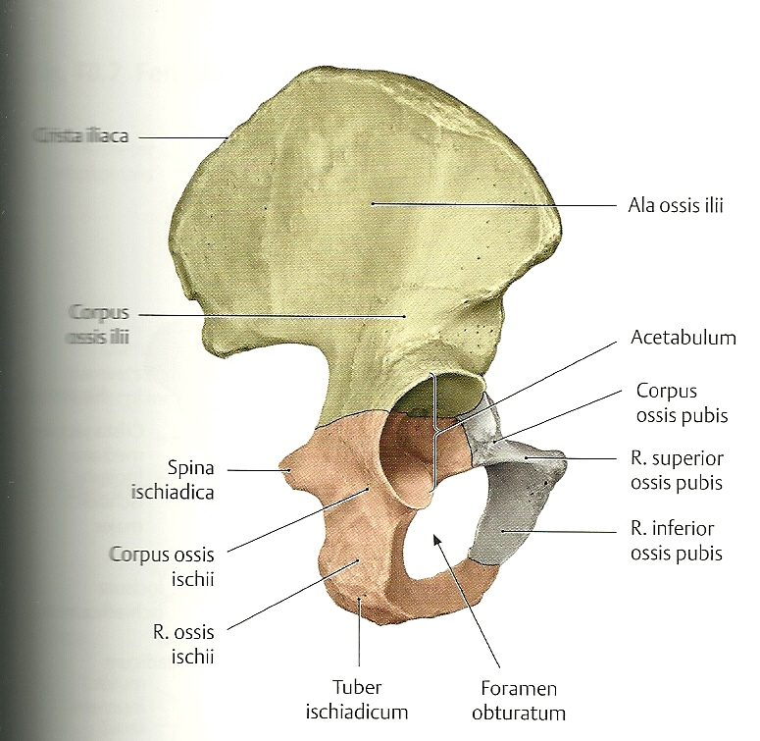
Os ilium, os ischii, os pubis

Slide 18
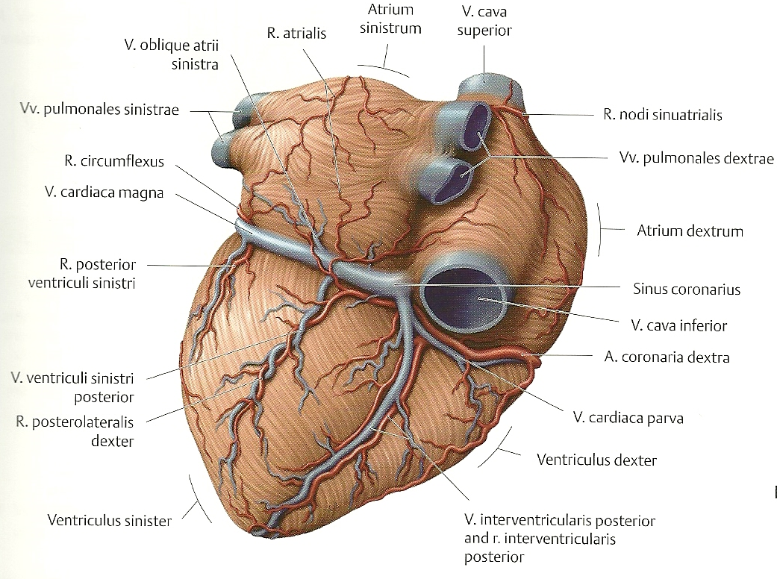
Vena cordis magna, parva

Slide 19
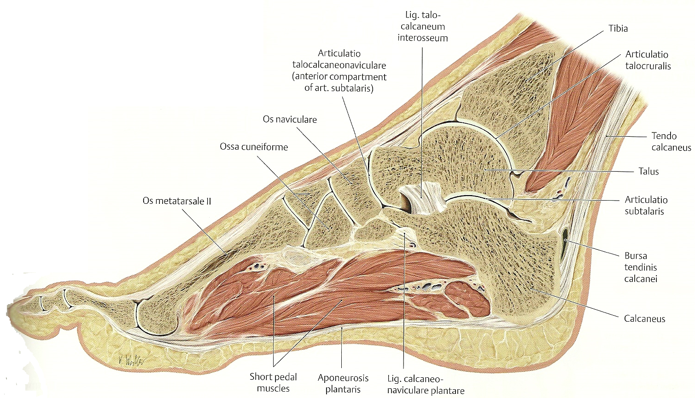
Tendo calcaneus

Slide 20
Ala ossis ilii

Slide 21
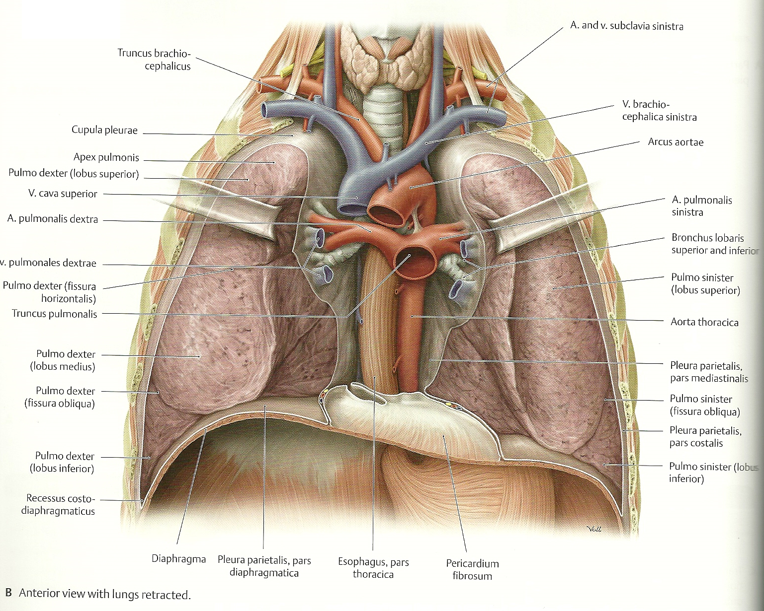
Apex pulmonis

Slide 22
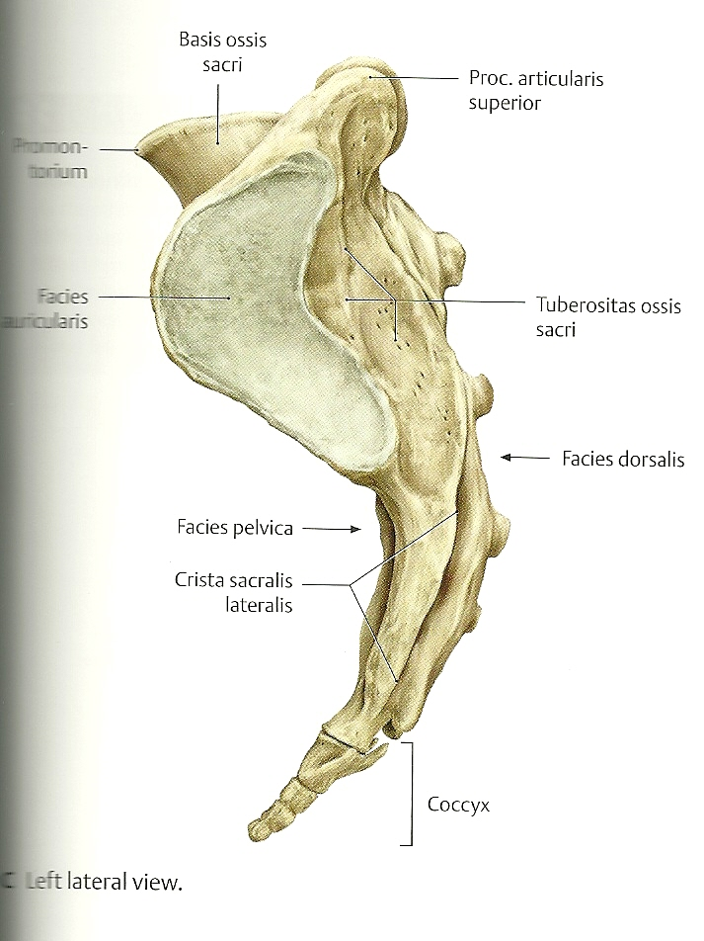
Basis ossis sacri

Slide 23
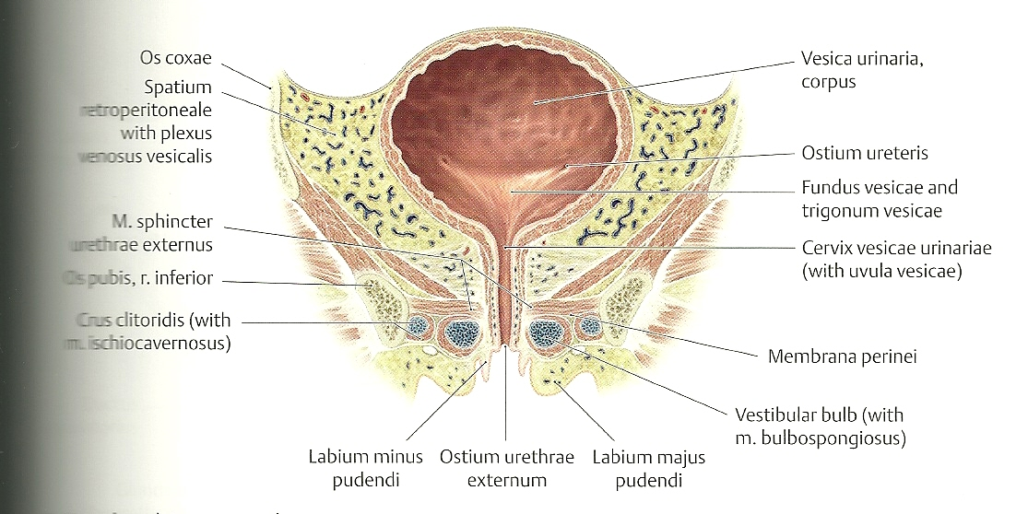
Cervix vesicae urinariae

Slide 24
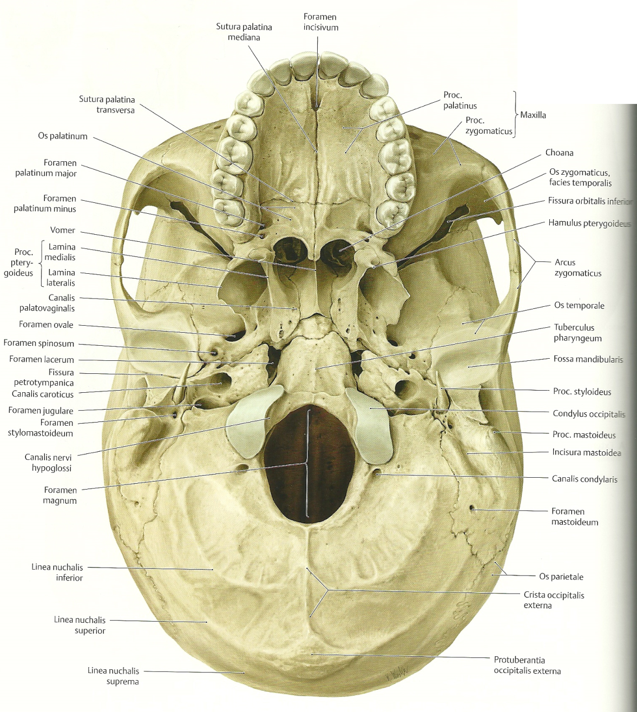
Foramen magnum

Slide 25
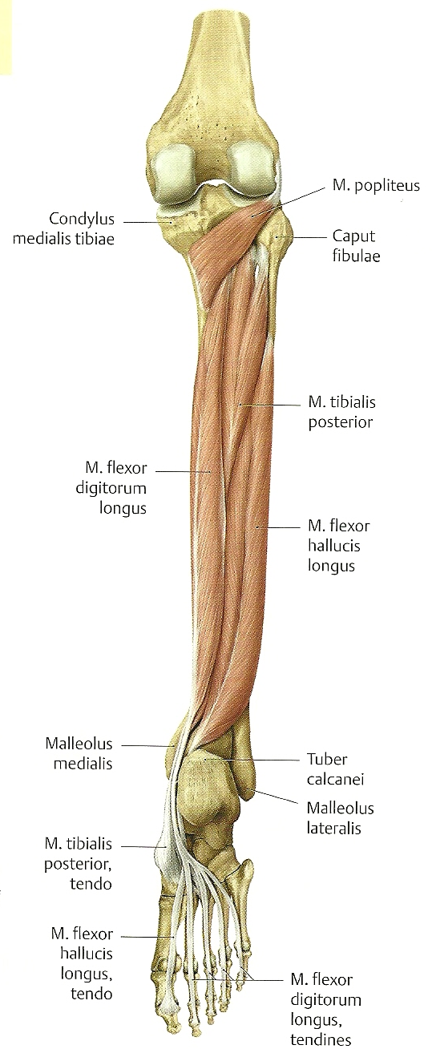
Musculus flexor hallucis longus

Slide 26
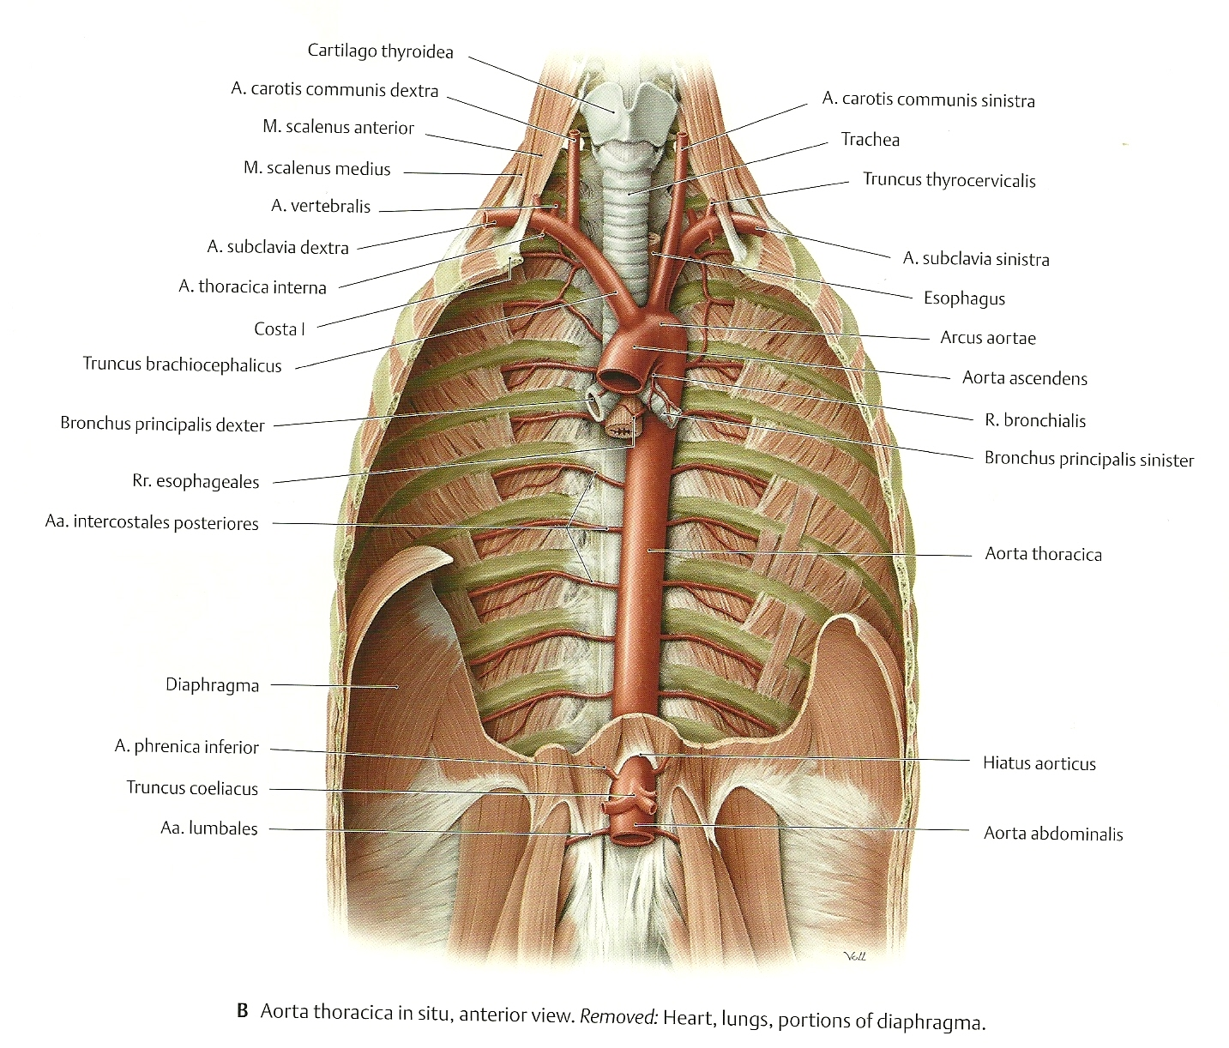
Pars thoracica aortae

