Slide 1
USMLE Step 1
Immunology

Slide 2
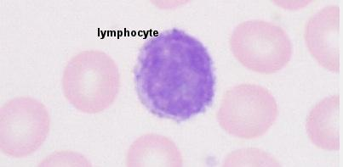
Q1
A 48-year-old man with chronic renal failure undergoes a cadaveric renal transplant. One week later, the patient has an elevated creatinine level. The surgical team is concerned about the possibility of acute transplant rejection. The cell type shown in the image is believed to be an important mediator of this process. In which of the following locations does this cell type complete maturation?
A, Bone marrow
B, Lung
C, Spleen
D, Thymus
E, Yolk sac

Slide 3
Q2
A 23-year-old man comes to the physician with a bacterial infection. On questioning the patient reveals a history of recurrent bacterial, fungal, and viral infections. Blood is drawn and sent for laboratory analysis, which reveals all level of immune cells (e.g., T and B lymphocytes) are low. Which of the following conditions is most likely to have caused the patient’s symptoms?
A, Ataxia-telangiectasia
B,Chédiak-Higashi disease
C,Common variable immunodeficiency
D,Job’s syndrome
E,Autosomal severe combined immunodeficiency
F,Wiskott-Aldrich syndrome
G,X-linked agammaglobulinemia

Slide 4
Q2
A 23-year-old man comes to the physician with a bacterial infection. On questioning the patient reveals a history of recurrent bacterial, fungal, and viral infections. Blood is drawn and sent for laboratory analysis, which reveals all level of immune cells (e.g., T and B lymphocytes) are low. Which of the following conditions is most likely to have caused the patient’s symptoms?
A, Ataxia-telangiectasia
B,Chédiak-Higashi disease
C,Common variable immunodeficiency
D,Job’s syndrome
E,Autosomal severe combined immunodeficiency
F,Wiskott-Aldrich syndrome
G,X-linked agammaglobulinemia

Slide 5
Q2
A 23-year-old man comes to the physician with a bacterial infection. On questioning the patient reveals a history of recurrent bacterial, fungal, and viral infections. Blood is drawn and sent for laboratory analysis, which reveals all level of immune cells (e.g., T and B lymphocytes) are low. Which of the following conditions is most likely to have caused the patient’s symptoms?
A, Ataxia-telangiectasia
B,Chédiak-Higashi disease
C,Common variable immunodeficiency
D,Job’s syndrome
E,Autosomal severe combined immunodeficiency
F,Wiskott-Aldrich syndrome
G,X-linked agammaglobulinemia

Slide 6
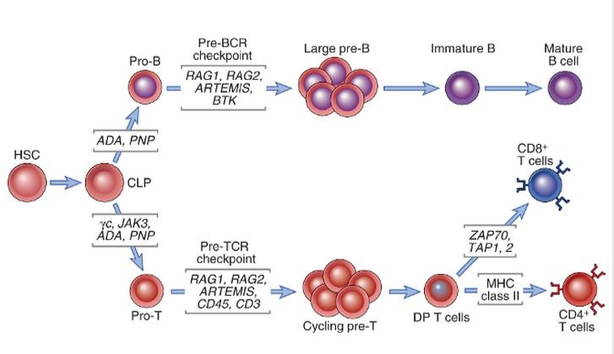
Q2
SCID (Basic Immunology, Abbas, p.226)

Slide 7
Q3
A 13-year-old boy is diagnosed with a hyperactive immune system. Normally an antigen will activate the immune system to trigger a proinflammatory response. Following the proinflammatory response, anti-inflammatory signals then dampen the immune response to prevent it from causing damage. This patient has trouble dampening the immune response after it is no longer needed. Decreased activity in which of the following anti-inflammatory cytokines is most likely the basis for this boy’s condition?
A,IFN-gamma
B,IL-1
C,TGF-beta
D,TNF-alpha
E,TNF-beta
Basic Immunology, Abbas p.283

Slide 8
Q3
A 13-year-old boy is diagnosed with a hyperactive immune system. Normally an antigen will activate the immune system to trigger a proinflammatory response. Following the proinflammatory response, anti-inflammatory signals then dampen the immune response to prevent it from causing damage. This patient has trouble dampening the immune response after it is no longer needed. Decreased activity in which of the following anti-inflammatory cytokines is most likely the basis for this boy’s condition?
A,IFN-gamma
B,IL-1
C,TGF-beta
D,TNF-alpha
E,TNF-beta
Basic Immunology, Abbas p.283

Slide 9
Q3
A 13-year-old boy is diagnosed with a hyperactive immune system. Normally an antigen will activate the immune system to trigger a proinflammatory response. Following the proinflammatory response, anti-inflammatory signals then dampen the immune response to prevent it from causing damage. This patient has trouble dampening the immune response after it is no longer needed. Decreased activity in which of the following anti-inflammatory cytokines is most likely the basis for this boy’s condition?
A,IFN-gamma
B,IL-1
C,TGF-beta
D,TNF-alpha
E,TNF-beta
Basic Immunology, Abbas p.283

Slide 10
Q4
A 19-year-old man comes to the physician with a bacterial infection. Without treatment, the patient’s immune system will most likely be able to fight off the infection within a few days. One of the tools the patient’s body uses against the organism is the membrane attack complex. The membrane attack complex functions as which of the following?
A,A chemoattractant for neutrophils
B,An anaphylactic signal causing degranulation of mast cells
C,An opsonization molecule, facilitating phagocytosis
D,A proteinaceous pore in the plasma membrane
E,A scaffold on cell membrane to which antibodies can bind

Slide 11
Q4
A 19-year-old man comes to the physician with a bacterial infection. Without treatment, the patient’s immune system will most likely be able to fight off the infection within a few days. One of the tools the patient’s body uses against the organism is the membrane attack complex. The membrane attack complex functions as which of the following?
A,A chemoattractant for neutrophils
B,An anaphylactic signal causing degranulation of mast cells
C,An opsonization molecule, facilitating phagocytosis
D,A proteinaceous pore in the plasma membrane
E,A scaffold on cell membrane to which antibodies can bind

Slide 12
Q4
A 19-year-old man comes to the physician with a bacterial infection. Without treatment, the patient’s immune system will most likely be able to fight off the infection within a few days. One of the tools the patient’s body uses against the organism is the membrane attack complex. The membrane attack complex functions as which of the following?
A,A chemoattractant for neutrophils
B,An anaphylactic signal causing degranulation of mast cells
C,An opsonization molecule, facilitating phagocytosis
D,A proteinaceous pore in the plasma membrane
E,A scaffold on cell membrane to which antibodies can bind

Slide 13
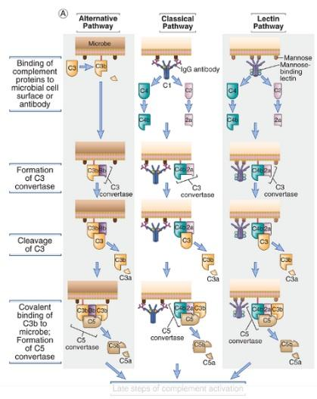
Q4
Complement system - Early steps (Basic Immunology, Abbas, p.158)

Slide 14
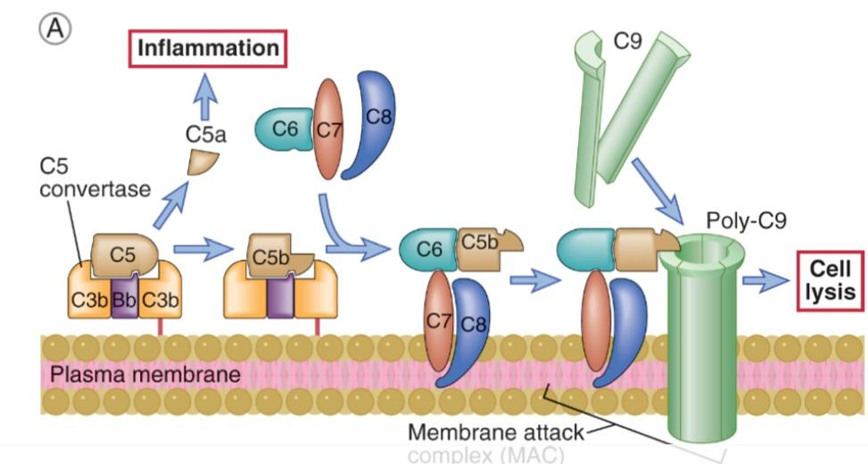
Q4
Complement system - Late steps (Basic Immunology, Abbas, p.161)

Slide 15
Q5
To assess the risk of erythroblastosis fetalis occurring during the future pregnancy of an Rh-negative woman, a clinician sends a sample of serum for detection of anti Rh-blood group antibodies. The laboratory performs an indirect Coomb’s test by mixing the patient’s serum with Rh-positive RBCs and then adding an anti-IgG antibody. In doing so, the laboratory technician observes agglutination of the RBCs. After receiving this test result, the clinician would be correct to conclude which of the following?
A,The Coomb’s test yielded a negative result, and therefore the mother does not have anti-Rh antibodies
B,The laboratory performed the test incorrectly; they should have mixed the patient’s serum with Rh-negative rather than Rh-positive RBCs
C,The patient has had previous pregnancies and all of her children are Rh-negative
D,The patient is currently pregnant with Rh-positive fetus
E,The presence of anti-Rh antibodies in the patient’s serum suggests that she has been pregnant with an Rh-positive fetus

Slide 16
Q5
To assess the risk of erythroblastosis fetalis occurring during the future pregnancy of an Rh-negative woman, a clinician sends a sample of serum for detection of anti Rh-blood group antibodies. The laboratory performs an indirect Coomb’s test by mixing the patient’s serum with Rh-positive RBCs and then adding an anti-IgG antibody. In doing so, the laboratory technician observes agglutination of the RBCs. After receiving this test result, the clinician would be correct to conclude which of the following?
A,The Coomb’s test yielded a negative result, and therefore the mother does not have anti-Rh antibodies
B,The laboratory performed the test incorrectly; they should have mixed the patient’s serum with Rh-negative rather than Rh-positive RBCs
C,The patient has had previous pregnancies and all of her children are Rh-negative
D,The patient is currently pregnant with Rh-positive fetus
E,The presence of anti-Rh antibodies in the patient’s serum suggests that she has been pregnant with an Rh-positive fetus

Slide 17
Q5
To assess the risk of erythroblastosis fetalis occurring during the future pregnancy of an Rh-negative woman, a clinician sends a sample of serum for detection of anti Rh-blood group antibodies. The laboratory performs an indirect Coomb’s test by mixing the patient’s serum with Rh-positive RBCs and then adding an anti-IgG antibody. In doing so, the laboratory technician observes agglutination of the RBCs. After receiving this test result, the clinician would be correct to conclude which of the following?
A,The Coomb’s test yielded a negative result, and therefore the mother does not have anti-Rh antibodies
B,The laboratory performed the test incorrectly; they should have mixed the patient’s serum with Rh-negative rather than Rh-positive RBCs
C,The patient has had previous pregnancies and all of her children are Rh-negative
D,The patient is currently pregnant with Rh-positive fetus
E,The presence of anti-Rh antibodies in the patient’s serum suggests that she has been pregnant with an Rh-positive fetus

Slide 18
Q5

Slide 19
Sources
First Aid Q&A for the USMLE STEP 1 (2nd edition)
Basic Immunology, Abbas et. al
Google

Slide 20
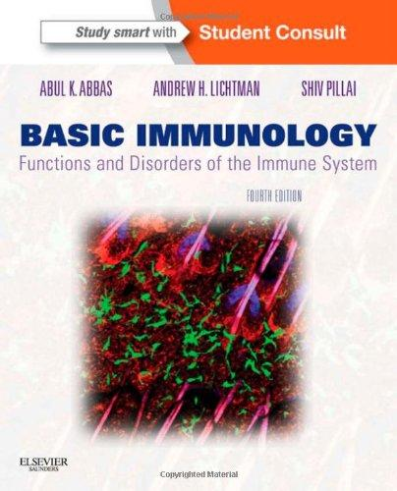
www.lekarskeknihy.cz, www.ilc.cz, www.megabooks.cz

