Slide 1
USMLE Step 1
Microbiology

Slide 2
Q1
A 30-year old sexually active man presents with a painful vesicle on his external genitalia and bilateral inguinal lymphadenopathy. A Tznack smear from the vesicle fails is negative, and polymerase chain reaction analysis of viral DNA is negative. A VDRL assay is also negative. Which of the following medications would be most helpful to this patient?
A, Acyclovir
B, Erythromycin
C, Foscarnet
D, Ribavirin
E, Vancomycin

Slide 3
Q1
A 30-year old sexually active woman presents with a painful vesicle on her external genitalia and bilateral inguinal lymphadenopathy. A Tznack smear from the vesicle is negative, and PCR analysis of viral DNA is negative. A VDRL assay is also negative. Which of the following medications would be most helpful to this patient?
A, Acyclovir
B, Erythromycin
C, Foscarnet
D, Ribavirin
E, Vancomycin

Slide 4
Q1
Differential diagnosis
1.Primary syphilis
2.Gentital herpes
3.Chancroid

Slide 5
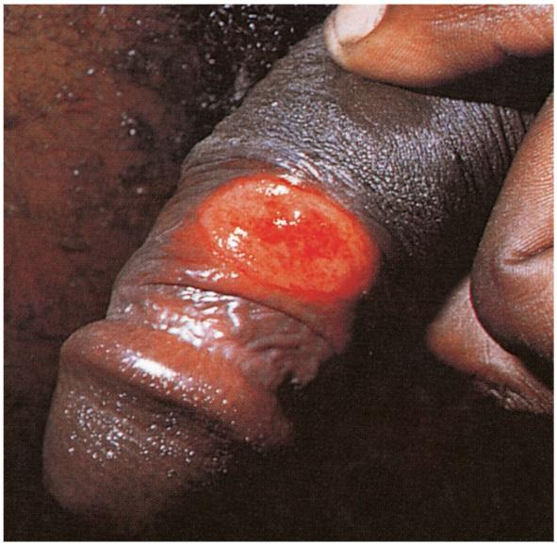
Medical Microbiology, Murray et al., p. 350

Slide 6
Q1
Primary syphilis
Painless ulcer with raised borders 10 to 90 days after initial infection
Secondary syphilis
Flu-like symptoms with a generalized mucocutaneous rash
Tertiary syphilis
Diffuse, chronic inflammation affecting various organs (e.g. neurosyphilis, cardiovascular syphilis) accompanied by gummas

Slide 7
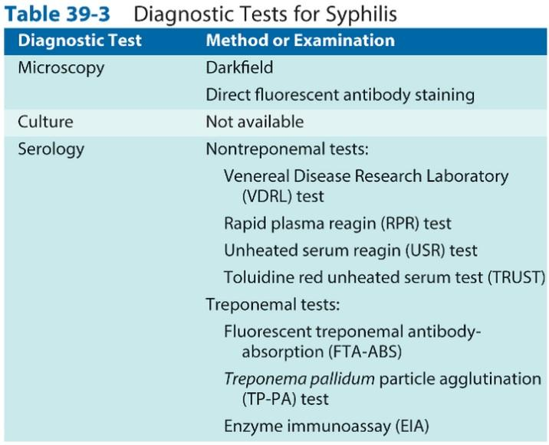
Medical Microbiology, Murray et al., p. 353

Slide 8
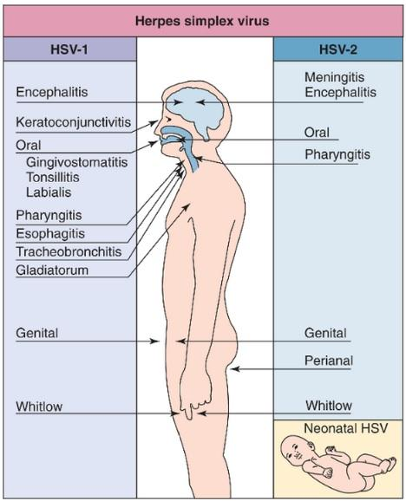
Medical Microbiology, Murray et al., p. 464

Slide 9
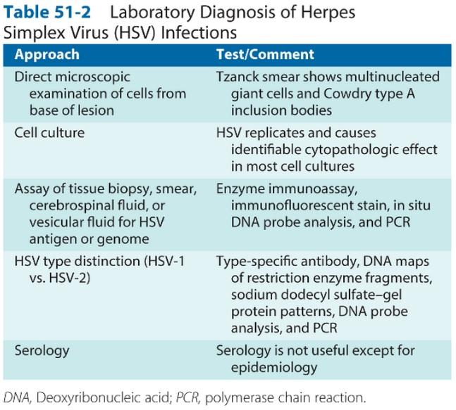
Medical Microbiology, Murray et al., p. 468

Slide 10
Q1
Tznack smear
A scraping of a base of a lesion
Cowdry type A acidophilic intranuclear inclusion bodies
A result of HSV disease mechanism
Inhibition of cellular macromolecular synthesis
Degradation of host cell DNA
Membrane permeation
Cytoskeletal disruption
Senescence of the cell

Slide 11
Q1
Chancroid
STD
More often symptomatic in men
Tender papule with erythematous base on the gentitalia or perianal area (5 - 7 days after infection)
Painful ulcer after 2 days, inguinal lymphadenopathy
Exclude syphilis and HSV
Microbe: Haemophilus ducreyi

Slide 12
Q1
Microbe: Haemophilus ducreyi
Microscopy
Small G (-) rod
Culture
Gonococcal agar
1-2% hemoglobin
5% fetal bovine serum
IsoViteleX (enrichment for fastidious organisms)
Vancomycin 3 ug/ml
Biochemical tests

Slide 13
Q1
A 30-year old sexually active woman presents with a painful vesicle on her external genitalia and bilateral inguinal lymphadenopathy. A Tznack smear from the vesicle is negative, and PCR analysis of viral DNA is negative. A VDRL assay is also negative. Which of the following medications would be most helpful to this patient?
A, Acyclovir
B, Erythromycin
C, Foscarnet
D, Ribavirin
E, Vancomycin

Slide 14
Q1
Acyclovir
Inhibits herpes viral polymerase (HSV 1,2; VSV; EBV)
Foscarnet
Inhibits viral DNA polymerase (CMV; acyclovir-resistant HSV)
Ribavirin
Inhibits inosine monophosphate dehydrogenase (RSV)
Vancomycin
G (+) multidrug-resistant organisms (e.g. S. aureus, C. difficile)

Slide 15
Q1
Microbe: Haemophilus ducreyi
Treatment
Most isolates of H. ducreyi are susceptible to ERYTHROMYCIN (drug of choice)

Slide 16
Q1
A 30-year old sexually active woman presents with a painful vesicle on her external genitalia and bilateral inguinal lymphadenopathy. A Tznack smear from the vesicle is negative, and PCR analysis of viral DNA is negative. A VDRL assay is also negative. Which of the following medications would be most helpful to this patient?
A, Acyclovir
B, Erythromycin
C, Foscarnet
D, Ribavirin
E, Vancomycin

Slide 17
Sources
First Aid Q&A for the USMLE STEP 1 (2nd edition)
Medical Microbiology, Murray et al.

Slide 18
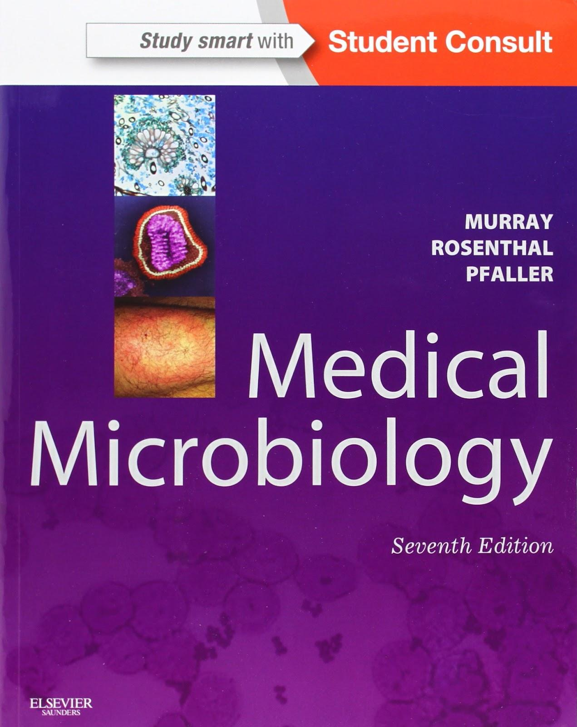
www.lekarskeknihy.cz, www.ilc.cz, www.megabooks.cz

