Slide 1
Basic medical terminology 4

Slide 2
Questions
What are the two main types of adjectives? What are their endings?
Based on what do I connect adjective to the noun?
What case is the noun in the state of dependency in?

Slide 3
What is the correct adjective for the noun in the triangle?
dextra
dextrum
dexter
dextrum
genu
orbita
pes
dexter
dextrum
dextra
dextra
dexter

Slide 4
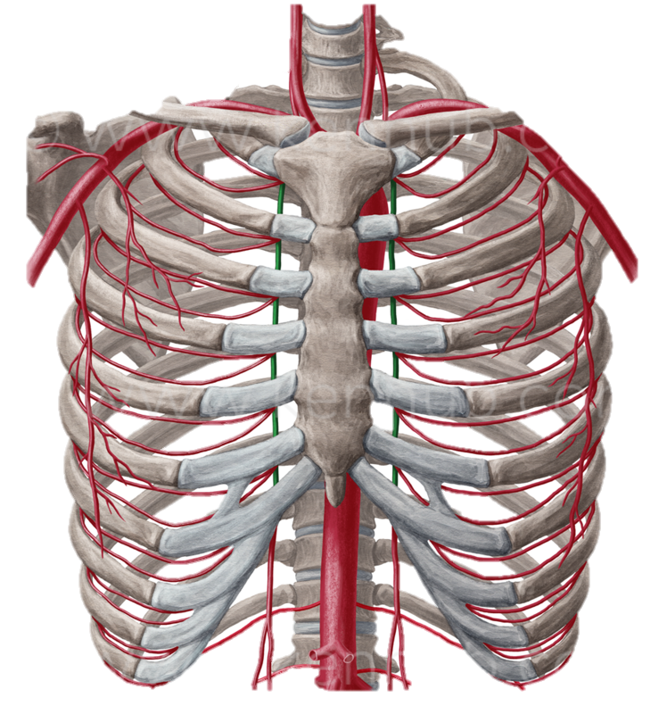
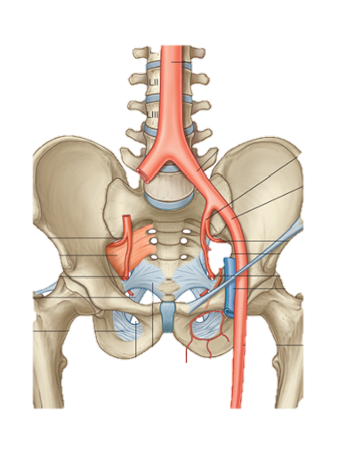
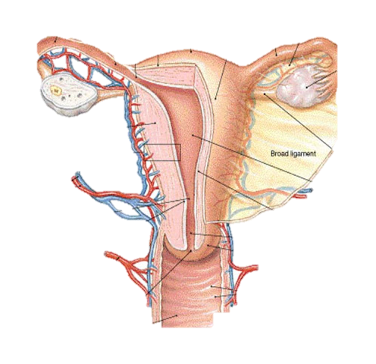
Arteriae
Notes:
Artheria thoracica interna

Slide 5
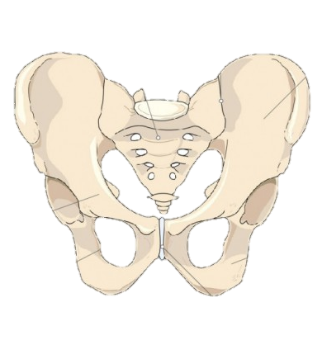
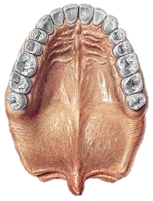
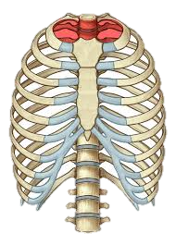
Apertura
Rhaphe

Slide 6
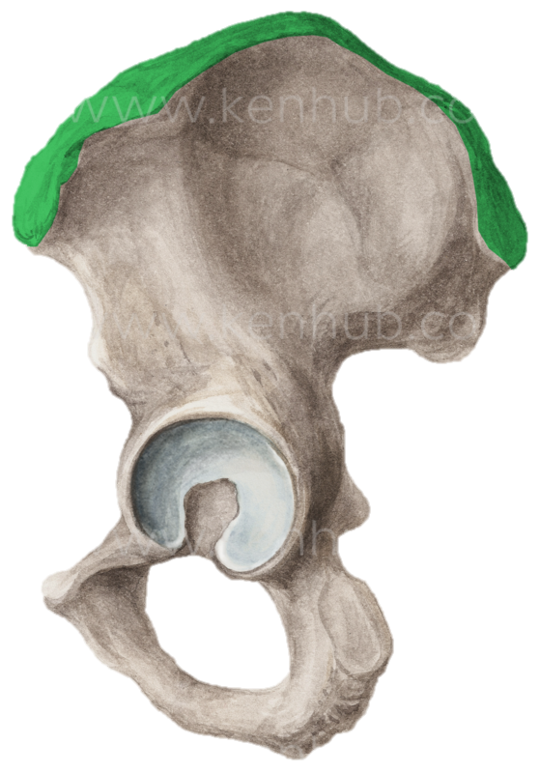
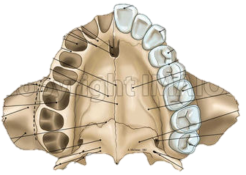
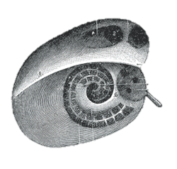
Cristae

Slide 7
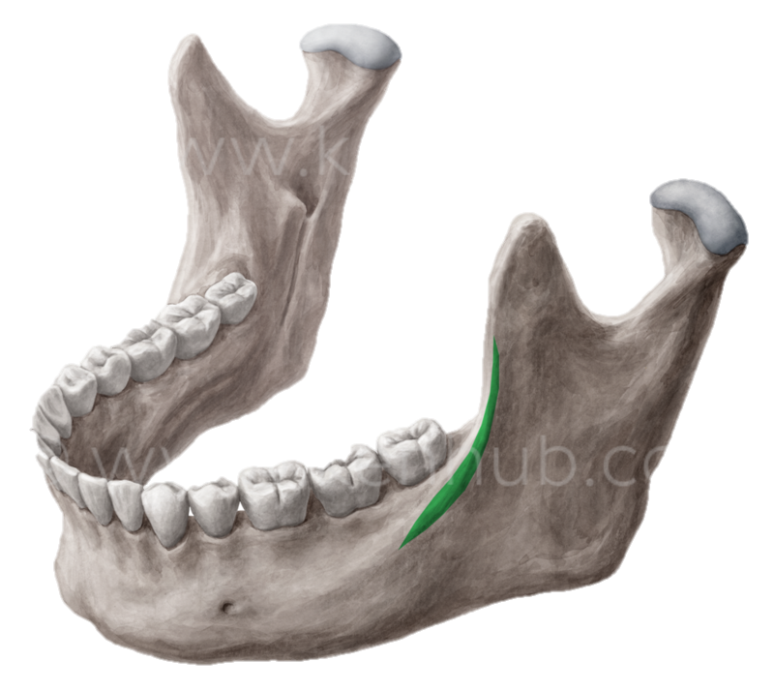
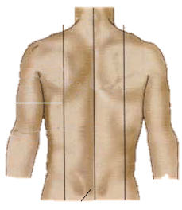
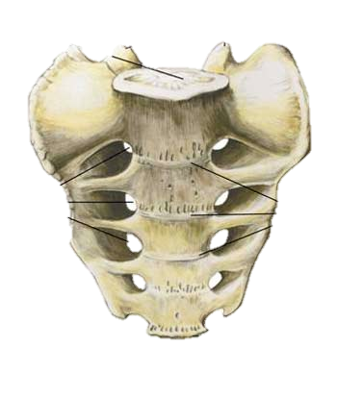
Lineae

Slide 8
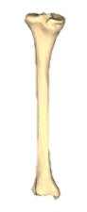
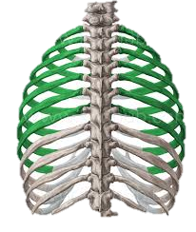
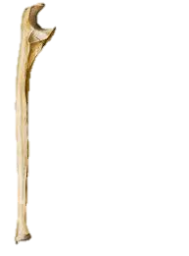
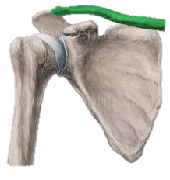
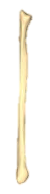
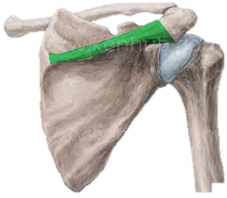
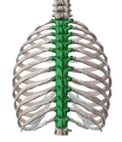
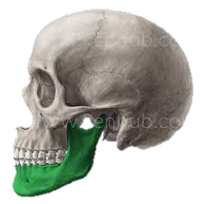
1
2
3
4
5
6
7
8

Slide 9
Ordinal numerals 1-7
Primus, a, um
Secundus, a, um
Tertius, a, um
Quartus, a, um
Quintus, a, um
Sextus, a, um
Septimus, a, um

Slide 10
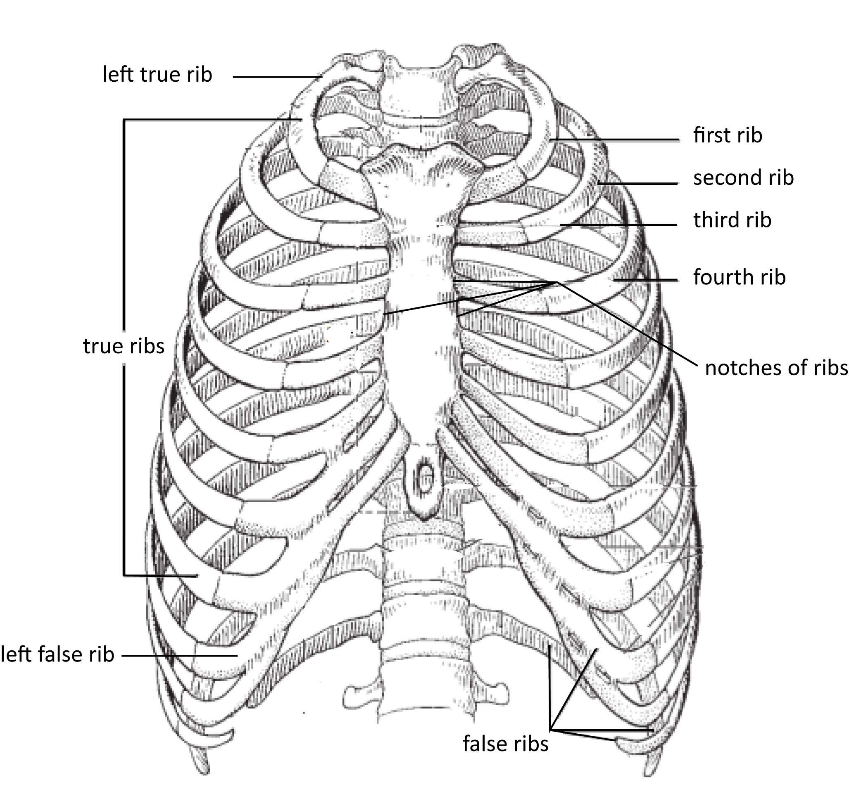
Costae
Costa vera sinistra
Costa prima
Costa secunda
Costa tertia
Costa quarta
Costae verae
Incisurae costarum
Costa spuria sinistra
Costae spuriae

Slide 11
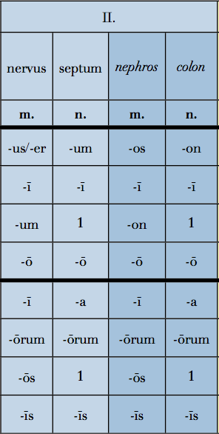
2nd declension - overview
Gen. sg. –I
Gender M/N
Nouns of the female gender in this declension are exceptions
Nom. sg. –US/-ER/-OS
Gender M
Nom. sg. –UM/-ON
Gender N

