Slide 1
1st declension
a-stems

Slide 2
Read
glandula linguae, in gutta tincturae, cum herbis, ruptura calvae, fracturae vertebrarum, ligamenta rupta, spondyli laesi, pneumonia acuta, scatula adlata, vena portae, atherosclerosis modica, carcinoma mammae, haemorrhagia periculosa, hydrocephalia, diphtheria perniciosa

Slide 3
Fill in the correct endings
fractura uln_, in aort_, ad scatul_, sine aqu_, rima palpebrar_, in glandul_ lingu_, sub aort_, fracturae complicat_, pneumonia aspiratori_, aqua menth_, arteri_ coronari_, vena port_, post pneumoni_ aspiratori_, ad scatul_ adlat_

Slide 4
Fill in full dictionary entry
columna, __, _
lagoena, __, _
dispnoe, __, _
medulla, __, _
linea, __, _
rhaphe, __, _

Slide 5
Decline Greek terms
diploe
chole
diabetes
dyspnoe
systole
ascites

Slide 6
Translate
lagoena aquae destillatae, causa diphteriae,
sine allergia, fractura ulnae, secundum naturam, operatio necessaria, palatum durum, trachea inflammata, columna vertebrarum, fractura mandibulae, rhaphe mediana, tuba auditiva, tonsillae palatinae, tunica mucosa, vesica fellea, rima in costa spuria

Slide 7
2nd declension
o-stems

Slide 8
Decline
praeventia
morbus
ganglion
virus periculosum
diabetes mellitus
methodus nova

Slide 9
Fill in the correct endings
fractura cost___ (pl), medicament_ contra scarlatin_, bacillus diphtheri_, muscul_ lingu_, period_ morb_, sine sept_ nas_, cum ven_ port_, ad rhaph_, propter anaemi_ periculos_, pro adult_, causa fractur_ complicat_

Slide 10
diamet_ transvers_ (Nom), propter fissur_ palat_ congenit_, sine ligament_ lat_ uter_, sub sign_ venen_ pernicios_, in tunic_ mucos_ (state), morb_ col_, sine insufficienti_ valvul_ dextr_

Slide 11
Join the expressions meaningfully
glandula, sub signo, ligamento, anomaliae, bulbus, post fracturam, medicamentum, in vesica, septum, sine insufficientia, digiti, colicae, columna, extractum, rami, intestino, unguentis, morborum, vena, acromion, rimae, ante therapiam, atrophia, in membranam, gutta, prope medullam, methodus
interosseam, nova, complicatae, oculi, musculorum, oblongatam, caeco, scapulae, valvulae, chronicorum, belladonnae, veneni, aquae, fellea, complicatam, medii, chirurgicam, thyroidea, portae, novum, nasi, congenitae, palpebrarum, nervorum, uteri, glycerini, vertebrarum

Slide 12
Give the plural
diameter obliquus, medicamentum pro adulto, rami dextri, periodo longa, sine periculo acuto, digiti medii, ad scapulam sinistram, ascites alvi, prope intestinum crassum, post therapiam operativam, sub olecranon ulnae, anguli costae, sutura cranii, propter fracturam costae verae

Slide 13
Give Latin/Greek names of colours
white black green blue colourless | yellow grey pale red purple

Slide 14
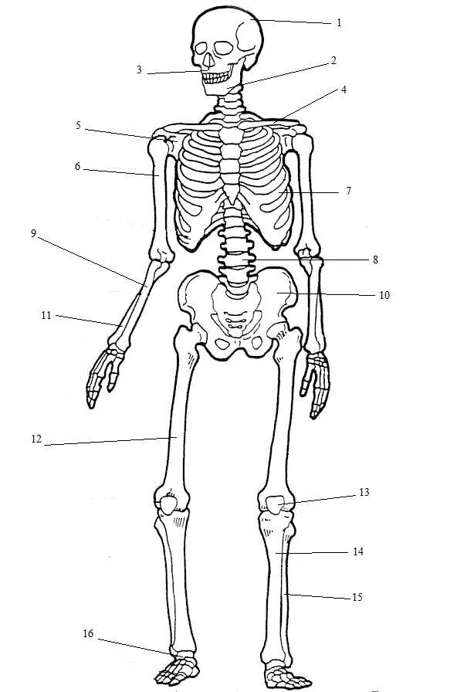
Name the parts of the skeleton you already know

Slide 15
Translate
substantia compacta, tunica mucosa vesicae felleae, sine aqua destillata, pneumonia chronica, insufficientia vesicae urinariae postoperativa, virus periculosum, arteria nutricia humeri, ligamenta lata uteri, unguentum glycerini, medicamentum bonum pro aegrotis, in lagoenam sterilisatam, fractura complicata scapulae dextrae, in glandula linguae, ova in ovario, prope venam cavam, pneumonia adamantina, ostium tubae auditivae, olecranon ulnae, in loco frigido

Slide 16
Translate into Latin
little hollow, without caecum intestine, cancer of gullet, congenital fissure of palate, with a new medicament, right branch of veins, posttraumatic bleeding in the brain because of rupture of vein, thoracic vertebra, in thyroid gland, because of contagious disease, in acute danger, after complicated fracture of calf bone, with congenital anomaly of wrist, open fracture of ankle, near to pericardium, without pale lips

Slide 17
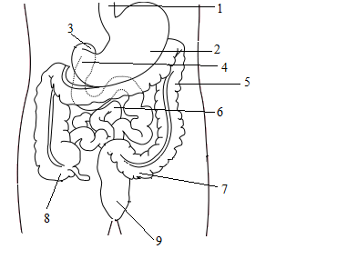
Name the parts of gastrointestinal tract you already know

