Slide 1
Study instructions

Slide 2
Demands
Active attendance at the classes – one unexcused absence possible, excuses give in to the study office
Possibility of substituting your classes in other seminar group (has to be the same week as your absence, max. twice a semester)
Taking two partial exams (in the case of successfull completion over 70 %, you get bonus 5 % for your final exam)
Regular homestudy required

Slide 3
Methods of teaching
Preparatory course
7 units in one semester – exercises in the handbook (Prucklová, Severová – Introduction to Latin and Greek Terminology in Medicine)
Drill in the IS
Study materials under your personal administration in IS
Study literature (illustrated dictionaries)

Slide 4
Why Latin/Greek?
universal, precise and flexible system of terms
Denote:
  Anatomical structures
  Medicaments
  Therapeutical methods
Used in:
  Diagnoses
  Dissection protocols
  Medical prescriptions
  Medical documentation --- communication between doctors from different environments/countries/fields of study

Slide 5
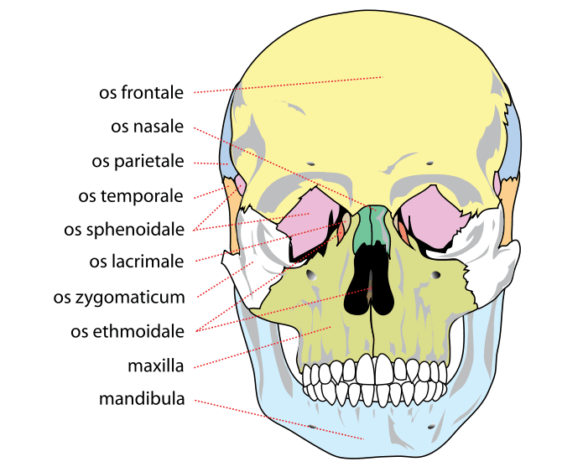
Anatomical structures

Slide 6
Medicaments
Paxil: an antidepressant and anti-anxiety drug (Pax=peace in Latin)
Lunesta: a sleeping medication (Luna=moon in Latin)
Viagra: a medication for erectile dysfunction (Vi[r]= man in Latin and Agra=field, usually farmed or fertile in Latin and Greek)
Fosamax: a drug for osteoporosis, or bone thinning (Os=bone Max=great in Latin)

Slide 7
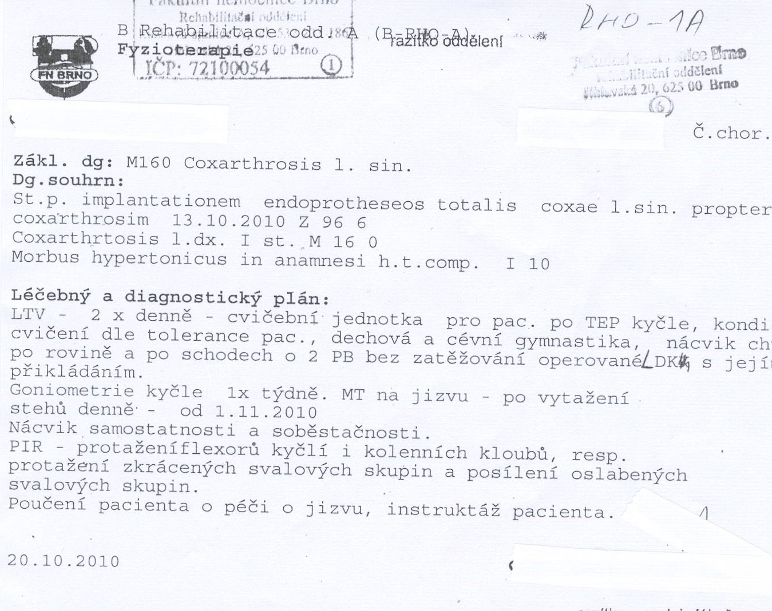
Diagnoses

Slide 8
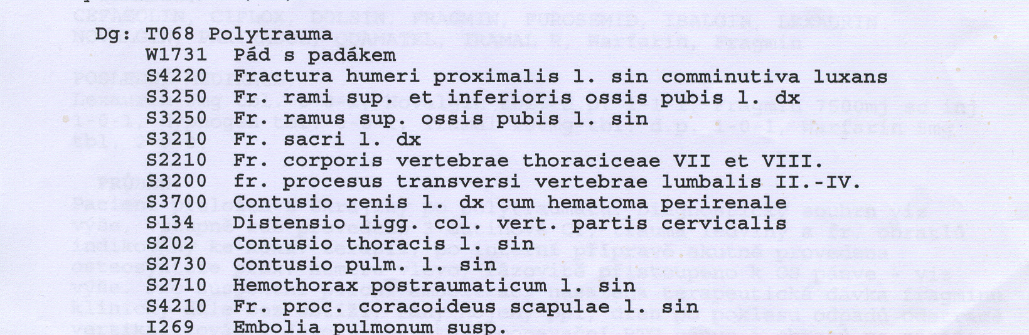
System of diagnose codes

Slide 9
Medical prescriptions

Slide 10
At the end of the course, you will be able to:
See the system in the terminology of anatomical structures ( = easier memorizing of the terms)
understand the principles of forming more complex terms
Understand a clinical diagnose
Write your own clinical diagnose
Write a medical prescription
Use the abbreviations in diagnoses and prescriptions

Slide 11
Latin pronunciation

Slide 12
Vowels
Short
  a – anaemia, allergia, appendix etc. – as in cut, shut, mud etc.
  e – membrum, cerebrum, epilepsia etc. – as in very, set, let, get etc.
  i – diabetes, internus, iliacus etc. – as in live, give, sit etc.
  o – osseus, aorta, tonsilla etc. – as in original, on, also etc.
  u – purus, gutta, profundus etc. – as in good, pull, put etc.
  y = i (in words of Greek origin)
Long
  a – sanus, oblongatus, coronarius etc. – as in car, park, lard etc.
  e – vena, cera, chole etc. – as in sad, declare, care etc.
  i – minimus, spina, signum etc. – as in clear, ear, read etc.
  o – mucosus, pneumonia, novus etc. – as in door, floor, call etc.
  u – fractura, sutura, purus etc. – as in root, room, soon etc.
  y = i

Slide 13
Diphtongs
Two vowels put together
ae – in words like anaemia, vertebrae, venae etc. pronounced always as long e as in care, declare, rare etc.
oe
  In the words of Latin origin (usually in the middle of a word) pronounced the same as diphtong ae (long e) – e.g. lagoena
  In the words of Greek origin (at the end of a word) pronounced as two syllables o-e – e.g. dyspno-e, diplo-e
eu – only in the words of Greek origin (pneumonia, eutrophia) pronounced in a phonetic way

Slide 14
Problematic consonants
c
  [ts] – before e/i/ae/oe – cera, acidum, caecus, coeliacus
  [k] – before a/o/u/consonant – cancer, costa, cura, clavicula
g – alwyas pronounced as in tongue, grave etc.
q(u) - [kv] – quantum, aqua
S – always pronounced as in sit, save etc.
T - if followed by –ia,-ie,-io,-iu pronounced as [ts] – patientia, substantia; however if preceded by s or x pronunciation remains [t] – ostium

Slide 15
Length of syllables
Two-syllable words – accent on the first syllable
like in vita, vena, cura, ulna etc.
Three or more-syllable words
  If the last but one syllable is long, it bears an accent – angina, carcinoma, retina, dentista etc.
  If the last but one syllable is short, the preceding syllable bears an accent – fibula, tunica, valvula, vesica etc.
  The length of vowels is not marked nor in Latin neither in this handbook!

Slide 16
Read the Hippocratic Oath
Iuro per Apollinem medicum et Sanitiam et Remediatiam et deos universos et universas, scitores faciens, perficiam secundem possibilitatem et actionem et iudicium meum iuramentum hoc et conscriptionem istam. eum qui docuit me artem hanc introducere inter meos, et communicare in vita, et in quo indiget dationem facere, et genus quod ab ipso fratribus aequale iudicare eligam.

Slide 17
et docebo artem hanc eos qui indigent discere absque pretio et conscriptione, et delusione et intemperantia et de reliqua universa disciplina traditionem facer filiis meis et eius qui me docuit et edoctis et temperatis et iuratis legi medicinali, alii autem nulli. dietationibusque utar omnibus iuvamento laborantium secundum possibilitatem et iudicum meum, et de incusatione et iniustitia prohibebor. neque dabo ulli farmacum rogatus mortale, neque narrabo consilium tale.

Slide 18
similiter autem neque mulieri pessarium corruptivum dabo. pure vero et sancte servabo vitam meam et artem meam. non incidam autem neque lapidatatem patientes, sed dimattam hoc opus hominibus huius operationis. ad domos autem ad quotcumque ivero, ibo ad utilitatem eorum qui laborant, absque omni iniustitia spontanea et corruptive alia, et venereorum operum in mulieribus corporibus liberorum et servorum.

Slide 19
ea vero quae in cura videro aut audivero, vel etiam absqua cura de vitis hominum, quae non sit conveniens loqui extra, tacebo, ceu neque videre ea putans. iuramentum itaque meum et conscriptionem hanc qui perfectum facit et non confringit erit diligibilis ut augeatur et in vita et arte honorandus ab omnibus hominibus insempiterno tempore, transgredienti autem et deieranti contraria horum.

Slide 20
Grammatical cathegories of nouns

Slide 21
Gender
Masculine
Feminine
Neutral
Not always intuitive – you have to learn the gender of particular words!!!

Slide 22
Number
Singular
Plural

Slide 23
Case
The relationships between nouns and adjectives are expressed not only by prepositions, but also by case endings (according to particular declension to which a noun belongs)
Nominative (Nom.) – the subject of sth – upright case (1st dictionary entry)
Genitive (Gen.) – functions as English preposition of, also possessive function, denotes the declension of a noun (2nd dictionary entry)
Accusative (Acc.) – the object of sth, with prepositions denoting motion towards sth – ad, prope, in
Ablative (Abl.) – expresses separation or motion away from sth, with prepositions e/ex, a/ab, de, sine, cum

Slide 24
Declension
Each noun belongs to one of 5 declensions according to which the case endings are put to them, the division of nouns into declensions is based on their stem (according to Gen. plural form)
1st declension – a-stems – ven-a-rum
2nd declension – o-stems – nerv-o-rum
3rd declension
  i-stems – pelv-i-um
  consonant stems – dolo-r-um, pon-t-um, sectio-n-um
4th declesion – u-stems – duct-u-um
5th declension – e-stems – faci-e-rum

Slide 25
Adjectives
Adjectives always have to correspond with the noun to which they belong in gender, number and case!!!!
fractura ulnae dextrae complicata
vertebrae thoracicae
ad lagoenam fuscam
cum anaemia perniciosa

Slide 26
Prepositions
with accusative
  ad = towards, to – ad cranium
  ante = before – ante fracturam
  post = after – post operationem
  per = through – per rectum
  in (motion)= towards, into – in lagoenam
  prope (motion) = near to – prope ulnam
  propter = because of – propter anaemiam
with ablative
  e/ex = out of – e scatula
  a/ab = from, by – a medico
  sine = without – sine insufficientia
  cum = with – cum digito medio
  pro = for the sake of – pro adulto

