Slide 1
Adjectives of the 3rd declension

Slide 2
a) Classify the adjectives into two groups according to their declensions. b) give the number of their nominative singular forms.
centralis, e opticus, a, um parietalis, e
ischiadicus, a, um tenuis, e crassus, a, um
ascendens, ntis sigmoideus, a, um suprarenalis, e
thyroideus, a, um biliaris, e felleus, a, um
longus, a, um brevis, e multiplex, icis
apertus, a, um cysticus, a, um migrans, ntis
solaris, e ruber, a, um rectus, a, um
biceps, itis acutus, a, um catarrhalis, e

Slide 3
1st + 2nd declension | 3rd declension | number of forms in nom. sg.

Slide 4
a) Give the gender of the nouns. b) Join the nouns with the adjectives in the correct form.
canalis ( ) + centralis, e ______________
+ opticus, a, um ______________
tuber ( ) + ischiadicus, a, um ______________
+ frontalis, e ______________
intestinum ( ) + tenuis, e ______________
+ crassus, a, um ______________
musculus ( ) + rectus, a, um ______________
+ biceps, itis ______________

Slide 5
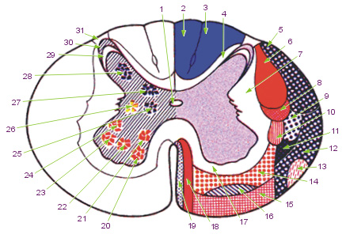
Canalis centralis

Slide 6
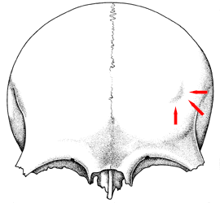
Tuber frontale

Slide 7
colon ( ) + ascendens, ntis ______________
+ sigmoideus, a, um ______________
glandula ( ) + suprarenalis, e ______________
+ thyroideus, a, um ______________
vesica ( ) + biliaris, e ______________
+ felleus, a, um ______________
caput ( ) + longus, a, um ______________
+ brevis, e ______________

Slide 8
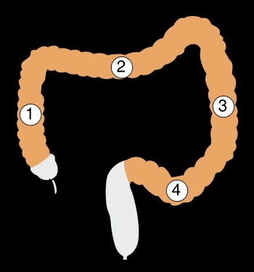
Colon Ascendens/sigmoideum

Slide 9
fractura ( ) + multiplex, icis ______________
+ apertus, a, um ______________
ren ( ) + cysticus, a, um ______________
+ migrans, ntis ______________
eczema ( ) + solaris, e ______________
+ ruber, a, um ______________
urocystitis ( ) + acutus, a, um ______________
+ catarrhalis, e ______________

Slide 10
A) Join the anatomical terms from the previous exercise with the word structura where appropriate. b) Join the clinical terms from the previous exercise with the word therapia where appropriate.

Slide 11
Join the terms with the preposition in to express direction/position.
term | in + direction | in + position
intestinum crassum/tenue
colon sigmoideum/ascendens
vesica fellea/biliaris
musculus rectus/biceps
fractura aperta/multiplex
urocystitis acuta/catarrhalis

Slide 12
A) Fill in missing endings in the picture. b) Join the terms from task A) with the word fractura where appropriate. c) Put the terms from task A) in plural where appropriate. b) Join the terms from task c) with the word fracturae where appropriate.

Slide 13
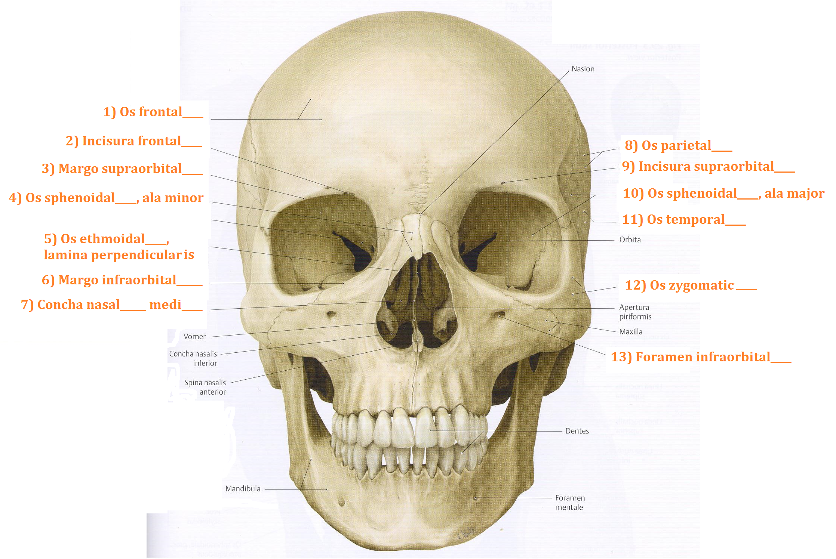

Slide 14
Give the noun which the underlined adjectives come from, its genitive singular form, gender, declension and meaning
term | nom. sg. | gen. sg. | gender | declension | meaning
os frontale
margo supraorbitalis
concha nasalis media
os parietale
os temporale
os occipitale

Slide 15
Form grammatically correct anatomical terms, do not change the word order.
fossula (pl.) --- tonsillaris, e (pl.)
rete --- articularis, e --- cubitus
musculus --- biceps, itis --- brachium
geniculum --- canalis --- nervus --- facialis, e
ligamentum --- teres, etis --- hepar/uterus
arteria --- iliacus, a, um --- communis, e
pars --- descendens, ntis --- duodenum
ramus --- communicans, antis --- cum --- nervus --- ulnaris, e
musculus (pl.) --- levator (pl.) ---- costa (pl.) --- brevis, e (pl.)

Slide 16
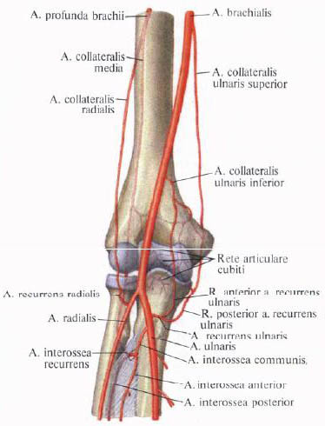
Rete articulare cubiti

Slide 17
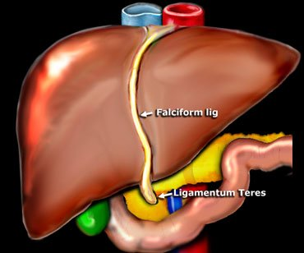
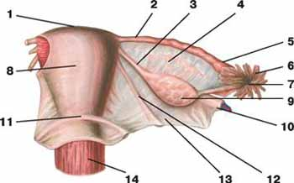
Ligamentum teres hepatis/uteri

Slide 18
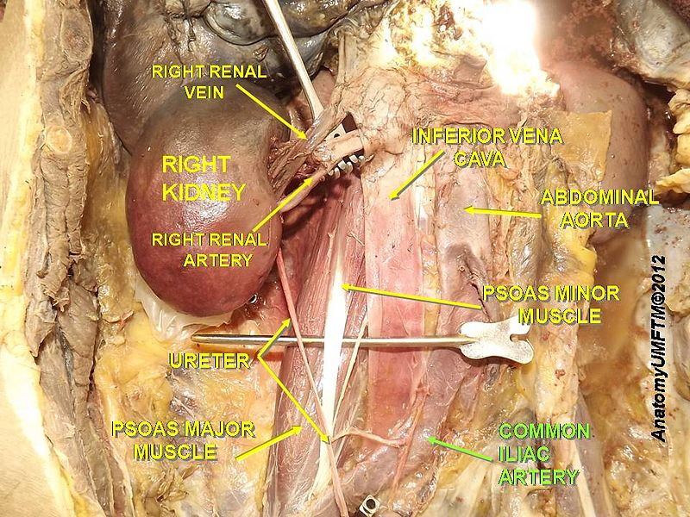
Arteria iliaca communis

Slide 19
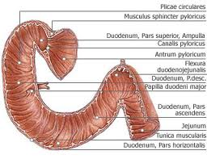
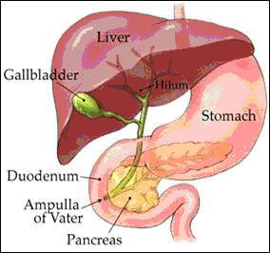
Pars descendens duodeni

Slide 20
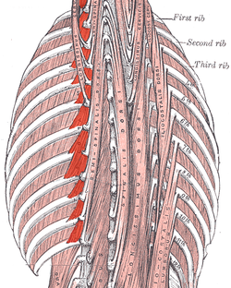
Musculi levatores costarum

Slide 21
Match the expressions on the left with the expressions on the right to form clinical terms.
Trauma grave articulationis acutae
Symptomata urocystitidis multiplices
Caries profunda dentis exacerbans
Insufficientia cordis herpetis simplicis
Therapia permanentis
Fracturae columnae vertebralis genus l. dx.

Slide 22
translate into latin.
Suprarenal gland
Simple joints
Lateral margin of the nail
Fossa for the lacrimal gland (literally of the lacrimal gland)
Nucleus of the abducent nerve
Vein accompanying the hypoglossal nerve (literally Accompanying vein of the hypoglossal nerve)

Slide 23
Short gastric arteries
Common carotid artery
Fissure of the round ligament
Long/short head of the biceps muscle of the femur
Orifice of the vermiform appendix

Slide 24
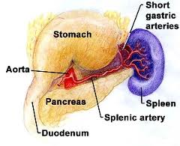
Arteriae gastricae breves

Slide 25
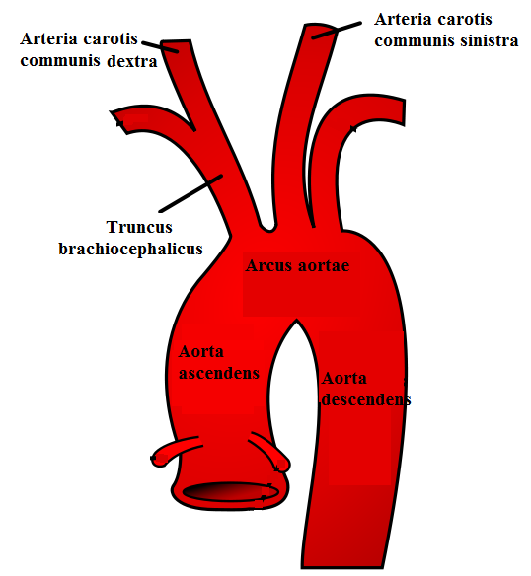
Arteria carotis communis

Slide 26
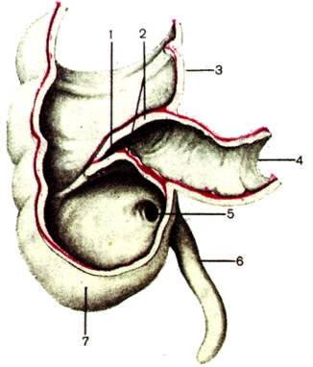
Ostium appendicis vermiformis

