Slide 1
Creating medical terms
How does it work?

Slide 2
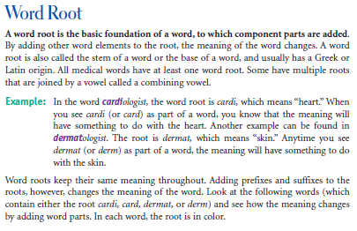

Slide 3
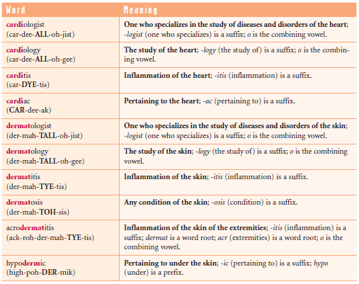

Slide 4
Word-formation principles in medical terminology
1) Derivation
a) Prefix: hypodermalis (=below)
b) Suffix: carditis (inflammation)
c) Prefix + suffix: cardiologia (=heart; study of sth)
2) Compounding: acrodermatitis (=extremity; skin)
3) Derivation + compounding: acrodermatitis (=see above + inflammation)
4) Abreviating: CT (=computed tomography)
5) Borrowing: shock; stress; missed abortion; bypass; drainage

Slide 5
Obesitas permagna
ROOT SUFFIX PREFIX ROOT
St. p. cholecystectomiam laparoscopicam
ROOT 1 PREFIX SUFFIX C. VOWEL SUFFIX
ROOT 2 ROOT 3 ROOT 1 ROOT 2

Slide 6
Analyse the structure of complex medical terms
cardiomyopathia
megalocardia
endocardium
pericarditis

Slide 7
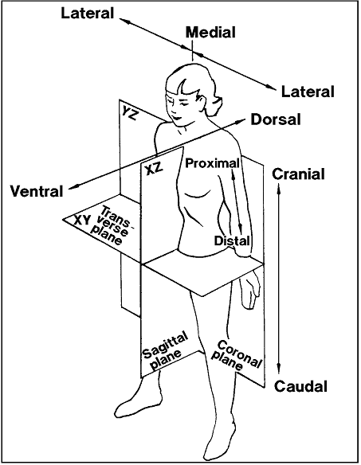
Body planes
= imaginary slices/cuts used to divide the body in a particular angle and direction
In Latin with suffix – alis
lateralis
cranialis
medialis
dorsalis etc.

