Slide 1
Basic medical terminology 2

Slide 2
Pronunciation – read correctly and explain the rules
Pars respiratoria tunicae mucosae nasi
Hiatus oesophageus
Musculus latissimus dorsi
Vena aquaeductus cochleae
Bursa subcutanea
Tunica mucosa uteri - myometrium
Ostium pharyngeum tubae auditivae
Fractura vertebrae thoracicae tertiae clausa
Hydrorhoea uteri gravidi amnialis
Status post extractionem dentium permanentium

Slide 3
Questions
How do I decide to what declension the word belongs to?
What are the genitive endings of Latin declensions?
What is stem?
How do I get to it?

Slide 4
Endings, endings everywhere…
In many languages, Latin and Greek among them, nouns inflect (change their form) for number and for case.
Inflection for number involves singular (sg.) : plural (pl.) forms (eg. forearm : forearms, antebrachium : antebrachia) and is present in English as well.
Inflection for case involves changing the form of the noun according to its syntactic function/meaning. Latin has extensive case system in which a special form is used for every specific meaning. In medical terminology we use four out of six Latin cases to express the following meanings:

Slide 5
Meaning of cases
LATIN
system of specific case endings + prepositions
1. NOMINATIVE – subject (ending)
2. GENITIVE – dependency of two nouns, possession (ending)
4. ACCUSATIVE – object, movement (preposition + ending)
6. ABLATIVE – place, location, instrument, cause (preposition + ending)
ENGLISH
prepositions or word order
subject of the sentence
of
object of the sentence
by, with, to, because of...
NOTE! In medical terminology accusative and ablative cases are used only after the preposition.
In books, cases are labelled with numbers or abbreviations nom., gen., acc., abl. for practical reasons.

Slide 6
Use the chart with endings to change the following words into plural
coxae
cervicis
coxa_ _ _ _ _ _ _ _ cervix_ _ _ _ _ _ _ _
_ _ _ _ _ _ _ _ _ _ _ _ _ _ _ _ _ _ _ _ _
_ _ _ _ _ _ _ _ _ _ _ _ _ _ _ _ _ _ _ _ _
mentum_ _ _ _ _ _ arcus _ _ _ _ _ _ _ _
_ _ _ _ _ _ _ _ _ _ _ _ _ _ _ _ _ _ _ _ _
_ _ _ _ _ _ _ _ _ _ _ _ _ _ _ _ _ _ _ _ _
1
cox-
1II
cervic-
coxae
cervices
menti
arcus
I1
ment-
1V
arc-
menta
arcus

Slide 7
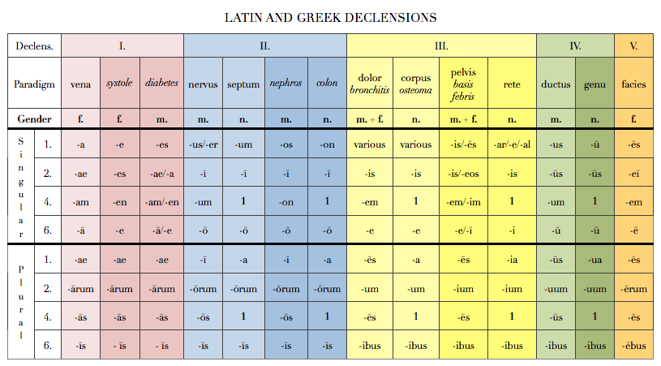
Latin and Greek Declensions

Slide 8
Introduction to syntax NOUN IN APPOSITION 1.
noun + noun < GENITIVE
Translated: using of
Meaning: state of dependency
EX: Fractura costae //fractura costarum

Slide 9
Latin and Greek Declensions

Slide 10
Prepositions and prepositional phrases
Denote:
Spatial relations sub, infra, post
Temporal relations post, ante
Causal relations propter, e/ex
Can be connected with:
Accusative case
Ablative case
Both Accusative and Ablative case

Slide 11
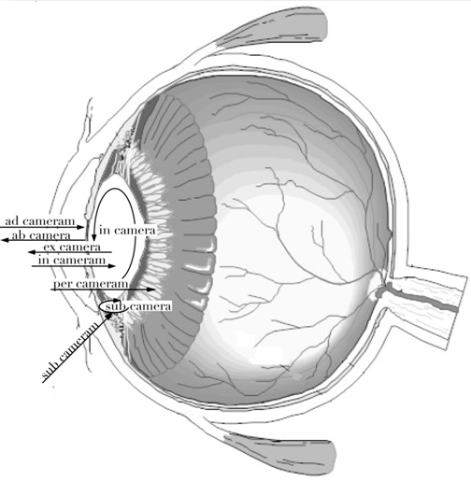

Slide 12
Latin and Greek Declensions

Slide 13
UBI ….. est? UBI…. sunt?
Ubi …scapula…est?
Ubi …orbitae…sunt?
Scapula prope claviculam est/ Orbitae in cranio sunt.
Scapula infra claviculam et supra humerum est.
Orbitae infra frontem et supra nasum sunt.
Infra Supra Prope Ad In Sub Ante Post Retro

Slide 14
Ist Latin declension
In the first declension we decline nouns that have:
Genitive sg. ending | -AE
Nominative sg. ending | -A
Gender | Mostly F Never N Exceptions M
Of Male gender can be:
Names of specialists – Dentista, ae, m.
Names of muscles – Agonista, ae, m.

Slide 15
Latin and Greek Declensions

