Slide 1
Basic medical terminology 3

Slide 2
Read and explain your pronunciation
Musculus latissimus dorsi
Pars respiratoria tunicae mucosae nasi
Vena aquaeductus cochleae
Hiatus oesophageus
Protuberantia occipitalis externa
Myometrium
Nucleus rhapes medianus

Slide 3
Read and guess the meaning
Corpus humanum e capite, collo, trunco, membris constat. Corpus hominis quattuor membra habet: duo membra superiora et duo membra inferiora. Membrum superius ex brachio, cubito, antebrachio, manu et digitis manus constat. Membrum inferius femur, genu, crus et pedem continet. Collum caput cum trunco corporis iungit, ubi viscera locata sunt. Partes trunci sunt: thorax, abdomen, pelvis. In cavitate thoracis cor et pulmones sunt.
Medicamenta in organismum humanum viis variis introducuntur: per os, per rectum, sub linguam, sub cutem, intra musculos.

Slide 4
Questions
What case expresses the state of dependency?
How is it usually translated into English?
What cases are used with prepositions in medical terminology?
Are there any prepositions connected with two cases?

Slide 5
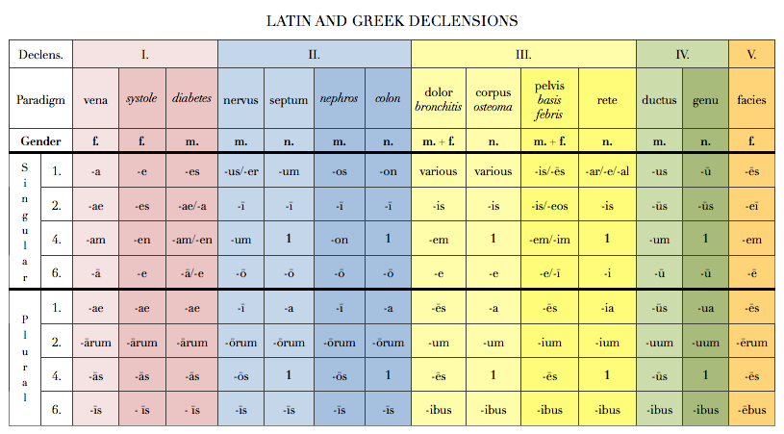
Noun(s) in apposition

Slide 6
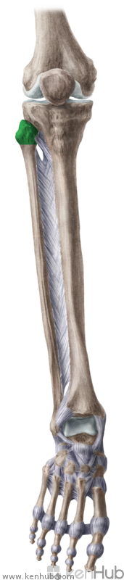
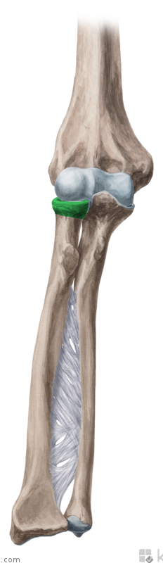
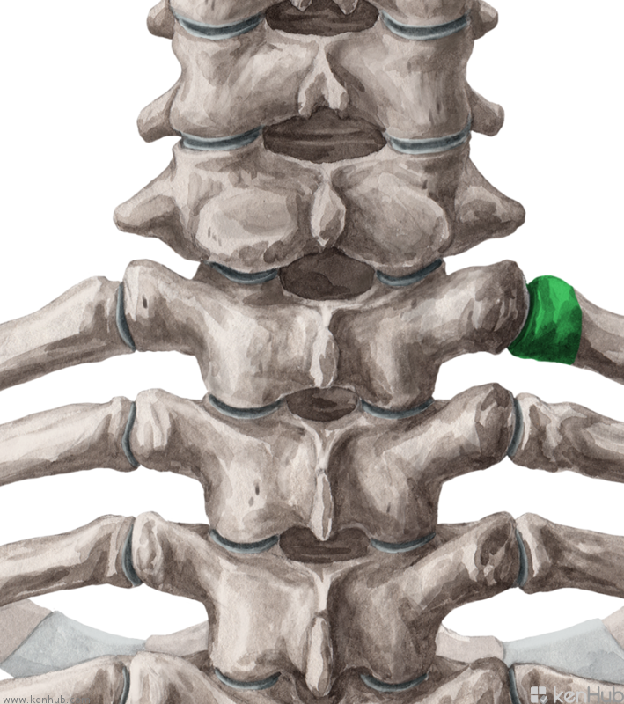
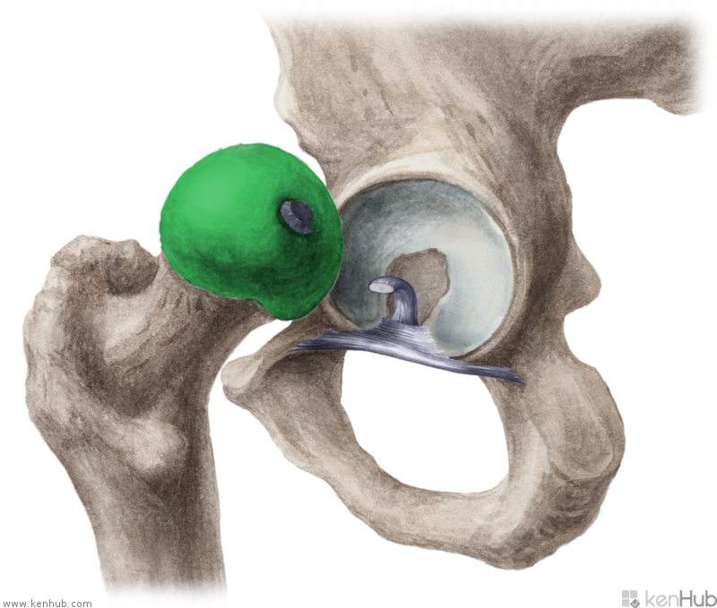
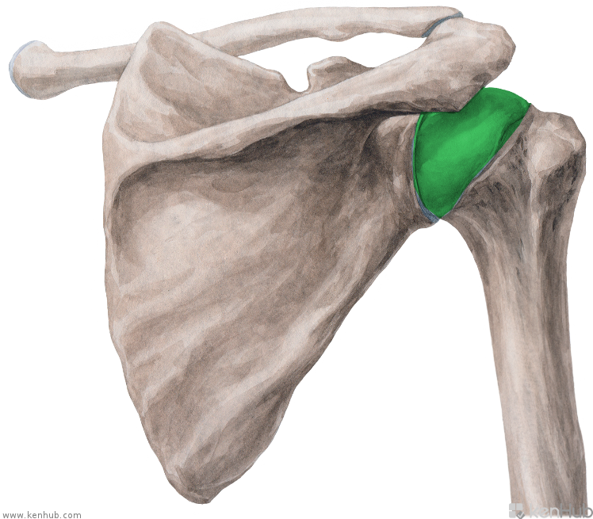
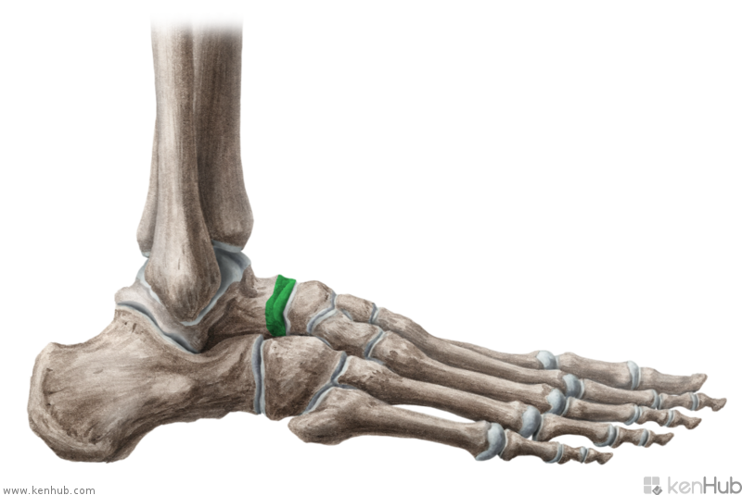
C
D
A
E
F
B

Slide 7
Prepositions

Slide 8
Read and guess the meaning
Corpus humanum e capite, collo, trunco, membris constat. Corpus hominis quattuor membra habet: duo membra superiora et duo membra inferiora. Membrum superius ex brachio, cubito, antebrachio, manu et digitis manus constat. Membrum inferius femur, genu, crus et pedem continet. Collum caput cum trunco corporis iungit, ubi viscera locata sunt. Partes trunci sunt: thorax, abdomen, pelvis. In cavitate thoracis cor et pulmones sunt.
Medicamenta in organismum humanum viis variis introducuntur: per os, per rectum, sub linguam, sub cutem, intra musculos.

Slide 9
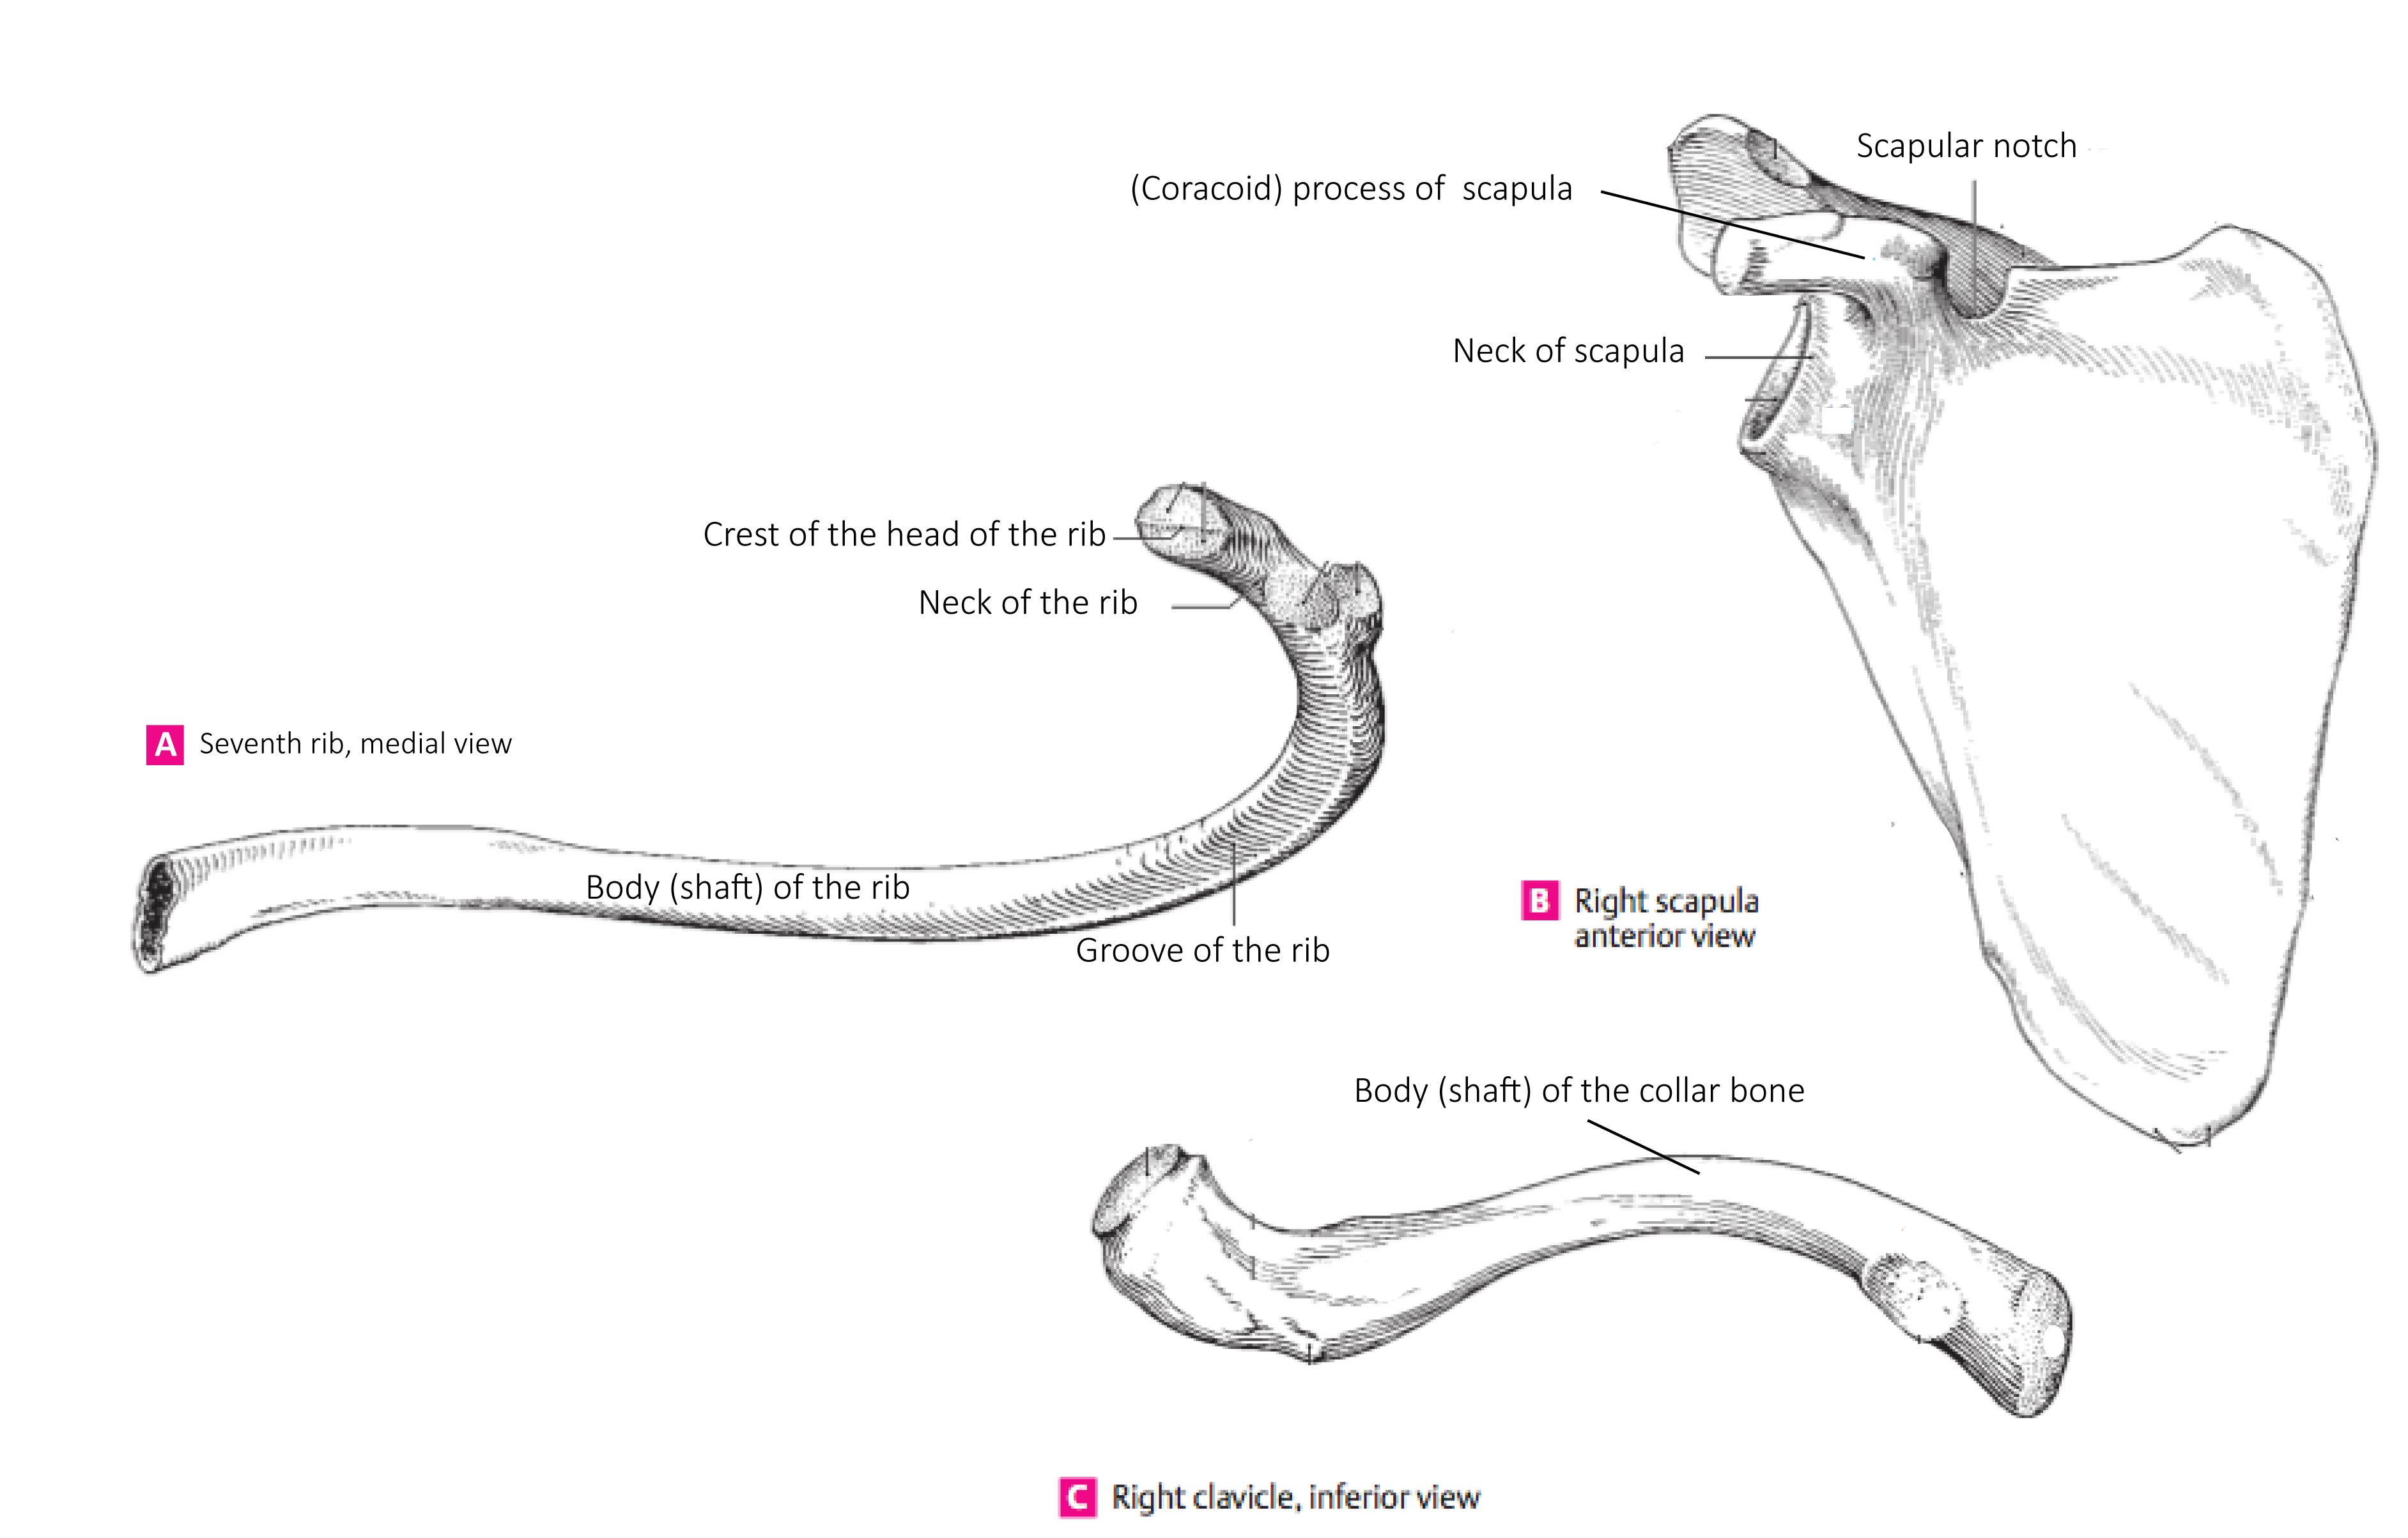

Slide 10
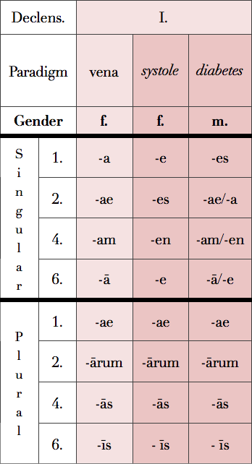
Overview of the 1st declension
Paradigm VENA : -a/-ae; > F
Paradigm DIABETES : -es/-ae; M
Paradigm SYSTOLE: -e/-es; F
--------------------------------------------------
Plural forms
Diabetes singular forms

Slide 11
Adjectives
Function : to qualify a noun
Forms : Alternate to reflect the gender, number and case of the noun
Gender > Male (m.) > Female (f.) > Neuter (n.)

Slide 12
Adjectives of the 1st and 2nd declension
Magnus, a, um
Magnus magna magnum
m. f. n.
coxa cervix
oculus sulcus
crus arcus
bucca metatarsus
fibula hallux
Dexter, a, um
Dexter dextra dextrum
m. f. n.
coxa cervix
oculus sulcus
crus arcus
bucca metatarsus
fibula hallux

