Slide 1
Basic medical terminology
1st and 2nd declensions

Slide 2
What is the correct adjective for the noun in the triangle?
transversus
transversa
anatomicus
accessorius
diameter
collum
nervus
transversum
anatomica
anatomicum
accessoria
accessorium

Slide 3
What is the correct adjective for the noun in the triangle?
dexter
dextra
palatina
lymphaticum
ovarium
fissura
nodus
dextrum
palatinum
palatinus
lymphatica
lymphaticus

Slide 4
What is the correct adjective for the noun in the triangle?
sinistra
sinister
periculosus
longus
brachium
periodus
morbus
sinistrum
periculosa
periculosum
longa
longus

Slide 5
What is the correct adjective for the noun in the triangle?
anatomica
anatomicus
durus
pharyngeum
ostium
palatum
anatomicum
tuberculum
dura
durum
pharyngeus
pharyngea

Slide 6
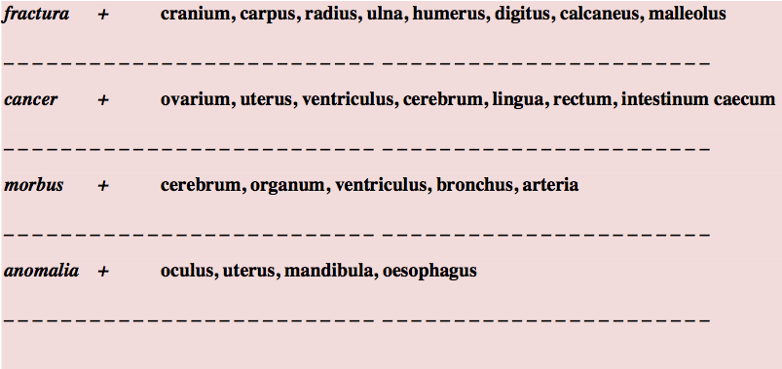
Connect nouns
cranii
carpi
radii
ulnae
humeri
digiti
calcanei
malleoli
ovarii
uteri
ventriculi
cerebri
linguae
recti
intestini caeci
cerebri
organi
ventriculi
bronchi
arteriae
oculi
uteri
mandibulae
oesophagi

Slide 7
Decide on declension and paradigm
Chole
Medulla
Therapia
Ascites
Methodus
Tarsus
Ganglion
Collum
Colon
Brachium
Alvus
Diameter
Cancer
Pylorus
Puer
Membrana

Slide 8
Change for plural or singular
EXAMPLE:
Diploe = nom. Sg. → Pl. = Diploae /because it is declined like 1st Greek declension, paradigm SYSTOLE
Acromia
Anomalia
Ostia
Cancri
Radii
Pylorus
Ophthalmos
Diabetes
Diameter
→
→
→
→
→
→
→
→
→
Acromion (II. Decl./colon)
Anomaliae (I. Decl./vena)
Ostium (II. Decl./cerebrum)
Cancer (II. Decl./musculus)
Radius (II. Decl./musculus)
Pylori (II. Decl./musculus)
Ophthalmi (II. Decl./nephros)
Diabetae (I. Decl./diabetes)
Diametri (II. Decl. Musculus)

Slide 9
What is the gender, number and case of the following nouns?
palata
angulis
oculos
ovariorum
nephron
alvo
icterum
olecranon
methodi
signo
palatum, i, n., nominative pl. or accusative pl.
angulus, i, m./ ablative pl.
oculus, i, m./ accusative pl.
ovarium, ii, n./ genitive pl.
nephros, i, m./ accusative sg.
alvus, i, f./ ablative sg.
icterus, i, m./ accusative sg.
olecranon, i, n./ nominative or accusative sg.
methodus, i, f./ genitive sg. or nominative pl.
signum, i, n./ ablative sg.

Slide 10
Decide what is correct
The cause of deadly anaemia
A causa anaemia perniciosa B causa anaemiae perniciosae
Insufficiency of the valve of the aorta
A insufficientia valvulae aortae B insufficientia aortae valvulae
Because of acute dyspnoea
A propter dyspnoen acutam B propter dyspnoen acuten
Fracture of the right collar bone
A fractura dextra clavicula B fractura claviculae dextrae

Slide 11
Find nouns and adjectives, which adjective is dependent on which noun?
Tunica serosa vesicae felleae
Plica venae cavae sinistrae
Therapia chirurgica tonsillae
Fractura fibulae complicata
Colica periculosa complicata

Slide 12
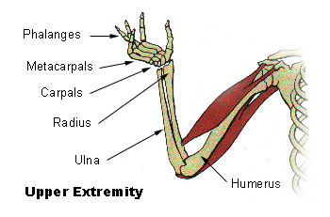
Ossa membri superioris et allia:
Right shoulder blade
Complicated fracture of the left collar bone
Humerus
True and false ribs
Radius
Fingers
Open fracture of the right ulna and radius
Wrist
Metacarpus
C
A
B
F
G
H
I
E
D

Slide 13
Form phrases from words in boxes
Uterus Ligamentum
Latus, a, um
Cerebrum
Transversus, a, um
Fissura
Antebrachium Membrana
Interosseus, a, um
Anomalia Bulbus
Congenitus, a, um
Oculus

Slide 14
Form phrases from words in boxes
Tunica Vesica
Mucosus, a, um
Felleus, a, um
Sinister, a, um
Thyreoideus, a, um
Lobus Glandula
Truncus
Accessorius, a, um
Nervus
Plica (pl.)
transversus, a, um
Rectum

Slide 15
Form phrases from words in boxes
Collum
Vesica
Felleus, a, um
Musculus (pl.)
Transversus, a, um
Dorsum
Apertura Ventriculus
Quartus, a, um
Medianus, a, um
Congenitus, a, um
Durus, a, um
Palatum Fissura

Slide 16
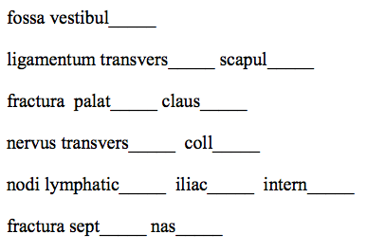
Fill in missing endings:

Slide 17
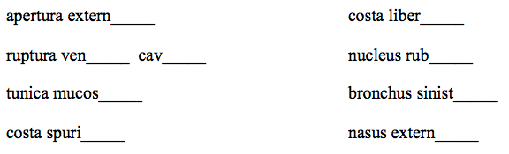
A) Fill in missing endings
B) Change into the plural

Slide 18
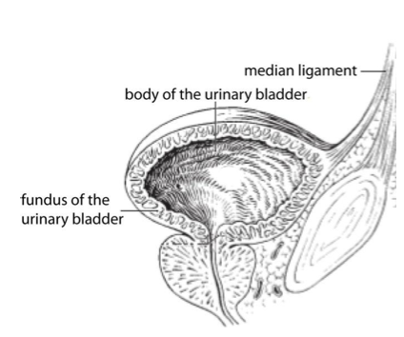
Translate the legend to the image:

Slide 19
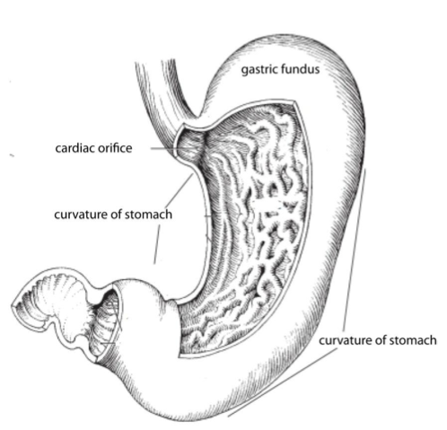
Translate the legend to the image:

Slide 20
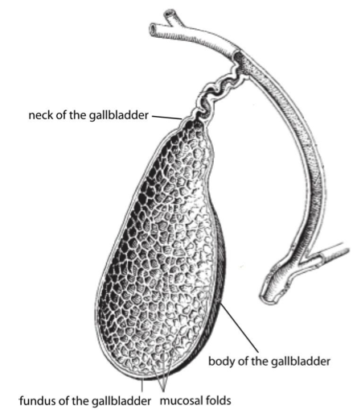
Translate the legend to the image:

