Slide 1
IIIrd declension
Consonant stems

Slide 2
Test
  EX. 1: Give nom. sg., gen. sg., gender, declension and example of the underlines nouns/ dictionary forms of the underlines adjective. Translate the expressions.
  Read the instructions carefully!
  EX. 2: Fill in missing endings:
  Tunica mucos…. vesic…. urinar….
  Post fractur…. uln… complicat…
  Fissura palat… dur…
  Glandula palatin…

Slide 3
Test
Ex. 3:
Sg.?/ Pl.? Complicated fractures of ribs
Word order: Theraphy of the rupture of the long muscle of the neck
Prepositions: Pills under the tongue (situation)

Slide 4
Specific features of the 3rd declension
All 3 genders are included (cortex m., radix f., femur n.)
Nom. Sg. – various endings (sanguis, excisio, abductor, rete, latus, femur, abdomen, cavitas)
  Nominative form is not interconnected with the gender. Words must be carefully memorized!
Two main groups:
  nominative and genitive stem differs (genitive is longer than nominative) Consonant stems
  nominative and genitive stem remains unchanged (genitive has same number of syllables as nominative) I- stems + exceptions

Slide 5
Specific features of the 3rd consonant declension
Stem in gen. sg. and nom sg. usually differs (pulm-o//pulmon-is, fem-ur//femor-is, rad-ix//radic-is)
For the proper inflection the genitive stem is necessary to know
1. pulm-o
2. pulmon-is
4. pulmon-em
6. pulmon-e

Slide 6
Declension paradigms
Consonant |  | I-stems |  | EXCEPTIONS
DOLOR | CORPUS | PELVIS | RETE | DOSIS

Slide 7
DOLOR
 | Sg. | Pl.
nom. | dolor | dolor-es
gen. | dolor-is | dolor-um
ak. | dolor-em | dolor-es
abl. | dolor-e | dolor-ibus

Slide 8
CORPUS
 | Sg. | Pl.
nom. | corpus | corpor-a
gen. | corpor-is | corpor-um
ak. | corpus | corpor-a
abl. | corpor-e | corpor-ibus

Slide 9
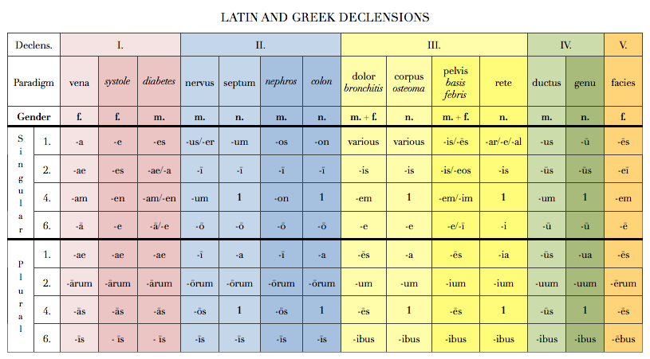
Latin and Greek declensions

Slide 10
EXCEPTIONS
os, ossis n. bone → gen. pl.–ium
vas, vasis, n. vessel
  In sg. follows paradigm CORPUS vas-vasis-vas-vase
  In pl. follows paradigm CEREBRUM vasa-vasorum-vasa-vasis
  GREEK NOUNS typical endings
    -itis//-itidis → inflammation
    -(o)ma//-(o)matis → tumour diseases/swellings

Slide 11
Connection with the adjective
F M N
SG.
1. cavitas magna dolor magnus foramen magnum
2. cavitatis magnae doloris magni foraminis magni
4. (in) cavitatem magnam dolorem magnum foramen magnum
6. (in) cavitate magna dolore magno foramine magno
PL.
1. cavitates magnae dolores magni foramina magna
2. cavitatum magnarum dolorum magnorum foraminum magnorum
4. (in) cavitates magnas dolores magnos foramina magna
6. (in) cavitatibus magnis doloribus magnis foraminibus magnis

Slide 12
Write down stems
Nom. Sg. Gen. sg. Stem
Abdomen
Dolor
Latus
Abductor
Encephalitis
Lien
Amputatio
Excisio
Luxatio
Apex
Extensor
Margo
Abdominis
Abdomin-
Doloris
Dolor-
Lateris
Later-
Abductoris
Abductor-
Encephalitidis
Encephalitid-
Lienis
Lien-
Amputationis
Amputation-
Excisionis
Excision-
Luxationis
Luxation-
Apicis
Apic-
Extensoris
Extensor-
Marginis
Margin-

Slide 13
Assign nouns to the paradimgs
vena
nervus
dolor
systole
septum
corpus
• musculus • vulnus • ulcus • digitus • albus •
• cavitas • vas • arterias • diarrhoas •
• ligamenta • aqua • crura • symptoma
• tumor • ren • abdomen • systolen • apex • cortex
• luxatio • ostio • os • radios • cor

Slide 14
What is a nominative form of these nouns?
Ex.: Injectionis > Injectio, feminine, DOLOR
Cervicis
Solutionis
Tumoris
Femoris
Vertebrae
Sacchari
Systoles
Oculi
Cancri
Phalangis
Ossis
Oris
Coli
Colli
Extremitatis
Capitis
Ganglii
Cervix
Solutio
Tumor
Femur
Vertebra
Saccharum
Systole
Oculus
Cancer
Phalangx
Os
Os
Colon
Collum
Extremitas
Caput
Ganglion

Slide 15
Change into nominative plural:
Femur
Mater
Flos
Foramen
Oedema
Apex
Caput
Melanoma
Cartilago
Injectio
Femora
Matres
Flores
Foramina
Oedemata
Apices
Capita
Melanomata
Cartilagines
Injectiones

Slide 16
Connect nouns to name structures:
Cranii
Thoracis
Abdominis
Laryngis
Nasi
Oris
Pharyngis
Uteri
Cavitas
Cervix
Uteri
Vesicae
urinariae
Linguae
Phalangis
Sterni
Tali
Tibiae
Uteri
Ossis metacarpi
Ossis metatarsi
Coccygis
Corpus
Brachii
Capitis
Carpi
Cervicis
Coxae
Cruris
Dorsi
Femoris
Pedis
Costae
Femoris
Fibulae
Humeri
Mandibulae
Phalangis
Radii
Ulnae
Regio
Caput

Slide 17
Assign adjectives to nouns
tumor• corpus• medicamentum•pes • os• foramen• diameter• vulnus
Benignus
Malignus
Novus
Novum
Bonum
Longum
sacrum
Obliqua
Humanum
Osseum
Adiposum
Alienum
Humanus
Sinister
dexter
Nutricium
Medium
Scissum
Sclopetarium
Contusum
Sectum
Punctum

Slide 18
Find Greek and Latin synonymes
English Latin Greek
_____________ Os, oris _____________
Kidney _____________ _____________
_____________ _____________ Colon
Brain _____________ _____________
_____________ Organum _____________
_____________ _____________ Hepar
Stitch _____________ _____________
_____________ Vulnus _____________
Mouth
Stoma
Ren
Nephros
Large intestine
Intestinum crassum
Cerebrum
Encephalon
Organ
Organon
Liver
Iecur
Sutura
R(h)aphe
Injury, wound
Trauma

Slide 19
Add loose attributes
Cavitas + septum nasi
Operatio + cervix uteri
Corpus + vertebra thoracica
Fractura + os sacrum
Luxatio + crus
Morbus infectiosus + abdomen
Dolor acutus + caput
Cavitas septi nasi
Operatio cervicis uteri
Corpus vertebrae thoracicae
Fractura ossis sacri
Luxatio cruris
Morbus infectiosus abdominis
Dolor acutus capitis

Slide 20
Change for nominative plural
sphincter
foramen nutricium
dolor chronicus
vas longum
musculus adductor
femur fractum
cartilago thyreoidea
vulnus punctum
sphincteres
foramina nutricia
dolores chronici
vasa longa
musculi adductores
femora fracta
cartilagines thyreoideae
vulnera puncta

