Slide 1
Basic medical terminology

Slide 2
Test
Orthography and typos
  operattio/excision/alimentorium…
Irregular stem formations
  Femur (femoris:femuris?)
  Hallux (hallcis:hallucis?)
  Cavitas (in cavite: cavitate?)
Prepositions
  in/sub

Slide 3
Missing endings/Translation
-oma words (gender?)
Position of the adjective
  Immediately after the noun
    Ulcus durum vaginae/ Functio laesa pulmonum
  At the end of the phrase
    Ulcus vaginae durum/ Functio pulmonum laesa
Plural forms
  Dent…… incisiv……

Slide 4
Inflect
us
um
Partus caesare _ _
Part _ _ caesare _
Part _ _ caesare _ _
Part_ caesare _
Part_ _ caesare _
Part_ _ _ caesare _ _ _ _
Part_ _ caesare _ _
6. Part_ _ _ _ caesare _ _
Genu valg _ _
Gen_ _ valg _
Gen _ valg _ _
Gen _ valg _
Gen_ _ valg _
Gen_ _ _ valg_ _ _ _
Gen_ _ valg _
6. Gen_ _ _ _ valg _ _
us
i
us
i
um
um
u
um
u
o
u
o
us
i
ua
a
uum
orum
uum
orum
us
os
ua
a
ibus
is
ibus
is

Slide 5
Inflect
Inflect
Rabies silvatic*_
Rabi_ _ silvatic_ _
Rabi _ _ silvatic _ _
Rabi _ silvatic_
Rabi _ _ silvatic_ _
Rabi_ _ _ _ silvatic _ _ _ _
Rabi_ _ silvatic _ _
Rabi_ _ _ _ silvatic _ _
Silvaticus, a, um
a
Manus fract_
Man_ _ fract _ _
Man_ _ fract _ _
Man _ fract _
Man _ _ fract _ _
Man _ _ _ fract _ _ _ _
Man_ _ fract _ _
6. Man_ _ _ _ fract _ _
a
ei
ae
us
ae
em
am
um
am
e
a
u
a
es
ae
us
ae
erum
arum
uum
arum
es
as
us
as
ebus
is
ibus
is

Slide 6
Which declension? Which paradigm?
Infarctum
Unguentum
Arcuatus
Arcus
Processus
Tempus
Manus
Talos
Nephros
Diei
Thoracici
Malleolo
Pulmo
Cochlearia
Lamina
Ligamenta
Radiata
Scatula
Canales
Scabies
Colore
Rhaphe
Radiatis
Neurosis

Slide 7
Which case? Say the nominative sg.
Cariei
Exitus
Obstructiones
Manum
Genua
Visus
Calvitiei
Foramina
Corporibus
Conchae
Morbi
Cochlearia
Traumatis
Vulneris
Nuclei
Sensus
Temporis
Psychosim
Articulationum
Sepsi
Regionis

Slide 8
Match nouns and adjectives
decubitus spontaneus, a, um
genu opticus, a, um
processus diaphragmaticus, a, um
facies profundus, a, um
nervus humanus, a, um
corpus dexter, a, um
partus xiphoideus, a, um

Slide 9
Match and change for nom. pl
-es, -ae
Species asthmaticus, a, um
Abscessus dolorosus, a, um
Decubitus acusticus, a, um
Partus subcutaneus, a, um
Facies spinosus, a, um
Meatus profundus, a, um
Usus Hippocraticus, a, um
Processus internus, a, um
-us, -i
-us, -i
-us, -i
-es, -ae
-us, -i
-us, -i
-us, -i

Slide 10
Change into the given case or connect with given preposition
Caries profunda
Exitus letalis
Manus dextra
Genu varum
Foramen magnum
Vulnera secta
Psychosis organica
Articulatio plana
Regio thoracis
4/pl
Post
cum
6/sg
4/sg
1/sg
propter
6/pl
6/sg
Caries profundas
Exitum letalem
Manu dextra
Genu varo
Foramen magnum
Vulnus sectum
Psychosim organicam
Articulationibus planis
Regione thoracis

Slide 11
Form loose attributes
Articulatio + (genu valgum)
Arcus + (vertebrae thoracicae)
Causa + (obstructio venae)
Effectus + (gargarisma novum)
Sanatio + (decubitus profundus)
Collapsus + (systema circulatorium)
Status + (canities praematura)
-us, -i
-arum, -arum
-is, -ae
-is, -i
-us, -i
-is, -i
-ei, -ae

Slide 12
Connect with preposition
Ex + dies
Post + infarctus acutus
Propter + partus praematurus
Sub + plexus venosus uterinus
In + decursus morbi
Ad + usus internus
Ante + processus spinosus
Pro + decubitus dolorosi
Sine + effectus malus
Ex die
Post infarctum acutum
Propter partum praematurum
Sub plexu venoso uterino
In decursu morbi
Ad usum internum
Ante processum spinosum
Pro decubitibus dolorosis
Sine effectu malo

Slide 13
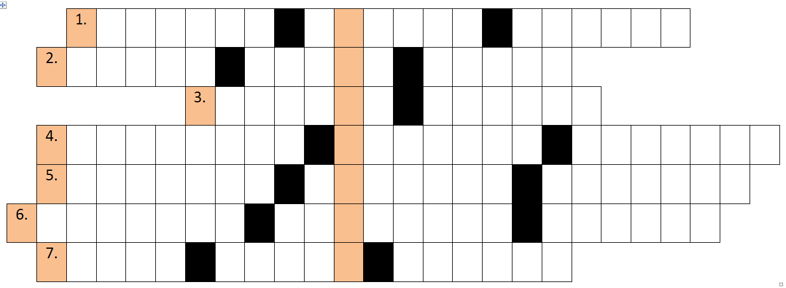
Solve the crossword
The cyst of the right ovary
Fossa of the hollow vein
Small lobes of the testis
Narrowing of the gallbladder
5. Removal of the benign tumor
6. Healing of the torn wound
7. Death during the delivery

