Slide 1
Basic medical terminology
Presentation by E. Dávidová

Slide 2
a) Circle all nouns of the 4th and 5th declension. b) Classify the nouns in the table into five groups according to their declensions. Give their genitive singular form, gender and paradigm.
carcinoma rabies pars sutura
processus diploe ophthalmos species
dentinum lens ascites sensus
crus dies abductor angulus cochlear
manus gaster cornu gargarisma

Slide 3
Give nominative singular forms to the nouns.
carie infarctu unguenti dentes
pulmonum pleuritidem gargarismate
temporibus labio morsum arcuum
ligamenta scabiem thoracis
laminarum scatulis neuroseos
dyspnoes nephron encephalo

Slide 4
a) Match the nouns in the oval with the adjectives in the correct form. b) Change the terms from task a) in genitive of singular.
genu
decubitus
partus
facies
usus
status
species
epilepticus, a, um – asthmaticus, a, um – postoperativus, a, um
externus, a, um – internus, a, um
pallidus, a, um – Hippocraticus, a, um
praematurus, a, um – complicatus, a, um
profundus, a, um – dolorosus, a, um
aromaticus, a, um – urologicus, a, um
varus, a, um – valgus, a, um

Slide 5
a) Decide what the case and number of underlined words are. b) Connect the terms in the tables with the adjectives below.
in genibus
dolor genus
in genua
dolor genuum
in genu
sanatio decubitus
prope decubitus
sub decubitu
sanatio decubituum
sub decubitibus
prope decubitum
propter cariem
therapia carierum
sub carie
therapia cariei
sub cariebus
propter caries
valgus, a, um dolorosus, a, um profundus, a, um

Slide 6
Put the terms into the required form.
abortus completus abl. sg. _________________________
habitus asthenicus gen. sg. _________________________
species urologicae acc. pl. _________________________
manus sinistra abl. sg. _________________________
genu dextrum acc. sg. ________________________
calvities praematura acc. sg. ________________________
abortu completo
habitus asthenici
species urologicas
manu sinistra
genu dextrum
calvitiem praematuram

Slide 7
a) Fill in the adjectives from the table in the correct form. b) Underline all nouns of the 4th and 5th declension in the terms.
facies __________ basis cranii
ligamenta __________ genus
foramina cartilaginis meatus __________ externi
decubitus regionis ossis __________
haemorrhagia ante partum __________
collapsus systematis __________
acusticus, a, um circulatorius, a, um cruciatus, a, um
internus, a, um praematurus, a, um sacer, cra, crum
interna
cruciata
acustici
sacri
praematurum
circulatorii

Slide 8
Connect the prepositions with the terms after plus in the correct form.
ad + usus internus
propter + partus complicatus
in (x) + tractus nervosi
in (x) + ductus hepaticus dexter
post + infarctus acutus
sine + effectus medicamenti
in (x) + aditus laryngis
in (x) + cornua uteri
in (x) + caries dentis profunda

Slide 9
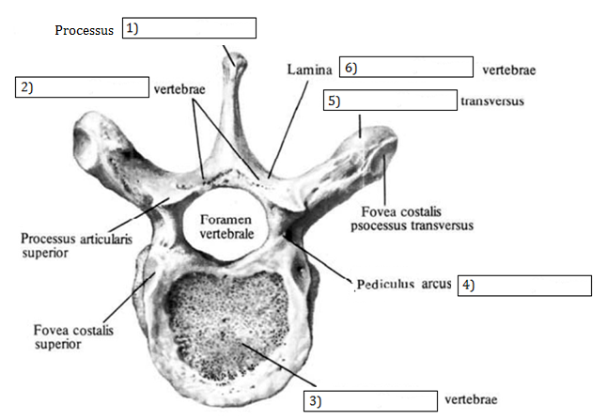
a) Fill in missing words in the correct form. Use the words in the table. b) Connect the terms 1-6 with the term fractura in singular and plural.
arcus (2x) processus spinosus, a, um vertebra corpus
spinosus
arcus
arcus
processus
vertebrae
corpus

Slide 10
Fill in missing endings.
Decursus morb_____
Unguentum contra scabi_____
Symptomata infarct_____
Vulnus punct_____ faci_____
Luxatio articulation_____ gen_____
Situs fet_____ transvers____
Abscessus meat_____ acustic_____ extern_____
Fractura apert_____ gen_____ sinistr_____
Mors fet_____ post part_____ praematur_____

Slide 11
Exitus post infarct_____ myocardi_____ acut_____
Dosis medicament_____ pro di_____
Musculus sphincter duct_____ choledoch_____
Dolores chronic_____ dent_____ propter cari_____ profund_____
(all in pl.)
Carcinoma pulmon_____ dextr_____ in sit_____
Abscessus subcutane_____ man_____ sinistr_____
Haemorrhagia ret_____ venos_____ bulb_____ ocul_____

Slide 12
Solve the crossword (answers). 1. Organs of eyesight 2. Foreign bodies in the stomach 3. Symptoms of heart attack 4. Human senses 5. Slipping out of the womb after delivery 6. Tear wounds of the eyelid 7. Pains in the tooth caused by a decay 8. Operation of bowlegs 9. Fingers of the right hand
 |  |  |  |  | 1. | O | R | G | A | N | A |  | V | I | S | U | S
 | 2. | C | O | R | P | O | R | A |  | A | L | I | E | N | A |  | G | A | S | T | R | I | S
3. | S | Y | M | P | T | O | M | A | T | A |  | I | N | F | A | R | C | T | U | S |  | C | O | R | D | I | S
 |  |  | 4. | S | E | N | S | U | S |  | H | U | M | A | N | I
5. | P | R | O | L | A | P | S | U | S |  | U | T | E | R | I |  | P | O | S | T |  | P | A | R | T | U | M
 |  |  | 6. | V | U | L | N | E | R | A |  | L | A | C | E | R | A |  | P | A | L | P | E | B | R | A | E
 |  | 7. | D | O | L | O | R | E | S |  | D | E | N | T | I | S |  | E | X |  | C | A | R | I | E
 | 8. | O | P | E | R | A | T | I | O |  | G | E | N | U | U | M |  | V | A | R | O | R | U | M
 |  | 9. | D | I | G | I | T | I |  | M | A | N | U | S |  | D | E | X | T | R | A | E

Slide 13
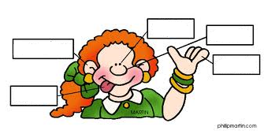
Name five human senses in Latin.

Slide 14
a) Match the anatomic terms with human senses to which they relate. b) Connect the terms in the right oval with the term structura.
tactus
gustus
auditus
visus
olfactus
cortex lentis
cartilago meatus acustici
musculus tensor tympani
caliculus gustatorius
auris interna
labyrinthus osseus
cutis
pars optica retinae
tunica mucosa nasi
papilla foliata
musculus sphincter pupillae

