Slide 1

INTEGUMENTARY SYSTEM
Skin thin type
thick type
Keratinized adnexa hair
nail
Nonkeratinized adnexa small sweat glands (ecrine)
great sweat glands (apocrine)
sebaceous glands (holocrine)
mammary glands

Slide 2
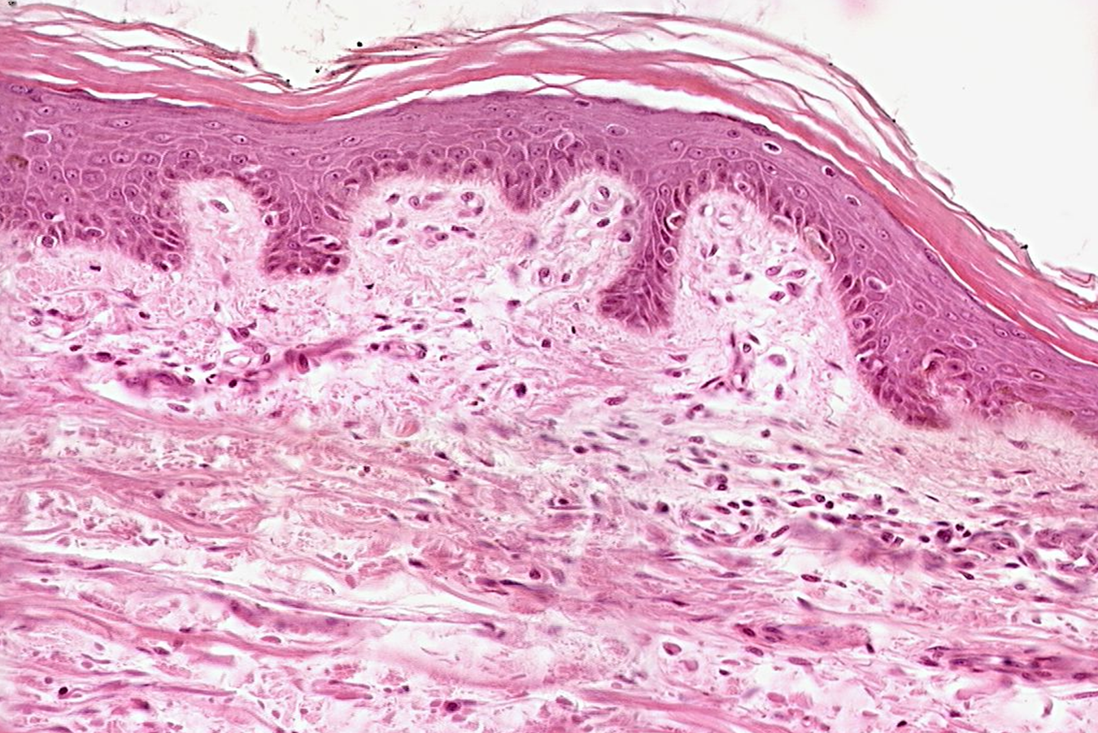
Skin (integumentum)
Epidermis
stratum corneum proprium
(stratum lucidum)
stratum granulosum
stratum spinosum
stratum basale
Dermis (corium)
pars papillaris
pars reticularis
Hypodermis)

Slide 3
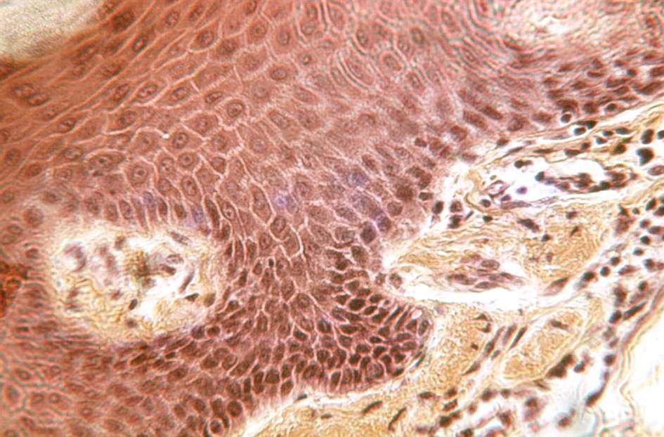
Epidermis
dermis

Slide 4
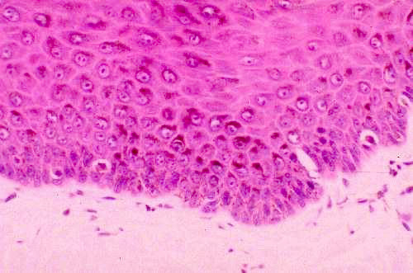
melanocytes

Slide 5
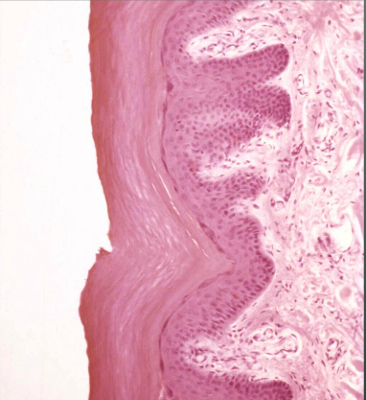
Thin skin Thick skin
Occurrence: palma manus, planta pedis

Slide 6
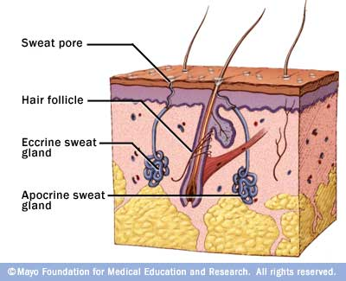
Skin glands small sweat (ecrine)
large sweat(apocrine)
sebaceous (holocrine) Gll. sebaceae
Gll. sudoriferae
General structure of glands:
excretory portion (ducts)
secretory portion
- glandular cells
- myoepithelial cells
https://dentalday.wikispaces.com/

Slide 7
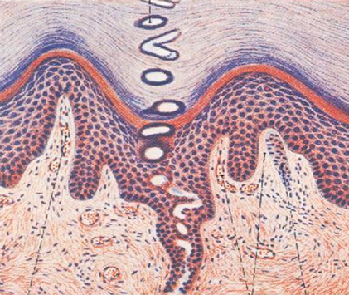

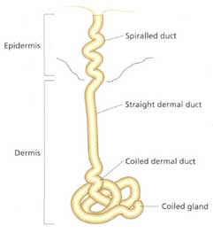
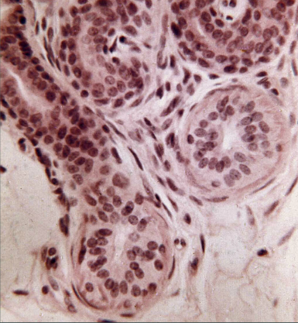
SWEAT GLANDS (gll. sudoriferae)
small ecrine
SWEAT – H₂O, NaCl₂, NH₃,
urea, uric acid, proteins

Slide 8

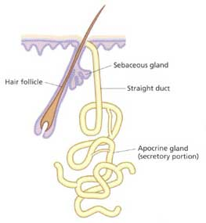
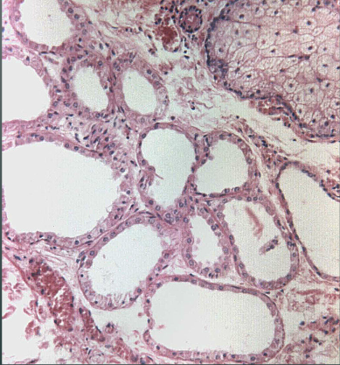
SWEAT GLANDS (gll. sudoriferae)
large apocrine
after pubery complet swea
–pheromones, fats, steroids;
under hormonal influence

Slide 9
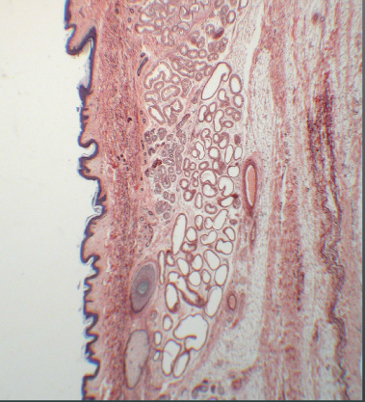

Skin from axilla – great sweat glands (apocrine, aromatic)

Slide 10
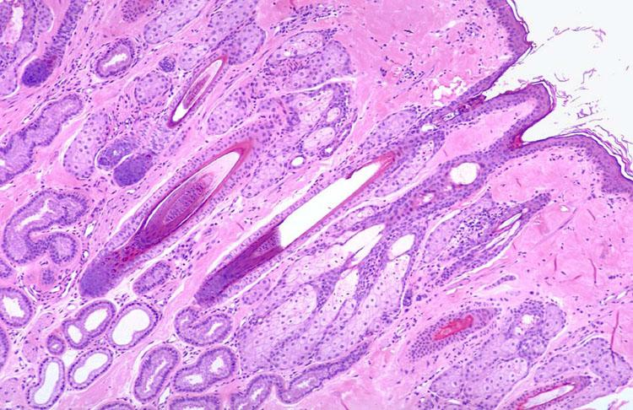
Skin from axilla(HE)
apocrine sweat gland
sebaceous glands

Slide 11
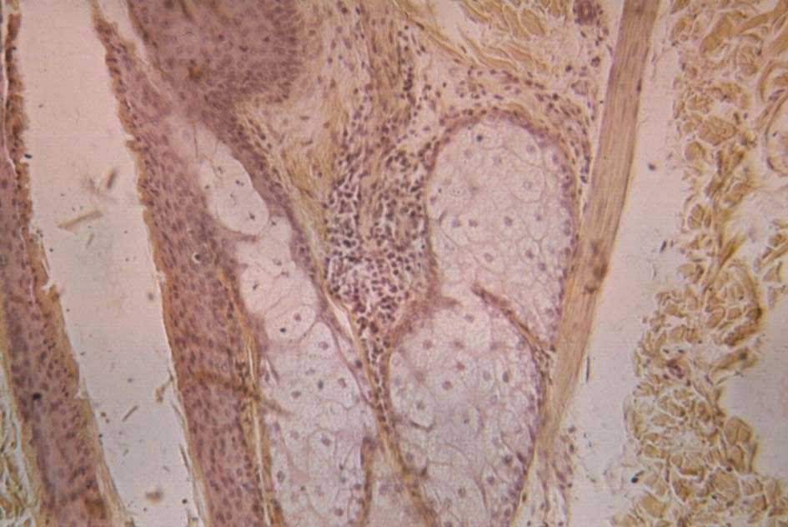
Sebaceous glands (HES)
m. arrector pili
hair follicle

Slide 12
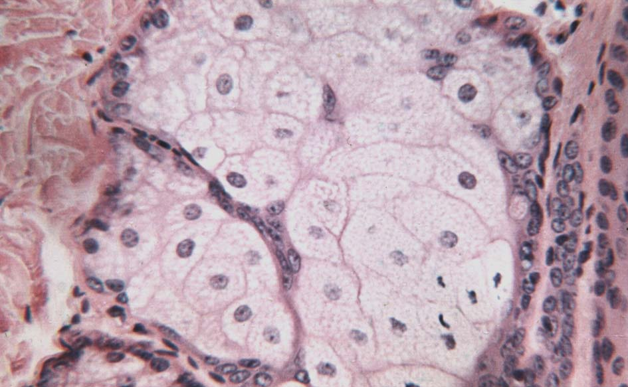
Sebaceous glands (HE)

Slide 13
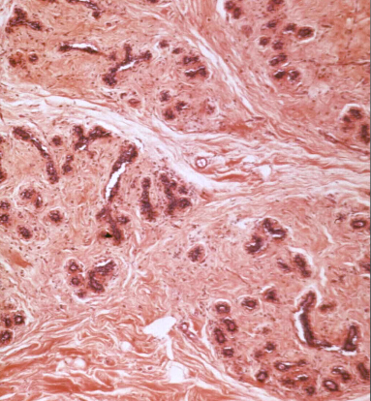
Mamma non lactans (HE)

Slide 14
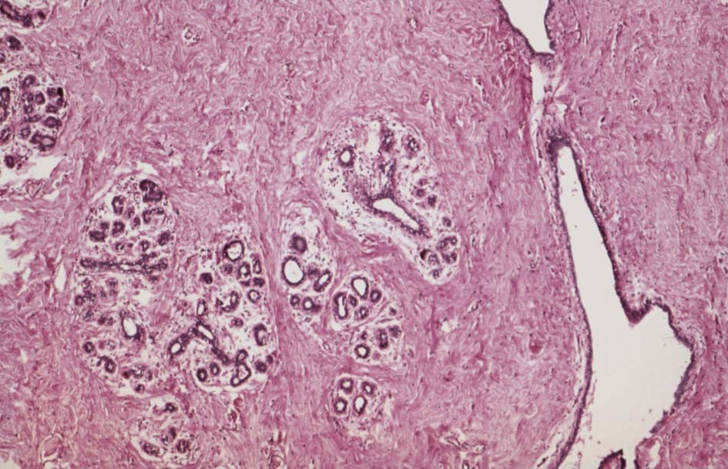
Mamma non lactans (HE)

Slide 15
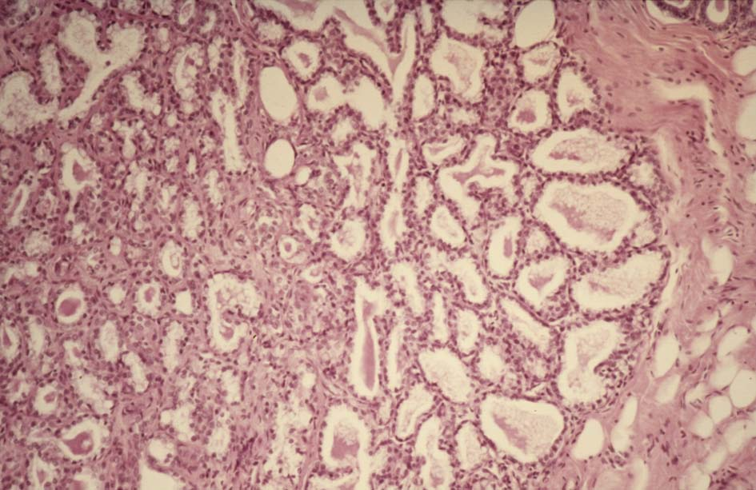
Mamma lactans (HE)

Slide 16
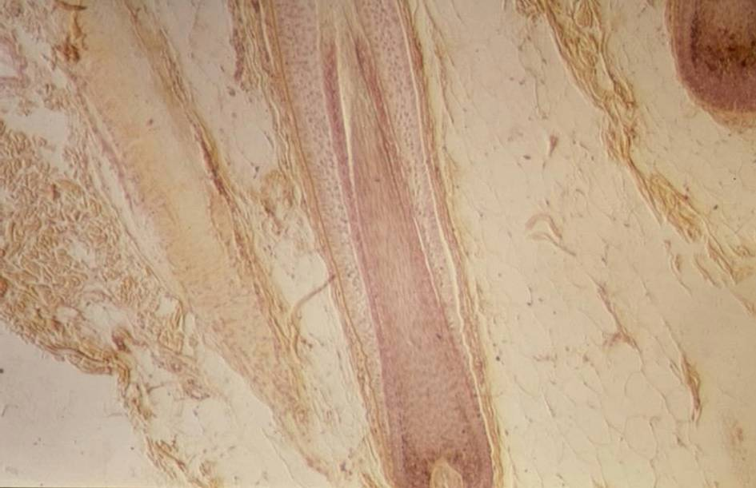
Skin with hair (HEŠ)

Slide 17
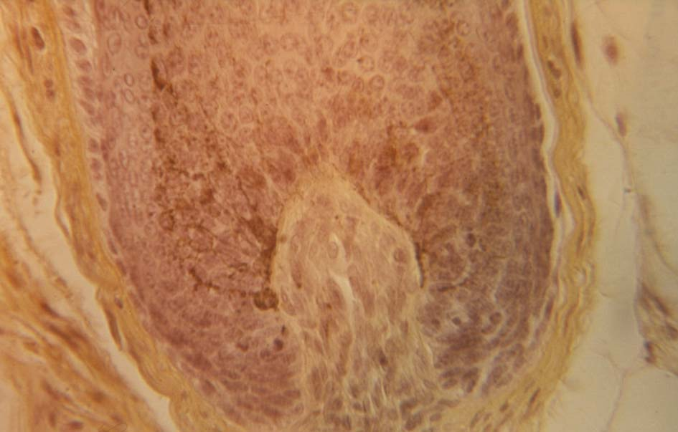
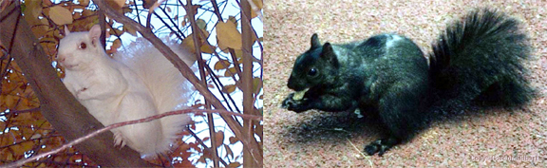
Hair – bulbus pili with melanocytes (HE)

Slide 18
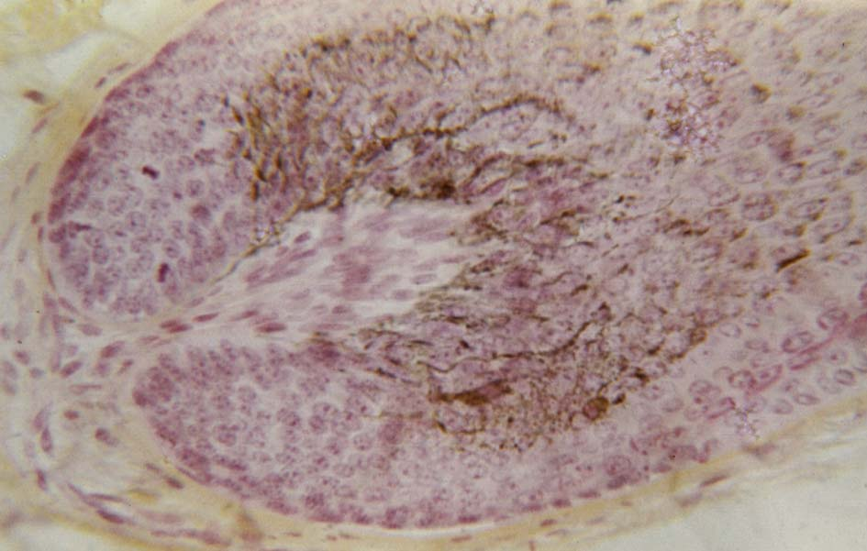
Hair – bulbus pili with melanocytes, papilla pili (HES)

Slide 19
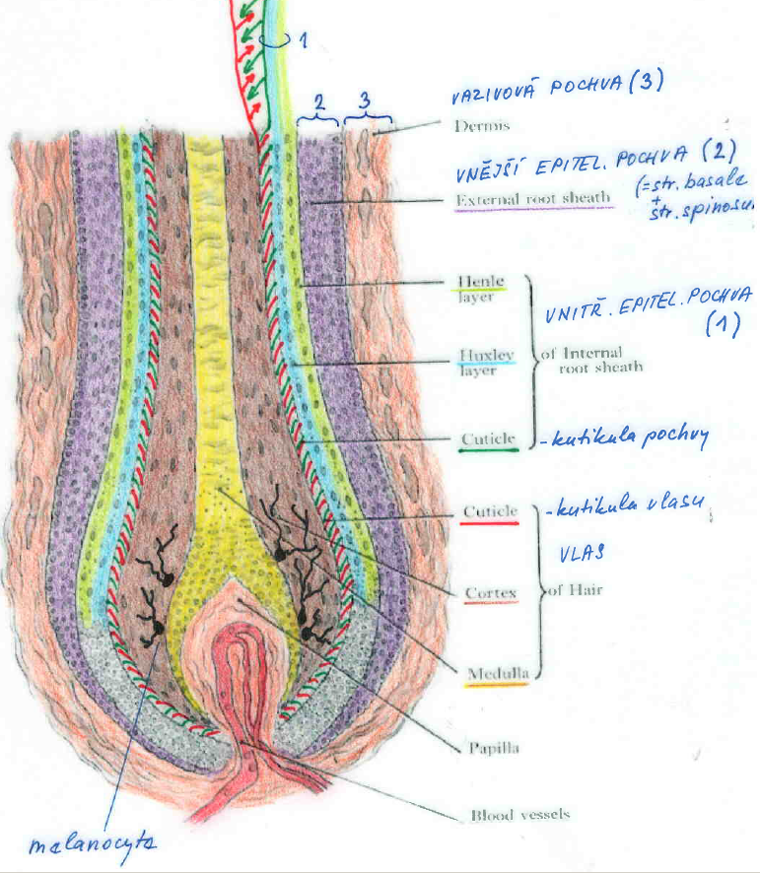
3
Hair (eng) – Vlas (cs) – Pilus (lat)
2 1
dermal sheath (1)
outer epithelial sheath(2)
Henle
Huxley
cuticle
of sheath
cuticle
of hair
cortex
medulla
dermal papilla
blood capillaries
inner epithelial sheath (3)
hair
melanocyte

Slide 20
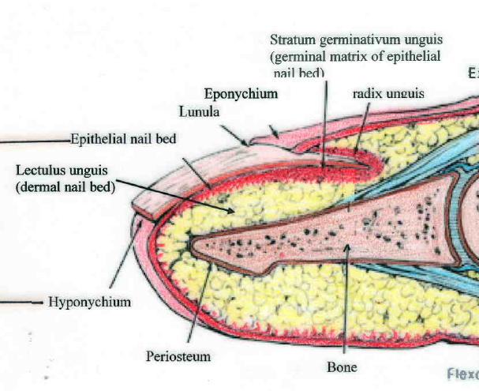
Nail (eng) – Nehet (cs) – Unguis (lat) – Onyx (gr)

Slide 21
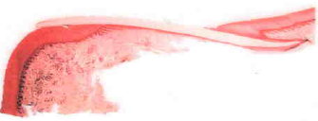
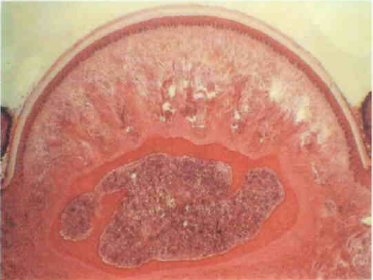
Nail (eng) – Nehet (cs) –Unguis (lat) – Onyx (gr)
Longitutudinal section
Cross section
vallum unguis nail plate
vulcus unguis
epidermal bed
dermal bad
bone

Slide 22
INTEGUMENTARY SYSTEM
Slides:
Skin from tip of finger
Skin with hair
Skin from axilla
Nail
Mamma non-lactans
Mamma lactans

Slide 23
Embryology
Development of skin and skin adnexa

Slide 24
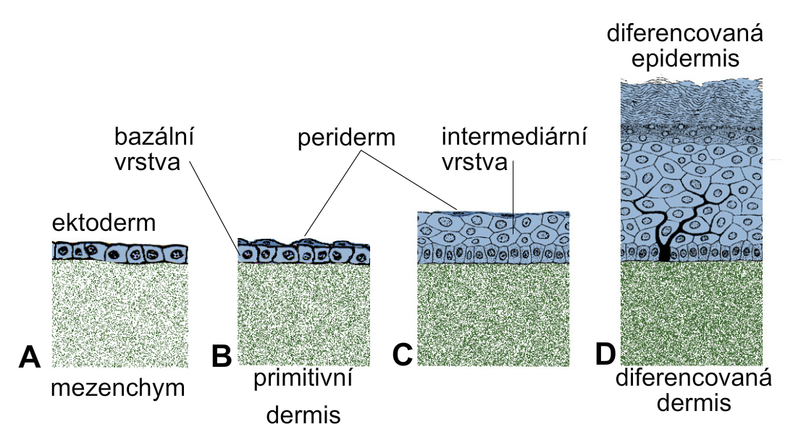
Development of epidermis and corium
differentiated
epidermis
basal intermediate
layer periderm layer
ectoderm
mesenchyme primitive differentiated
dermis dermis

Slide 25
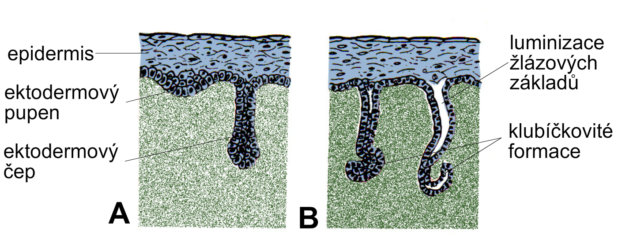
Development of sweat glands
development
of lumen
in glandular ducts
convolution
of secretory portion
epidermis
ectodermal bud
ectodermal peg

Slide 26
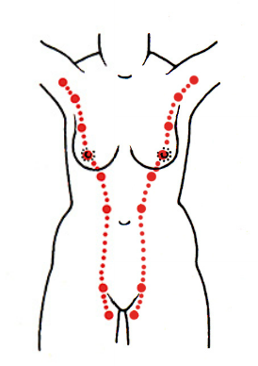
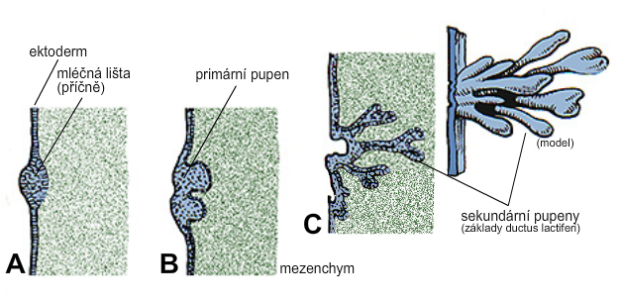
Development of mammary line and gland
B, C: primary and secondar ectodermal buds
ingrowth mesenchyme

Slide 27
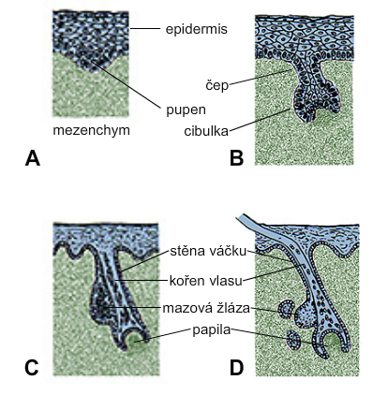
Development of hair and sebaceous gland
epidermis
peg
bud
hair bulb
mesenchyme
hair follicle
hair root
sebaceous gl.
papilla

