Slide 1
Digestive system 1
Pictures from MedAtlas version 3,0

Slide 2
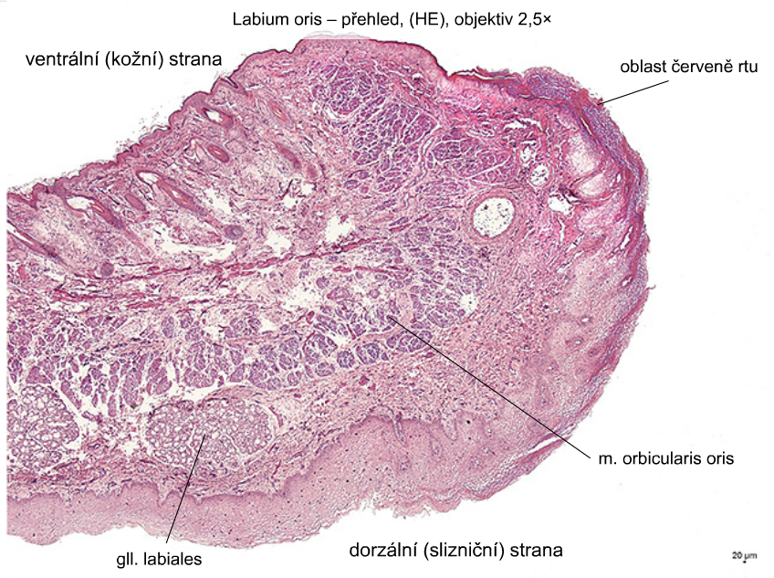
Labium oris
ventral (skin) side
transitional zone
(red of lip)
dorsal (mucosal) side

Slide 3
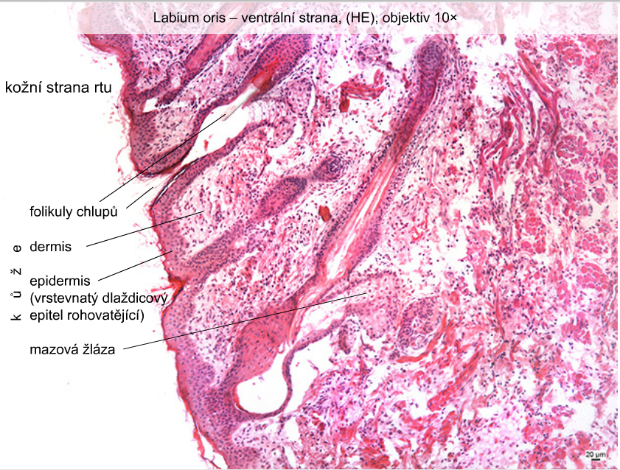
Labium oris – ventral side
skin side of lip
hair follicles
skin – dermis
– epidermis
sebaceous gland

Slide 4
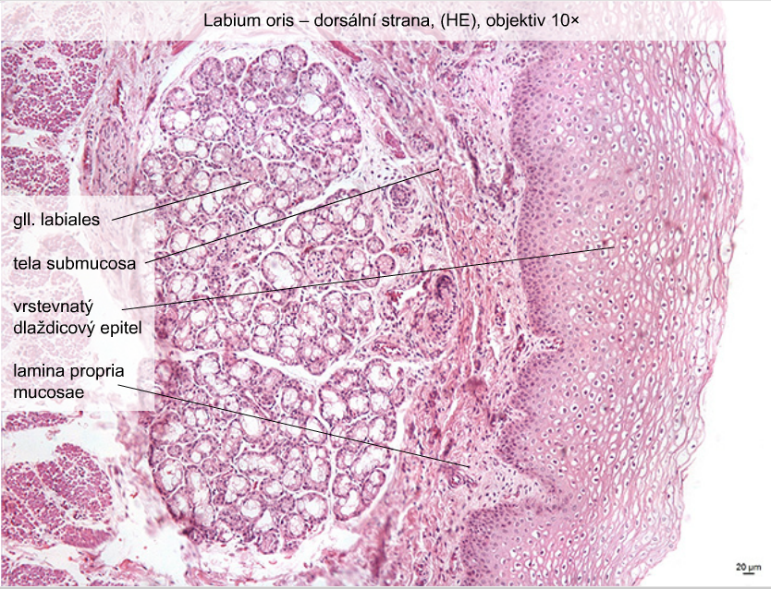
Labium oris – dorsal side
stratified
squamous epithelium

Slide 5
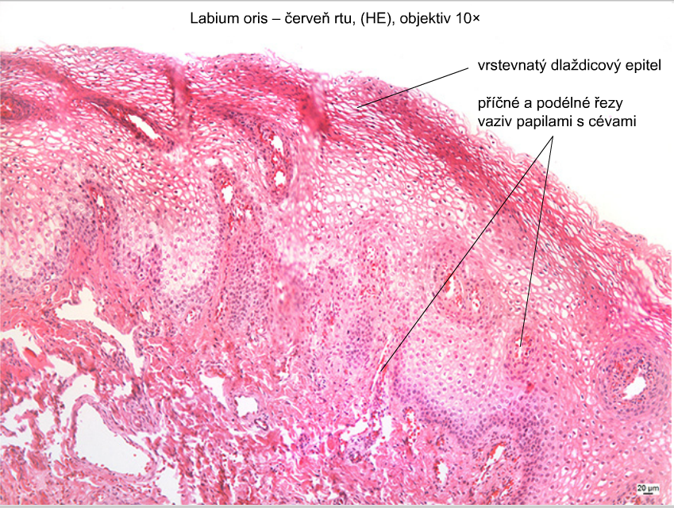
Labium oris – transitional (red) zone
stratified
squamous epithelium
cross and longitudinal sections
of papillae with blood vessels

Slide 6
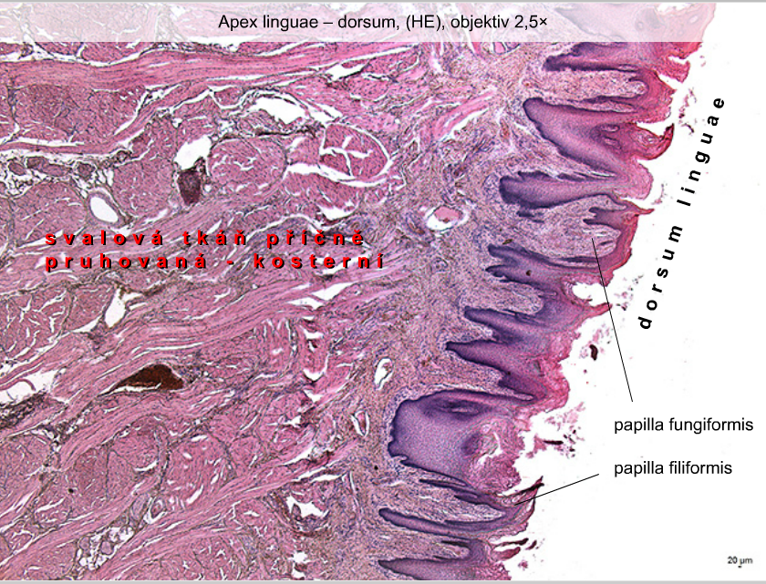
Cross striated - skeletal muscle tissue

Slide 7
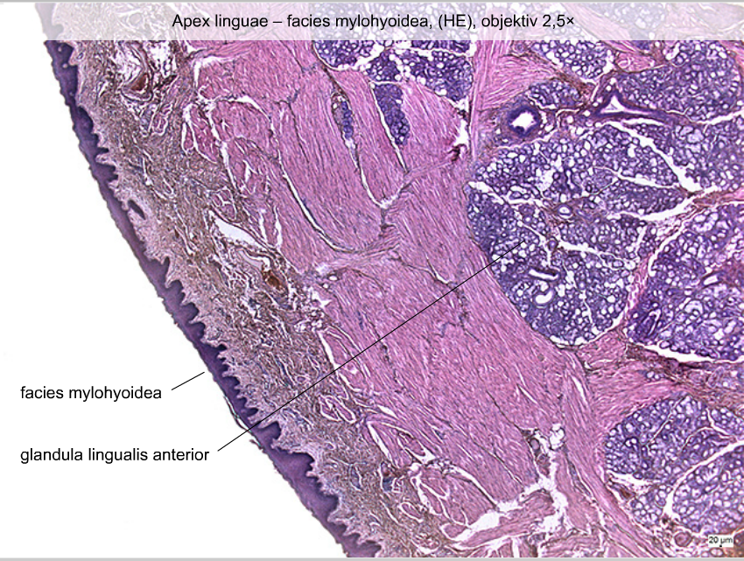

Slide 8
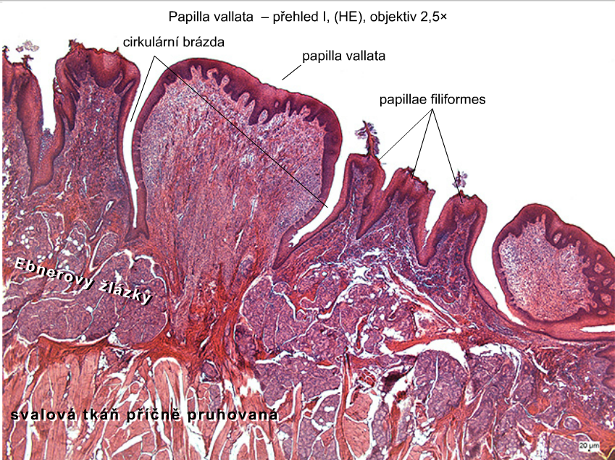
circular furrow
Ebner´s glands
Cross striated - skeletal muscle tissue

Slide 9
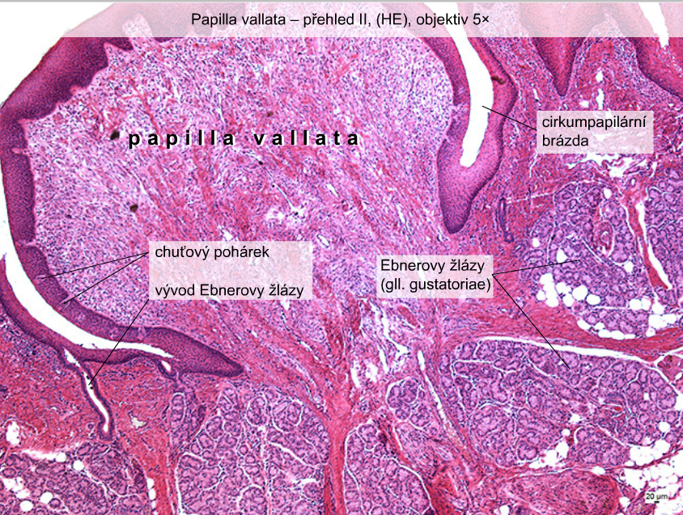
circular furrow
taste bud
duct of Ebner´s gland
Ebner´s glands

Slide 10
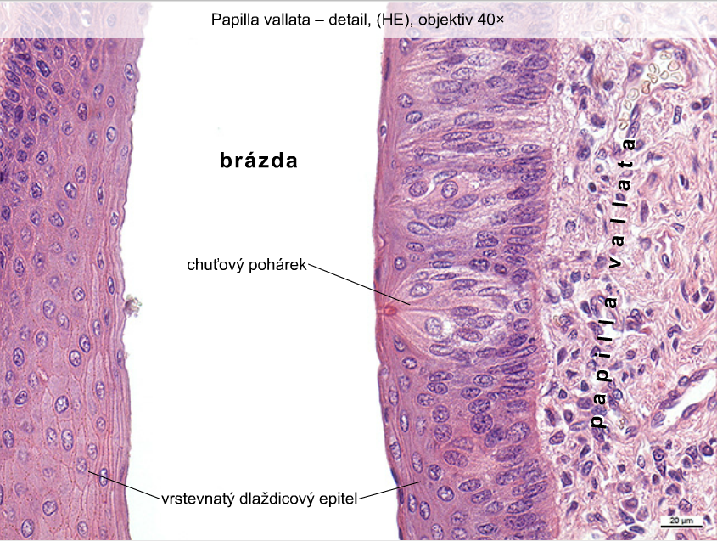
circular
furrow
taste bud
stratified squamous
eithelium

Slide 11
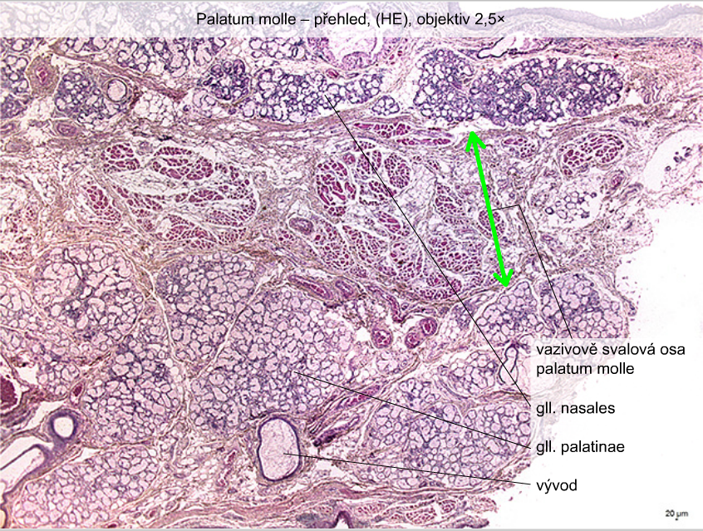
Palatum molle
fibromuscular axis
of soft palate
duct of gland

Slide 12
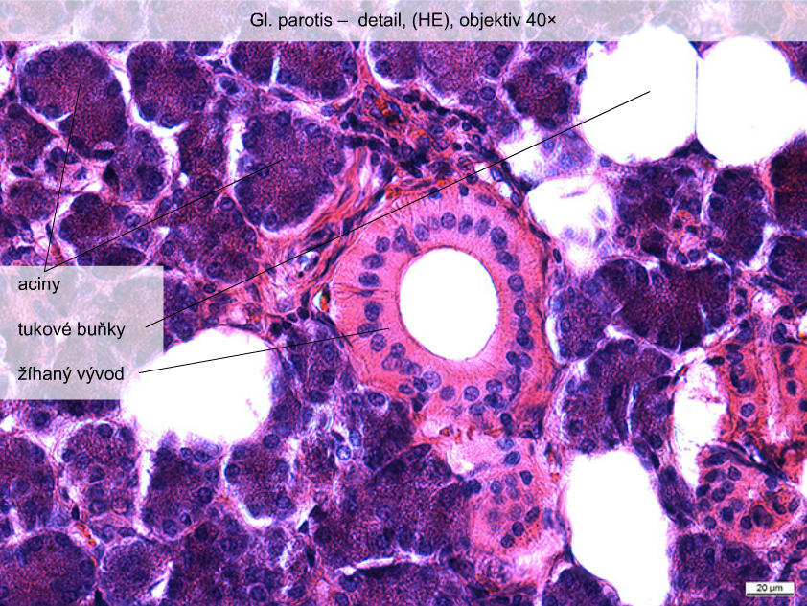
acini
adipous cells
striated duct

Slide 13
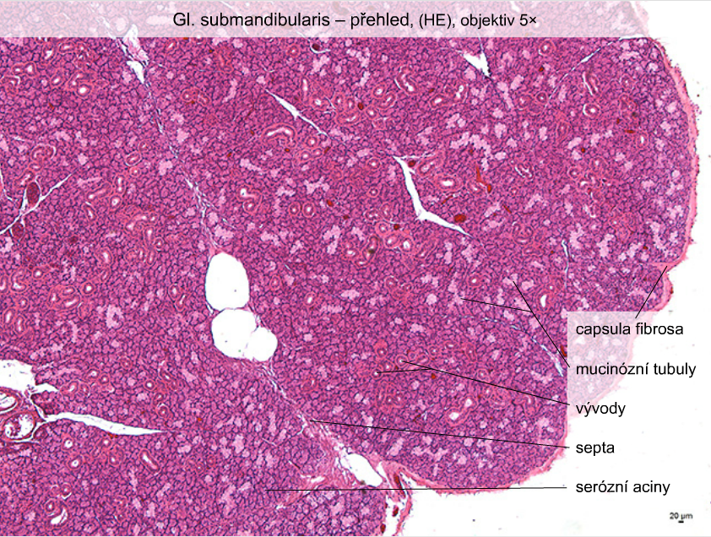
mucous tubules
ducts
septa
serous acini

Slide 14
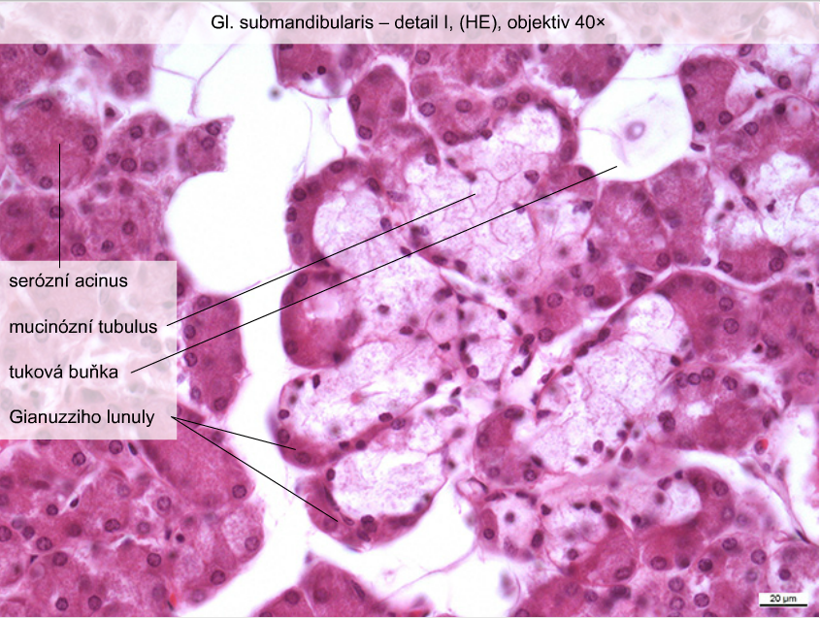
serous acinus
mucous tubule
adipous cell
serous demilune
(of Gianuzzi)

Slide 15
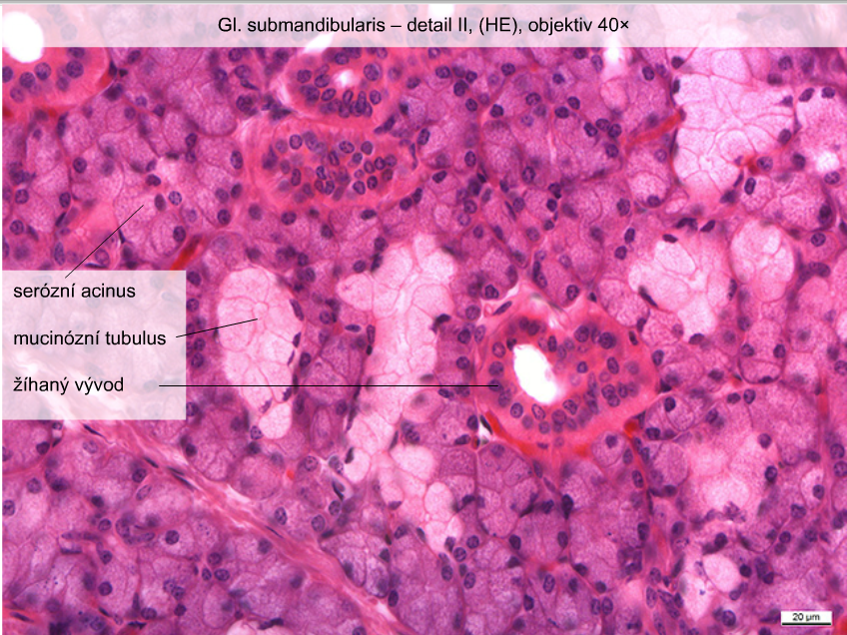
serous acinus
mucous tubule
striated duct

Slide 16
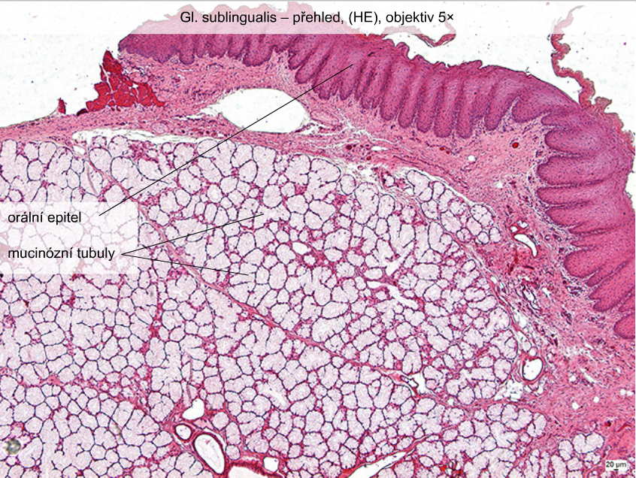
oral epithelium
mucous tubules

