Slide 1
Nursing communication
Jana Strakova
Dpt. of Nursing, Faculty of Medicine, Masaryk University

Slide 2
Content of seminar
What is (nursing) communication ?
Functions of communication
Verbal speech and body talk (non-verbal speech)
Specific factors of communication with patients at hospital, barriers
People with disabilities, elderly people – communication difficulty
Communication at palliative medicine, bad news
Specifics of communication at Czech community + selected useful sentences for practice
INSTRUCTIONS FOR PRACTICE

Slide 3
WHAT is A COMMUNICATION ?
Powerful activity
Life changing activity
Essential and important part of nursing care
Which goals of communication do you generally know?
Do you know some goals of communication in nursing practice (healthcare)?

Slide 4
What is an effective communication?
An effective communication in healthcare influences patient satisfaction, compliance, decrease levels of psychological and emotional distress (Chant et al., 2001)
Campbell, 2006 identified poor communication as one of the commonest causes of complaints in healthcare
How to make your communication effective?
What benefits of effective communication with patients do you know?

Slide 5
FUNCTIONS OF COMMUNICATION
Share information
Give motivation
Emotion expression
Change st.

Slide 6
Communication skills of carevivers
Which skills of care givers are necessary for effective communication with patients ?
  Speaking
  Listening
  Watching
  Touching
  All together means: Understanding of needs
  Patients and care giver can have different perception of reality and own needs

Slide 7
Verbal speech and body talk (non-verbal speech)

Slide 8
Verbal communication
During spoken communication the sender transmits a message from the brain via organs involved in voice production (larynx, tongue, palate and lips) to the receiver.
The receiver picks up the message through their ears, which is transmitted to the brain via auditory nerves, than can react.

Slide 9
Verbal communication
Effective spoken communicastion reqiures an awareness of the impact of personal and social factors (for sender and receiver too), e.g.:
Caregiver | Patient | Both of them
duration of practice | illness | age
specialization | disabilities | gender
motivation for work | level of stress | culture
self-satisfaction | expectations | religion

Slide 10
Non-verbal communication (body talk)
Non verbal communication is an important part of communication process
60 per cent of information is picked up via non-verbal way
Forms of body language:
  Paralinquistic phenomenon
  Gestures
  Facial expression (mimics)
  Posturology
  Proxemics
  Haptics (contact to somebody)

Slide 11
Non-verbal communication (body talk)
Non verbal communication is A VERY INDIVIDUAL PROCESS
General statements for understanding non verbal communication are valid for nationalities/cultures/ethnicity
Across nationalities/cultures/ethnicity meaning can be very different

Slide 12
PARALINQUISTIC PHENOMENON
Speed of speech, speed of reply
Dynamics of speech
Volume and high of voice, intonation
https://www.youtube.com/watch?v=4gv6HLqnysw
https://www.youtube.com/watch?v=zRdTMeu9pfY

Slide 13
gestures
= Movement of hands and arms
It Helps to sender code information
Gestures helps to understand coded information to receiver (could be misleading too)

Slide 14
FACIAL EXPRESSION (MIMICS)
One of the most important communication channels
Dominant role of eyes, lips, mouth, eyebrows

Slide 15
posturology
Body position talks about our feeling too
Focused mostly on extremities, chest and head
Basic positions: sitting, standing

Slide 16
Gestures+mimics+posturology
https://www.youtube.com/watch?v=JoX8r8fNmtU

Slide 17
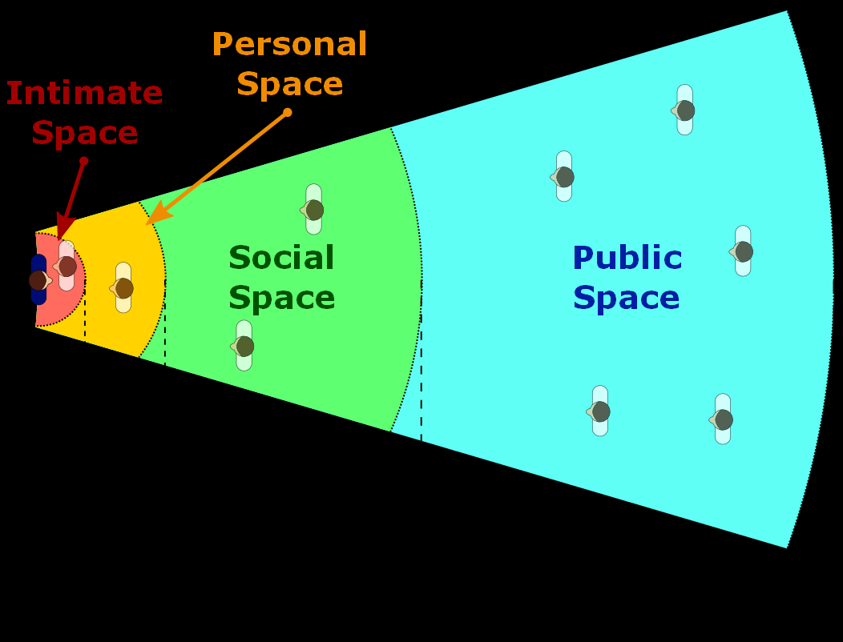
proxemics
Communication by using room (zones) around
Basic zones: intimate, personal, social, public
Different to culture and religion

Slide 18
haptics
Physical contact to someboty
Caregivers really often disturb intimacy of patients
Which procedures disturbs intimacy the most?

Slide 19
haptics
How is the feeling of patient with frequently disturbed intimate zone by caregivers?
  Patient=new born baby
  Patient=14 years old girl
  Patient=70 years old senior
  Patient=you
Which reactions can we activate? (by insensitive handling)

Slide 20
Communication at hospital, barriers

Slide 21
Communication at hospital, barriers
VALID FACOTRS:
Specific surroundings
Patient's/ staff needs and feelings
Language of professionals
Invasive procedures
Separation from family, …

Slide 22
Communication at hospital - HOW TO ASK ABOUT …. ? rules
Communication is never ending part of every day nursing assessment
  e.g.: objective scale (score) assessment - pain assessment, nutrition screening, subjective describing of feeling…
During asking is very important to:
  eliminate possibility of misunderstanding of patients on minimum
  Scales, questionnaires: give exact instructions
  to take a time
  Goal is: get from patient exact answer as possible
  Do not answer instead patients

Slide 23
disabilities

Slide 24
Mental – keep dignity all the time
Physical - visually impaired (purblind, blind)
- hearing impaired (weak hearing, deaf)
All the time try to find way how improve communication – use compensatory tools

Slide 25
Visually impaired - Principles of communication
Help to man use compensatory tools: glasses, use Braille, large printed text
don't hesitate to address like first
Introduce yourself
Offer your help, don't pressure to do st.
Speak directly, not to guide
Correctly describe situation – avoid: here, there, just over there… What is a correct description of situation?

Slide 26
Hearing impaired – principles of communication
Start communication with eyes contact
Help to man use compensatory tools: lips reading, finger spelling, hearing aid (devices), writing on the list
Useful strategies:
Reduce noise
Speak normally
Keep hands away from face
Avoid complex words
Repeat it

Slide 27
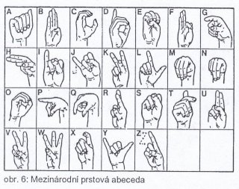
Finger spelling – international alphabet
Ask for your colleague: „May I measure your blood pressure“?

Slide 28
Difficult situations at communication
Say a bad news

Slide 29
how to say a bad news ?
It is not easy
There is no universal phrase for all
Usefull strategies:
  Honesty
  Stop if patient doesn't want to know
  Be very carefull when you talk about prognosis – no false promises
  don't take hope
  Secrecy all time
  Next talk – continuity of process

Slide 30
how to say a bad news ?
Useless strategies:
  Do nothing
  Lie or „not say a true“
  No respond to patint's signal, e.g. I am afraid …

Slide 31
Specifics of communication at THE Czech community + selected useful sentences for practice

Slide 32
SPECIFICS
To be on formal terms with patients
For identification of patient:
  on the bed/wall is a board with name of patient for easy orientation
  strap around wrist (check before medication!!!)
All the time knock the door
Try to speak in Czech
To inform patient about all intervention before you start

Slide 33
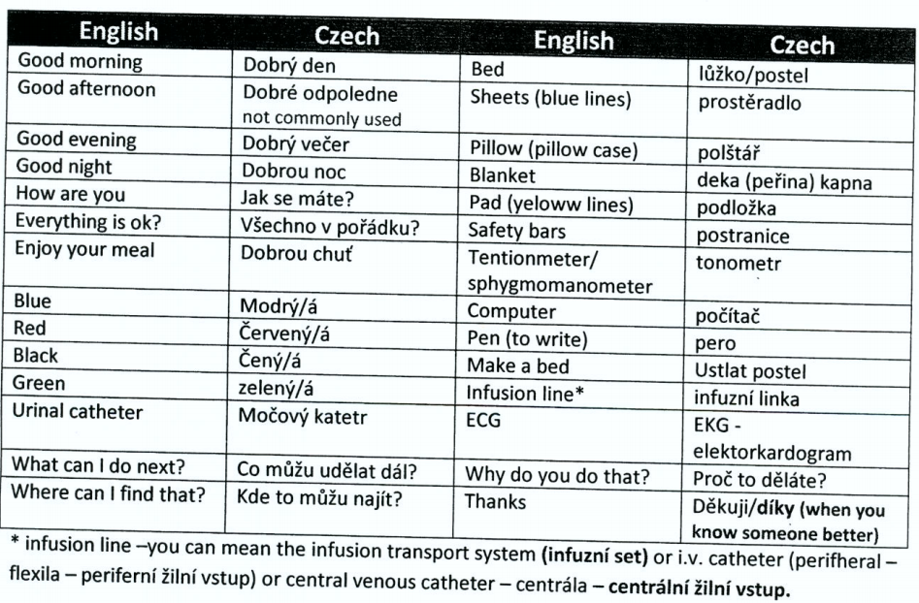
USEFULL SENTENCES

Slide 34
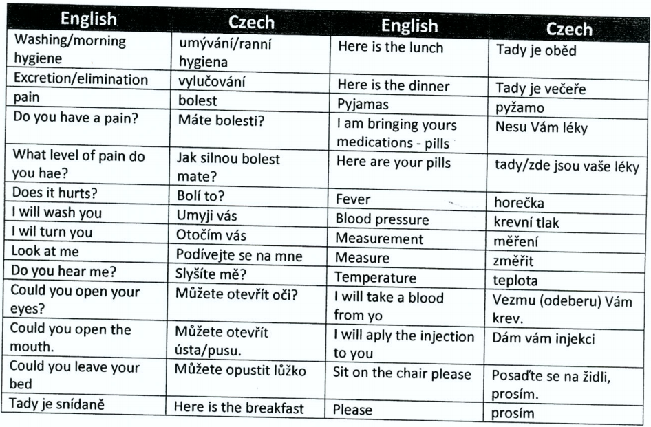

Slide 35
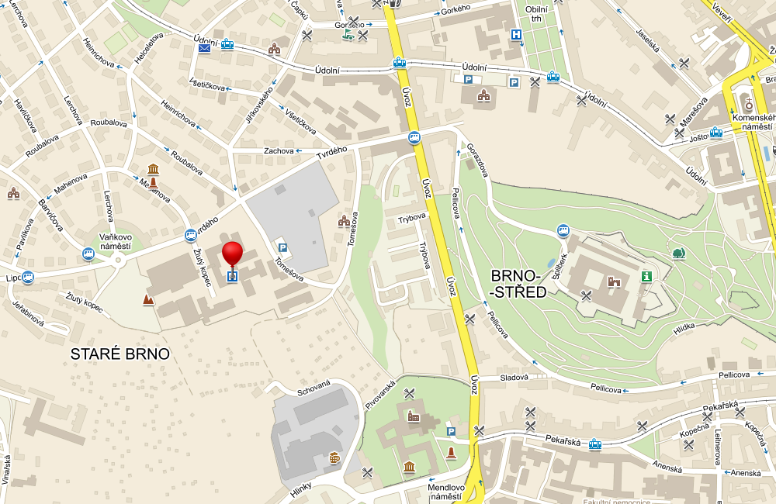
INFORMATION FOR PRACTICE IN HOSPITAL

Slide 36
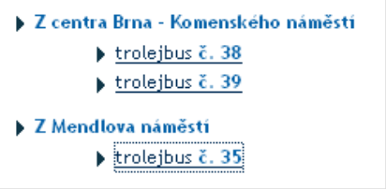
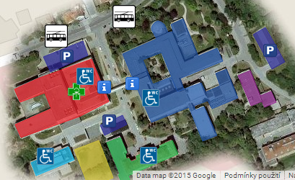
Meeting point for students: Main entrance to the hospital (see red build in the picture, there is a hepl desk)
Time of arrival: 5:55 in the morning
Practice takes from 6:30 to 10 o'clock

Slide 37

What to bring with?
CLEAN AND IRONED UNIFORM
Only short sleeved shirt or T-shirt
NO PICTURES, WRITING ON SHIRT OR T-SHIRT !!!

Slide 38
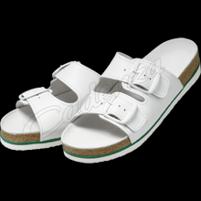
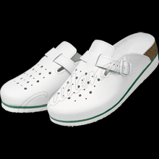
What to bring with?
SHOES – ONLY white color with white socks
LONG HAIR – to comb long hair – ponytail

Slide 39
What to bring with?
REMOVE all JEWELS from your fingers and wrist
Dont use strong nail polish !
Padlock
IDENTIFICATION CARD FOR PRACTICE
(ask for it at International Office - Marketa Neckarova)
A PEN (for writing to the documentation, to make some notes…)

Slide 40

ENJOY your practice
strakova@med.muni.cz

