Slide 1
FEMALE GENITAL ORGANS (ORGANA GENITALIA FEMININA)

Slide 2
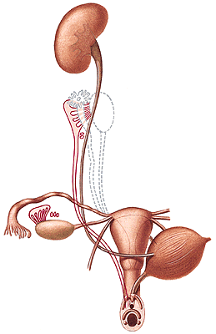
Organa genitalia interna:
Ovarium
Tuba uterina (Fallopian tube)
Uterus
Vagina
Organa genitalia externa:
Mons pubis
Labia majora pudendi
Labia minora pudendi
Clitoris
Glandulae vestibulares majores
Glandulae vestibulares minores
Bulbi vestibuli
Ductus Mülleri, plica genitalis
Torus genitalis

Slide 3
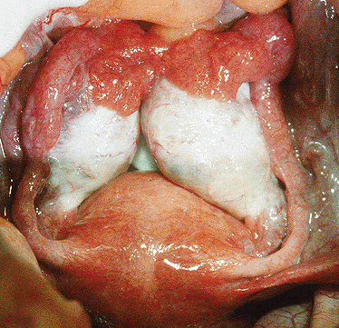
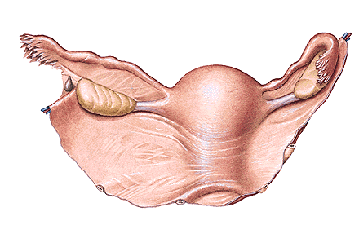
OVARIUM
Extremitas tubaria et uterina
Lig. suspensorium ovarii
Lig. ovarii proprium
Facies medialis et lateralis
Margo liber et mesovaricus
Hilum ovarii
Mesovarium – lig. latum uteri

Slide 4
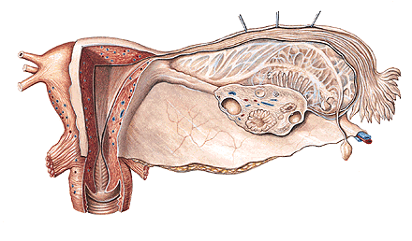
Tunica albuginea
Cortex ovarii - folliculi ovarii, corpora lutea
Medulla ovarii

Slide 5
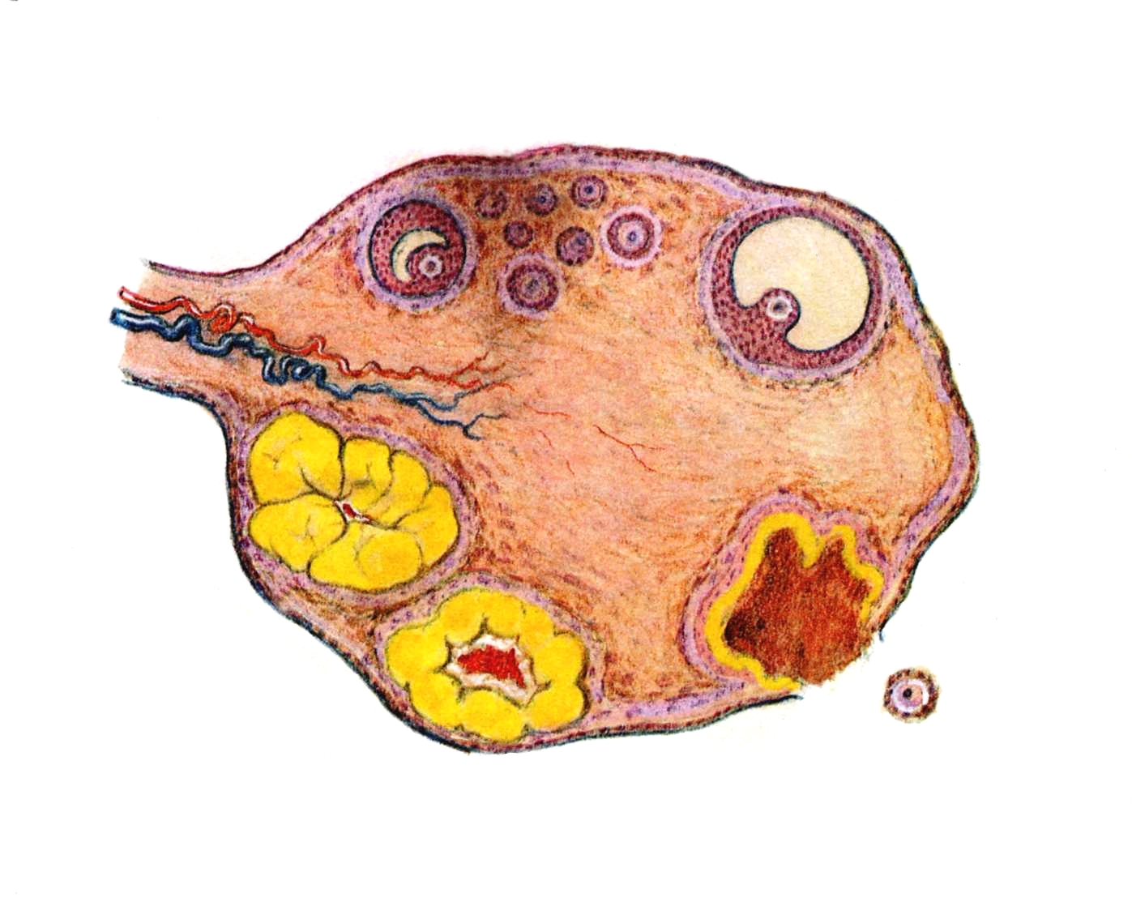
Folliculi ovarici primarii
Folliculus ovaricus vesiculosus (Graaf) - ovum (120µm)
Ovulation
Corpus rubrum (hemorrhagicum)
Corpus luteum
Corpus luteum graviditatis
Corpus albicans

Slide 6
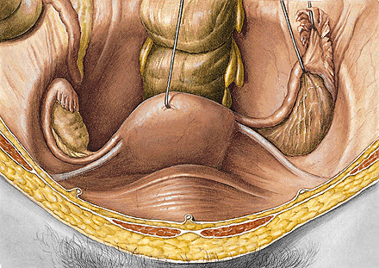
Nullipara – fossa ovarica
Multipara – fossa of Claudius

Slide 7
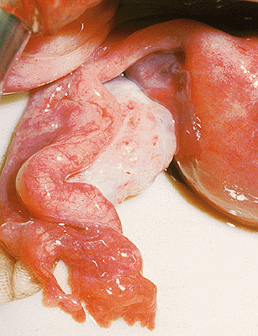
TUBA UTERINA (FALLOPIAN TUBE)
Infundibulum
Ostium abdominale
Fimbriae
Fimbria ovarica
Ampulla
Isthmus
Pars uterina – ostium uterinum
Mesosalpinx

Slide 8
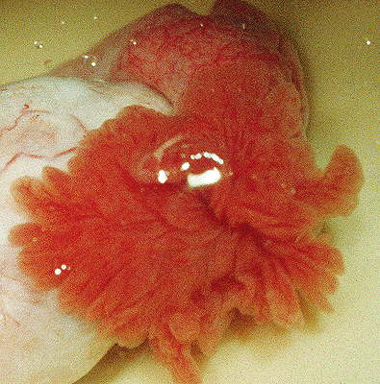
OSTIUM ABDOMINALE TUBAE UTERINAE

Slide 10
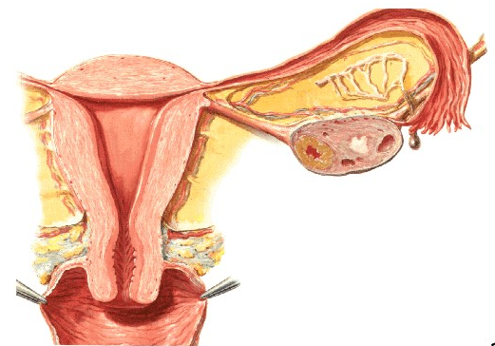
Plicae tubariae
Ectopic tubal pregnancy

Slide 11
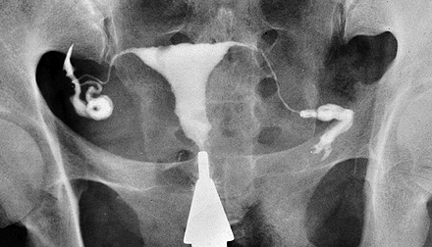
HYSTEROSALPINGOGRAPHY

Slide 12
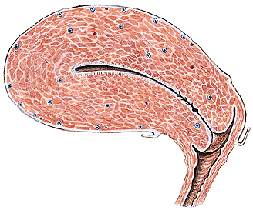
UTERUS (HYSTERA, METRA)
Corpus Margo dexter et sinister
Isthmus Cornu dextrum et sinistrum
Cervix - portio vaginalis Cavum uteri
- portio supravaginalis Canalis isthmi
Fundus Canalis cervicis
Facies vesicalis Plicae palmatae
Facies intestinalis Ostium uteri

Slide 13
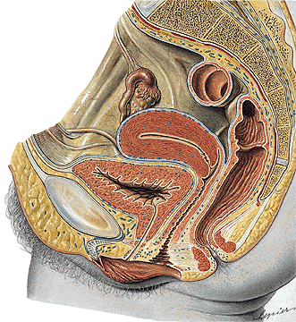

Slide 14
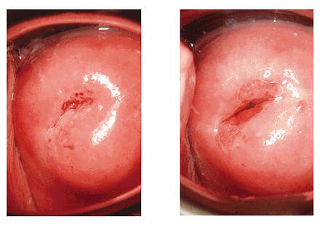
OSTIUM UTERI
NULLIPARA
MULTIPARA

Slide 15
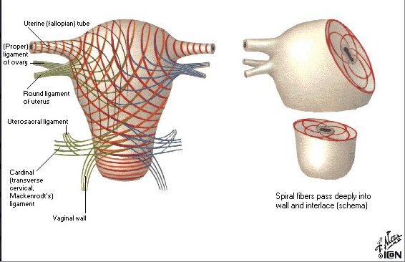
Endometrium - zona basalis
- zona functionalis
Glandulae uterinae
Glandulae cervicales
Myometrium

Slide 16
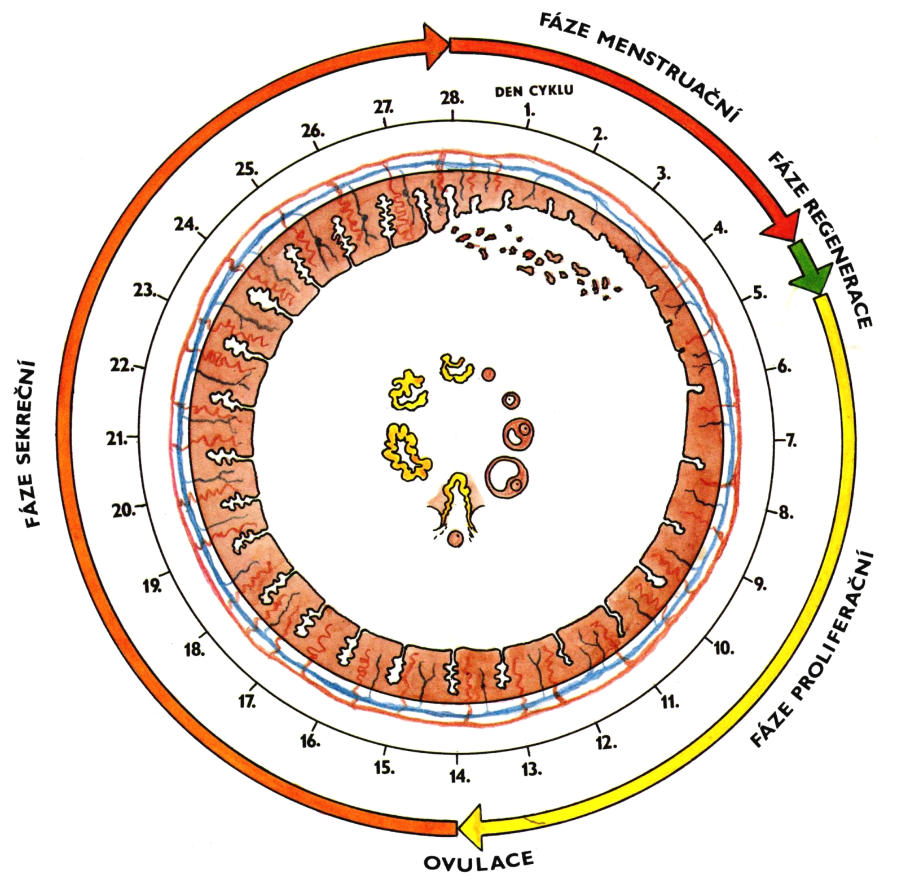
ISCHEMIA
Menarche
Menopause (climacterium)
Menstrual cycle:
1. Phase of menstruation
2. Phase of proliferation
3. Phase of secretion
4. Phase of ischemia

Slide 17
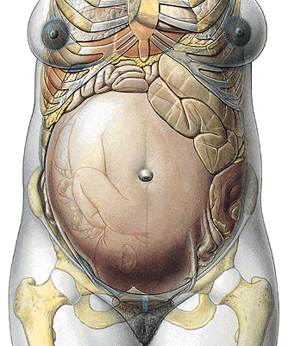
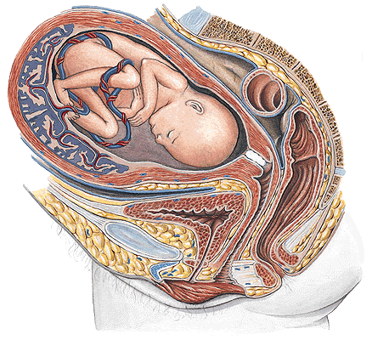
GRAVIDITAS
Embryoblast
Trophoblast

Slide 18
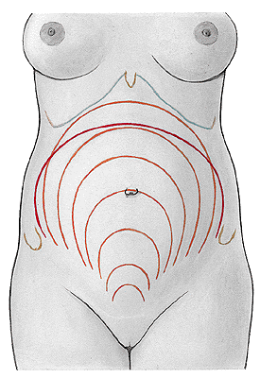
9
8
10
7
6
5
4
3

Slide 19
Perimetrium
Excavatio vesicouterina
Excavatio rectouterina (Douglas)

Slide 20
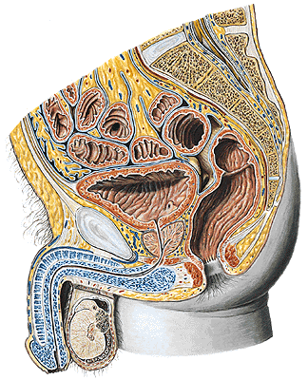
Excavatio rectovesicalis

Slide 21
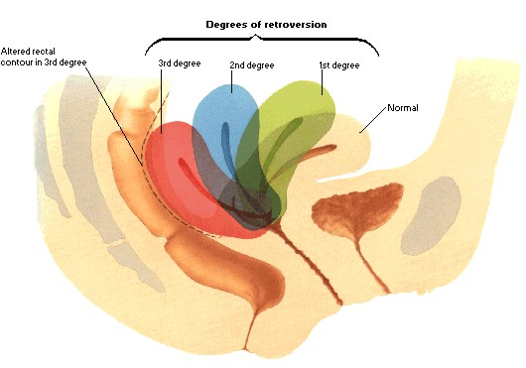
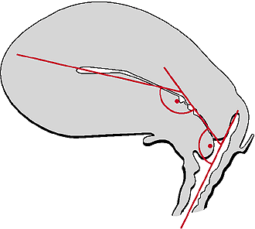
Anteversio
Anteflexio

Slide 22
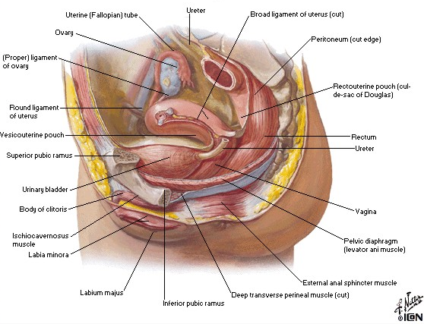
PARAMETRIUM

Slide 23
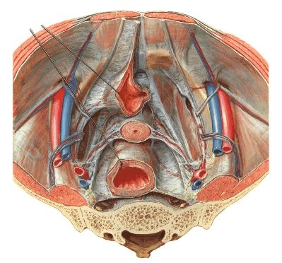
FASCIA PELVIS VISCERALIS
– ligamentum laterale vesicae urinariae
– ligamentum cardinale (cervicale transversum)
– ligamentum laterale rectale

Slide 24
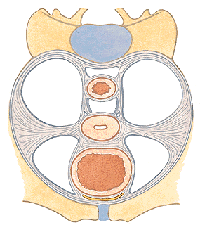
PARAMETRIUM
Lig. pubocervicale
- lig. pubovesicale
- lig. vesicouterinum
Lig. sacrouterinum
(m. rectouterinus)

Slide 25
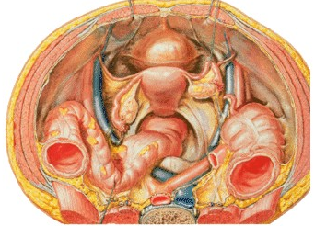
Plica sacrouterina
Lig. teres uteri

Slide 26
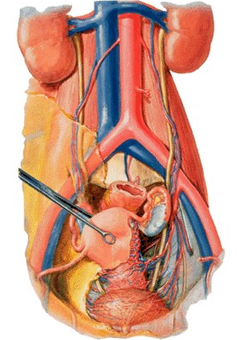
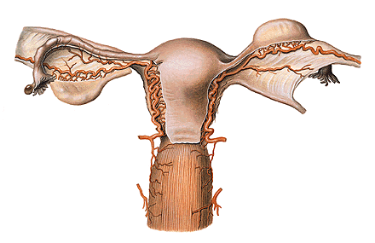
A. uterina x ureter

Slide 27
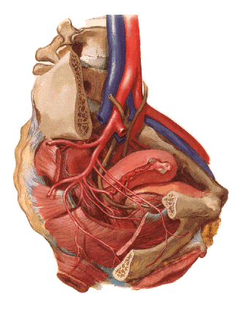
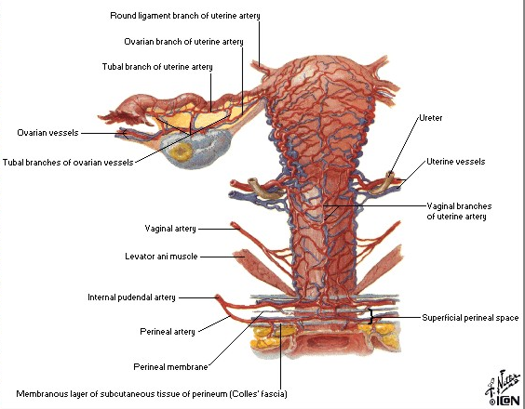
A. UTERINA
- r. uretericus
- rr. vaginales
- rr. helicini
- r. tubarius
- r. ovaricus

Slide 28
Lymphatic drainage of the uterus
Nll. lumbales,
iliaci int.,nodus lymph. uterinus (Bayer),
iliaci ext.,
inguinales spf.,
sacrales

Slide 29
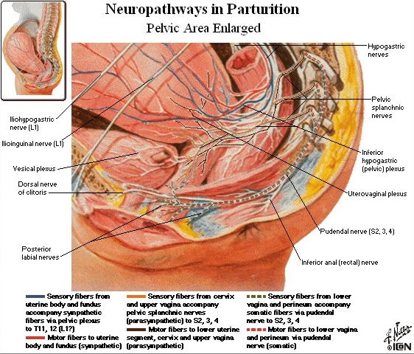

Slide 30
VAGINA (COLPOS)
Ostium vaginae
Vestibulum vaginae
Paries anterior
Paries posterior
Rugae vaginales
Columna rugarum ant.
et posterior
Fornix
Receptaculum seminis
Septum urethrovaginale
Carina urethralis

Slide 31
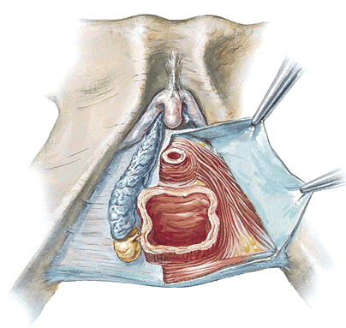

Slide 32
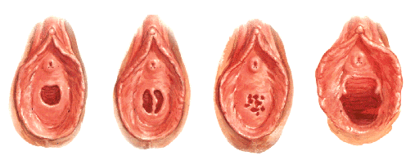
Ostium vaginae:
Hymen
Defloratio
Carunculae hymenales

Slide 33
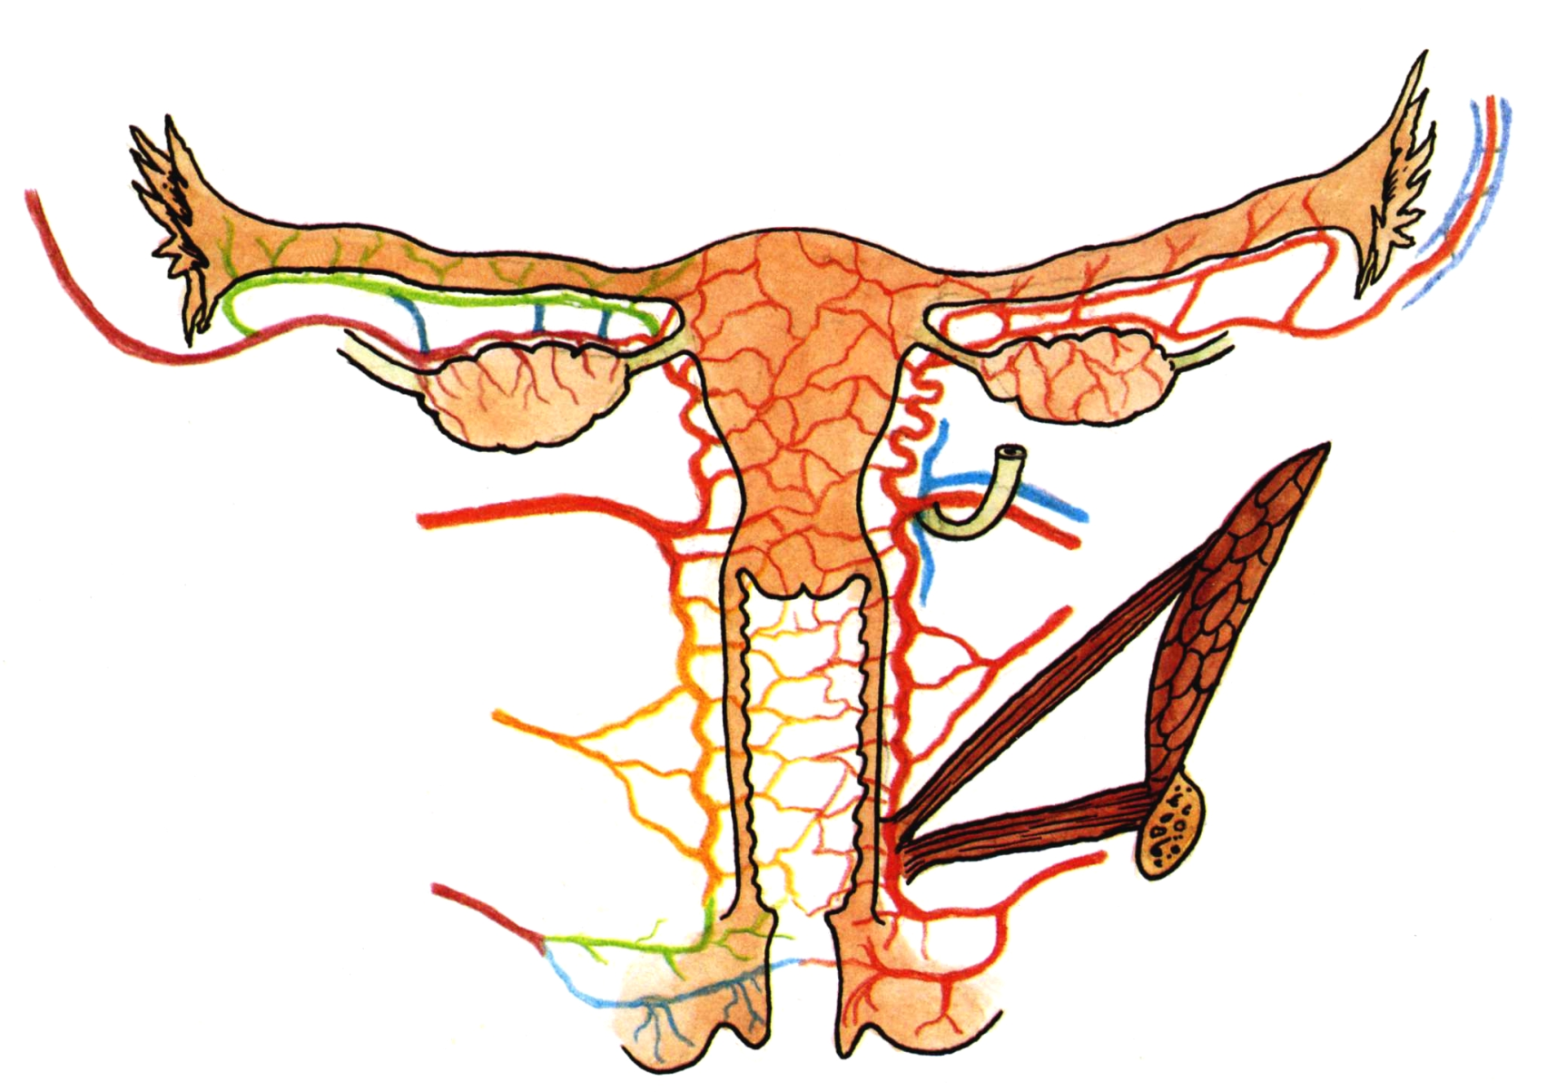
uterina
- a. vaginalis
A. rectalis media
A. pudenda int.
Plexus venosus uterovaginalis
Nll. iliaci int., ext, inguinales spf.
Plexus uterovaginalis, n. pudendus

Slide 34
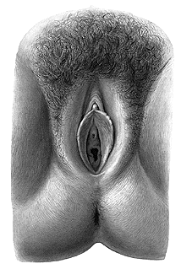
ORGANA GENITALIA EXTERNA (PUDENDUM/VULVA)
Mons pubis – pubes
Labium majus pudendi – commissura labiorum ant. et post.
Rima pudendi
Sulcus genitofemoralis
Sulcus interlabialis
Labium minus pudendi
- praeputium clitoridis
- frenulum clitoridis
- frenulum labiorum
Vestibulum vaginae
Smegma
Perineum
Raphe perinei

Slide 35
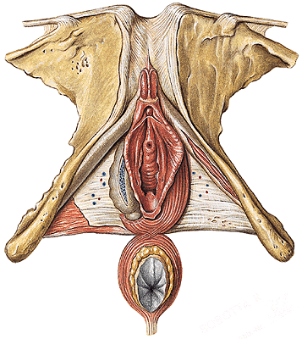
CLITORIS
Crura clitoridis
Corpus clitoridis
Glans clitoridis
Lig. fundiforme
Lig. suspensorium

Slide 36
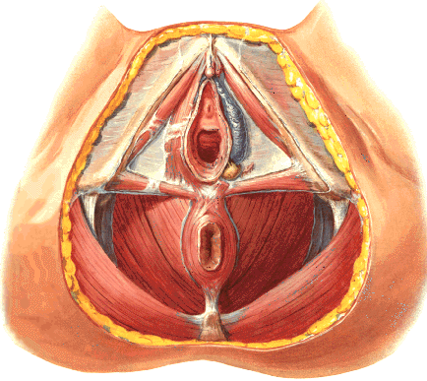
BULBI VESTIBULI
GLANDULAE VESTIBULARES MAJORES (BARTHOLlN)
GLANDULAE VESTIBULARES MINORES
pudenda int., aa. pudendae ext.
V. dorsalis clitoridis spf. and vv.labiales ant. – vv.pudendae ext.,
V.dorsalis clitoridis prof. and v.bulbi vestibuli – v.pudenda int.,
Nn.lymph.inguinales spf.
N.ilioinguinalis, genitofemoralis, pudendus. Autonomic plexuses.

Slide 37
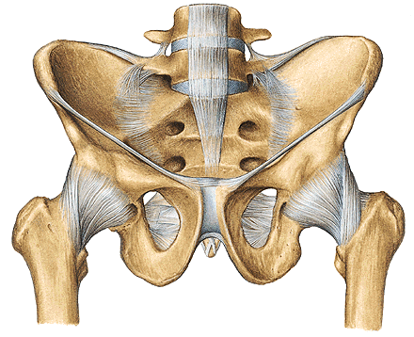

Slide 39
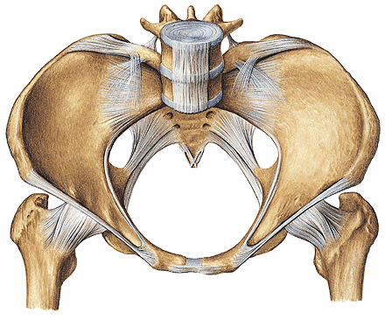

Slide 40
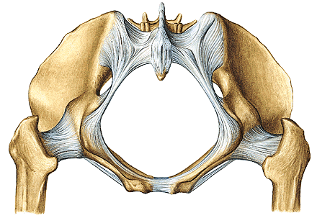

Slide 41
LIGAMENTUM LATUM UTERI
LIGAMENTUM OVARII PROPRIUM
LIGAMENTUM SUSPENSORIUM OVARII
LIGAMENTUM TERES UTERI

Slide 42
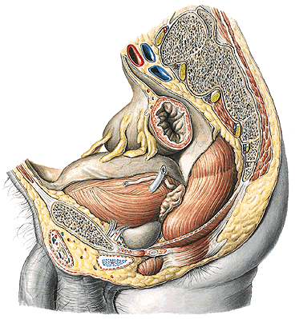
CAVITAS PELVIS PERITONEALIS
EXCAVATIO RECTOVESICALIS

Slide 43
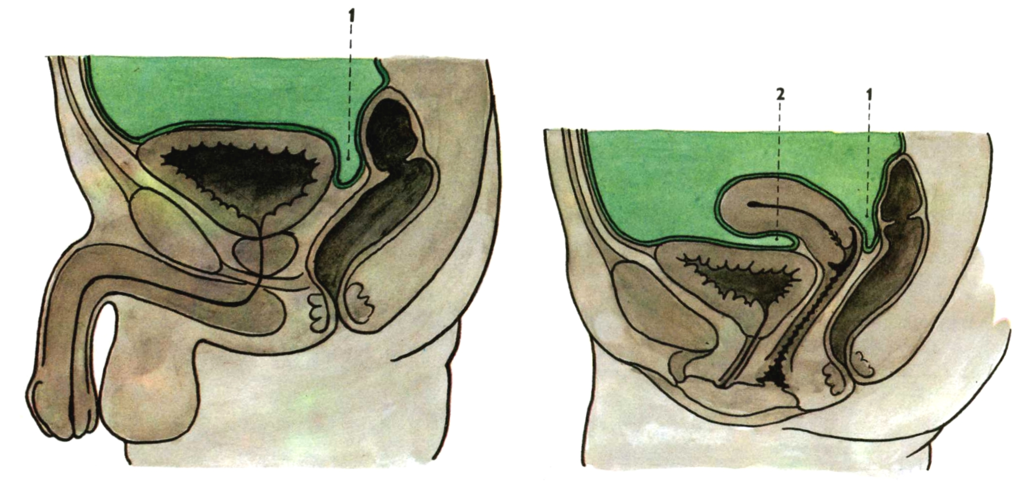
Median section through
the female pelvis
excavatio rectouterina (Douglas)
excavatio vesicouterina
Median section through
the male pelvis
1. excavatio rectovesicalis

Slide 44
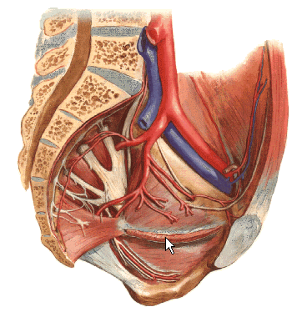
ILIACA INT.
- a. iliolumbalis
- aa. sacrales lat.
- a. obturatoria
- a. glutea sup.
- a. glutea inf.
- a. umbilicalis

Slide 45
iliaca int.
- a. uterina
- a. vaginalis
- a. vesicalis inf.
- a. rectalis media
- a. pudenda int.

Slide 46
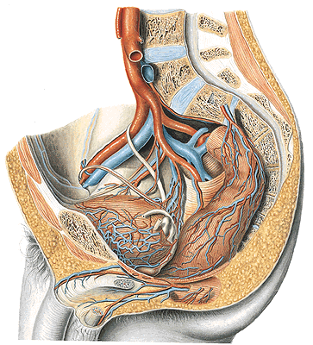
ductus deferentis
Rr. prostatici

Slide 47
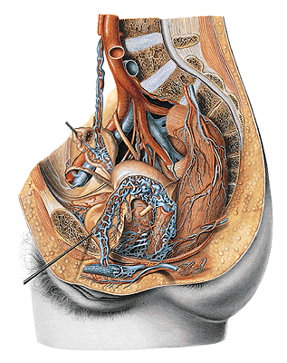
Plexus venosus vaginalis (prostaticus)
Plexus venosus uterinus
Plexus venosus vesicalis
Plexus venosus rectalis
Plexus venosus sacralis

Slide 48
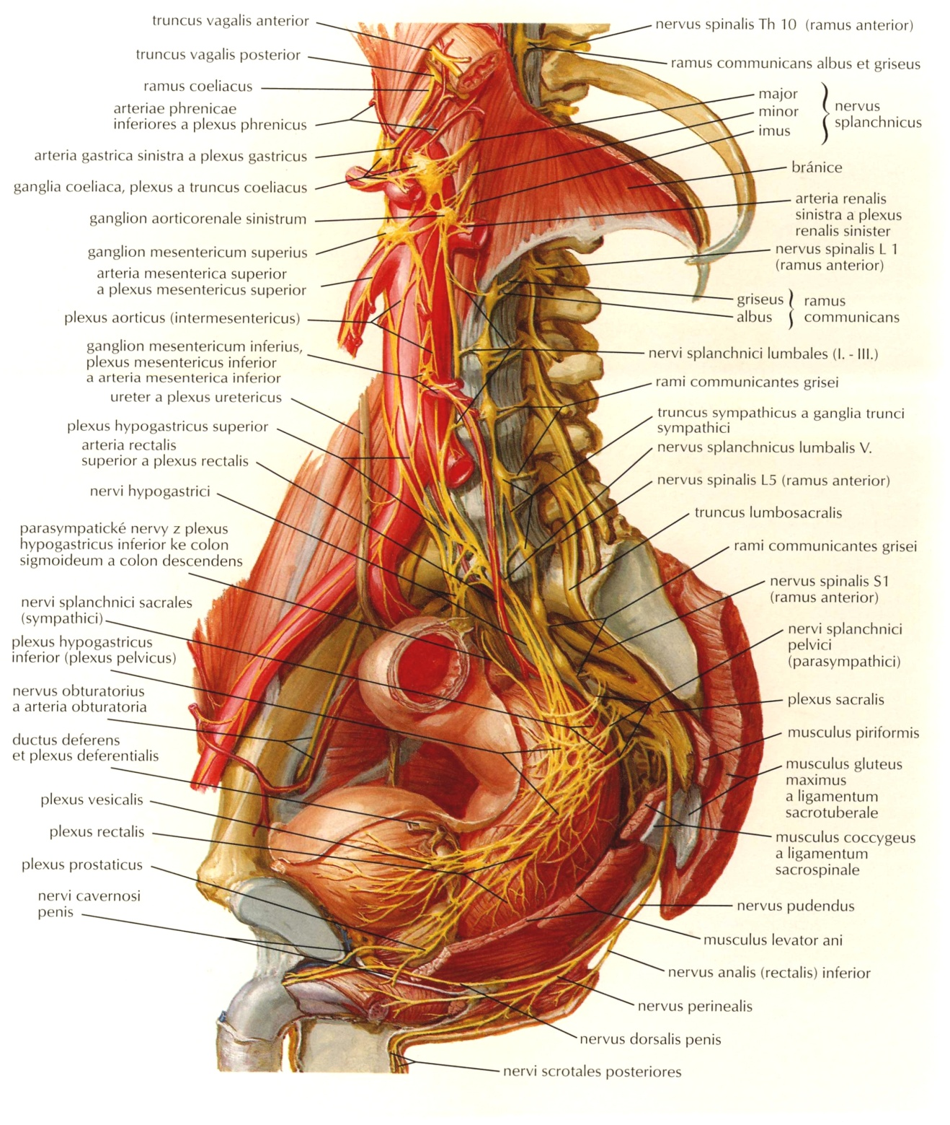
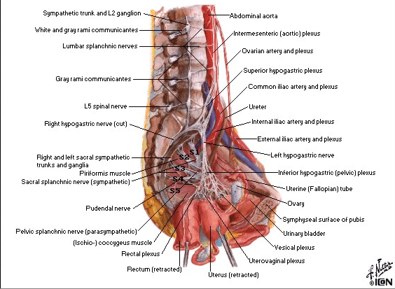
Plx. hypogastr. sup.
N. hypogastricus
Plx. hypogastr. inf.
Plx. uterovaginalislis
Plx. vesicalis
Plx. rectalis
Plx. prostaticus
Notes:
48

Slide 49
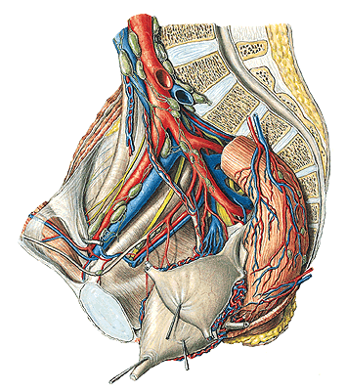
NLL. ILIACI EXTERNI
NLL. ILIACI INTERNI
NLL. INGUINALES SPF.
NLL. SACRALES
NLL. LUMBALES

Slide 50
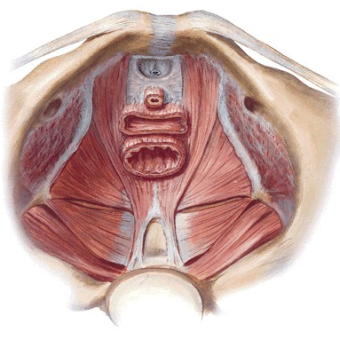
DIAPHRAGMA PELVIS
M. levator ani – pars iliaca (m. iliococcygeus)
– pars pubica (m. pubococcygeus)
(m. pubovaginalis, m. puborectalis)
M. (ischio)coccygeus
Hiatus urogenitalis

Slide 51
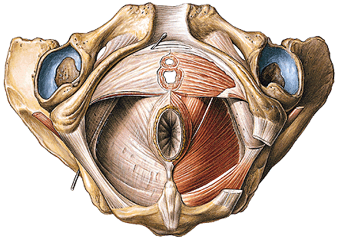
SACCUS PROFUNDUS PERINEI/DIAPHRAGMA UROGENITALE
Lig. transversum perinei
M. sphincter urethrae externus (m. sphincter urethrovaginalis)
M. compressor urethrae
Centrum perineale

Slide 52
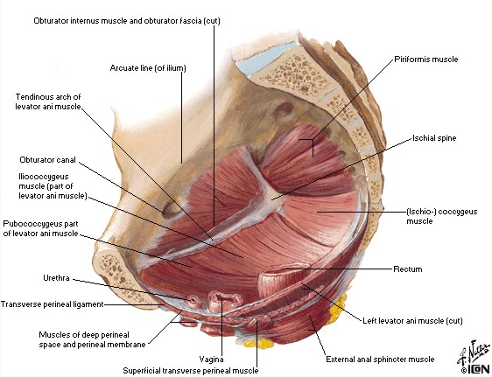

Slide 53
A.,v. et n. perinealis
penis (clitoridis) – a. dorsalis penis (clitoridis)
– a. profunda penis (clitoridis)
V. dorsalis penis (clitoridis) spf. – vv. pudendae ext.
V. dorsalis penis (clitoridis) profunda – vv. pudendae int.
N. dorsalis penis (clitoridis)
Gl. bulbourethralis

Slide 54
SPATIUM SUPERFICIALE PERINEI
M. ischiocavernosus Rima pudendi
M. bulbospongiosus
M. transversus perinei superficialis
Centrum perineale/tendineum perinei
M. sphincter ani externus
Corpus/Lig. anococcygeum

Slide 55
FOSSA ISCHIOANALIS/-RECTALIS
a. et v. pudenda interna, n. pudendus – canalis pudendalis
aa., vv. et nn. rectales inf.

Slide 56
Recessus pubicus fossae
ischioanalis

Slide 57
Fascia obturatoria
Canalis pudendalis
(Alcock)
Fascia sup.
diaphragmatis pelvis
Fascia inf.
diaphragmatis pelvis
Fossa ischioanalis/-rectalis

Slide 58
PELVIC FASCIA (spatium sub-/infraperitoneale)
FASCIA PELVIS PARIETALIS
FASCIA PELVIS VISCERALIS
Arcus tendineus fasciae pelvis
– ligamentum pubocervicale
(puboprostaticum)
– ligamentum sacrouterinum
(sacrogenitale)

Slide 59
Diaphragma pelvis
Recessus pubicus fossae ischioanalis/-rectalis
Saccus perinei profundus
Membrana perinealis/Fascia inf.diaphragmatis urogenitalis
Spatium perinei spf.
Fascia perinei spf.

Slide 62
Illustrations and photographs were copied from:
Atlas der Anatomie des Menschen/Sobotta.
Putz,R., und Pabst,R. 20. Auflage. München:
Urban & Schwarzenberg, 1993
Netter: Interactive Atlas of Human Anatomy.
Windows Version 2.0
Čihák R: Anatomie 2 (Splanchnologia). Avicenum,
zdravotnické nakladatelství, Praha, 1988.

