Slide 1
Newborn skull

Slide 2
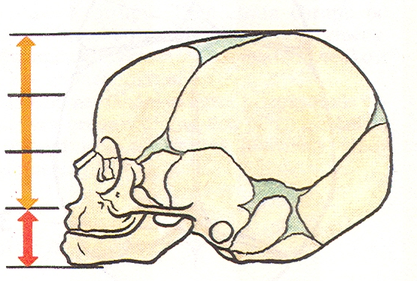
Neurocranium : Splanchnocranium
8:1

Slide 3
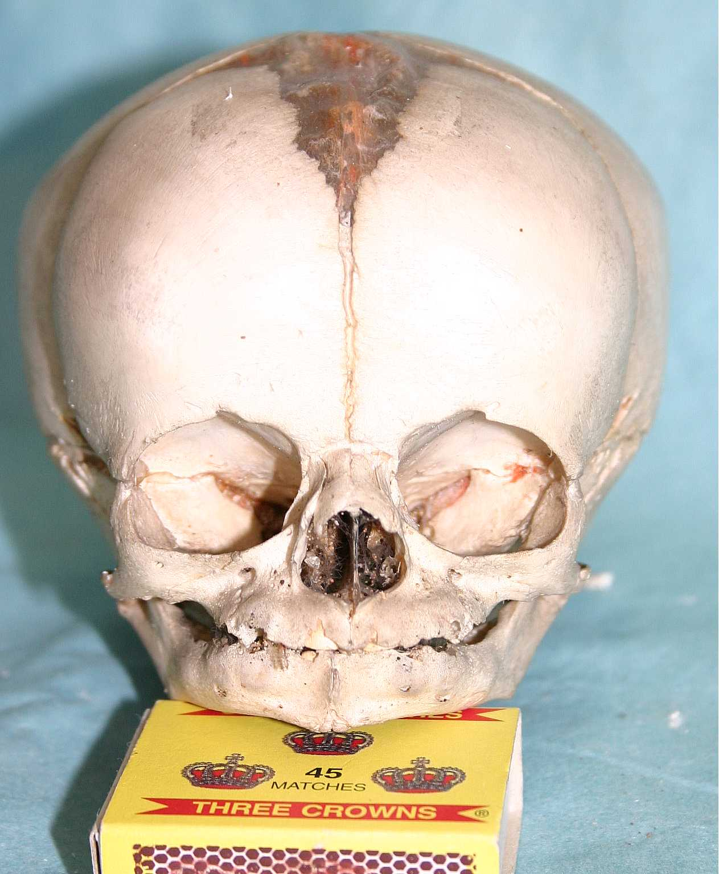
Fonticulus major
Neurocranium
Splanchnocranium

Slide 4
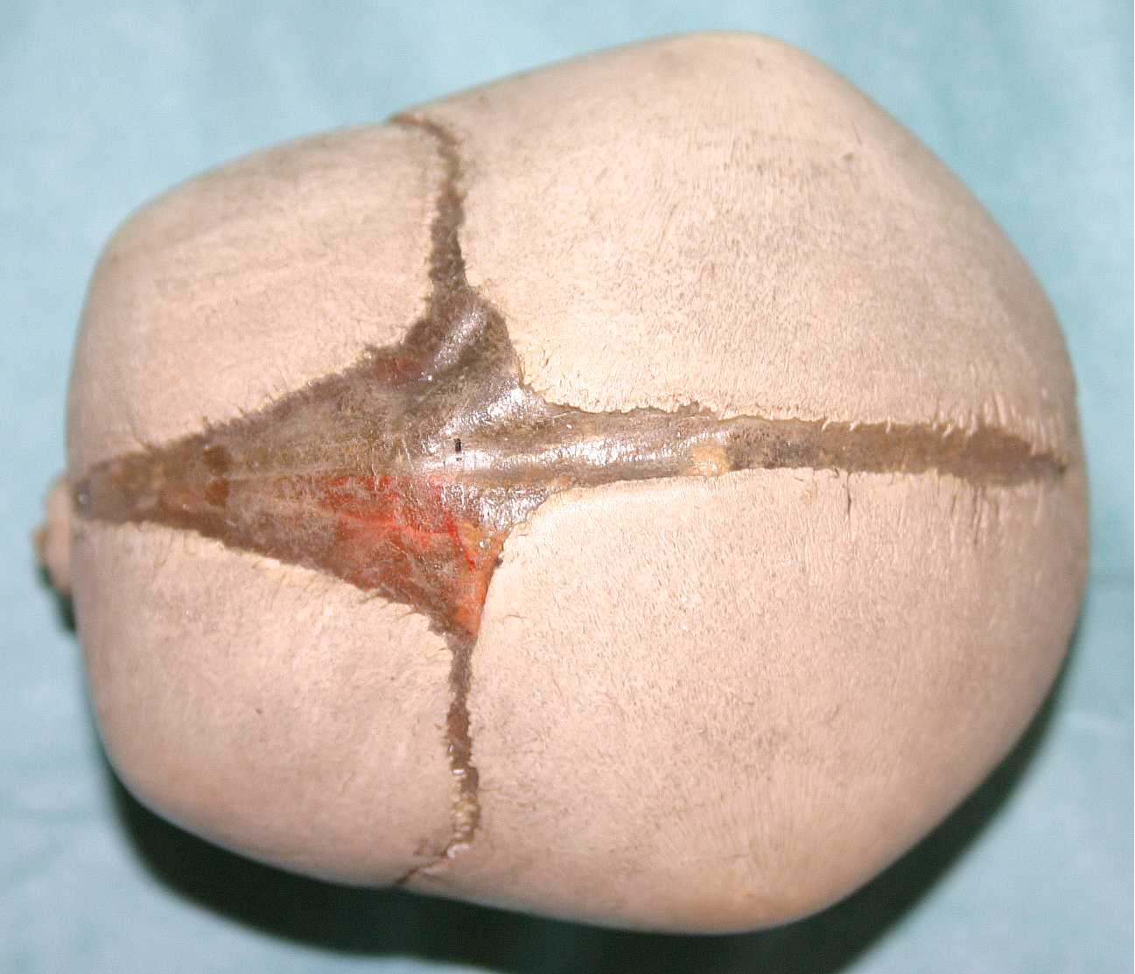
Tuber parietale
Fonticulus major
Tuber frontale

Slide 5
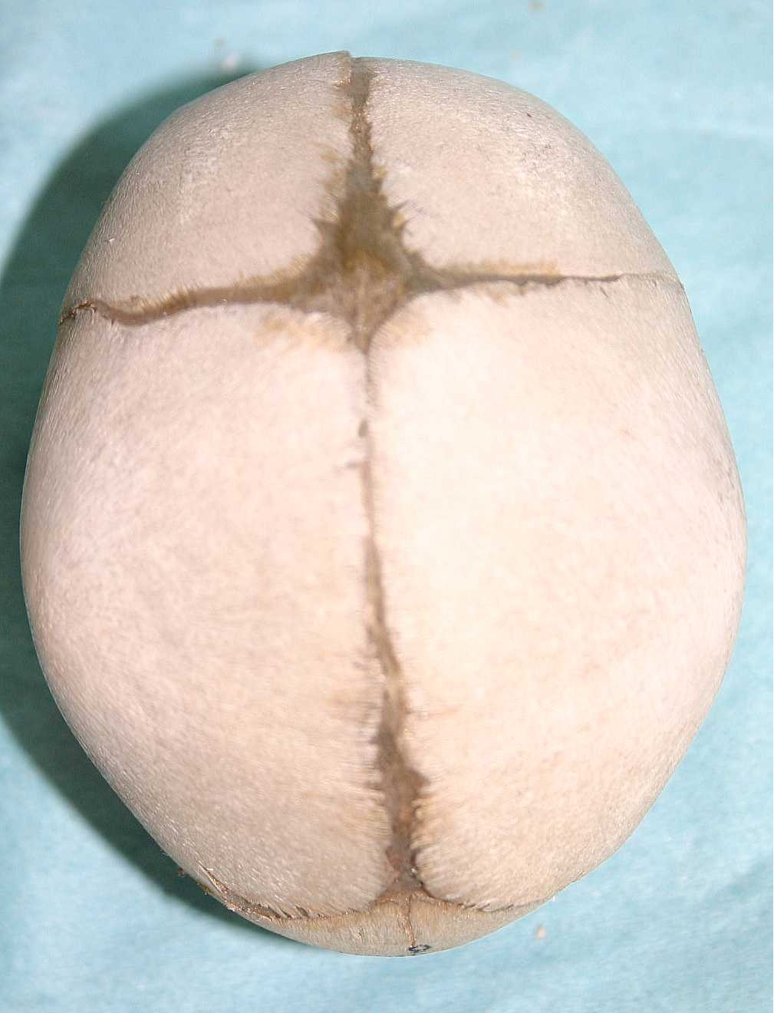
Fonticulus major
Fonticulus minor

Slide 6
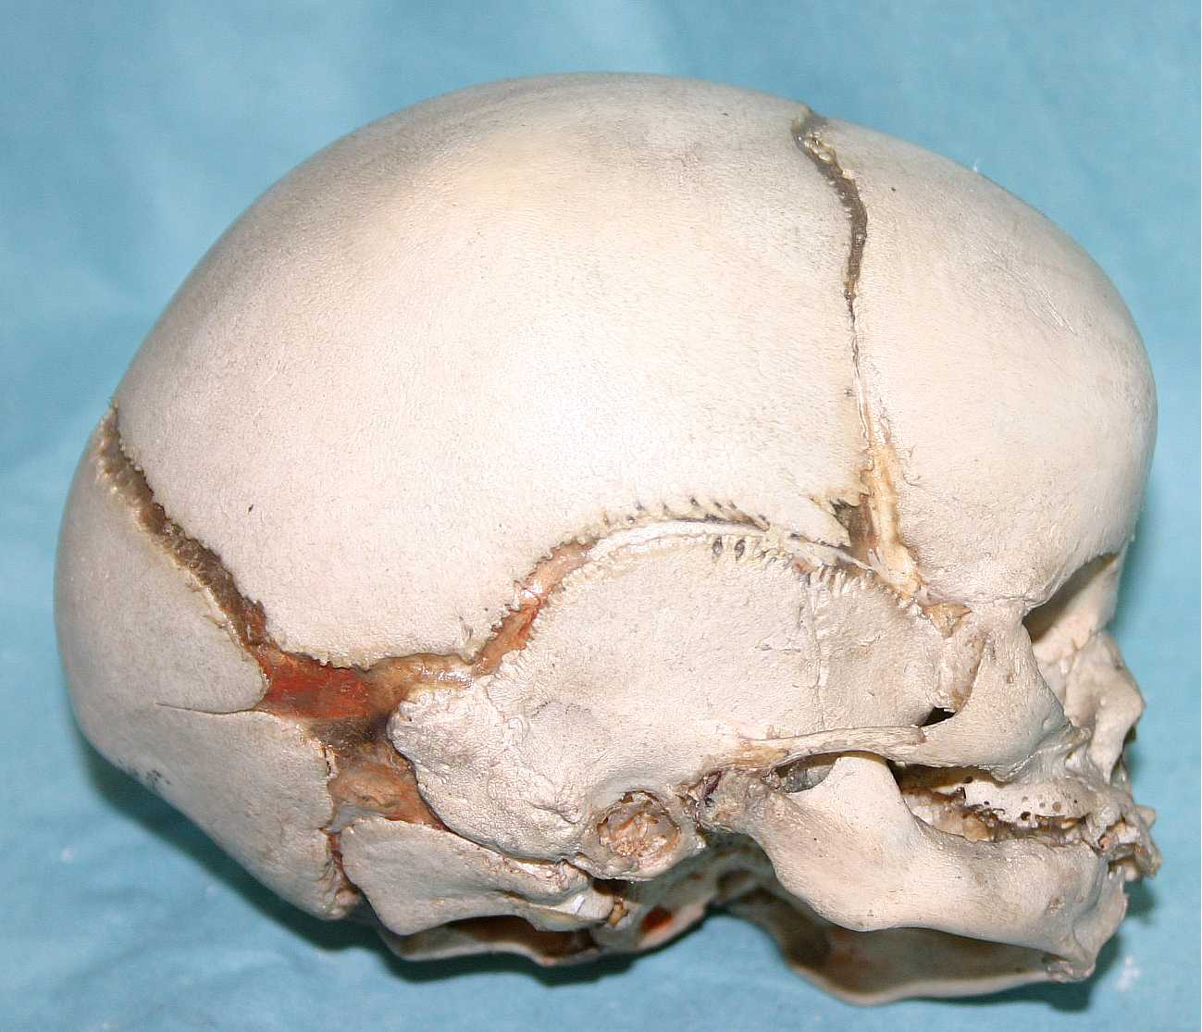
Fonticulus sphenoidalis
Fonticulus mastoideus

Slide 7
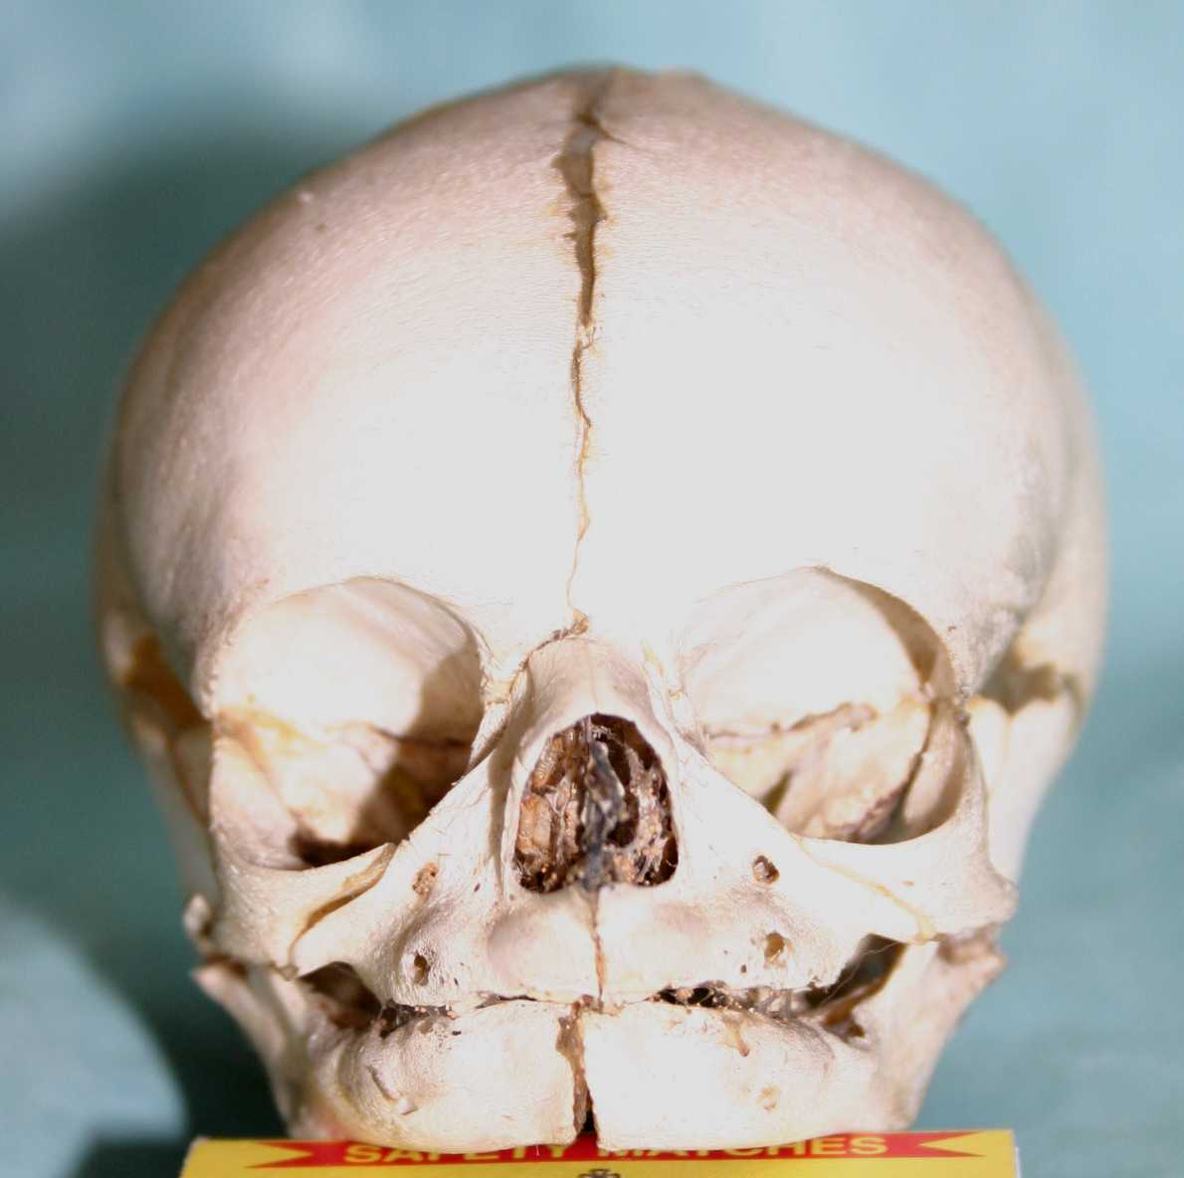
Sutura frontalis
Symphysis mentis

Slide 8
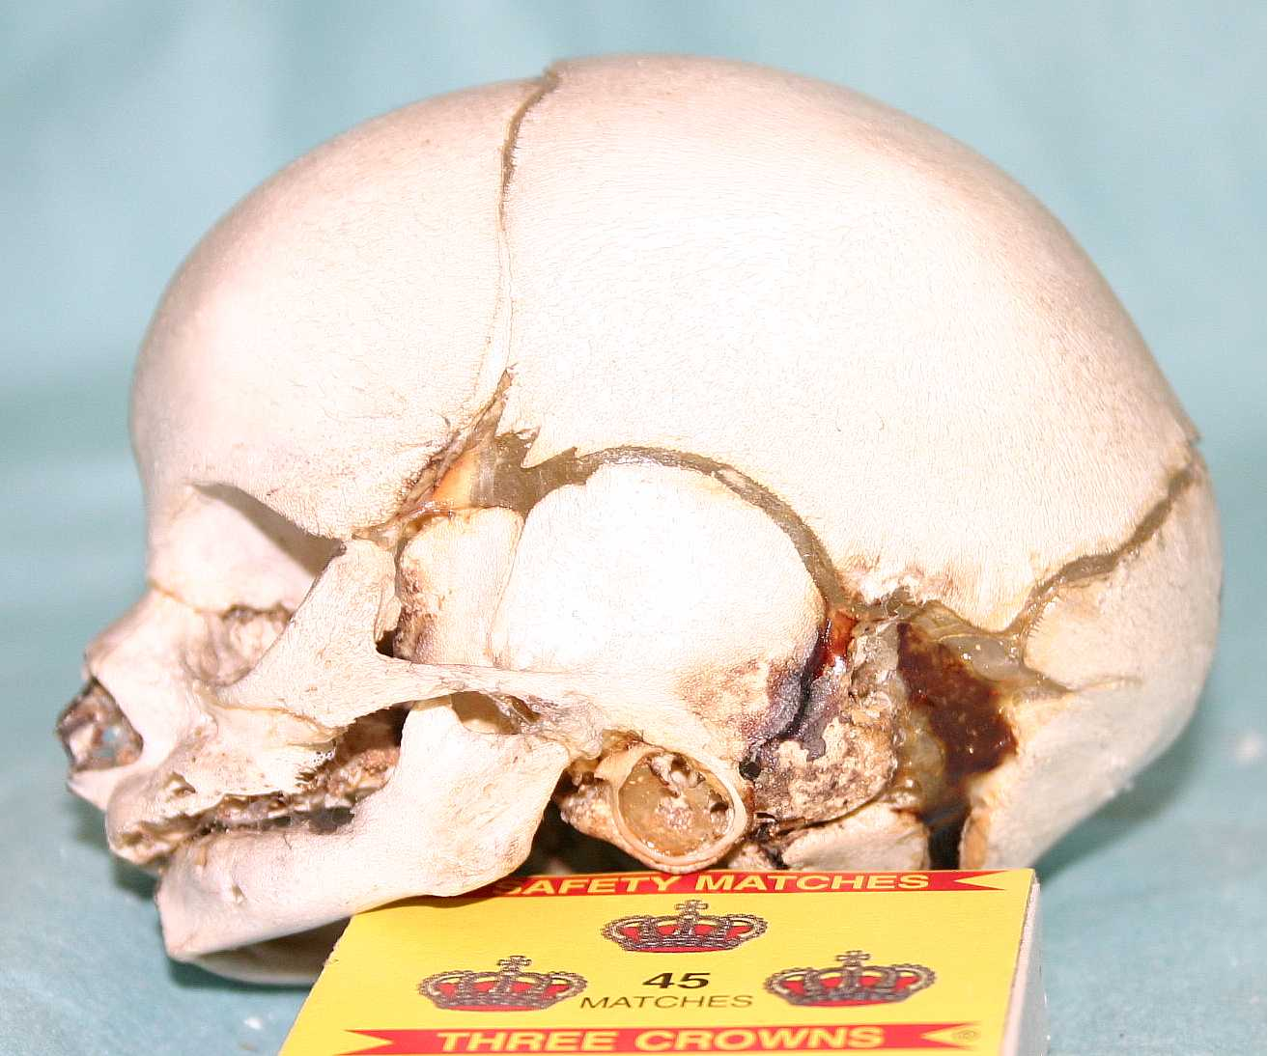
Anulus tympanicus

Slide 9
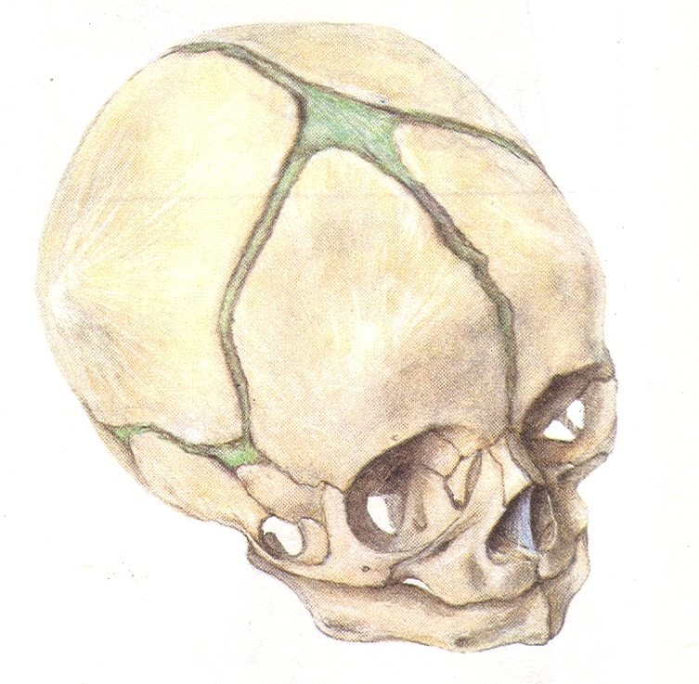
Newborn skull
capacity 370 ccm
circumference 34 cm
length 11-12 cm, width 9-10 cm
big neurocranium
fonticuli (major, minor, sphenoidalis,mastoideus)
low splanchnocranium
without processus alveolares (maxillae et mandibulae)
without paranasal sinuses
sutura frontalis
anulus tympanicus
symphysis menti
mandibular angle 150 - 170º

