Slide 1
Study instructions

Slide 2
Demands
Active attendance at the classes – one unexcused absence possible, excuses give in to the study office
Possibility of substituting your classes in other seminar group (has to be the same week as your absence, max. twice a semester)
Taking two partial exams (in the case of successfull completion over 70 %, you get bonus 5 % for your final exam)
Regular homestudy required

Slide 3
Methods of teaching
Preparatory course
7 units in one semester – exercises in the handbook (Prucklová, Severová – Introduction to Latin and Greek Terminology in Medicine)
Study materials under your personal administration in IS
Drill in the IS
Study literature (illustrated dictionaries)

Slide 4
Why Latin/Greek?
universal, precise and flexible system of terms
Denote:
  anatomical structures
  medicaments
  therapeutical methods, diagnoses
Used in:
  clinical diagnoses
  dissection protocols
  medical prescriptions
  medical documentation --- communication between doctors from different environments/countries/fields of study

Slide 5
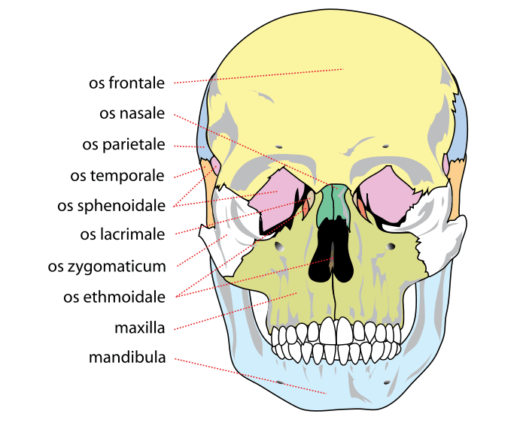
Anatomical structures

Slide 6
Medicaments
Paxil: an antidepressant and anti-anxiety drug (Pax=peace in Latin)
Lunesta: a sleeping medication (Luna=moon in Latin)
Viagra: a medication for erectile dysfunction (Vi[r]= man in Latin and Agra=field, usually farmed or fertile in Latin and Greek)
Fosamax: a drug for osteoporosis, or bone thinning (Os=bone Max=great in Latin)

Slide 7
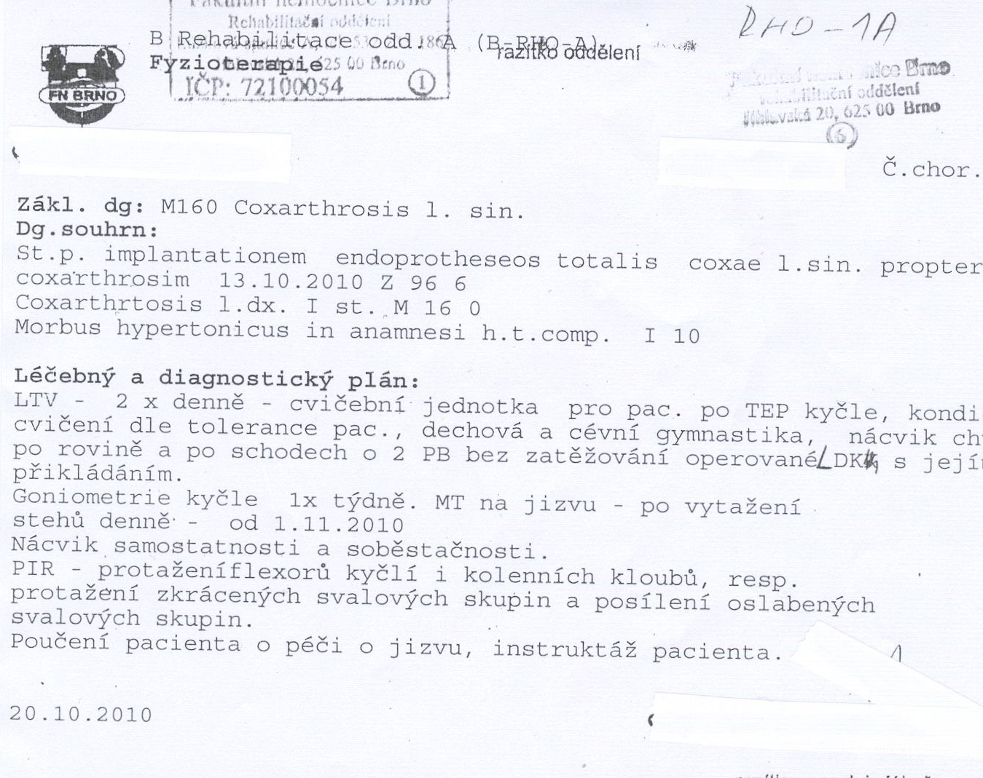
Diagnoses

Slide 8
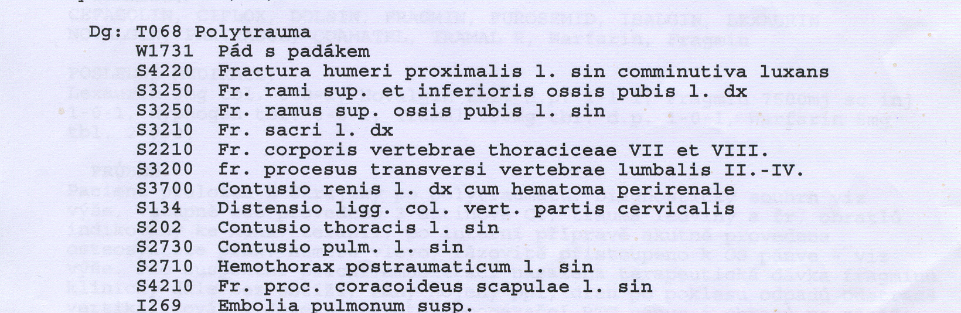
System of diagnose codes

Slide 9
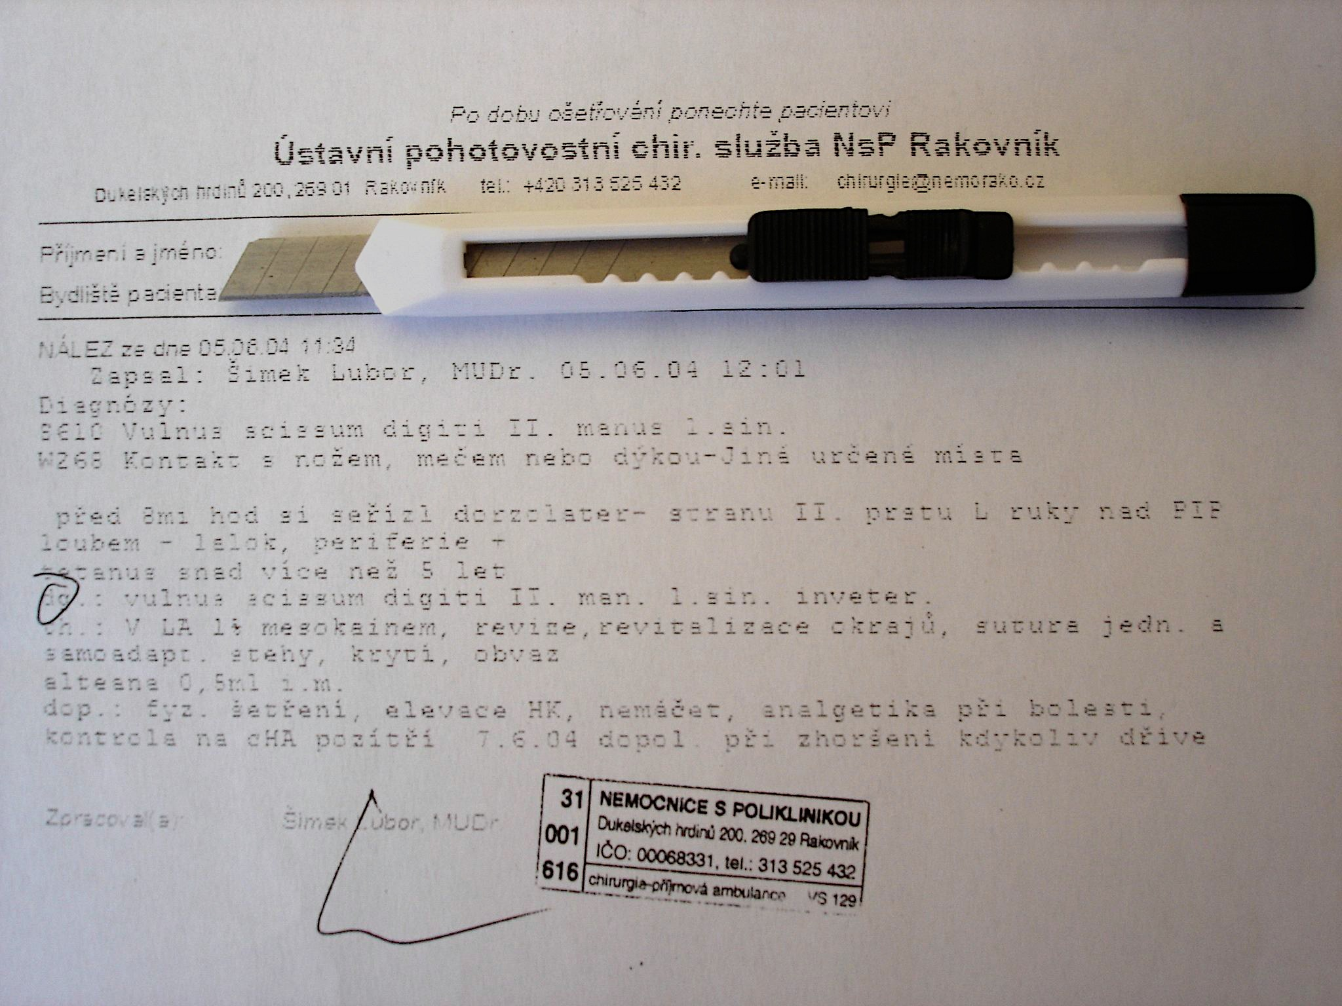

Slide 10
Medical prescriptions

Slide 11
At the end of the course, you will be able to:
understand the system in the terminology of anatomical structures ( = easier memorizing of the terms)
understand the principles of forming more complex terms
understand a clinical diagnose
write your own clinical diagnose
write a medical prescription

Slide 12
Latin pronunciation

Slide 13
Read aloud :
hypnosis
ala
olla
eupnoe
ileus
mucus
haematoma
iliacus
ossa
diploe
cubitus
venae
diameter
sacralis
ulcus
iris
sutura
sigmoideus
depressor
area
oesophagus
melior
meatus
leucocytus

Slide 14
Vowels
A | Ā | B | C | D | E | Ē | F | G | H | I | Ī | K | L | M | N
O | Ō | P | Q | R | S | T | U | Ū | V | X | Y | Y | Z
Vowels
Long Short
Ā (father) frāctūra A (cut) lingua
Ē (sad) artēria E (met) vertebra
Ī (intrigue) spīna I (intrigue) digitus
I (yes) > J
Ō (door) sensōrius O (on) skeleton
Ū (boom) ruptūra U (put) uterus
Y (analysis) hypophysis Y (lady) tympanum
Diphtongs
AE=Ē (care) anaemia
OE=Ē (care) lagoena
Greek words
OE (o-e) dyspnoe
EU (e-u) euthanasia

Slide 15
Consonants I.
A | Ā | B | C | D | E | Ē | F | G | H | I | Ī | K | L | M | N
O | Ō | P | Q | R | S | T | U | Ū | V | X | Y | Ŷ | Z
Consonant/group of consonants | Pronunciation | Example
1: c + a, o, u, consonants c + ae, oe, e, i, y | [k] medical [ts] tsar | camera, costa, cultivatio, cranium caecus, coeliacia, centrum, circulatio, cynismus
2: ch | [x] loch | chirurgia, cholera

Slide 16
Consonants II.
Consonant/group of consonants | Pronunciation | Example
3: g gu + vowel | [g] ground [gv] | gramma, gastritis lingua, sanguis
4: h | [h] house | herba, haematologia
5: j + vowel | [y] yes | iniectio/injectio, maior/major
6: p p + h | [p] present [f] physiology | pneumonia, pulmo phantasia, pharmacia
7: qu+ vowel | [kv] quarrel | aqua, quadriceps
8: r r+h | [r] rupture [r] | vertebra, ruptura rheuma, rhinitis

Slide 17
Consonants III.
Consonant/group of consonants | Pronunciation | Example
9: s/ss s between two vowels and following after l, r, n | [s] some [z] zebra | serum, fossa nasus, incisura, pulsus, tonsilla, inversus, suspensio
10: t ti + vowel s/t/x + ti + vowel t+h | [t] tongue [tsi] [ty] [t] | trauma, tactus operatio, substantia tibia, ostium, mixtio therapia, thermometrum
11: z | [z] zone | zoologia

Slide 18
Read aloud :
cancer, medicamentum, lingua
thorax, pulsus, contusio
corpus, exitus, functio
hemispherium, angulus, fractura
intestinum, aqua, pharmacon
oedema, musculus, defectus
medicus, operatio, infarctus
homo, bronchus, duodenum
angina, haemorrhagia, spasmus
encephalon, bacterium, acne
migraena, pharynx, dysenteria
inflammatio, leucaemia, virus
laparoscopia, typhus, organismus
therapia, digitus, gingiva
gangraena, diagnosis, tonsilla
injectio, lympha, oxygenium
vademecum, insufficientia, chirurgia

Slide 19
Grammatical concepts of Latin

Slide 20
Gender
Masculine (e.g. nervus)
Feminine (e.g. fractura)
Neutral (e.g. cerebrum)
Not always intuitive – you have to learn the gender of each noun !!!

Slide 21
Number
Singular (=1)
Plural (=2 and more)

Slide 22
Case
English: the order of the words in a sentence/phrase gives the information on their grammatical function
e.g. Teacher gives a book to the student.
(subject – verb – direct object – indirect object)
Latin: the form of each word in a sentence/phrase gives the information on its grammatical function
e.g. Magister dat librum discipulo.

Slide 23
What happens if we swip the order of the words?
English: meaning changes
Student give a book to the teacher.
  isolated word does not give any information on its function
Latin: nothing
Dat magister librum discipulo.
Librum magister discipulo dat.
Discipulo magister librum dat. etc.
  isolated word gives all the information on its grammatical function
All sentences mean the same, because the forms of the words did not change!

Slide 24
How do cases work in medical terms?
Nominative (Nom.) – the subject of sth – upright case (1st dictionary entry)
Genitive (Gen.) – functions as English preposition of, also possessive function, denotes the declension of a noun (2nd dictionary entry)
Accusative (Acc.) – the object of sth, motion towards sth, with prepositions (ad, prope, in, propter, post, ante, etc.)
Ablative (Abl.) – expresses separation or motion away from sth, with prepositions (e/ex, a/ab, de, sine, cum, etc.)

Slide 25
status post implantationem osteoprotheseos coxae sine complicationibus
Nominative: status (the subject of the phrase, usually stands first)
Genitive: osteoprotheseos (implantation of the osteoprothesis)
coxae (osteoprothesis of the hip)
Accusative: implantationem (after preposition post)
Ablative: complicationibus (after preposition sine)

Slide 26
What will you find in the dictionary?
Latin noun is presented in three forms
English noun is presented only in its single form
(nominative singular)
Muscle = MUSCULUS, I, M.
Bone = OS, OSSIS, N.
Main form
(full nominative)
Genitive ending/or even full Genitive form
Gender abbreviation
CAUTION! When learning new words ALL THREE FORMS are EQUALLY important
for the future ability to use the noun in the context.

Slide 27
Genitive ending = Declension
DECLENSION | 1st | 2nd | 3rd | 4th | 5th
GENITIVE ENDING | -ae (-es) | -i | -(?)-is | -us | -ei
EXAMPLE | coxa, ae, f. | humerus, i, m. cranium, ii, n. | coccyx, gis, f. dens, dentis, m. femur, oris, n. pelvis, is, f. | arcus, us, m. genu, us, n. | facies, ei, f.
Declensions are groups of nouns (or adjective) that use the same set of suffixes (=endings).

Slide 28
Declension
= a group of nouns that form their cases the same way (have the same system of endings), see the chart
Each noun belongs to one of 5 declensions, the division of nouns into declensions is based on their stem (according to Gen. plural form)
1st declension – a-stems – ven-a-rum
2nd declension – o-stems – nerv-o-rum
3rd declension
  i-stems – pelv-i-um
  consonant stems – dolo-r-um, pon-t-um, sectio-n-um
4th declesion – u-stems – duct-u-um
5th declension – e-stems – faci-e-rum

Slide 29
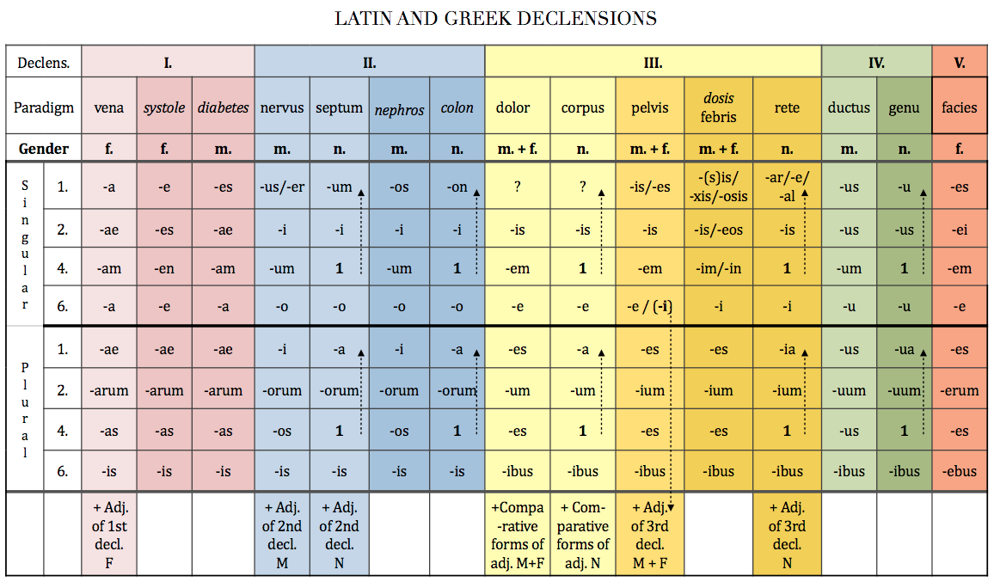
Latin and Greek declensions

Slide 30
Stem of a word
= a form to which affixes (endings) can be attached
IT IS CRUCIAL TO KNOW THE STEM TO CREATE ALL OTHER CASES !!!
In Latin we need to remove the genitive ending in order to gain the genitive stem
ven-a
ven-ae
humer-us
humer-i
diamet-er
diametr-i
dol-or
dolor-is
corp-us
corpor-is
de-ns
dent-is
arc-us
arc-us
gen-u
gen-us
faci-es
faci-ei

Slide 31
Adjectives
= words that give new information on nouns, modify nouns
Adjectives always have to correspond with the noun to which they belong in gender, number and case!!!!
fractura ulnae dextrae complicata
vertebrae thoracicae
ad lagoenam fuscam
cum anaemia perniciosa
Why do you think this is so?

Slide 32
Prepositions
with accusative
  ad = towards, to – ad cranium
  ante = before – ante fracturam
  post = after – post operationem
  per = through – per rectum
  in (motion)= towards, into – in lagoenam
  prope (motion) = near to – prope ulnam
  propter = because of – propter anaemiam
with ablative
  e/ex = out of – e scatula
  a/ab = from, by – a medico
  sine = without – sine insufficientia
  cum = with – cum digito medio
  pro = for the sake of – pro adulto

Slide 33
Exercise
Assign the words from the vocabulary in Handout 1 to their declensions using the chart
Decide the stem of each word

