Slide 1
How do I decide to what declension the word belongs to?
What are the genitive endings of Latin declensions?
What is stem?
How can we identify the stem of a Latin noun?

Slide 2
When do we use:
Nominative?
Genitive?
Accusative?
Ablative?

Slide 3
Use the chart with endings to change the following words into plural
coxa cervix
Gen _ _ _ _ _ _ _ _ _ _ _ _ _ _ _ _
stem _ _ _ _ _ _ _ _ _ _ _ _ _ _ _ _
Nom. pl. _ _ _ _ _ _ _ _ _ _ _ _ _ _ _ _
mentum arcus
_ _ _ _ _ _ _ _ _ _ _ _ _ _ _
_ _ _ _ _ _ _ _ _ _ _ _ _ _ _
_ _ _ _ _ _ _ _ _ _ _ _ _ _ _

Slide 4
Introduction to syntax
NOUN IN APPOSITION 1.
noun + noun < GENITIVE
  Translated: using of
  Meaning: state of dependency, possession
  EX: Fractura costae //fractura costarum
        Fracture of rib Fracture of ribs
        ! = rib fracture = rib fractures

Slide 5
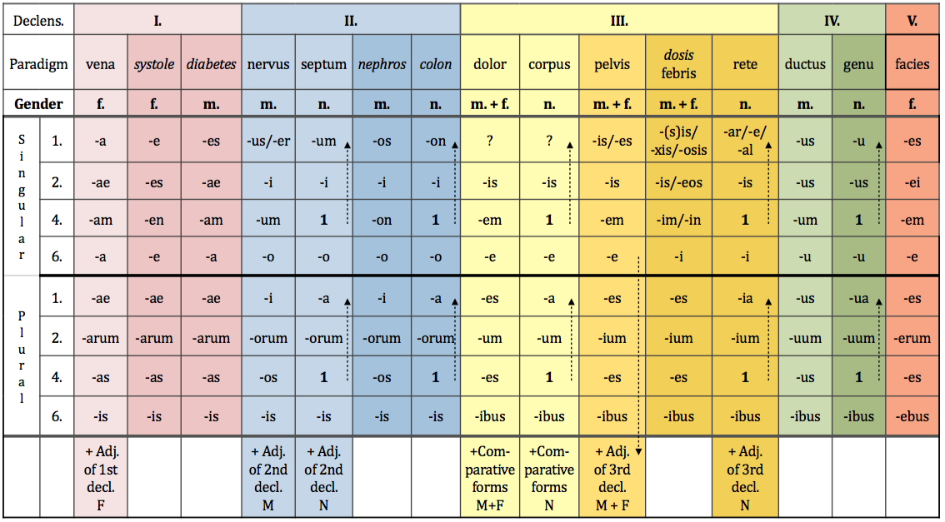
Genitive singular and plural

Slide 6
Connect two nouns
ex: caput + costa > caput costae head of rib
caput + femur >
caput + fibula >
caput + humerus >
caput + phalanx >
caput + radius >
caput + talus >
caput + ulna >

Slide 7
Prepositions and prepositional phrases
Denote:
  Spatial relations sub, infra, post
  Temporal relations post, ante
  Causal relations propter, e/ex
Can be connected with:
  Accusative case
  Ablative case
  Both Accusative and Ablative case

Slide 8
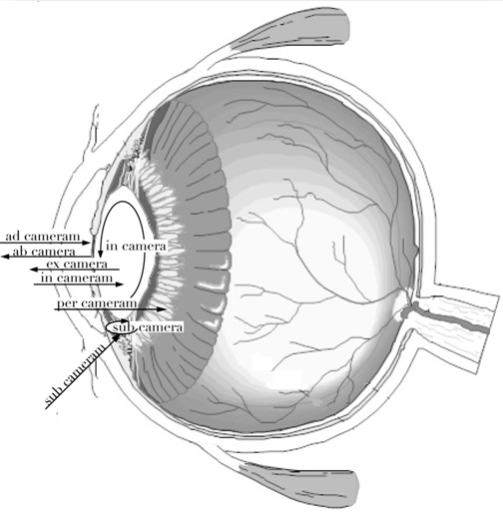

Slide 9
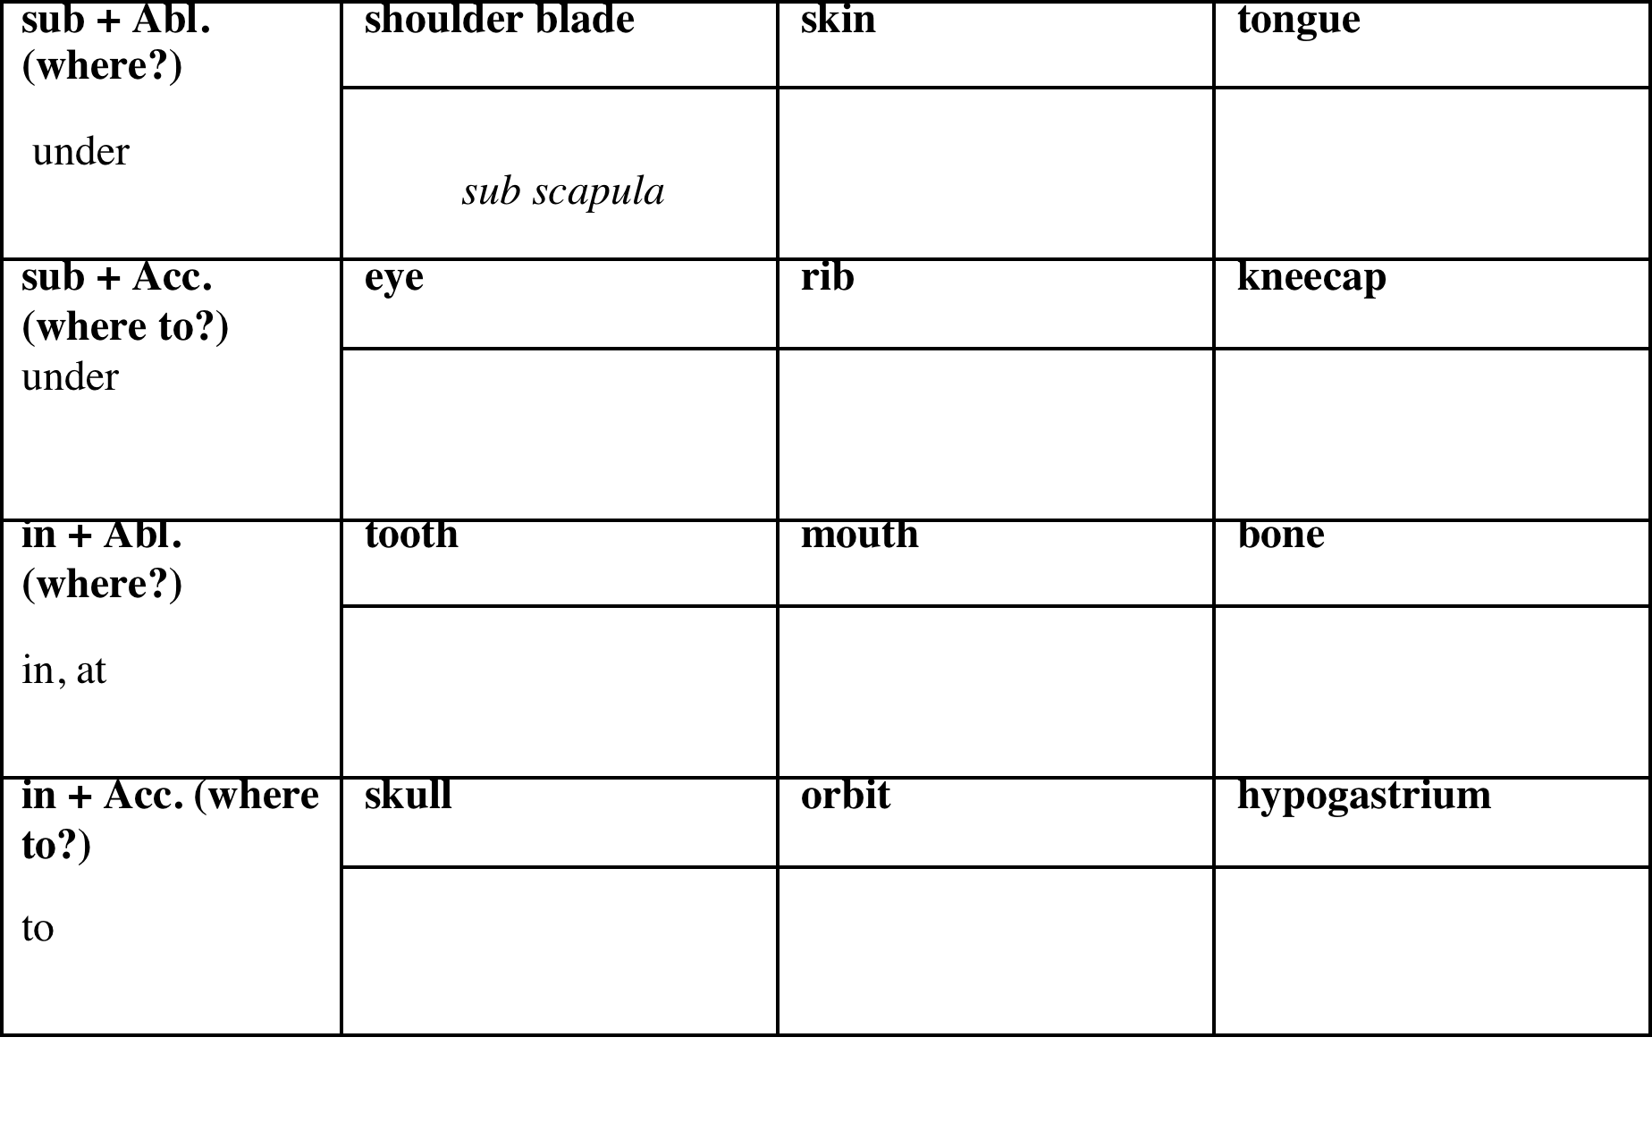
Connect nouns with prepositions

Slide 10
1st LATIN declension
In the 1st declension we decline nouns that have:
Genitive sg. ending | -AE
Nominative sg. ending | -A
Gender | Mostly F Never N Exceptions M
EXCEPTIONS!!!
NOUNS OF THE 1st Declension that are of masculine gender are:
Names of specialists – Dentista, ae, m.
Names of muscles – Agonista, ae, m.

Slide 11
1st GREEK declension
In the first declension we decline nouns that have:
Genitive sg. ending | -E | -ES
Nominative sg. ending | -ES | -AE
Gender | F | M

Slide 12
Latin and Greek Declensions
Latin Greek

