Slide 1
Questions
What case expresses the state of dependency?
How is it usually translated into English?
What cases are used with prepositions in medical terminology?
Are there any prepositions connected with two cases?
Which prepositions are connected with the ablative case?

Slide 2
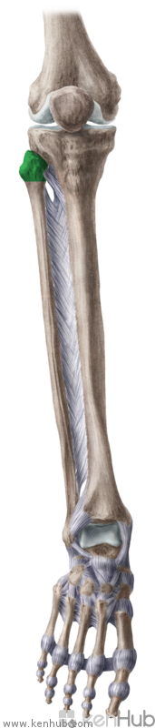
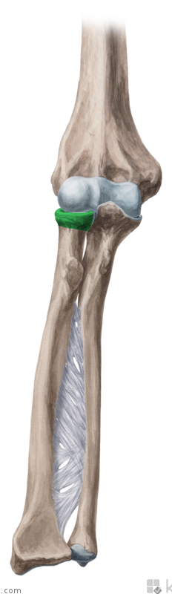
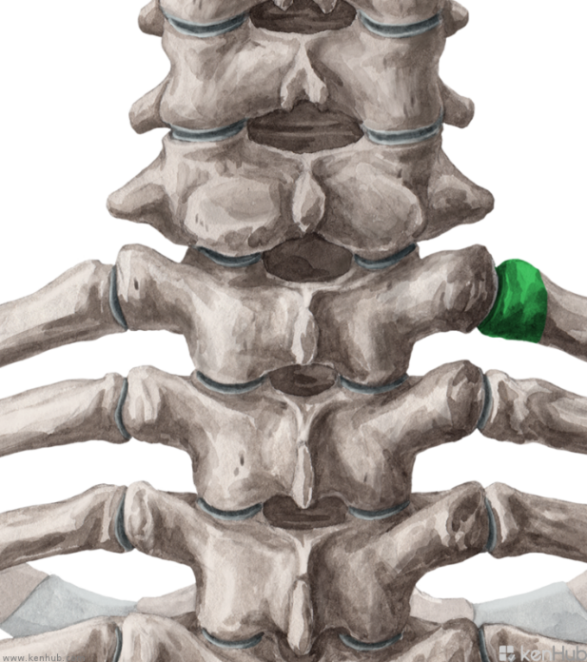
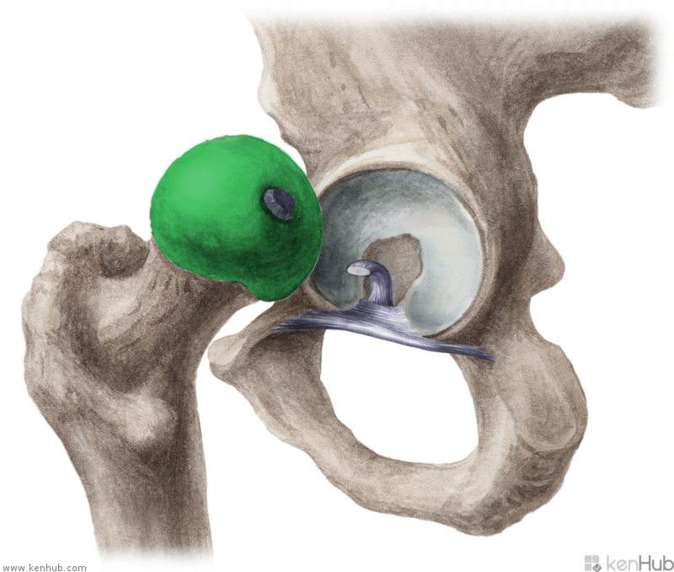
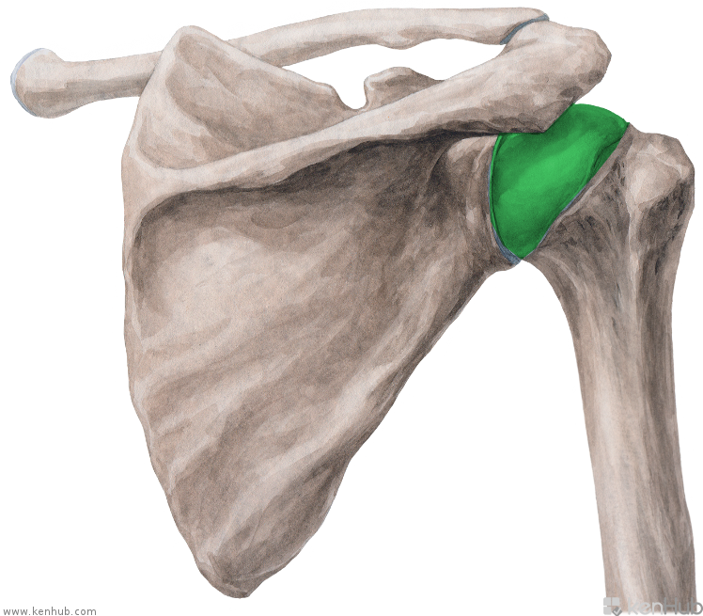
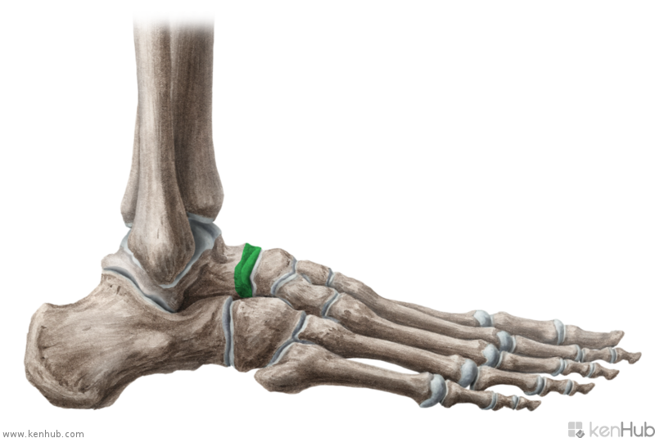
C
D
A
E
F
B
Notes:
Na všetkých obrázkoch je hlavica nejakej kosti: úlohou študentov je preložiť anat. termíny do latinčiny.
A. Caput costae, B. Caput humeri, C. caput fibulae, D. caput radii, E. caput femoris, F. caput tali

Slide 3
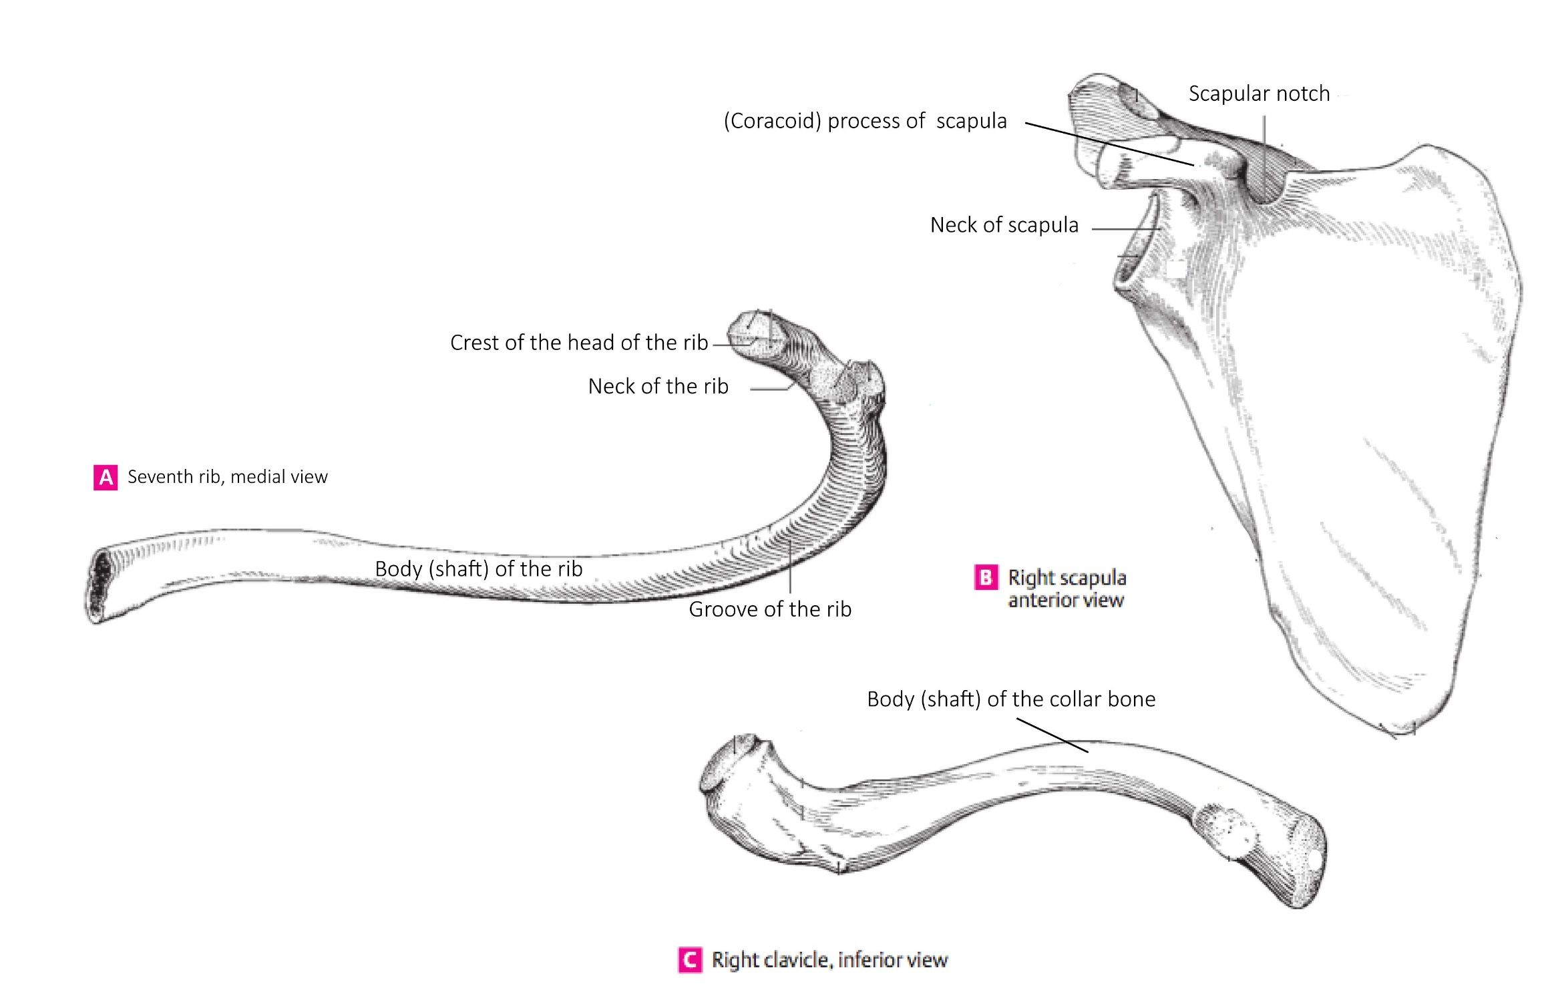

Slide 4
Adjectives of the 1st and 2nd declension, dictionary entry
Magnus, a, um
Magnus magna magnum
m. f. n.
coxa cervix
oculus sulcus
crus arcus
bucca metatarsus
fibula hallux
Dexter, a, um
Dexter dextra dextrum
m. f. n.
(* liber, libera, liberum)
coxa cervix
oculus sulcus
crus arcus
bucca metatarsus
fibula hallux

Slide 5
Agreed-attribute
What is the correct adjective for the noun in the triangle?
dextra
dextrum
dexter
dextrum
genu
orbita
pes
dexter
dextrum
dextra
dextra
dexter

Slide 6
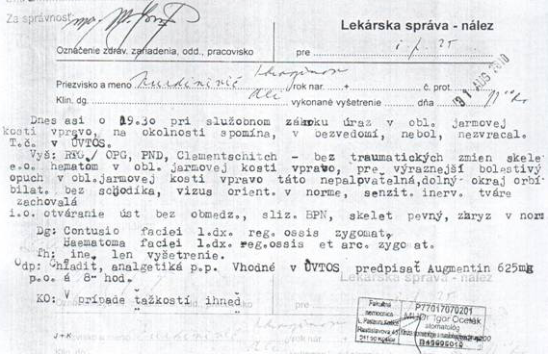
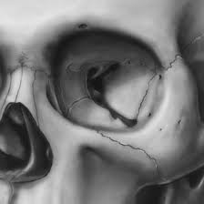
Contusio faciei l.dx. reg. ossis zygomat.
Contusio faciei lateris dextri regionis ossis zygomatici
Haematoma faciei l. dx. reg. ossis et arc. zygomat.
Haematoma faciei lateris dextri regionis ossis et arcus zygomatici
Notes:
Prečítať a pokúsiť sa preložiť, demonštrovať skratky, záznam je z väzenského zariadenia, poukazuje pravdepodobne na silný úder do tváre a neprimeraný zákrok väzenskej polície (táto inf. Je pre zaujímavoať, nemusí byť uvedené)

