Slide 1
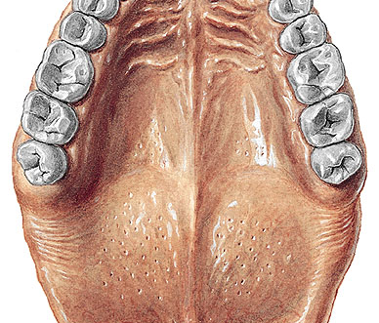
TRANSVERSE PALATINE FOLD?
HARD PALATE?
MEDIAN RAPHE?
SOFT PALATE?

Slide 2
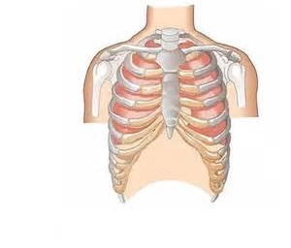
CLAVICLE?
ARM BONE?
TRUE RIBS?
BREASTBONE?
FALSE RIBS?

Slide 3
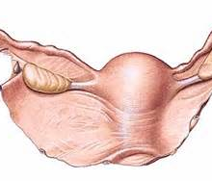
OVARY?
UTERUS?
WIDE LIGAMENT OF UTERUS?

Slide 4
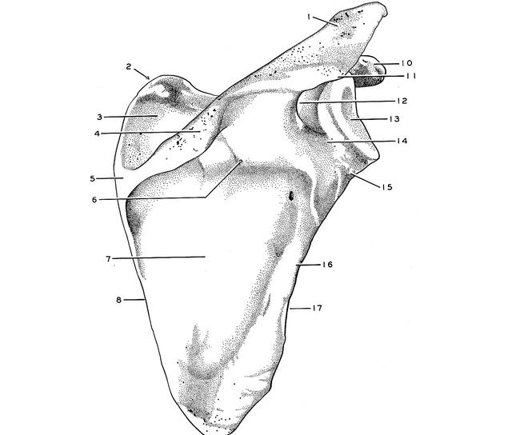
ACROMION PROCESS?
SPINE OF SCAPULA?
FOSSA OF SHOULDER BLADE? (or GLENOID FOSSA)
HEAD OF SCAPULA?

Slide 5
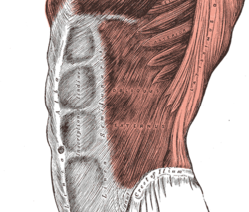
WHITE LINE?

Slide 6
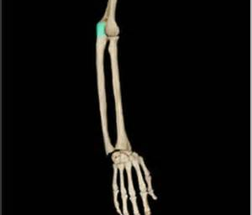
OLECRANON PROCESS OF ULNA?
ULNAR BONE?
RADIAL BONE?
FINGERS OF HAND?

Slide 7
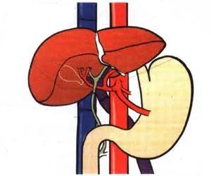
VENA CAVA INFERIOR?
LIVER?
STOMACH?
HEPATIC PORTAL VEIN?

Slide 8
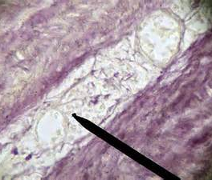
V_ _ _ V_ _ _ _ _ _ ??
small blood vessels that supply or drain the walls of the larger arteries and veins and connect with a branch of the same vessel or a neighboring vessel

Slide 9
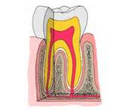
TOOTH?
ENAMEL?
DENTINE?
CEMENTUM?

Slide 10
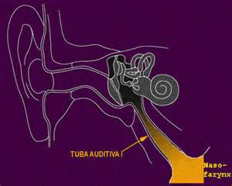

Slide 11
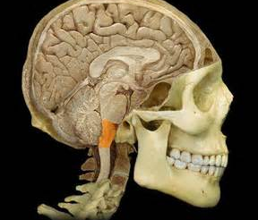
PROLONGATION OF SPINAL CORD?

Slide 12
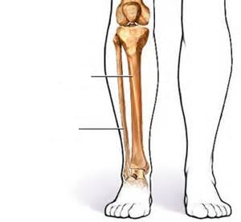
SHINBONE?
CALF BONE?

