Slide 1
Questions
What is the form of an adjective put to a noun dependent on?
What are the endings of the adjectives?
How do we decline the adjectives like e.g magnus, a, um (liber, era, erum)?
What prepositions are used with Accusative
Ablative
both?

Slide 2
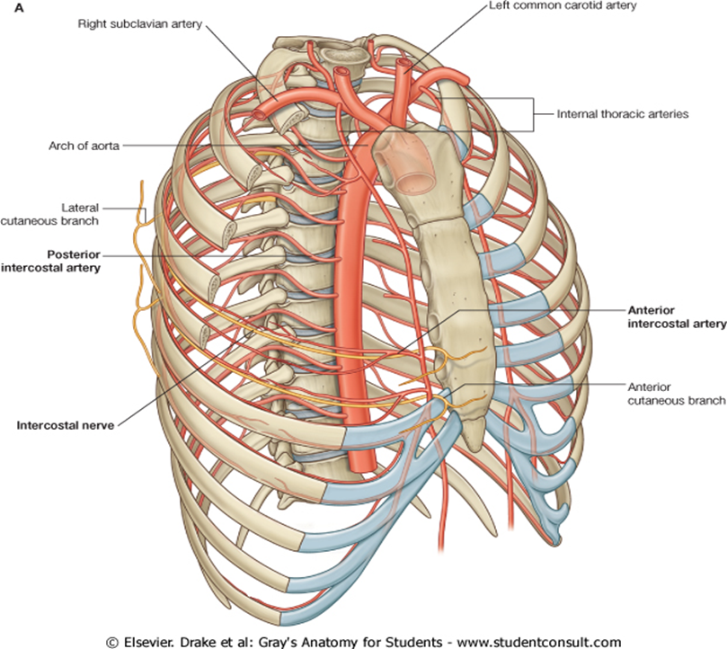
internal thoracic artery?

Slide 3
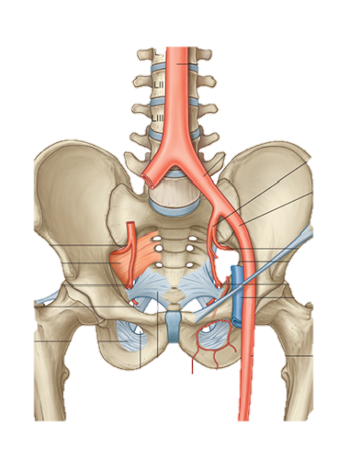
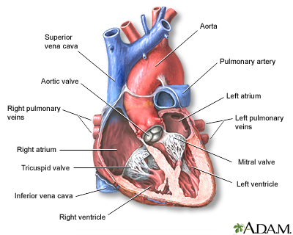
external iliac artery? arch of aorta?

Slide 4
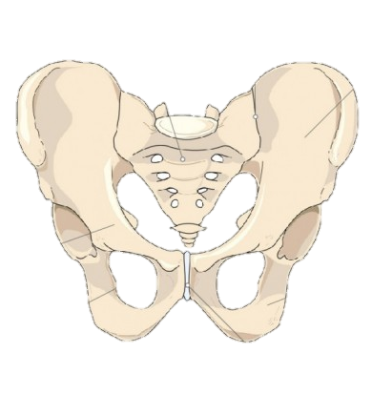
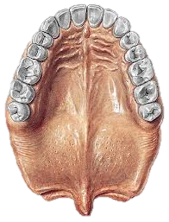
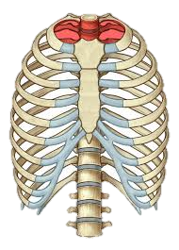
aperture of pelvis? medial rhaphe? thoracic aperture?

Slide 5
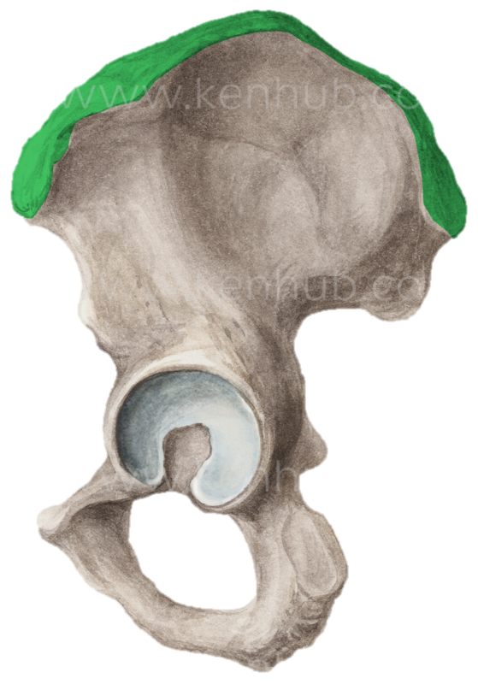
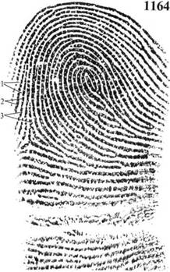
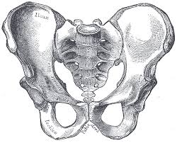
iliac crest? ridges of skin (dermal ridges)? pubic crest?

Slide 6
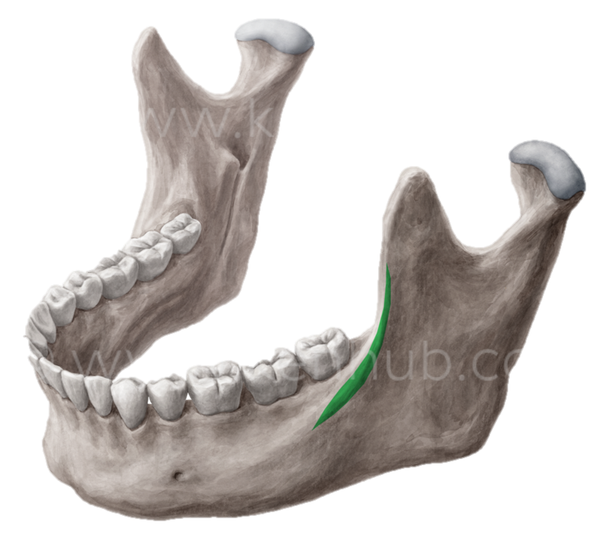
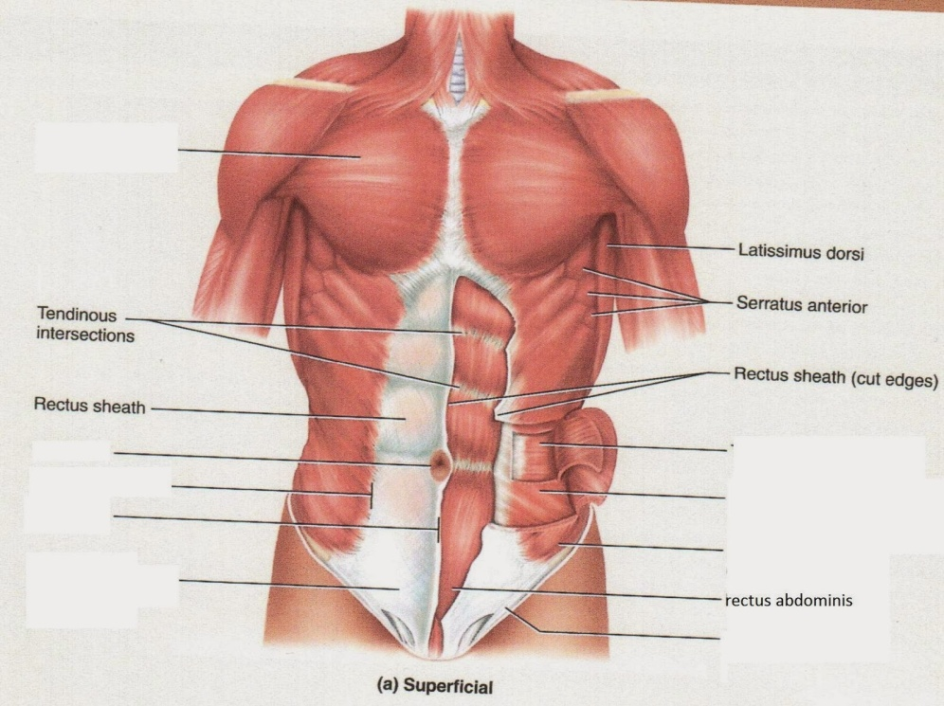
oblique line of lower jaw? white line?

Slide 7
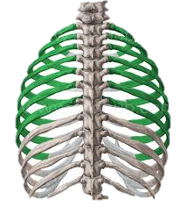
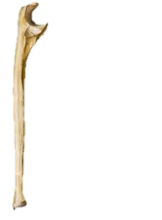
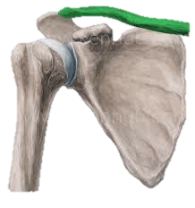
right tibial bone? right collar bone? true ribs? left ulnar bone?

Slide 8
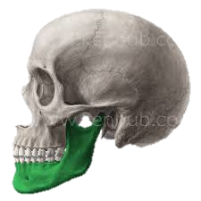
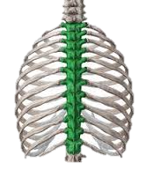
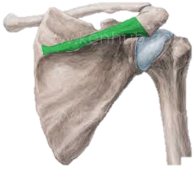
left lower jaw? right fibula? spine of right shoulder blade? thoracic vertebras?

Slide 9
Ordinal numbers
primus, a, um
secundus, a, um
tertius, a, um
quartus, a, um
quintus, a, um
sextus, a, um
septimus, a, um
octavus, a, um
nonus, a, um
decimus, a, um
undecimus, a, um
duodecimus, a, um

Slide 10
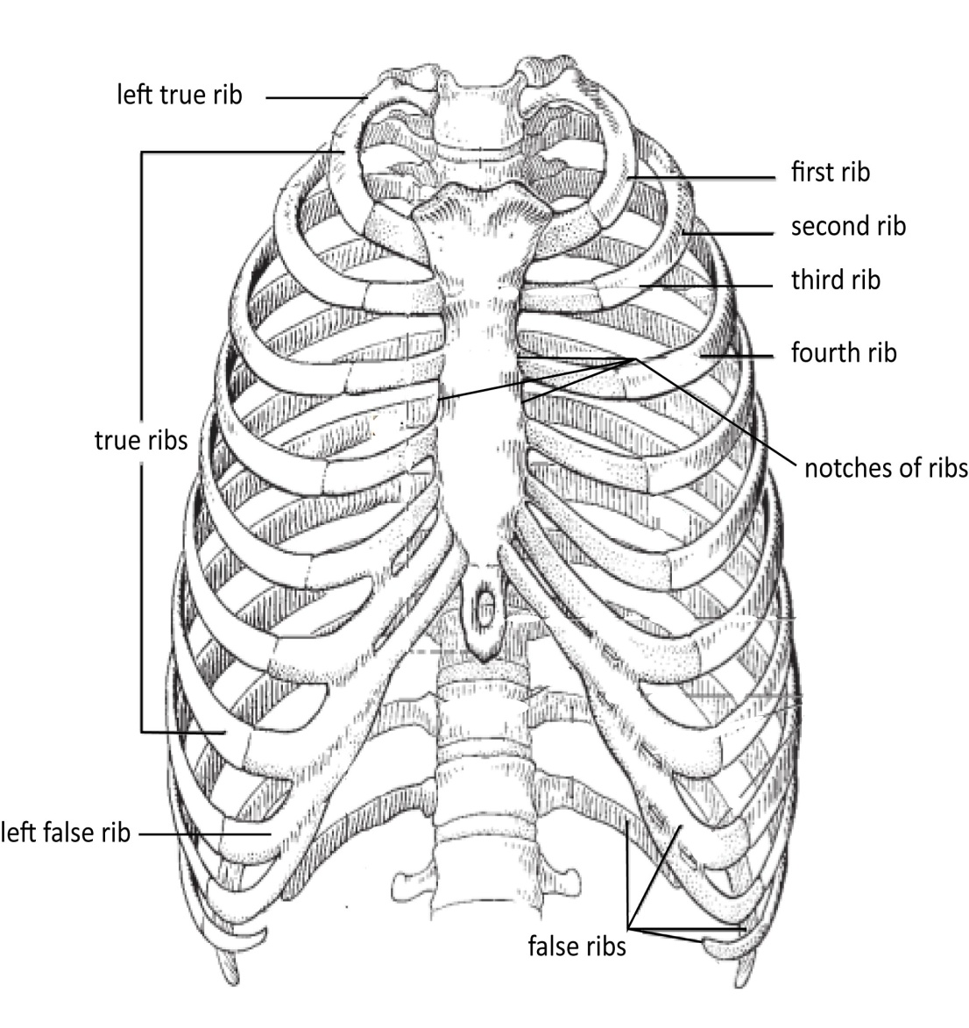
Ribs

Slide 11
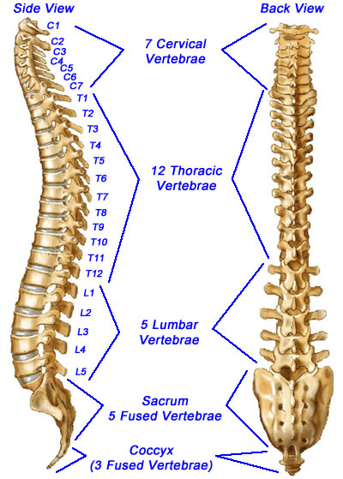
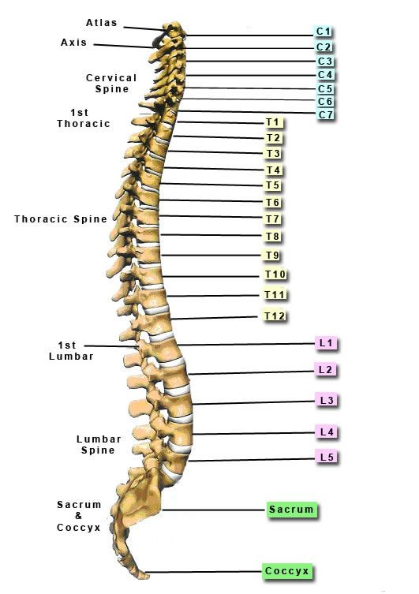
Vertebras

Slide 12
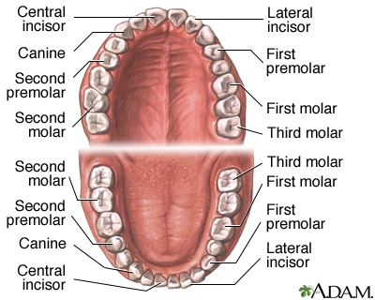
Teeth

Slide 13
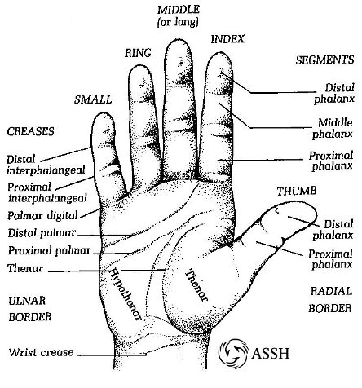
Fingers

Slide 14
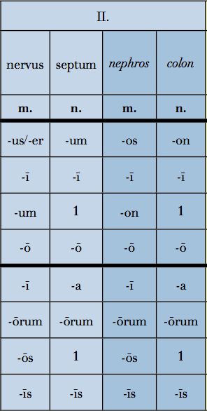
2nd declension
Latin Greek
Gen. sg. –I
Gender M (F)/N
Nouns of the female gender in this declension are exceptions
Nom. sg. –US/-ER/-OS
Gender M (F)
Nom. sg. –UM/-ON
Gender N

