Slide 1
3rd declension
consonant + i-stems

Slide 2
Specific features of the 3rd declension
All 3 genders are included (cortex m., radix f., femur n.)
Nom. Sg. – various endings (sanguis, excisio, abductor, rete, latus, femur, abdomen, cavitas)
Nominative form is not interconnected with the gender!!!
Two main groups:
nominative and genitive stem differs (genitive is longer than nominative) Consonant stems
nominative and genitive stem remains unchanged (genitive has same number of syllables as nominative) I- stems + exceptions

Slide 3
Consonant stems
stem in gen. sg. and nom sg. usually differs (pulm-o//pulmon-is, fem-ur//femor-is, rad-ix//radic-is)
for the proper inflection it is necessary to know the genitive form
1. pulm-o
2. pulmon-is
4. pulmon-em
6. pulmon-e

Slide 4
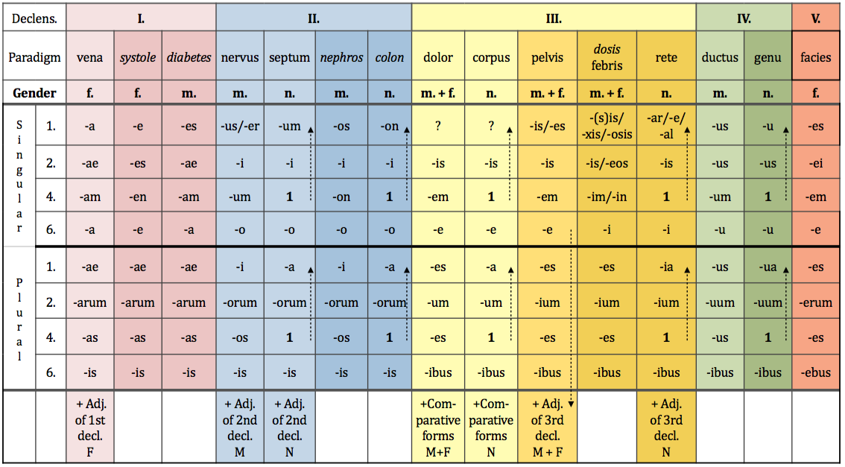
Paradigms of consonant stems

Slide 5
i-stems
stem in nom. sg. and gen. sg. does not differ (pelv-is //pelv-is, canal-is//canal-is, ret-e// ret-is, dos-is//dosis)
1. cut-is
2. cut-is
4. cut-em
6. cut-e

Slide 6
Paradigms of i-stems

Slide 7
Difference between consonant and i-stems?

Slide 8
What nouns are declined as pelvis?
masculine and feminine nouns…
which have the same nominative and genitive forms:
cutis, is, f.; canalis, is, m.; auris, is, f.; cystis, is, f.; axis, is, f.
whose genitive stem ends in two consonants
dens, ntis, m.; pars, rtis, f.; pons, ntis, m.; mens, ntis, f.; lens, ntis, f.

Slide 9
Nouns declined like rete?
Only the following three neuters:
animal, alis, n.
calcar, aris, n.
cochlear, aris, n.

Slide 10
Words of Greek origin

Slide 11
Nouns declined like dosis?
feminine nouns of Greek origin ending in –sis, -xis, or –osis
*in the dictionary you can identify them according to the double Genitive ending –is/-eos
some Latin nouns:
febris, is, f.
sitis, is, f.
tussis, is, f.
pertussis, is, f.
tuberculosis, is, f.

