Slide 1
4th and 5th declension

Slide 2
What are the typical features of 4th/5th declension?
Are there any similarities with the declensions you already know?
What is the gender of the nouns of 4th/5th declension?

Slide 3
 | 4 | 5
Genitive? | -us | -ei
Gender? | masculine(mostly) neutral (2) | feminine
Common points? | ? | ?

Slide 4
Special notes
artus, us, m. Abl. Pl. artubus
arcus, us, m. arcubus
manus, us, f.
acus, us, f.
species, erum, f.

Slide 5
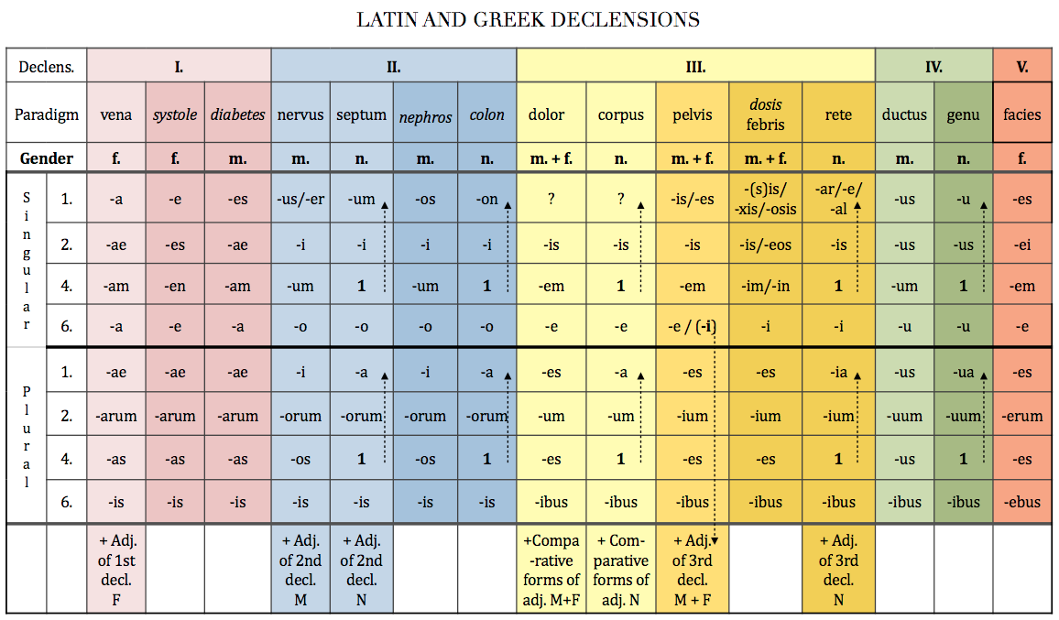

Slide 6
How can you decline nouns ending in –us?
Decide the declension of the following nouns:
longus
ulcus
fetus
uterus
morbus
infarctus
nasus
sinus
vulnus
crus

Slide 7
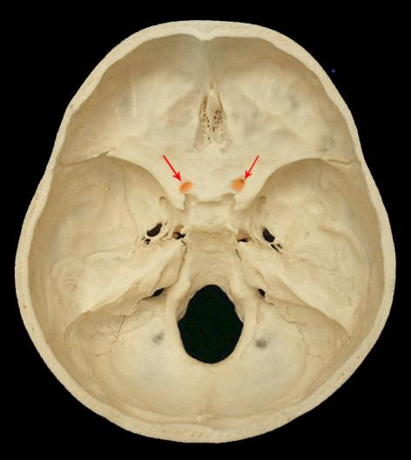
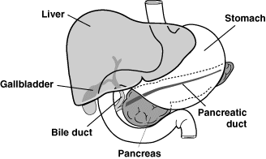
canalis = a narrow tubular passage or channel, e.g. optic canal
ductus = a passage with well-defined walls, esp. for the passage of excretion or secretion
bile duct ?
optic canal ?

Slide 8
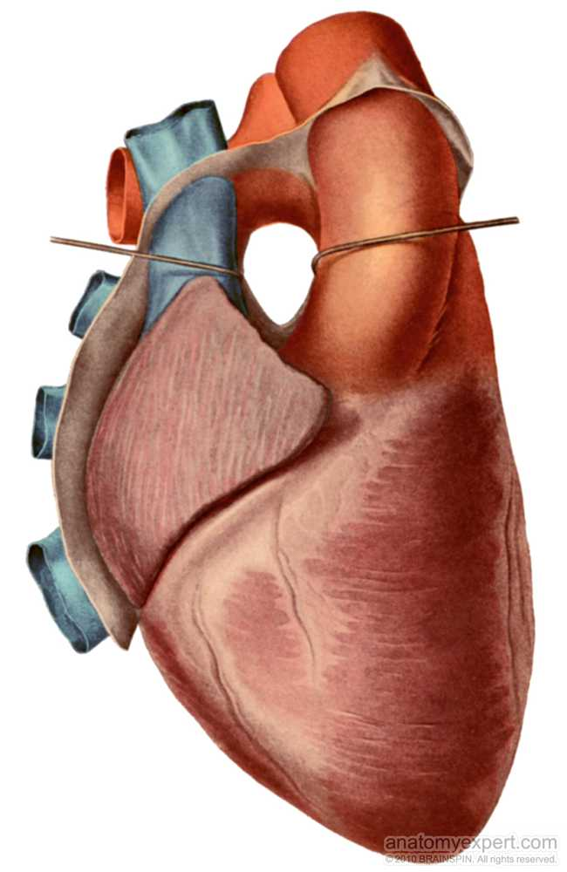
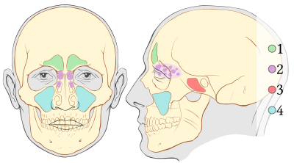
sinus = a cavity in bone, esp. the pair cavities in the facial part of skull
transverse sinus of pericardium?
1 frontal sinuses
2 ethmoid sinuses
3 sphenoid sinus
4 maxillary sinuses

Slide 9
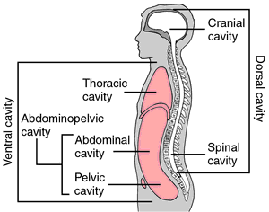
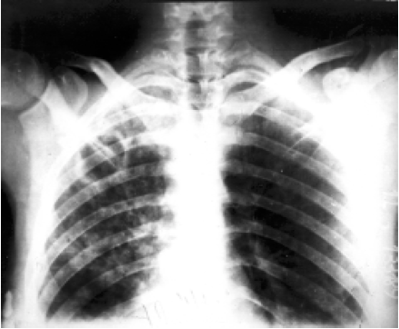
cavitas = a cavity of organs or the regions of body
caverna = a cavity with many interconnected chambers; a pathological cavity caused by the decay of tissues, e.g. cavernae tuberculosae

Slide 10
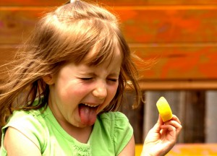
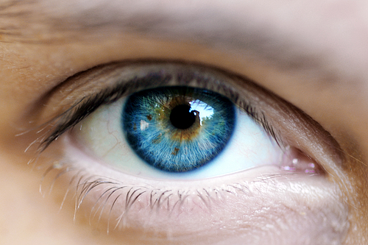
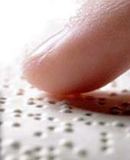
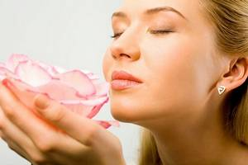
Sensus humani:
visus ~ auditus ~ olfactus ~ tactus ~ gustus
1
2
3
4
5

Slide 11
Pulsus…
parvus tardus celer bigeminus

Slide 12
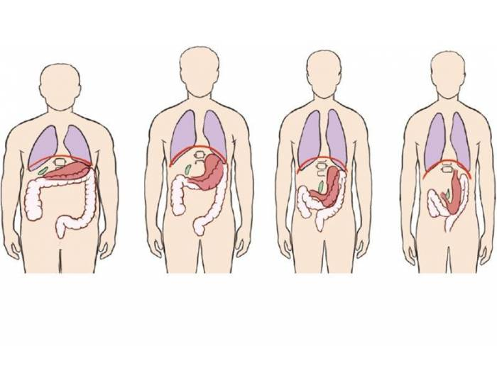
Habitus…
= a general body type or constitution of a person; posture or position of the body
A hypersthenicus
B sthenicus
C hyposthenicus
D asthenicus
a) b) c) d)
*Gr. sthenos = strength
Which of these is the average/normal?

Slide 13
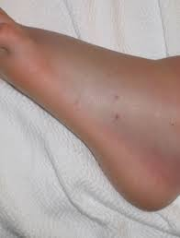
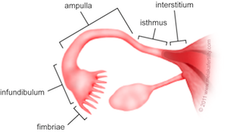
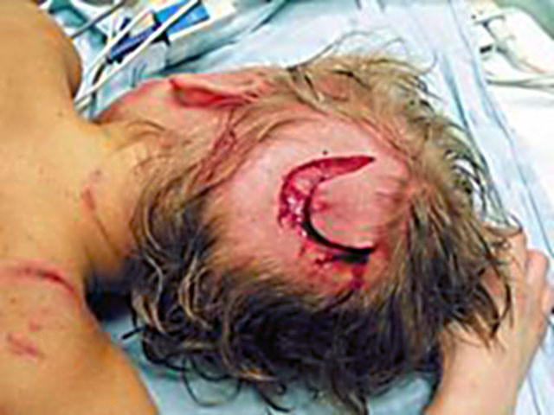
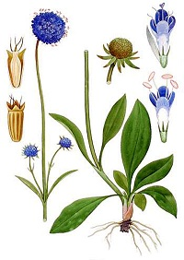
Morsus…
m. serpentis
→ Create diagnoses according to the pictures!
m. canis
*m. diaboli 1. a plant used to treat scabies
2. the fimbriated distal end of the Fallopian tube, infundibulum

Slide 14
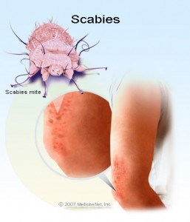
Scabies
(Lat. scabere = to scratch)
= a contagious skin disease caused by a tiny mite (Sarcoptes scabiei) laying eggs under the skin, the characteristic itching is caused by the reaction to the feces of the mite
grey ointment against scabies?

Slide 15
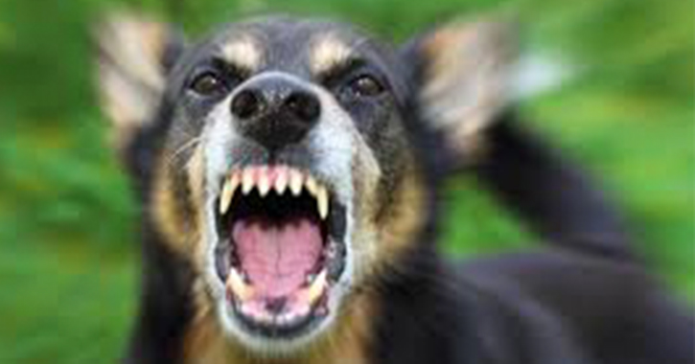
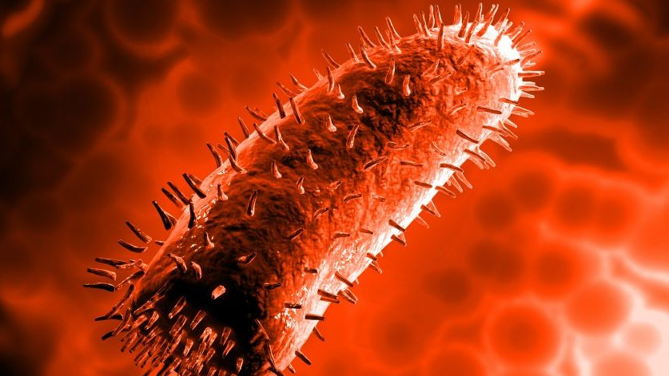
Rabies
= an acute viral disease (a virus of the family Rhabdoviridae) of the central nervous system transmitted through saliva from the bite of an infected animal, it is also called hydrophobia because of the typical symptom of the disease; the symptoms include extreme thirst, fever, depression, confusion, hard swallowing, muscle spasms, sensitivity to touch, light or loud noise; if not prevented, it is almost always fatal
r. silvatica
r. domestica
death due to rabies after the bite of an animal?

Slide 16
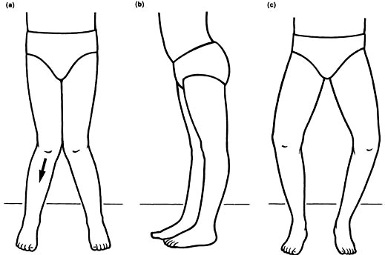
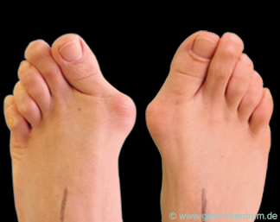
valgus
x
varus
?? ??
state after the operation of a toe twisted inwards of the left foot?
Notes:
Genu valgum, genu varum

Slide 17
in situ…
morbus ischemicus cordis, cardiostimulator in situ
tumor mammae l. sin., implantatus in situ
tear wound of the head, a foreign body in the place (of the wound)?
cancer of the small intestine, carcinoma in its (original) place?
x
metastases of the tumor towards the liver?

Slide 18
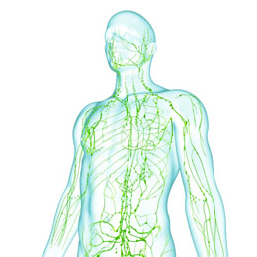
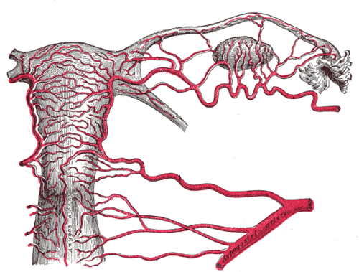
Plexus…
uterine venous network?
deep lymphatic network?
state after the excision of a lymphatic node due to carcinoma?

Slide 19
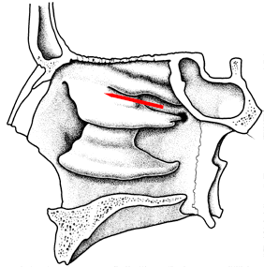
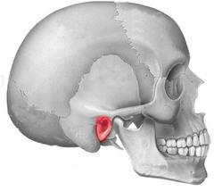
Meatus…
= an opening or passage, esp. one leading to the body surface, external opening of a canal
medial meatus of the nose?
nasopharyngeal meatus?
external acoustic meatus?
Notes:
Meatus acusticus externus

Slide 20
Status…
post operationem --->
propter asthma --->
propter epilepsiam --->
-ivus -icus

