Slide 1
Basic medical terminology
autumn 2015

Slide 2
Study materials
Prucklová, R. – Severová, M.: Introduction to Latin and Greek Terminology in Medicine. Praha: KLP, 2012 (Unit 1-7)
Teachers’ own materials (e.g. hand-outs, presentations, activity cards) which are going to be periodically uploaded on the IS in Study materials of your subject.
"Drill" on the IS (https://is.muni.cz/auth/dril/?lang=en )

Slide 3
Testing
Two partial exams
  each successfully written partial test (over 70 %) means that you get bonus 5 % for your final exam)
Credit test
  70% required if you were not successful in any of the partial tests
  65% required if you were successful in ONE of the partial tests
  60% required if you were successful in BOTH partial tests

Slide 4
Testing
All students are sitting all their tests in his/her group only.
During the “Dissections week” (December 14-18, 2015) seminars will concentrate on practising, the mock version of the credit test is going to be explained.
Students can sit the credit test in the extra week (December 21-23, 2015) or during the 14th week of the semester (January 4-8, 2016), there are no exceptions to this whatsoever.
Resits of the credit test will take place only during the exam period, i. e. January, 11 – February 19, 2016.
The number of possible credit test resits is two.
The dates and number of resits set by the teacher before the exam period is final, it means no other dates will be added during the exam period or later.

Slide 5
Testing
Results of the tests will be available to students in the Notebook on the IS.
The student’s results will be given in percentage together with the pass mark.
The student will have the access to his/her tests during his/her teacher’s office hours only.

Slide 6
Attendance
Absences are going to be electronically registered in the IS. In order to be sure you have been registered as present in the class, be punctual, the attendance is always checked immediately after the beginning of the class.
We can tolerate ONE unexcused absence only; all further absences have to be properly excused by the Study Department.
Unexcused absences are regularly recorded in the Notebook on the IS, and students having these records cannot sit the credit test.
The student may substitute a class in another group two times per semester; the substitution is possible only in the same week when he/she missed a class in his/her own group.
The substitution is not possible in the week for which a partial test or the credit test has been planned.
The teacher at whom the student substitutes a class notes the information about the student’s substitution in the Notebook on the IS.

Slide 7
Course objectives
To familiarize with basic medical terminology
To understand rules of creating Latin terms and to understand meaning of particular terms based on:
  Morphological analysis
  Syntactical analysis
To create correct Latin terms (both from anatomical and clinical terminology)
To understand basics of pharmacological Latin
To master the vocabulary in a systematic way

Slide 8
Latin in medical terminology
Definite set of terms that name the parts and structures of the human body
First worldwide official standard terminology appeared 1895 (Basiliensia Nomina Anatomica) since then it was periodically updated and changed to implement new findings and/or understanding of the anatomical structures
Current terminology is approved by FCAT (Federative Committee on Anatomical Terminology) and published in 1998 as TERMINOLOGIA ANATOMICA
(cf. http://www.unifr.ch)

Slide 9
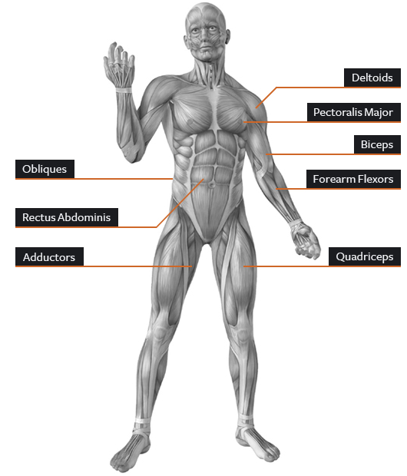
Anatomical structures
Musculus deltoideus
Musculus pectoralis major
Musculi obliqui abdominis
Musculus biceps brachii
Musculus rectus abdominis
Musculus flexor carpi
Musculi adductores
m. adductor longus
m. adductor brevis
Musculus quadriceps femoris

Slide 10
Latin in the clinical terminology
Non-definite set of terms that names diseases, health conditions or causes of death
First authoritative list of diseases and causes of death 1868 (Nomenclature of diseases), 1893 Bertillon's classification of diseases
Current terminology ICD-10 (International Classification of Diseases) is approved by WHO and published every ± 10 years (www.who.int/classifications/icd/en/)
Widely used in medical documentation e.g. medical reports, surgical and hospital reports, pathological reports (central Europe, Russia and former republics of USSR, partly Western Europe - Germany, Austria)

Slide 11
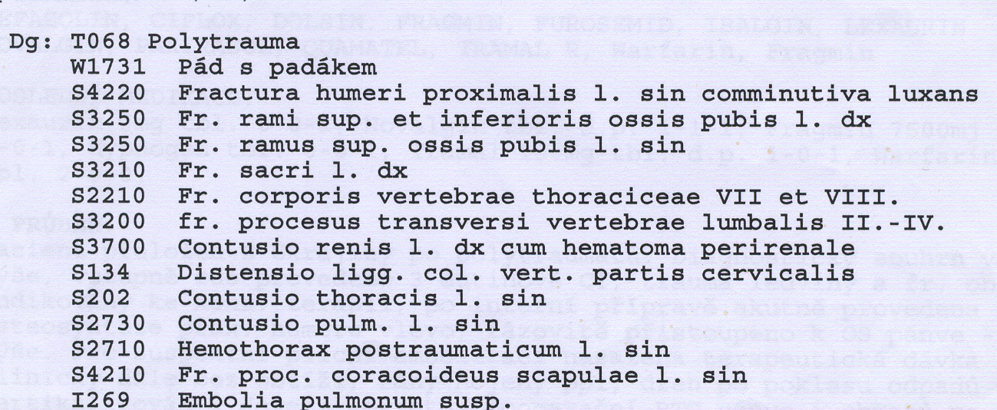
Diagnose
ICD http://apps.who.int/classifications/icd10
S20.2 = Contusion of thorax

Slide 12
Latin in the pharmacologic terminology
Definite set of terms used in European Pharmacopoea (current version is 8th ed.) to name:
  essential medicines (acidum phosphoricum)
  classes of medicines (antipyretica, spasmolytica)
  forms of medicines (solutio, injectio, tabuletta)
  drugs (calendula officinalis)
Prescriptions
  main part of the prescription including name and quantity of the medicine as well as the way of its administration is usually written in Latin, using system of routine abbreviations

Slide 14
At the end of the course, you will be able to:
understand the system in the terminology of anatomical structures ( = easier memorizing of the terms)
understand the principles of forming more complex terms
understand a clinical diagnose
write your own clinical diagnose
write a medical prescription

Slide 15
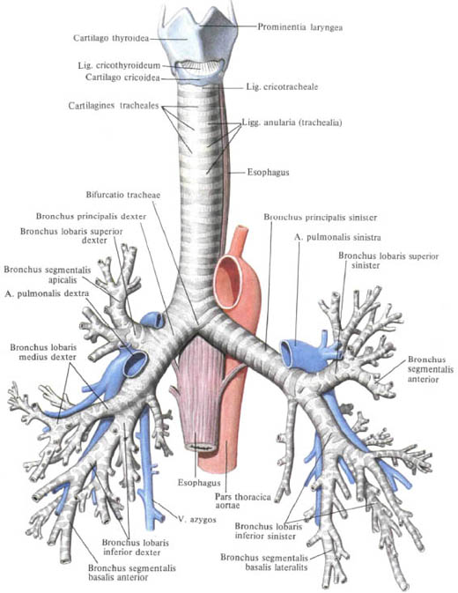
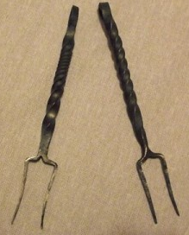
Latin medical terminology
Many ancient terms are based
on metaphors and similes,
i.e. they are formed from words
of nonmedical origin:
Animals , Letters of alphabet,
Musical instruments, Household utensils,
Military objects, Agricultural tools/products....
Eg.: bifurcatio = bifurcation
1. a division into two
branches.
      2. the point at which
      division into two
      branches occurs.
Furca = a two-pronged fork bifurcatio tracheae

Slide 16
Latin pronunciation

Slide 17
Vowels
A | Ā | B | C | D | E | Ē | F | G | H | I | Ī | K | L | M | N
O | Ō | P | Q | R | S | T | U | Ū | V | X | Y | Y | Z
Vowels
Long Short
Ā (father) frāctūra A (cut) lingua
Ē (sad) artēria E (met) vertebra
Ī (intrigue) spīna I (intrigue) digitus
I (yes) > J
Ō (door) sensōrius O (on) skeleton
Ū (boom) ruptūra U (put) uterus
Y (analysis) hypophysis Y (lady) tympanum
Diphtongs
AE=Ē (care) anaemia
OE=Ē (care) lagoena
Greek words
OE (o-e) dyspnoe
EU (e-u) euthanasia

Slide 18
Read aloud
hypnosis
ala
olla
eupnoe
ileus
mucus
haematoma
iliacus
ossa
diploe
cubitus
venae
diameter
sacralis
ulcus
iris
sutura
sigmoideus
depressor
area
oesophagus
melior
meatus
leucocytus

Slide 19
Consonants
A | Ā | B | C | D | E | Ē | F | G | H | I | Ī | K | L | M | N
O | Ō | P | Q | R | S | T | U | Ū | V | X | Y | Ŷ | Z
Consonant/group of consonants | Pronunciation | Example
1: c + a, o, u, consonants c + ae, oe, e, i, y | [k] medical [ts] tsar | camera, costa, cultivatio, cranium caecus, coeliacia, centrum, circulatio, cynismus
2: ch | [x] loch | chirurgia, cholera

Slide 20
Consonants II
Consonant/group of consonants | Pronunciation | Example
3: g gu + vowel | [g] ground [gv] | gramma, gastritis lingua, sanguis
4: h | [h] house | herba, haematologia
5: j + vowel | [y] yes | iniectio/injectio, maior/major
6: p p + h | [p] present [f] physiology | pneumonia, pulmo phantasia, pharmacia
7: qu+ vowel | [kv] | aqua, quadriceps
8: r r+h | [r] rupture [r] | vertebra, ruptura rheuma, rhinitis

Slide 21
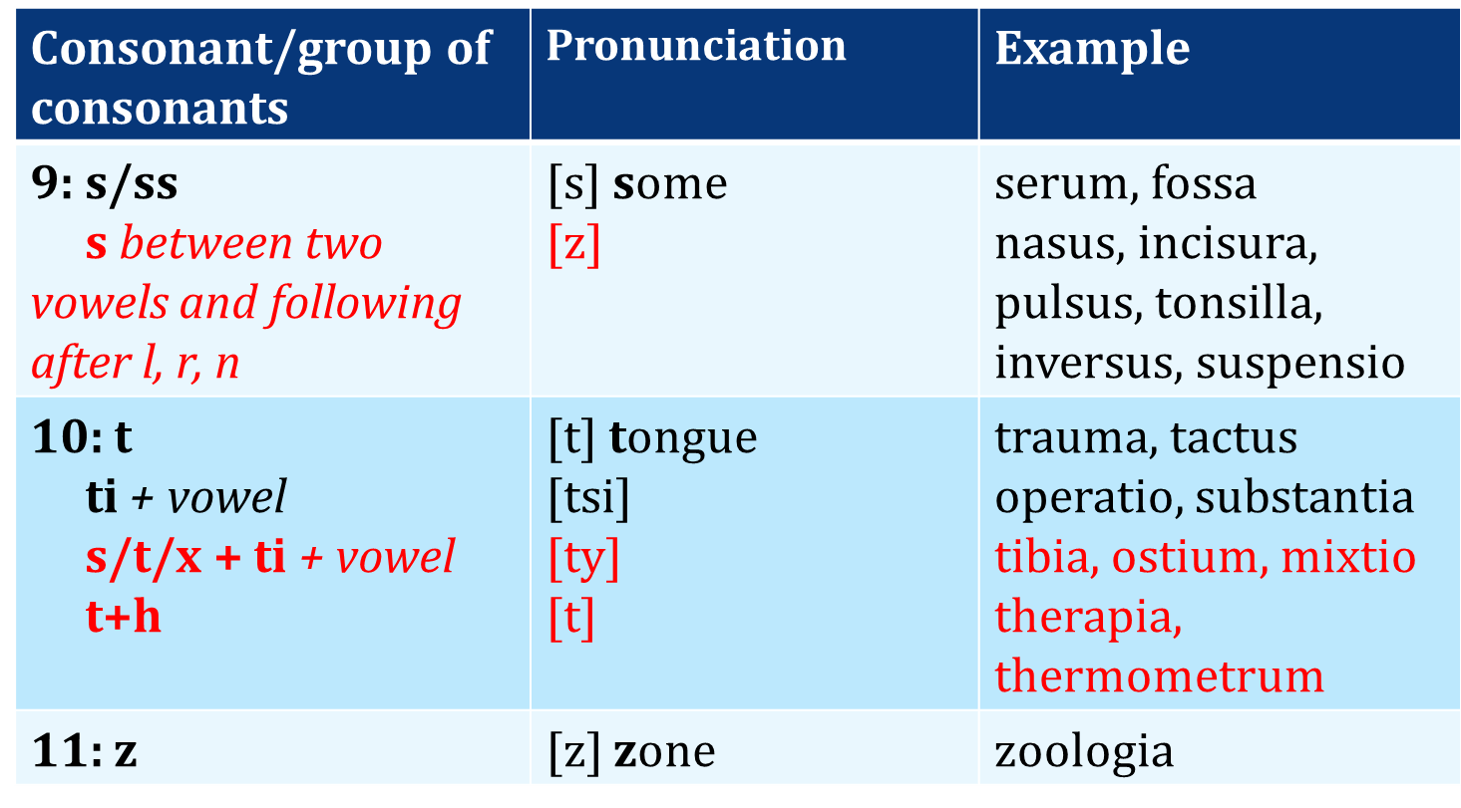
Consonants III

Slide 22
Read aloud
cancer, medicamentum, lingua
thorax, pulsus, contusio
corpus, exitus, functio
hemispherium, angulus, fractura
intestinum, aqua, pharmacon
oedema, musculus, defectus
medicus, operatio, infarctus
homo, bronchus, duodenum
angina, haemorrhagia, spasmus
encephalon, bacterium, acne
migraena, pharynx, dysenteria
inflammatio, leucaemia, virus
laparoscopia, typhus, organismus
therapia, digitus, gingiva
gangraena, diagnosis, tonsilla
injectio, lympha, oxygenium
vademecum, insufficientia, chirurgia

Slide 23
Grammatical categories

Slide 24
What will you find in the dictionary?
English words are presented in one single form
!!!Latin words are presented in three forms!!!
E.g.:
MUSCULUS, I, M. = MUSCLE
OS, OSSIS, N. = BONE
English translation
Main form
(full nominative)
Genitive ending/or even full Genitive form
Gender abbreviation
!CAUTION! ALL THREE FORMS are EQUALLY important for the future ability to use the noun in the context.

Slide 25
Gender
There are three genders in Latin
  Masculine (e.g. nervus)
  Feminine (e.g. vena)
  Neutral (e. g. cerebrum)
There is nothing, which could indicate the gender to you
YOU HAVE TO LEARN IT BY HEART

Slide 26
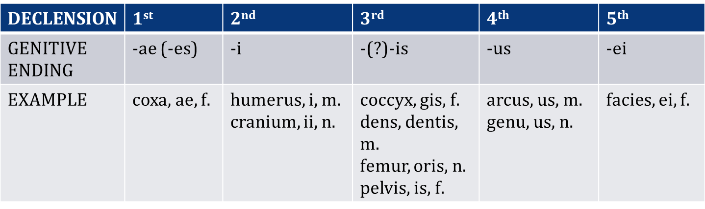
Genitive ending => Declension
Declensions are groups of nouns (or adjectives) using the same set of suffixes (=endings)
There are 5 declensions in Latin

Slide 27
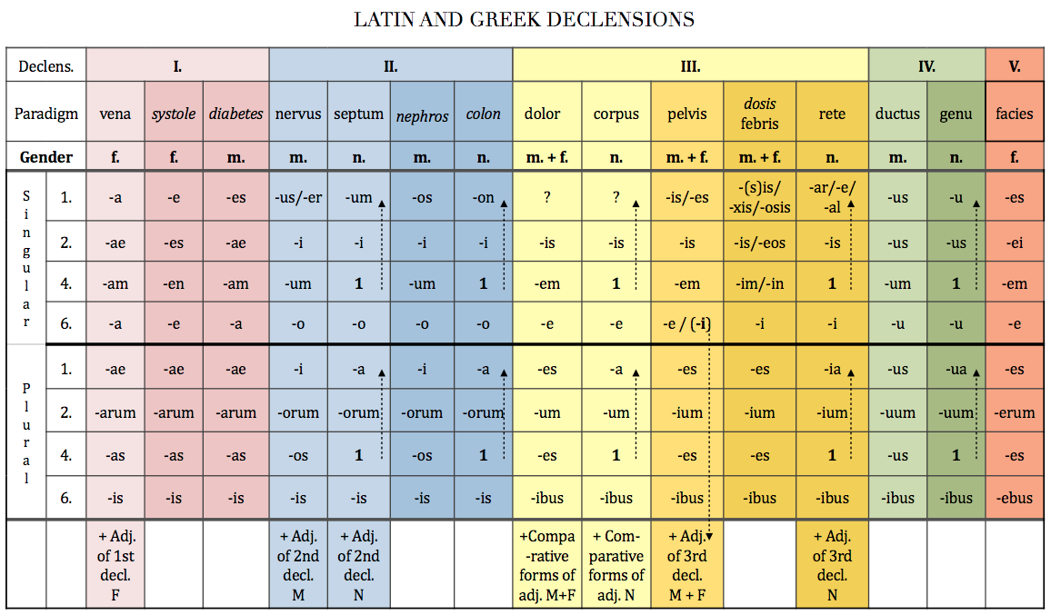

Slide 28
Genitive ending = stem of a word
A stem is a form to which affixes (endings) can be attached
In some declensions (1st, 4th, 5th, and in majority of cases also 2nd) the nominative and genitive forms of the word have identical stem
In some declensions (3rd, partially 2nd) word’s stem can greatly different
In Latin we need to remove the genitive ending in order to gain the genitive stem
ven-a
ven-ae
humer-us
humer-i
diamet-er
diametr-i
dol-or
dolor-is
corp-us
corpor-is
de-ns
dent-is
arc-us
arc-us
gen-u
gen-us
faci-es
faci-ei

Slide 29
Decide what is the stem of the noun
ex: caput, capit-is
skeleton, skeleti
os, ossis
cranium, cranii
orbita, orbitae
collum, colli
cervix, cervicis
thorax, thoracis
costa, costae
discus, disci
processus, processus
vertebra, vertebrae
pelvis, pelvis
coxa, coxae
ilia, ilium
coccyx, coccygis
ischium, ischii
pubes, pubis
symphysis, symphysis
nasus, nasi
dens, dentis
mandibula, mandibulae
clavicula, claviculae
scapula, scapulae
sternum, sterni
humerus, humeri
arcus, arcus
radius, radii
ulna, ulnae
metacarpus, metacarpi
carpus, carpi
phalanx, phalangis
femur, femoris
patella, patellae
tibia, tibiae
fibula, fibulae
metatarsus, metatarsi

Slide 30
Read and write down the number of declension
3
3
3
2
5
3
1
2
1
2
2
2
2
3
1
2
2
3
3
4
3
2
2
3
1
2
3
3
3
2
2
4
3
2
2
3
3
0. corpus, oris, n.
cutis, is, f.
1. caput, itis, n.
2. capilli, orum, m.
3. facies, ei, f.
4. os, oris, n.
lingua, ae, f.
5. mentum, i, n.
6. axilla, ae, f.
7. brachium, ii, n.
8. cubitus, i, m.
9. antebrachium, ii, n.
10. carpus, i, m.
11. pollex, icis, m.
12. palma, ae, f.
13.,18. digitus, i, m.
14. sulcus, i, m.
15.,28. penis, is m.
16. femur, oris, n.
17. genu, us, n.
19. frons, frontis, f.
20. oculus, i, m.
21. nasus, i, m.
22. auris, is, f.
23. bucca, ae, f.
24. collum, i, n.
cervix, icis, f.
25. pectus, oris, n.
26. abdomen, inis, n.
27. hypogastrium, ii, n.
29. truncus, i, m.
30. manus, us, f.
31. crus, cruris, n.
32. tarsus, i, m.
talus, i, m.
33. pes, pedis, m.
34. hallux, ucis, m.

