Slide 1
Basic medical terminology 6
IIIrd declension : Consonant stems

Slide 2
Specific features of the 3rd declension
All 3 genders are included (cortex m., radix f., femur n.)
Genitive ending: -is
Nom. Sg. – various endings (sanguis, excisio, abductor, rete, latus, femur, abdomen, cavitas)
!NOMINATIVE form is NOT interconnected with the GENDER! Words must be carefully memorized!
Two main groups:
nominative and genitive stem differs (genitive is longer than nominative) Consonant stems
nominative and genitive stem remains unchanged (genitive has same number of syllables as nominative)
I- stems + exceptions

Slide 3
Specific features of the 3rd declension -Consonant stems
Stem in gen. sg. and nom sg. usually differs
pulm-o//pulmon-is
fem-ur//femor-is
rad-ix//radic-is
For the proper inflection the GENITIVE form is NECESSARY to know
1. pulm-o
2. pulmon-is
4. pulmon-em
6. pulmon-e

Slide 4
Declension paradigms
Consonant |  | I-stems |  | EXCEPTIONS
DOLOR | CORPUS | PELVIS | RETE | DOSIS, FEBRIS
M. + F. | N. | M. + F. | N. | F.

Slide 5
DOLOR
 | Sg. | Pl.
nom. | dolor | dolor-es
gen. | dolor-is | dolor-um
ak. | dolor-em | dolor-es
abl. | dolor-e | dolor-ibus

Slide 6
CORPUS
 | Sg. | Pl.
nom. | corpus | corpor-a
gen. | corpor-is | corpor-um
ak. | corpus | corpor-a
abl. | corpor-e | corpor-ibus

Slide 7
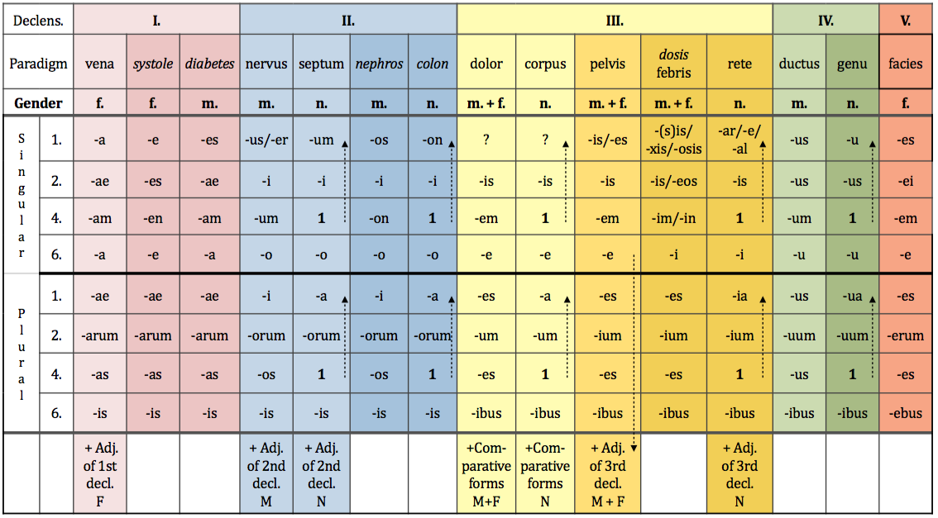
Latin and Greek declensions

Slide 8
EXCEPTIONS
os, ossis n. bone → gen. pl.–ium
vas, vasis, n. vessel
In sg. follows paradigm CORPUS vas-vasis-vas-vase
In pl. follows paradigm CEREBRUM vasa-vasorum-vasa-vasis
GREEK NOUNS typical endings
-itis//-itidis → inflammation
-(o)ma//-(o)matis → tumour diseases/swellings

Slide 9
Connection with the adjective
F M N
SG.
1. cavitas magna dolor magnus foramen magnum
2. cavitatis magnae doloris magni foraminis magni
4. (in) cavitatem magnam dolorem magnum foramen magnum
6. (in) cavitate magna dolore magno foramine magno
PL.
1. cavitates magnae dolores magni foramina magna
2. cavitatum magnarum dolorum magnorum foraminum magnorum
4. (in) cavitates magnas dolores magnos foramina magna
6. (in) cavitatibus magnis doloribus magnis foraminibus magnis

Slide 10
Write down stems
Nom. Sg. Gen. sg. Stem
Abdomen
Dolor
Latus
Abductor
Encephalitis
Lien
Amputatio
Excisio
Luxatio
Apex
Extensor
Margo
Abdominis
Abdomin-
Doloris
Dolor-
Lateris
Later-
Abductoris
Abductor-
Encephalitidis
Encephalitid-
Lienis
Lien-
Amputationis
Amputation-
Excisionis
Excision-
Luxationis
Luxation-
Apicis
Apic-
Extensoris
Extensor-
Marginis
Margin-

Slide 11
Assign nouns to paradimgs
vena
nervus
dolor
systole
septum
corpus
• musculus • vulnus • ulcus • digitus • albus •
• cavitas • vas • arterias • diarrhoas •
• ligamenta • aqua • crura • symptoma
• tumor • ren • abdomen • systolen • apex • cortex
• luxatio • ostio • os • radios • cor

Slide 12
What is a nominative form of these nouns?
Ex.: Injectionis > Injectio, feminine, DOLOR
Cervicis
Solutionis
Tumoris
Femoris
Vertebrae
Sacchari
Systoles
Oculi
Cancri
Phalangis
Ossis
Oris
Coli
Colli
Extremitatis
Capitis
Ganglii
Cervix
Solutio
Tumor
Femur
Vertebra
Saccharum
Systole
Oculus
Cancer
Phalangx
Os
Os
Colon
Collum
Extremitas
Caput
Ganglion

Slide 13
Change into nominative plural:
Femur
Mater
Flos
Foramen
Oedema
Apex
Caput
Melanoma
Cartilago
Injectio
Femora
Matres
Flores
Foramina
Oedemata
Apices
Capita
Melanomata
Cartilagines
Injectiones

Slide 14
Connect nouns to name structures:
Cranii
Thoracis
Abdominis
Laryngis
Nasi
Oris
Pharyngis
Uteri
Linguae
Phalangis
Sterni
Tali
Tibiae
Uteri
Ossis metacarpi
Ossis metatarsi
Coccygis
Cavitas
Corpus
Brachii
Capitis
Carpi
Cervicis
Coxae
Cruris
Dorsi
Femoris
Pedis
Costae
Femoris
Fibulae
Humeri
Mandibulae
Phalangis
Radii
Ulnae
Regio
Caput
Cervix
Uteri
Vesicae
urinariae

Slide 15
Assign adjectives to nouns
tumor• corpus• medicamentum•pes • os• foramen• diameter• vulnus
Benignus
Malignus
Novus
Novum
Bonum
Longum
sacrum
Obliqua
Humanum
Osseum
Adiposum
Alienum
Humanus
Sinister
dexter
Nutricium
Medium
Scissum
Sclopetarium
Contusum
Sectum
Punctum

Slide 16
Find Greek and Latin synonyms
English Latin Greek
_____________ ___________ soma
_____________ os, oris _____________
kidney _____________ _____________
_____________ _____________ colon
brain _____________ _____________
_____________ organum _____________
_____________ _____________ hepar
stitch _____________ _____________
_____________ vulnus __________
body
corpus
mouth
stoma
ren
nephros
large intestine
intestinum crassum
cerebrum
encephalon
organ
organon
liver
iecur
sutura
r(h)aphe
injury, wound
trauma

Slide 17
Add loose attributes
Cavitas + septum nasi
Operatio + cervix uteri
Corpus + vertebra thoracica
Fractura + os sacrum
Luxatio + crus
Morbus infectiosus + abdomen
Dolor acutus + caput
Cavitas septi nasi
Operatio cervicis uteri
Corpus vertebrae thoracicae
Fractura ossis sacri
Luxatio cruris
Morbus infectiosus abdominis
Dolor acutus capitis

Slide 18
Change for nominative plural
sphincter
foramen nutricium
dolor chronicus
vas longum
musculus adductor
femur fractum
cartilago thyreoidea
vulnus punctum
sphincteres
foramina nutricia
dolores chronici
vasa longa
musculi adductores
femora fracta
cartilagines thyreoideae
vulnera puncta

Slide 19
Specific features of the 3rd declension -Latin I-stems
Masculine and feminine nouns
have the same numbers of syllables in the nominative and the genitive singular:
ca-na-lis, ca-na-lis
pel-vis, pel-vis
pu-bes, pu-bis
a group of consonants is preceding the genitive ending -is
(i.e. the stem ends in a group of consonants)
pars, part-is
dens, dent-is
Neutral nouns
words ending in nom. sg. in -e, -al or –ar
only few words: animal, alis, n., calcar, aris, n., cochlear, aris, n., rete, is, n.

Slide 20
Declension paradigms
Consonant |  | I-stems |  | EXCEPTIONS
DOLOR | CORPUS | PELVIS | RETE | DOSIS, FEBRIS
M. + F. | N. | M. + F. | N. | F.

Slide 21
PELVIS
I-STEM MASCULINE AND FEMININE GENDER NOUNS
 | Sg. | Pl.
nom. | pelvis | pelv-es
gen. | pelv-is | pelv-ium
ak. | pelv-em | pelv-es
abl. | pelv-e | pelv-ibus

Slide 22
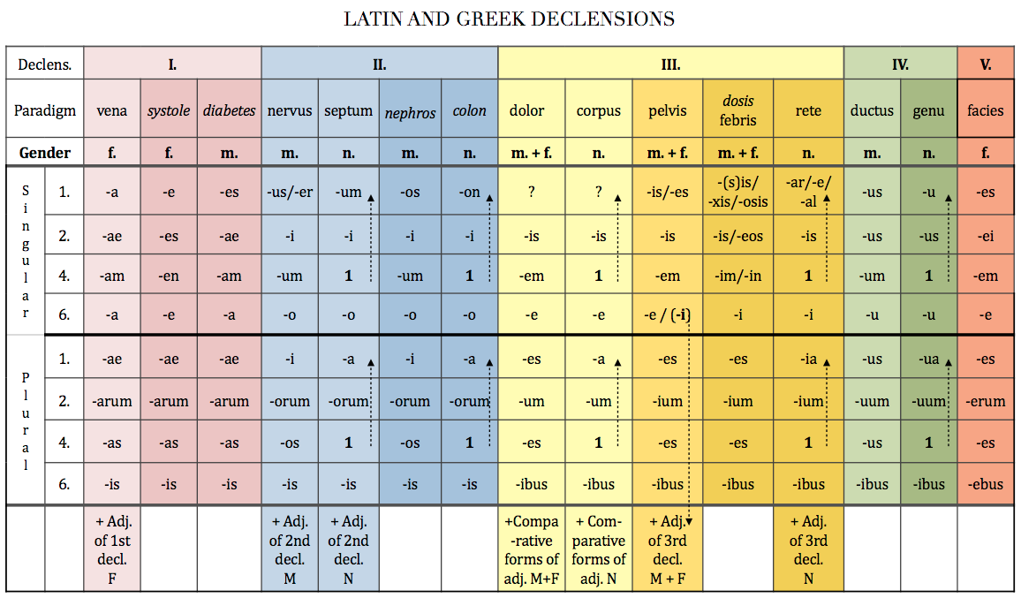

Slide 23
The difference between paradigms PELVIS and DOLOR

Slide 24
The difference between paradigms PELVIS and DOLOR
 | Sg. | Pl.
nom. | dolor | dolor-es
gen. | dolor-is | dolor-um
ak. | dolor-em | dolor-es
abl. | dolor-e | dolor-ibus
 | Sg. | Pl.
nom. | pelvis | pelv-es
gen. | pelv-is | pelv-ium
ak. | pelv-em | pelv-es
abl. | pelv-e | pelv-ibus
CONSONANT-STEM MASCULINE AND FEMININE GENDER NOUNS
I-STEM MASCULINE AND FEMININE GENDER NOUNS

Slide 25
RETE
I-STEM NEUTRAL GENDER NOUNS
 | Sg. | Pl.
nom. | rete | ret-ia
gen. | ret-is | ret-ium
ak. | rete | ret-ia
abl. | ret-i | ret-ibus

Slide 26
NEUTRAL GENDER NOUNS

Slide 27
DOSIS
Only feminine nouns decline according to paradigm dosis
These words are mostly of Greek origin
in nominative singular they end in -sis, -xis, -osis
and the genitive singular is the same
 | Sg. | Pl.
nom. | dosis | dos-es
gen. | dos-is / -eos | dos-ium
ak. | dos-im / -in | dos-es
abl. | dos-i | dos-ibus
Some Latin words are declined according to dosis, but they do not have Greek endings:
febris, is, f, tussis, is, f., pertussis, is, f., sitis, is, f., tuberculosis, is, f.

Slide 28
Write down the stem and guess the paradigm word
os, ossis, n.
cutis, is, f.
mors, tis, f.
pulmo, onis, f.
trauma, atis, n.
basis, is /eos, f.
animal, alis, n.
latus, eris, n.
tussis, is, f.
pubes, is, f.
oss-
cut-
mort-
pulmon-
traumat-
bas-
animal-
later-
tuss-
pub-
corpus
pelvis
pelvis
dolor
corpus
dosis
rete
corpus
dosis
auris

