Slide 2
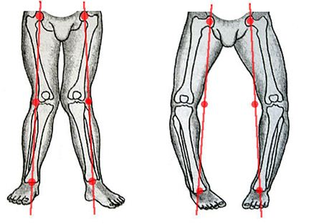
genua valga genua vara

Slide 3
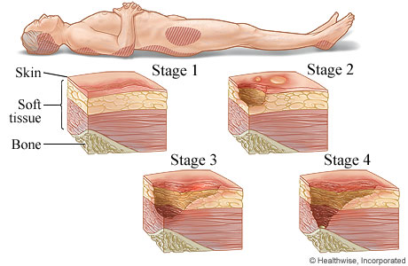
decubitus profundus

Slide 4
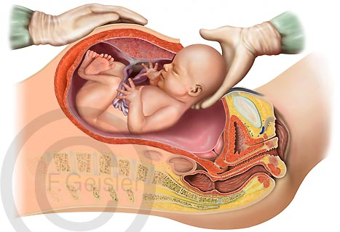
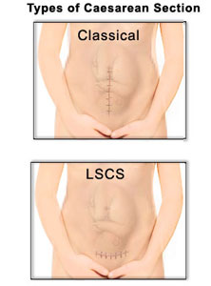
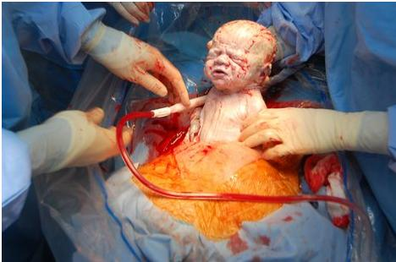
LSCS - Lower Segment Caesarean Section
– today the most commonly used type of Caesarean section
The term is derived from Latin verb caedo, ... caesum meaning „to cut“, „to free by cutting“
From this verb Latin nouns with stem: -cisio (English - cision) are derived:
excisio, incisio, discisio...
partus caesareus / sectio caesarea

Slide 5
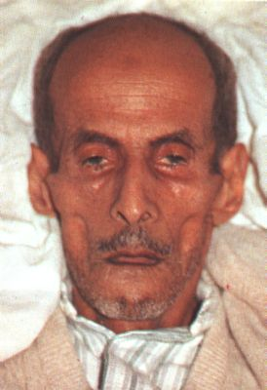
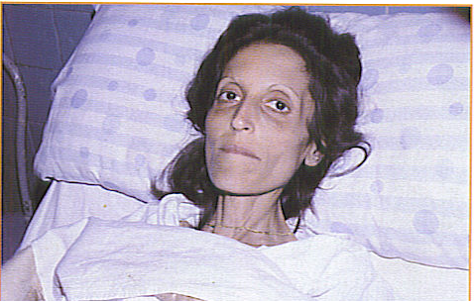
The facial expression produced in the by impending death or long illness (accompanied by pain), excessive evacuations, excessive hunger, and the like, e.g.by peritonitis (inflammation of peritoneum) or cholera. Its synonym is facies abdominalis.
The nose is sharp, the eyes sunken, the temples fallen in, the ears cold and drawn in and their lobes distorted, the skin of the face hard, stretched and dry, and the colour of the face pale or dusky.
facies Hippocratica / facies abdominalis

Slide 6
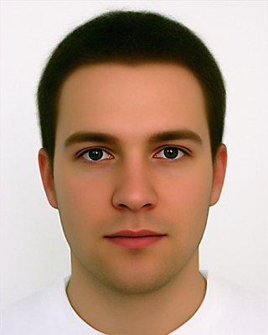
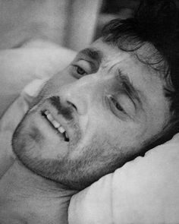
facies composita – normal, calm facial expression of healthy person
facies dolorosa – facial expression showing signs of pain

Slide 7
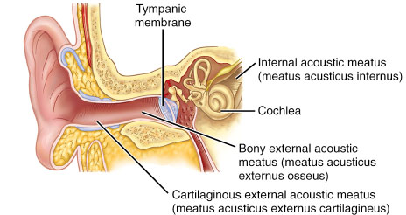
membrana tympani
meatus acusticus externus et internus

Slide 8
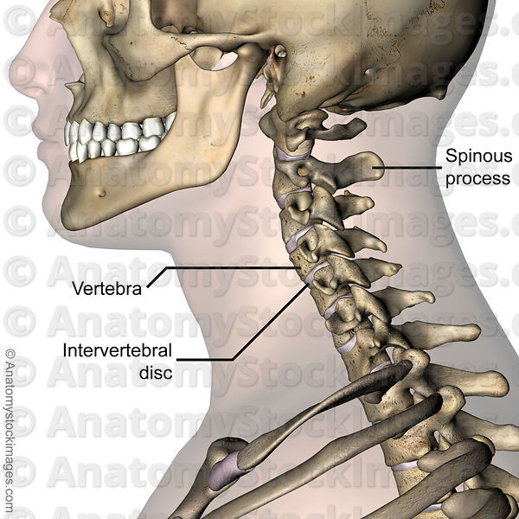
processus spinosus
discus vertebralis

Slide 9
What are the Greek and Latin synonyms?
English Latin Greek
__________ _____________ chole
wound _____________ _____________
_____________ _____________ nephros
_____________ cerebrum _____________
stomach _____________ _____________
_____________ _____________ thorax
_____________ oculus _____________
liver _____________ __________
bile
bilis
vulnus
trauma
kidney
ren
brain
encephalon
ventriculus
stomachos
thorax
pectus
eye
opthalmos
jecur
hepar

Slide 10
Form corresponding loose atributes
articulatio (genu + dexter, tra, trum)
arcus (vertebrae + thoracici, ae, a)
causa (obstructio venae)
ligamenta (manus + sinister, tra, trum)
effectus (gargarisma + novus, a, um)
sanatio (decubitus + profundus, a, um)
collapsus (systema + circulatorius, a, um)
status (canities + praematurus, a, um)

Slide 11
Connect the nouns with adjectives
infarctus spinosus, a, um
partus dolorosus, a, um
plexus externus, a, um
processus venosus, a, um
usus praematurus, a, um
decubitus acutus, a, um

Slide 12
Connect the phrases with the preposition
post + infarctus acutus
propter + partus praematurus
sub +plexus venosus uterinus
in + decursus morbi
ad + usus internus
ante + processus spinosus
sine + effectus malus

Slide 13
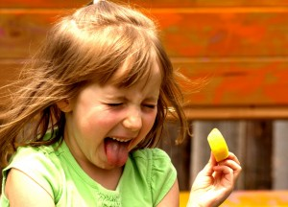
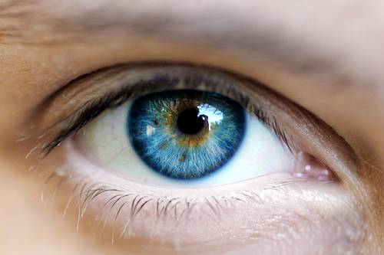
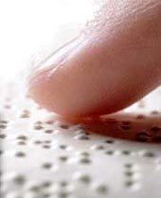

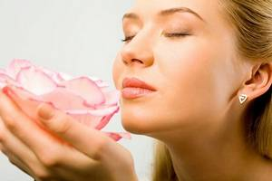
Sensus humani:
visus ~ auditus ~ olfactus ~ tactus ~ gustus
1
2
3
5
4

Slide 14
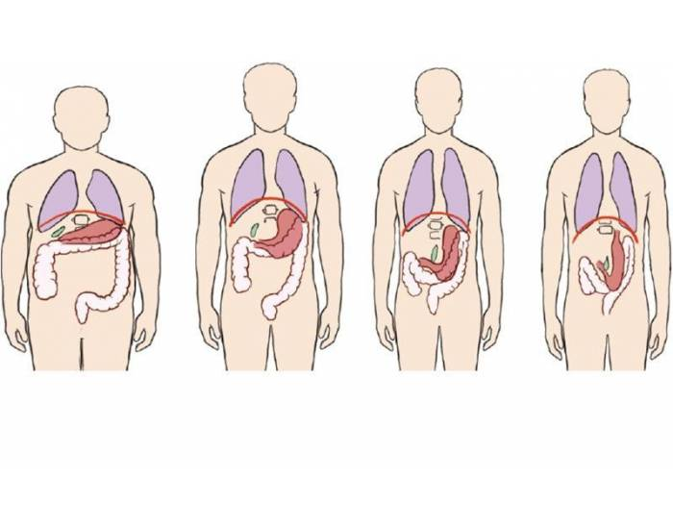
HABITUS
= a general body type or constitution of a person; posture or position of the body
A hypersthenicus
B sthenicus
C hyposthenicus
D asthenicus
a) b) c) d)
*Gr. sthenos = strength
Which of these is the average/normal?

Slide 15
Fill in the given nouns to complete the phrases
facies ~ status ~ processus ~ meatus ~ manus ~ usus
~ apparatus ~ species
a) medicamentum ad _______ externum
b) amputatio phalangis mediae digiti III _______dextrae traumatica
c) apertura _______acustici externi
d) os, labia, palatum, oesophagus, ventriculus, intestina: organa
_______ digestorii
e) _______ urologicae propter inflammationem vesicae urinariae
f) fractura _______ spinosi vertebrae T7
g) _______post resectionem lobi sinistri pulmonis propter metastases
h) aegrotus cum _______ pallida
usum
manus
meatus
apparatus
species
processu
status
facie

Slide 16
Form phrases from words in boxes and translate them into English
cum partus
anaesthesia
praematurus, a, um
partus praematurus cum anaesthesia
premature delivery with anesthesia
dens
profundus, a, um
caries
caninus, a, um
caries profunda dentis canini
deep dental decay of canine tooth
exisio lacteus, a, um
caries
dens propter
excisio dentis lactei propter cariem
excision of a milk tooth because of dental decay
operatio status
femur
fractura post
dexter, tra, trum
status post operationem fracturae femoris dextri
state after operation of right femur
excisio, onis, f. - excision

