Slide 1
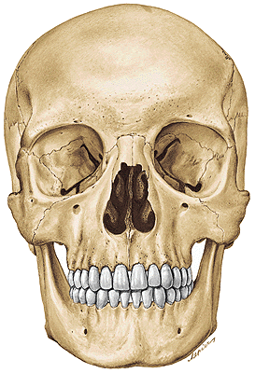
Splanchnocranium
Lecture 5
Dentistry Autumn 2015
RNDr. Michaela Račanská, Ph.D.

Slide 2
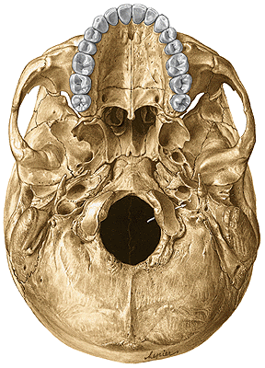
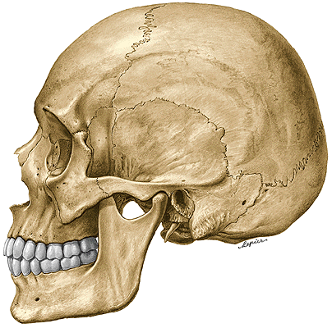
Splanchnocranium
Maxilla
Os nasale
Os lacrimale
Os zygomaticum
Vomer
Os palatinum
Concha nasalis inferior
Mandibula
Os hyoideum

Slide 3
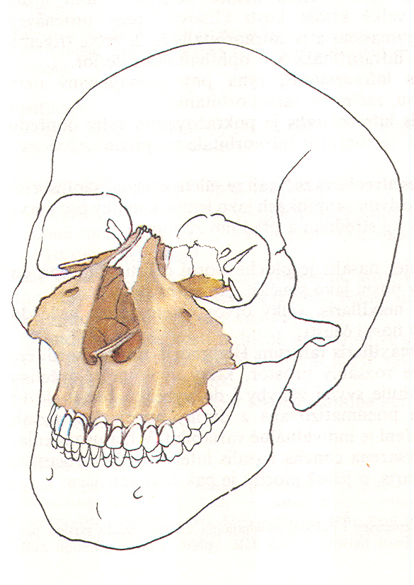
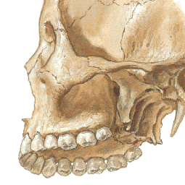
Maxilla
Corpus maxillae
Facies anterior
Facies nasalis
Facies orbitalis
Facies infratemporalis
Processus maxillae
Processus frontalis
Processus zygomaticus
Processus alveolaris
Processus palatinus

Slide 4
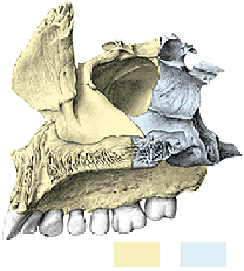
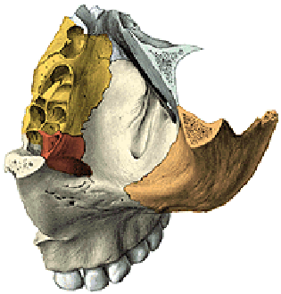
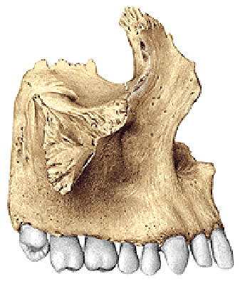
Corpus maxillae
Facies infratemporalis
Facies anterior
foramen infraorbitale
fossa canina
incisura nasalis
spina nasalis anterior
Facies orbitalis
margo infraorbitalis
sulcus infraorbitalis
canalis infraorbitalis
(canales alveolares)
Facies nasalis
crista infrazygomatica
tuber maxillae
foramina et canales alveolares
sinus maxillaris
hiatus maxillaris
(antrum Highmori)

Slide 5
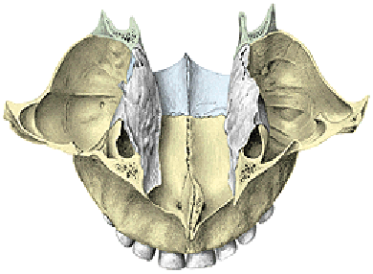
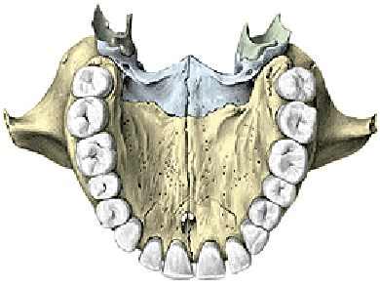
Processus frontalis maxillae
Incisura nasalis
(apertura piriformis)
Crista lacrimalis anterior
Crista ethmoidalis
Crista conchalis
Processus zygomaticus maxillae
Processus palatinus maxillae
Os incisivum (praemaxilla)
Foramen incisivum
Canalis incisivus
Crista nasalis
Torus palatinus

Slide 6
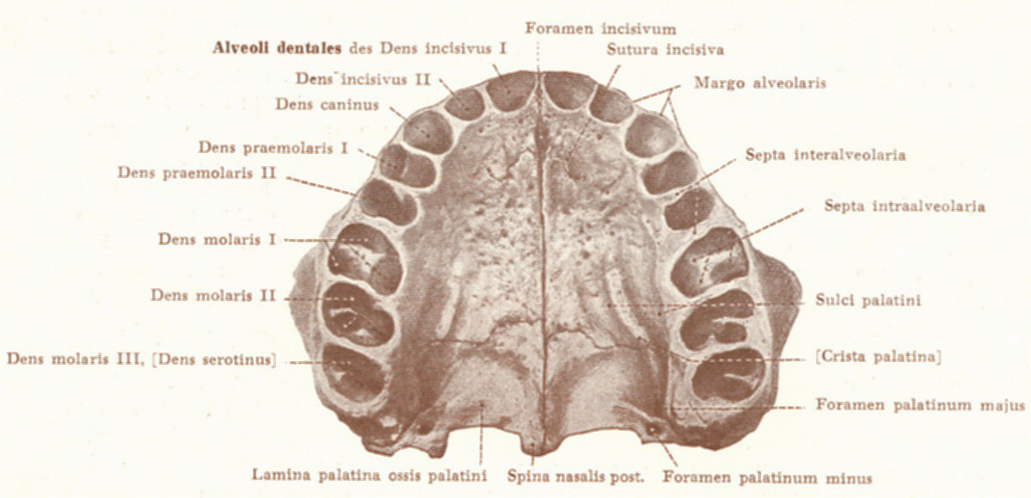
Processus alveolaris maxillae
Arcus alveolaris
Alveoli dentales
Juga alveolaria
Septa interalveolaria
Septa intraalveolaria

Slide 7
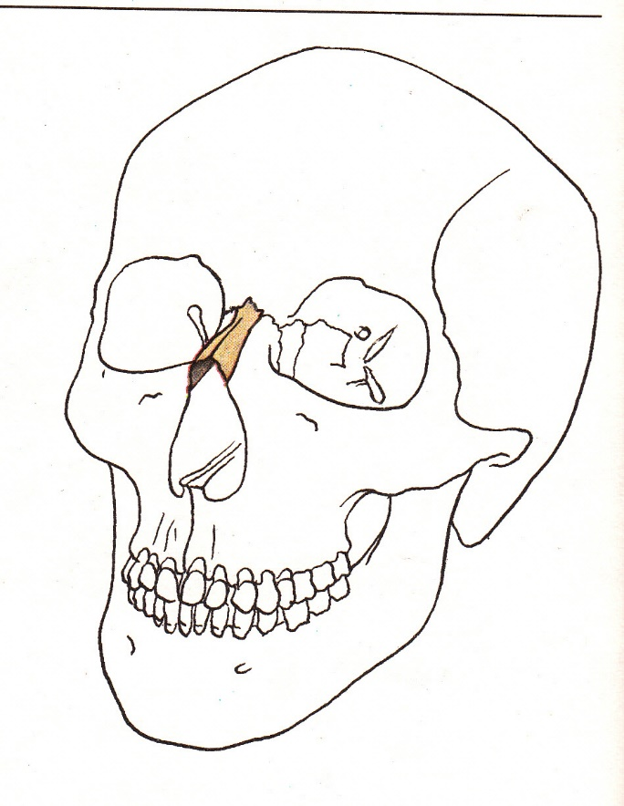
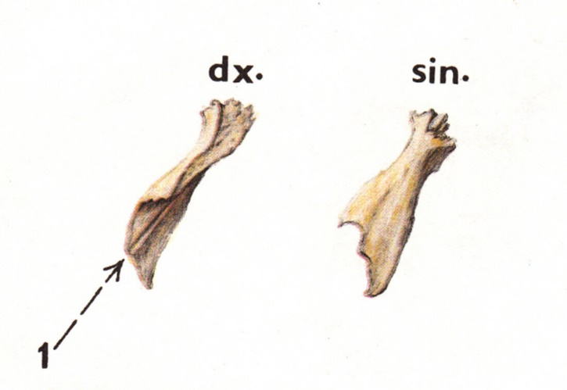
Os nasale
Sulcus ethmoidalis

Slide 8
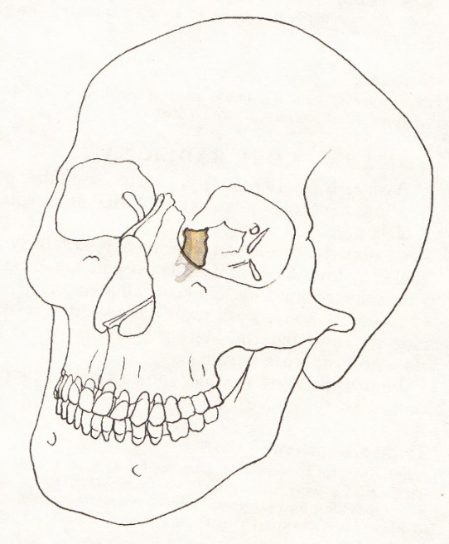
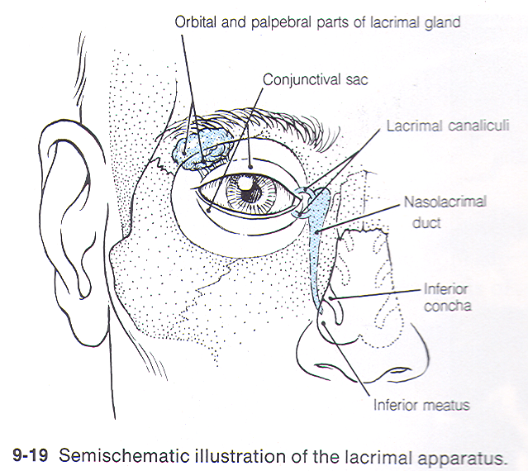
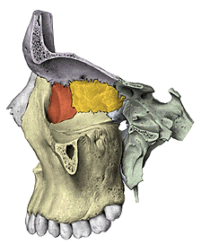
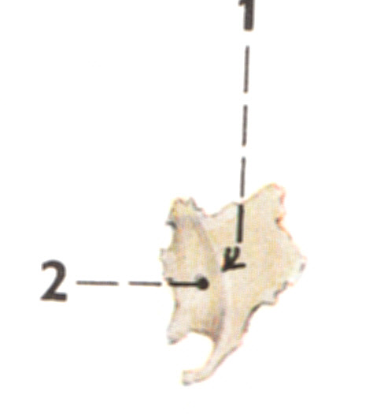
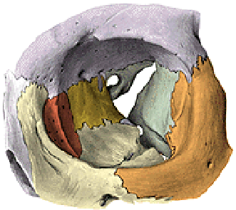
Os lacrimale
Crista lacrimalis posterior
Sulcus lacrimalis
Fossa sacci lacrimalis
Canalis nasolacrimalis
Hamulus lacrimalis

Slide 9
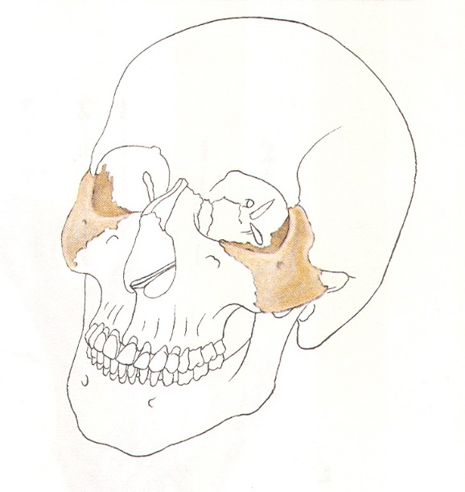
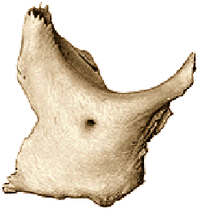
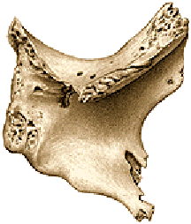
Os zygomaticum
Corpus
Facies lateralis - foramen zygomaticofaciale
Facies orbitalis - foramen zygomaticoorbitale
Facies temporalis - foramen zygomaticotemporale
Processus maxillaris, frontalis, zygomaticus
Arcus zygomaticus

Slide 10
Os zygomaticum bipartitum (os japonicum) – sutura (mostly horizontal one).

Slide 11
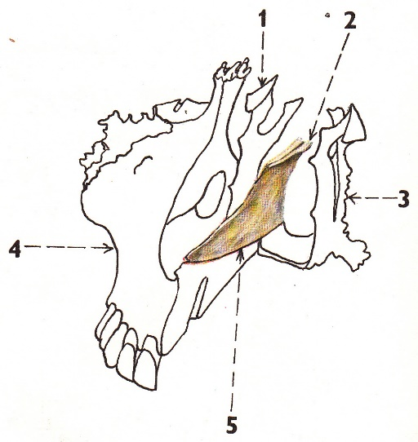
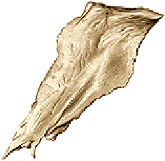
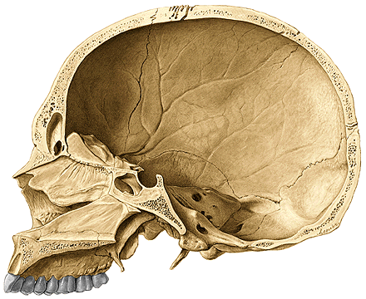
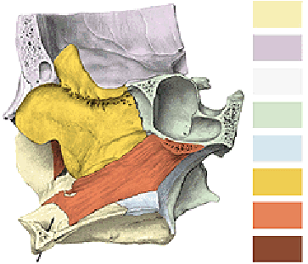
Vomer
Alae vomeris (rostrum ossis sphenoidalis)

Slide 12
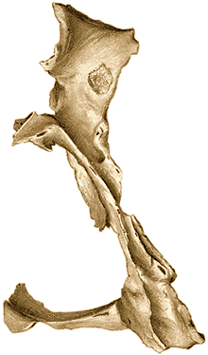
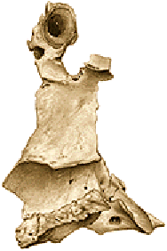
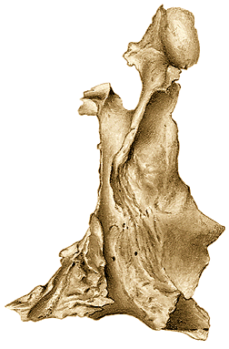
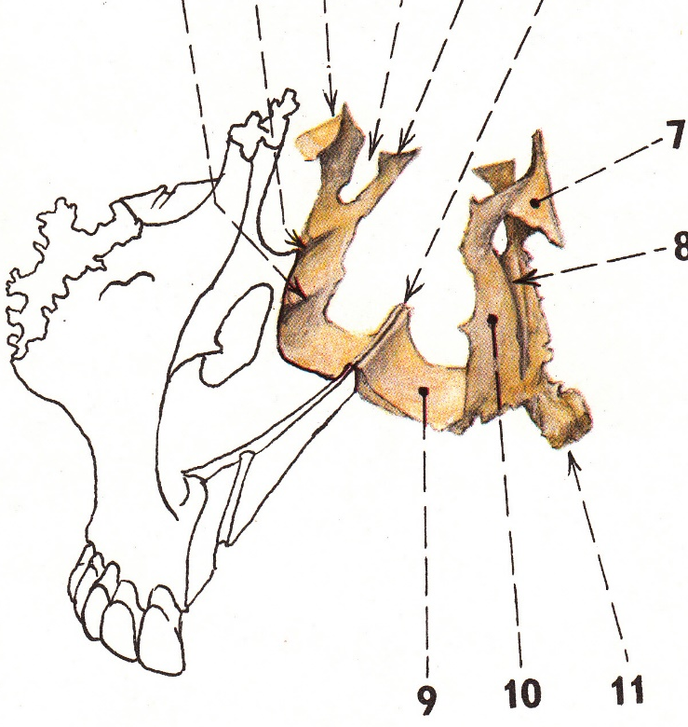
Os palatinum
Lamina horizontalis
Spina nasalis posterior
Crista nasalis
Foramen palatinum majus
Processus pyramidalis
Foramina palatina minora
Lamina perpendicularis
Crista conchalis
Crista ethmoidalis
Processus orbitalis et sphenoidalis
Incisura (foramen) sphenopalatinum
Sulcus palatinus major (pterygopalatinus)

Slide 13
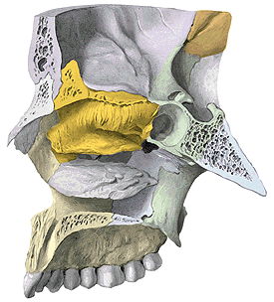
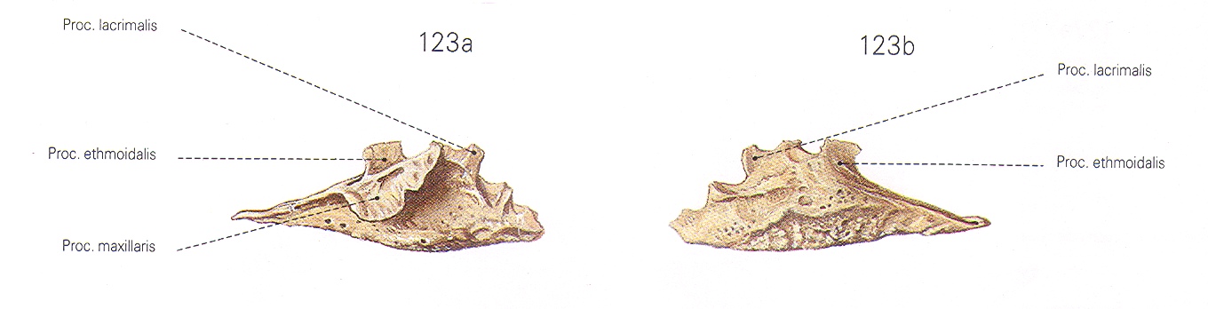
Concha nasalis inferior
Processus maxillaris
Processus lacrimalis
Processus ethmoidalis

Slide 14
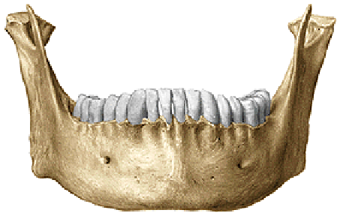
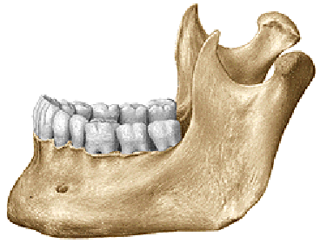
Mandibula
Corpus mandibulae (basis mandibulae)
Ramus mandibulae dx. et sin.
Angulus mandibulae dx. et sin.

Slide 15
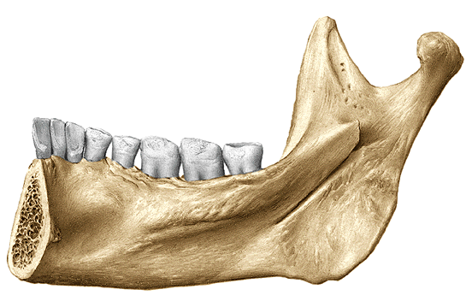
Corpus mandibulae
Fossa digastrica
Spina mentalis (sup. et inf.)
Linea mylohyoidea
Fovea sublinqualis
Fovea submandibularis
Crista buccinatoria
Trigonum retromolare

Slide 16
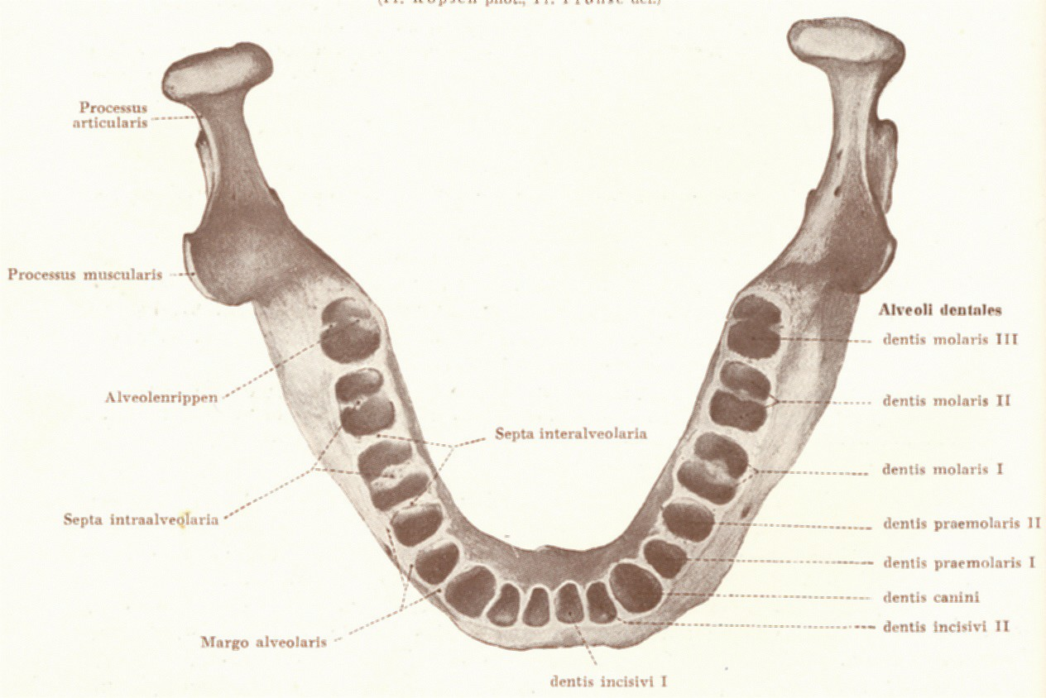
Corpus mandibulae
Tuberculum mentale
Protuberantia mentalis
Foramen mentale
Linea obliqua (trigonum retromolare)
Pars alveolaris
Alveoli dentales, juga alveolaria
Septa interalveolaria, intraalveolaria

Slide 17
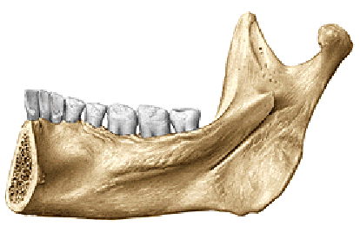
Ramus mandibulae
Processus condylaris
Caput mandibulae
Collum mandibulae
Fovea pterygoidea
Processus coronoideus
Incisura mandibulae
Foramen mandibulae
Canalis mandibulae
Lingula mandibulae
Sulcus mylohyoideus

Slide 18
Angulus mandibulae (120º-125º)
Tuberositas masseterica
Tuberositas pterygoidea

Slide 19
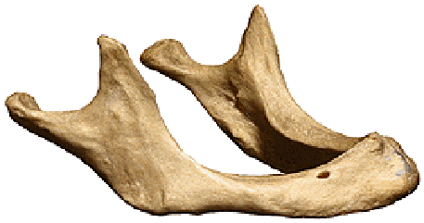
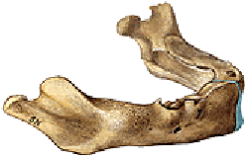
Mandible of the newborn
Mandible of an senilis

Slide 20
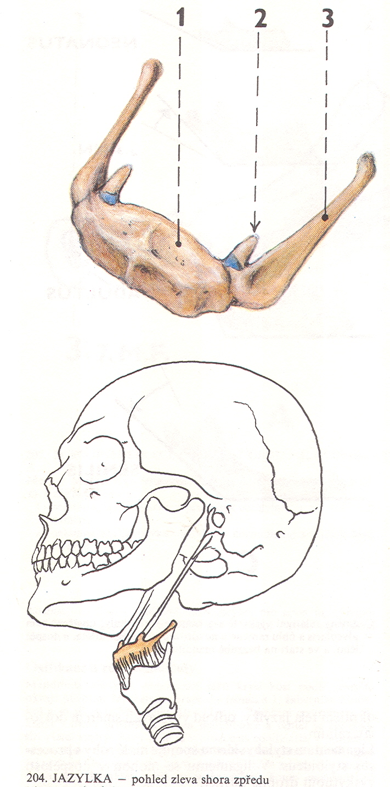
Os hyoideum
Corpus ossis hyoidei
Cornua minora ossis hyoidei
Cornua majora ossis hyoidei

Slide 21
Skull cavities
Lecture 6
Dentistry Autumn 2015
RNDr. Michaela Račanská, Ph.D.

Slide 22
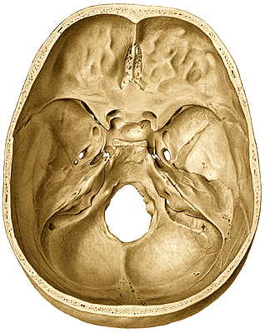
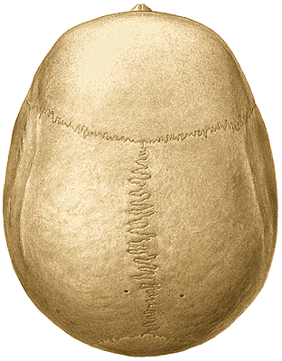
Calvaria
Basis cranii

Slide 23
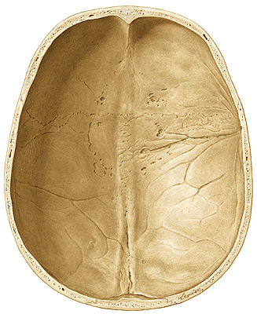
Calvaria
frons, vertex, occiput
sutura sagittalis, coronalis, lambdoidea, squamosa
tubera frontalia, parietalia
linea temporalis superior et inferior,
foramina parietalia
impressiones gyrorum
juga cerebralia
foveolae granulares
sulci arteriosi
sulcus sinus sagitalis superior
sulcus sinus transversi

Slide 24
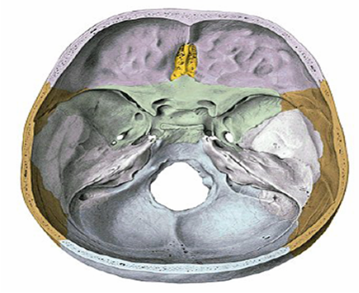
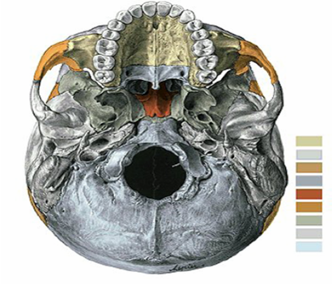
Basis cranii interna
Basis cranii externa
Notes:
Basis interna cranii

Slide 25
BASIS CRANII INTERNA
Fossa cranii anterior
Fossa cranii media
Fossa cranii posterior

Slide 27
BASIS CRANII EXTERNA
Fossa cranii anterior
Fossa cranii media
Fossa cranii posterior

Slide 28
FOSSAE CRANII
FOSSA TEMPORALIS
FOSSA INFRATEMPORALIS
FOSSA PTERYGOPALATINA
ORBITA
CAVITAS NASI OSSEA
CAVUM ORIS

Slide 29
Fossa temporalis
Medial wall
linea temporalis superior (os frontale, os parietale)
facies temporalis alae majoris ossis sphenoidalis
pars squamosa ossis temporalis
Ventral wall
facies temporalis ossis zygomatici (processus frontalis)
processus zygomaticus ossis frontalis
Lateral wall
arcus zygomaticus
crista infratemporalis
Content
m. temporalis + nerves + vessels
Conections
orbita fissura orbitalis inferior
fossa infratemporalis

Slide 30
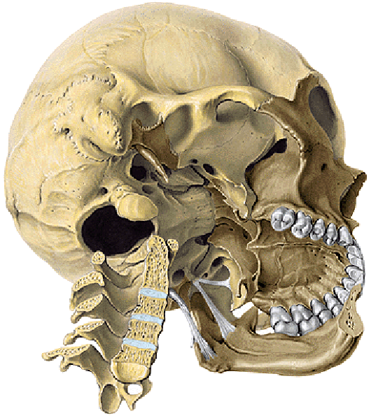
Roof
Crista infratemporalis
Facies infratemporalis alae majoris ossis sphenoidalis
Medial wall
Lamina lateralis processus pterygoidei
Lateral wall
Ramus mandibulae
Ventral wall
Facies infratemporalis corporis maxillae (tuber maxillae)
Content
mm. pterygoidei + nerves + vessels
Openings
foramen ovale
foramen spinosum
foramen mandibulare
fissura orbitalis inferior
Fossa infratemporalis

Slide 31
Fossa pterygopalatina
Roof
Facies maxillaris alae majoris ossis sphenoidalis
Medial wall
Lamina perpendicularis ossis palatini
Ventral wall
tuber maxillae
Dorsal wall
Processus pterygoideus ossis sphenoidalis
Content
Vessels and nerves (ganglion pterygopalatinum)

Slide 32
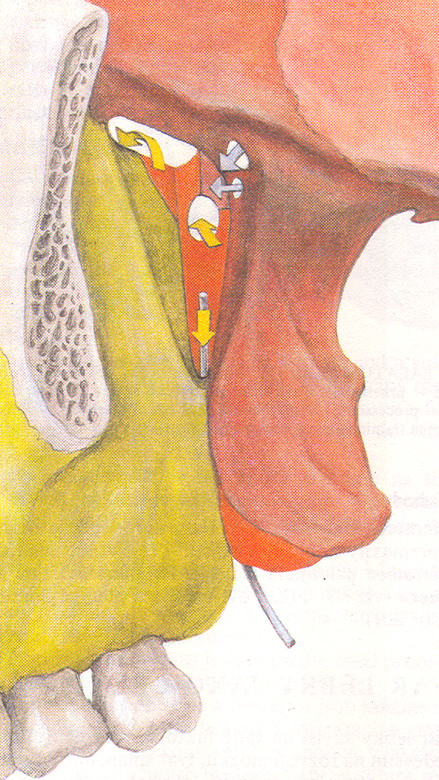
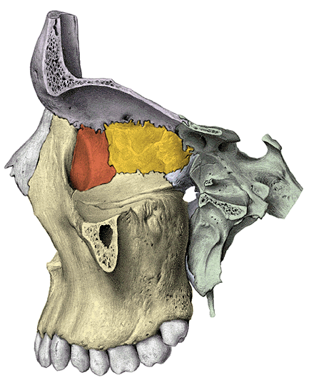
Fossa pterygopalatina – openings and communications
foramen rotundum
fossa cranii media
canalis palatinus major
cavum oris
fissura orbitalis inferior
orbita
foramen sphenopalatinum
cavum nasi osseum
canalis pterygoideus
basis cranii externa

Slide 33

Fossa pterygopalatina

Slide 34
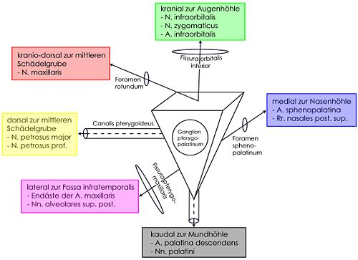

Slide 35
Orbita
Aditus orbitae (base)
margo supraorbitalis, infraorbitalis
Apex
Canalis opticus
Roof
pars orbitalis ossis frontalis
ala minor ossis sphenoidalis
(fovea trochlearis, fossa glandulae lacrimalis)
Floor
facies orbitalis corporis maxillae
(sulcus & canalis infraorbitalis)
facies orbitalis ossis zygomatici
processus orbitalis ossis palatini

Slide 36
Lateral wall
facies orbitalis ossis zygomatici
facies orbitalis alae majoris ossis sphenoidalis
openings: fissura orbitalis superior
fissura orbitalis inferior
foramen zygomaticoorbitale
Medial wall
processus frontalis maxillae
os lacrimale
lamina orbitalis ossis ethmoidalis
(fossa sacci lacrimalis)
ala minor ossis sphenoidalis
openings: foramen ethmoidale anterius
foramen ethmoidale posterius

Slide 37
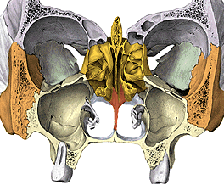
Cavitas nasi ossea
Apertura piriformis
Choanae
Roof
Floor (palatum durum)
Medial wall (septum nasi)
Lateral wall (3 layers)

Slide 38
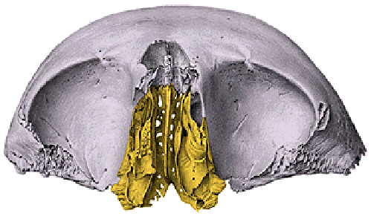

Roof: ossa nasalia,
pars nasalis ossis frontalis,
lamina cribrosa ossis ethmoidalis,
corpus ossis sphenoidalis
Floor: (palatum durum)
processus palatini maxilae
lamina horizontalis ossis palatini
(os incisivum)
Notes:
Strop nosní dutiny

Slide 39
Medial wall (septum nasi)
lamina perpendicularis ossis ethmoidalis
vomer

Slide 40


Lateral wall
Lateral layer
processus frontalis maxillae
corpus maxillae
lamina medialis processus pterygoidei
Middle layer
os lacrimale
lamina perpendicularis ossis palatini
Medial layer
concha nasalis inferior
labyrinthus ethmoidalis
(concha nasalis superior et media,
bulla ethmoidalis, processus uncinatus)

Slide 41


Meatus nasi:
Meatus nasi superior:
Above concha nasalis media
celullae ethmoidales posteriores
sinus sphenoidalis
Meatus nasi medius:
between concha nasalis media and concha nasalis inferior
sinus frontalis
sinus maxillaris
celullae ethmoid. ant. et med
Meatus nasi inferior:
bellow concha nasalis inferior
Meatus nasi communis:
Between margines of conchae
and septal part
Meatus nasopharyngeus
Behind posterior margines of conchae and choanas

Slide 42



Cavum oris osseum
Roof (palatum durum)
processus palatinus maxillae
os incisuvum
lamina horizontalis ossis palatini
Lateral and anterior walls
processus alveolares maxillae and mandibulae
Floor–
Muscles!!!!!!!

Slide 43


X-ray of the head

Slide 44
Head axial projection
sagittal suture
lambdoid suture
frontal sinus
roof of right orbit
cribriform plate
supraorbital margin
fronto-zygom. suture
superior orbital fissure
right orbit
zygomatic arch
ethmoidal air cells
superior border of petrous bone
nasal septum
maxillary sinus
inferior nasal concha
mastoid air cells
maxilla
nasal septum
mastoid process
nasal aperture
ramus of mandible
mandibular canal
angle of mandible
tooth

Slide 45
Head lateral projection
compact bone (lamina ext. et int.)
spongy bone (diploe)
coronal suture
lambdoid suture
frontal sinus
hypoglossal fossa
nasal bone
dorsum sellae
sphenoid sinus
petrosal bone
external/internal acoustic meatus
maxillary sinus
condylar process
ant. nasal spine
palatine process of maxilla
ramus of mandible
C2
angle of mandible
body of mandible
mandibular canal

Slide 46

Newborn skull
Neurocranium : Splanchnocranium
8 : 1

Slide 47

Newborn skull
capacity 370 ccm
circumference 34 cm
length 11-12 cm, width 9-10 cm
big neurocranium
fonticuli (major, minor, sphenoidalis, mastoideus)
low splanchnocranium
without processus alveolares (maxillae et mandibulae)
without paranasal sinuses
sutura frontalis
anulus tympanicus
symphysis menti
mandibular angle 150 - 170º

Slide 48

Gender differences of the skull
glabella, arcus superciliares
tubera frontalia and parietalia
processus mastoideus
protuberantia occipitalis externa (regio nuchae)
protuberantia mentalis
tuberositas masseterica
processus alveolares

Slide 49
The pictures used in this lecture were taken from following sources:
Putz, R. (2008):
Atlas of Human Anatomy Sobotta. Elsevier Books.
Keith L. Moore, Arthur F. Dalley (2005):
Clinically Oriented Anatomy. Williams and Wilkins.
Platzer, W., Kahle, W., Leonhardt H. (1992):
Locomotor system. Georg Thieme Verlag, Stuttgart,
New York, 4th edition.
Čihák, R. (1987): Anatomie 1. Avicenum, Zdravotnické nakladatelství.
Netter, F. H. (1997):
Interactive Atlas of Clinical Anatomy. Novartis, USA.

