Slide 1
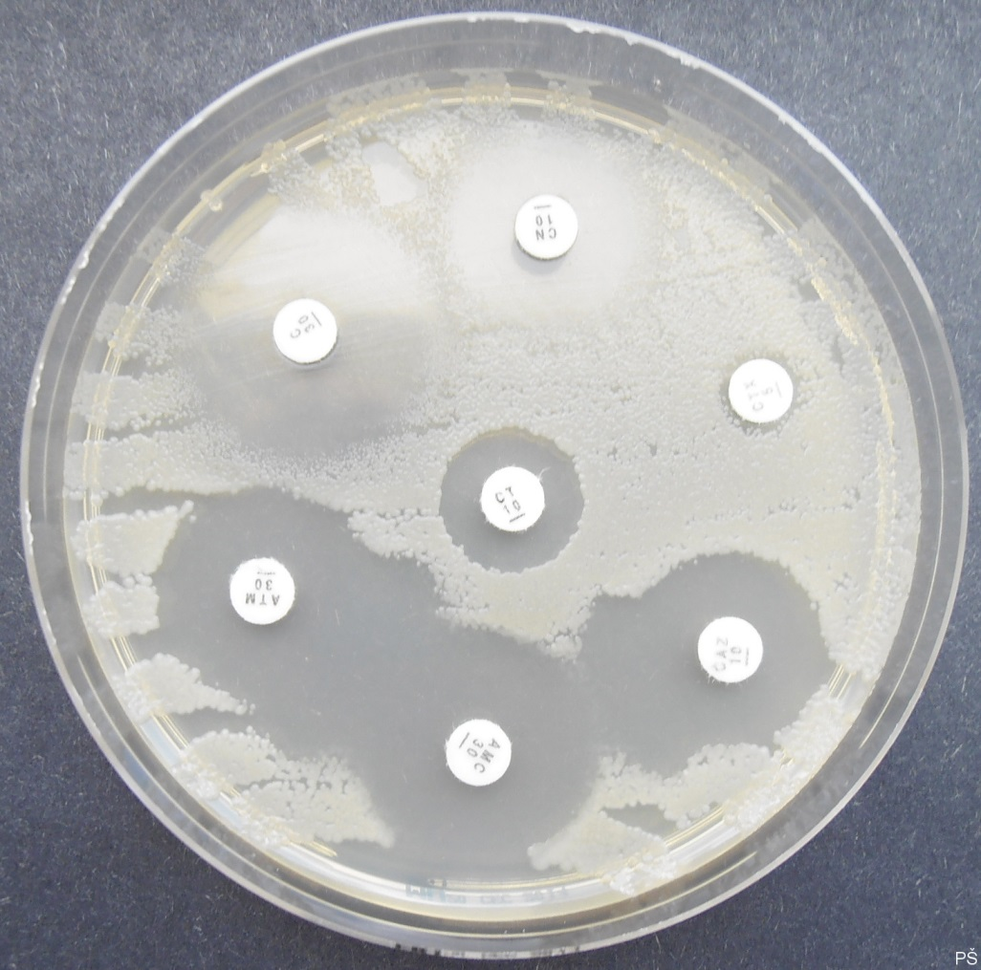
Detection of Extended-Spectrum β-Lactamases (ESBLs) producers
Double disc synergy test - Synergism among amoxicillin-clavulanate (AMC) disc and other antibiotics (ceftazidime and aztreonam in this case)

