Slide 1
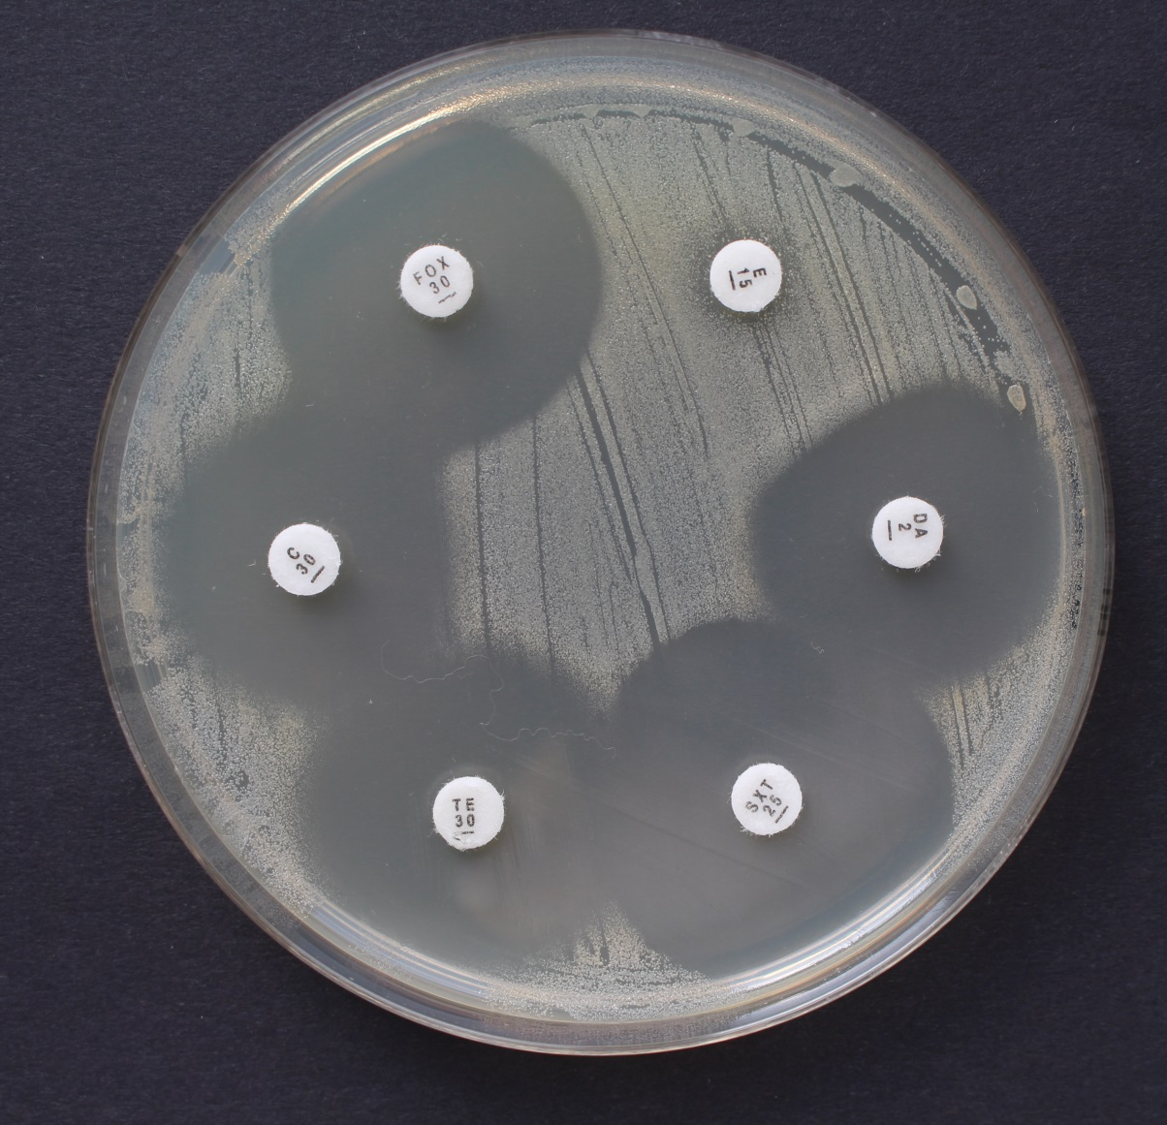
Inducible resistance
Induction among erythromycin (E) and clindamycin (DA) disk

