Slide 1
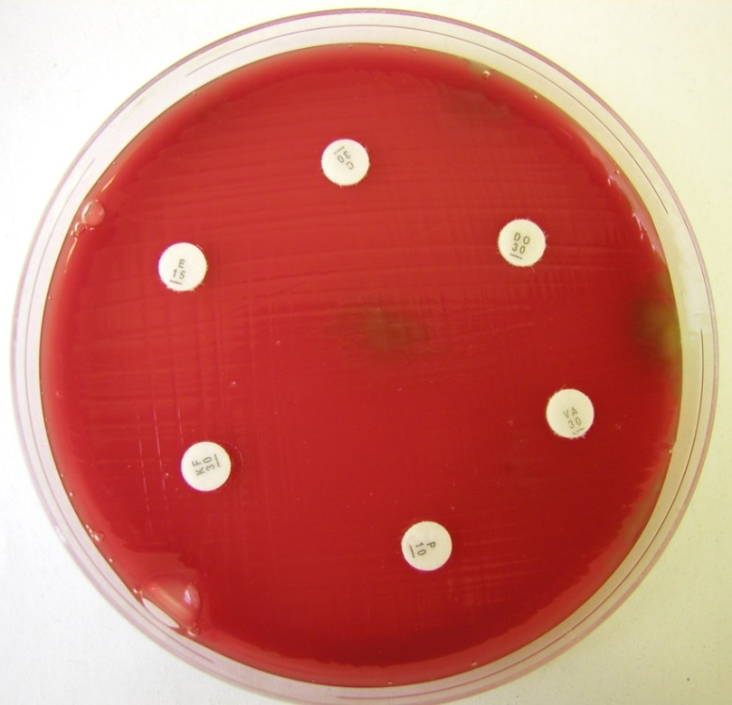
Susceptibility to antibiotics
Disc diffusion susceptibility testing for pneumococcus

