Slide 1
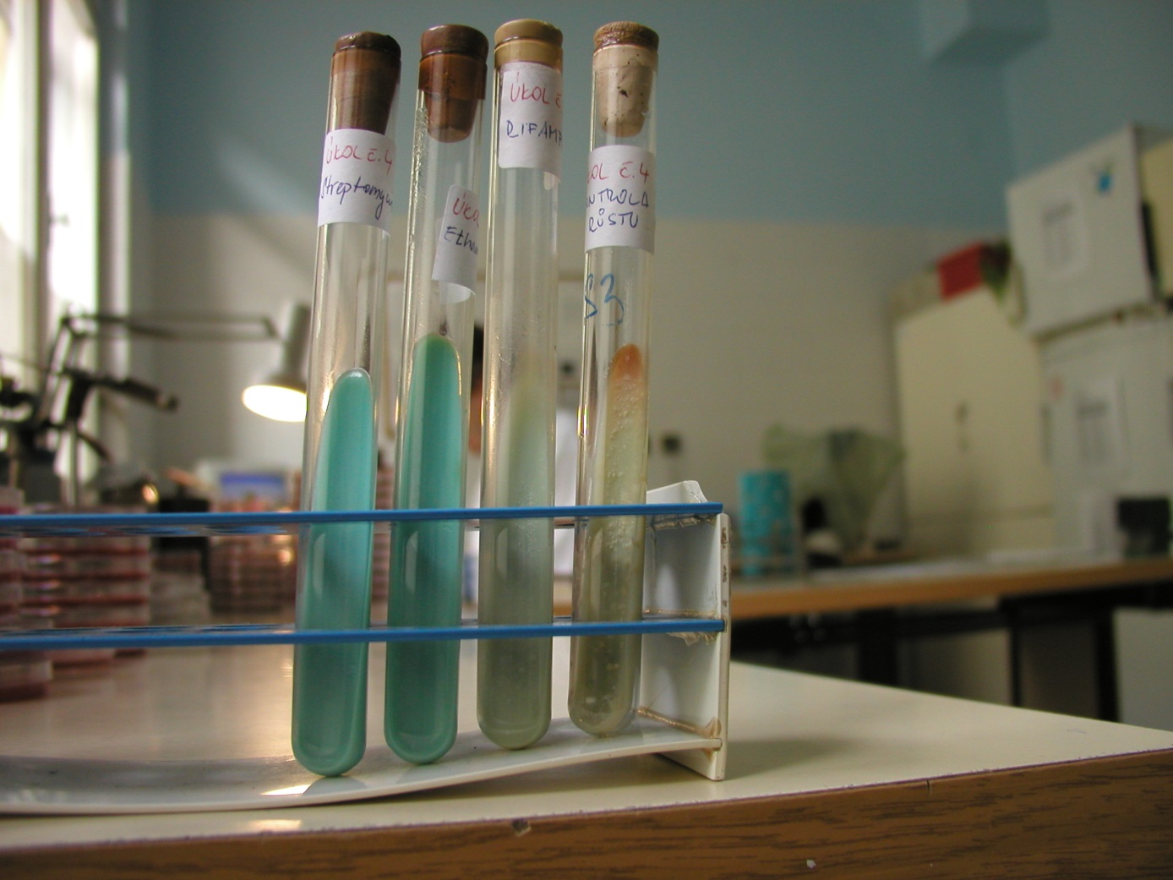
Susceptibility to mycobacteria
Antituberculotics

