Slide 1
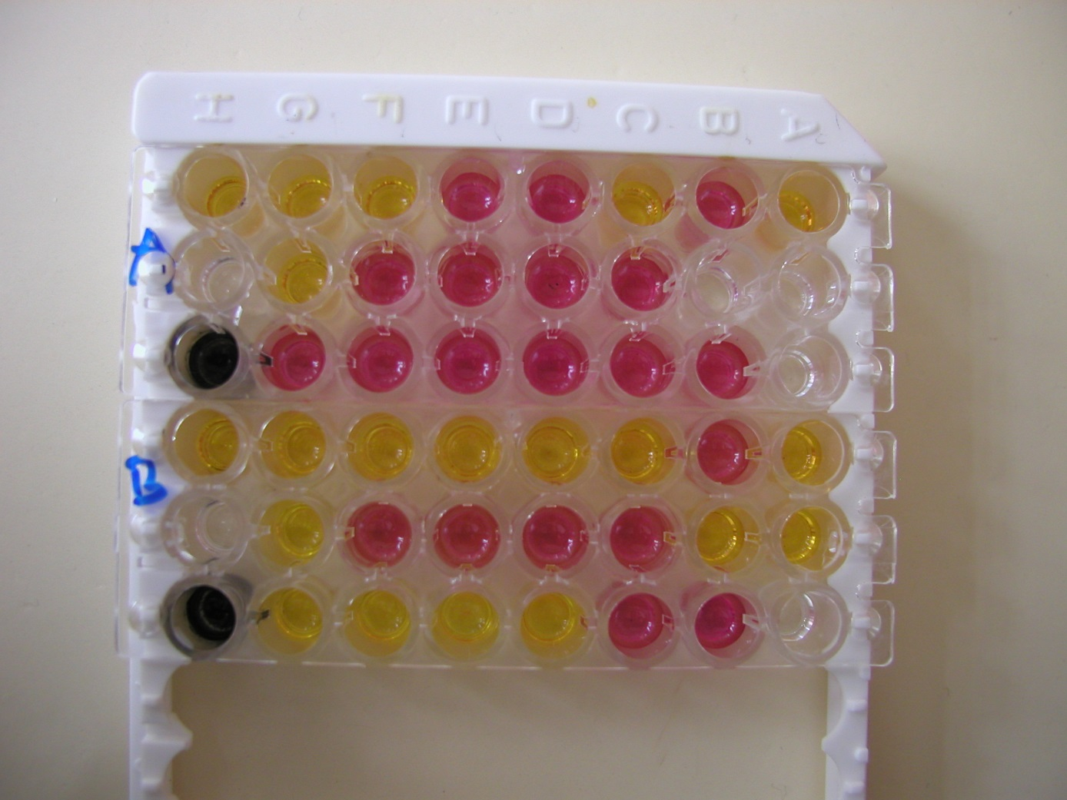
Anaerotest
Biochemical test used for anaerobes identification

