Slide 1
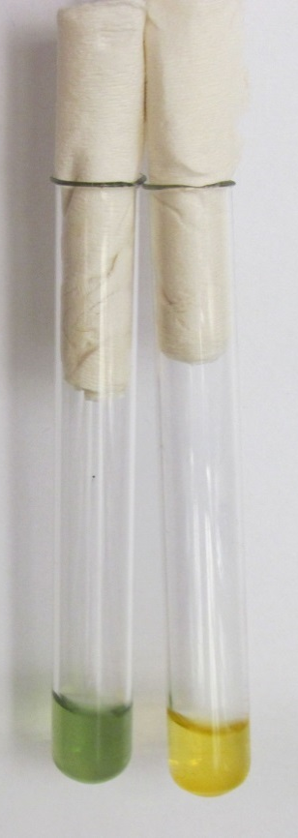
Arabinose test
Simple test used for E. faecalis (green) and E. faecium (yellow) differentiation

