Slide 1
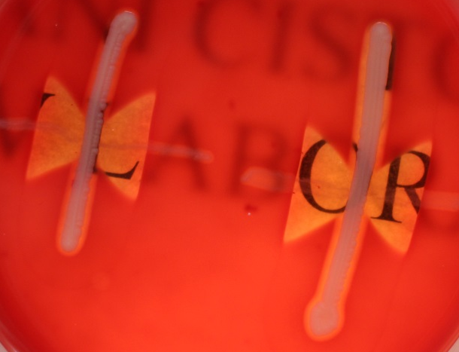
CAMP test
S. agalactiae is CAMP-positive
Beta-haemolysis leads to complete brightening of blood agar

