Slide 1
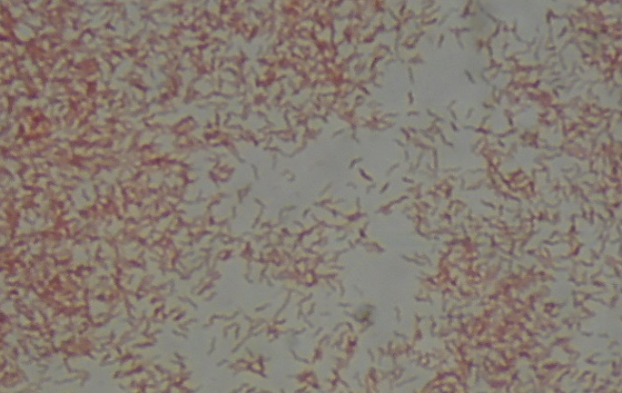
Campylobacter sp.
Gram-negative curved rods

