Slide 1
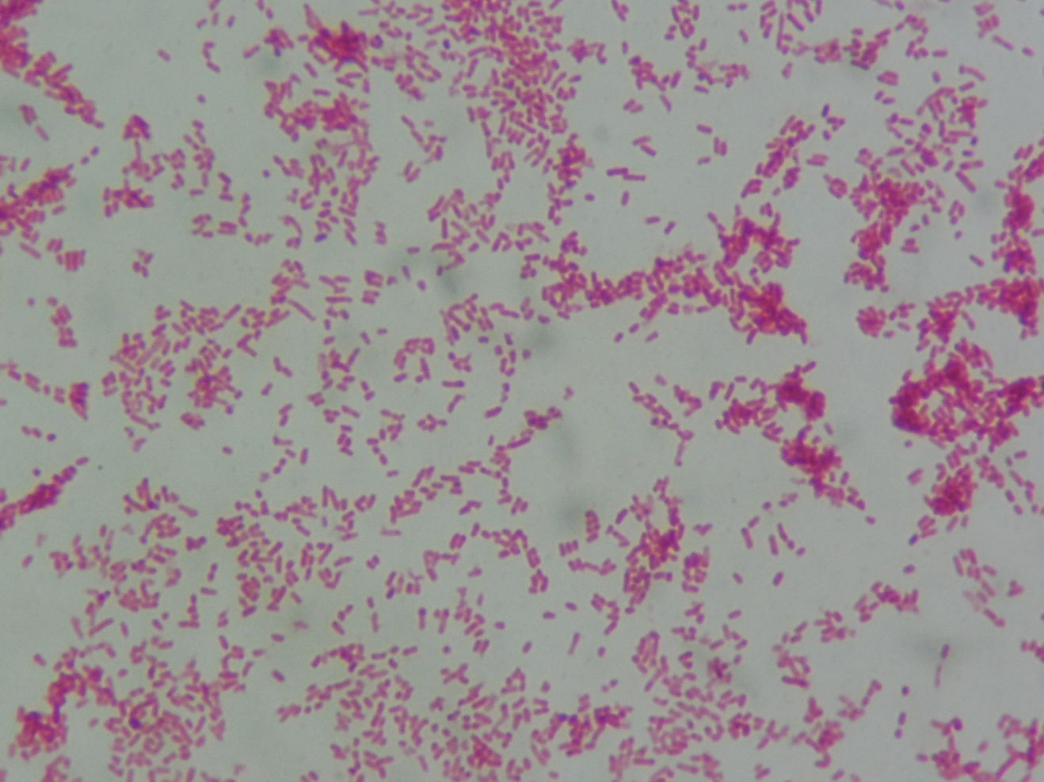
Escherichia coli
Gram-negative rods

