Slide 1
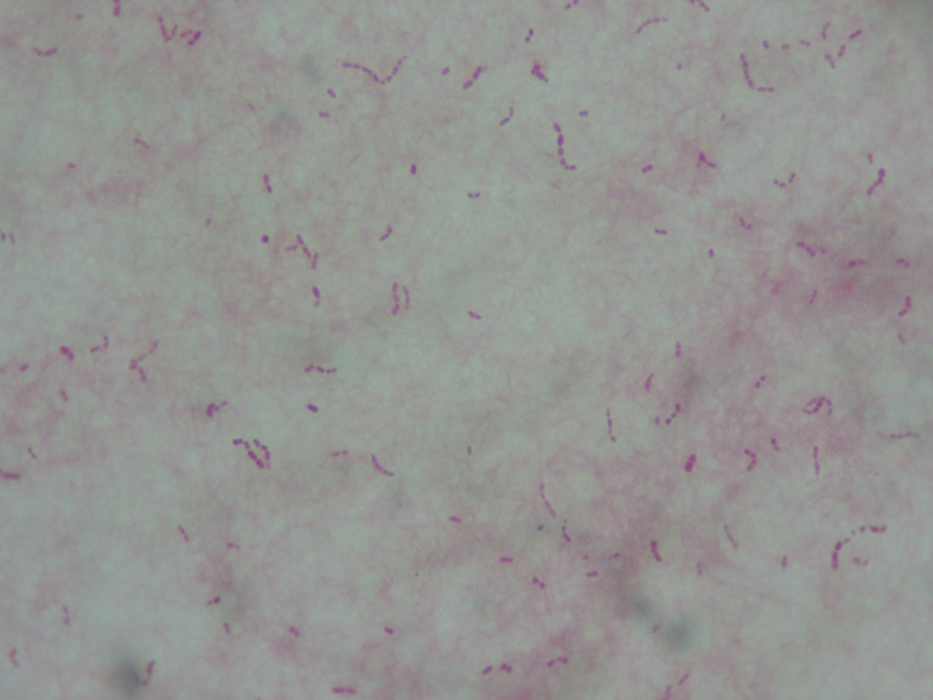
Legionella pneumophila
Gram-negative short rods

