Slide 1
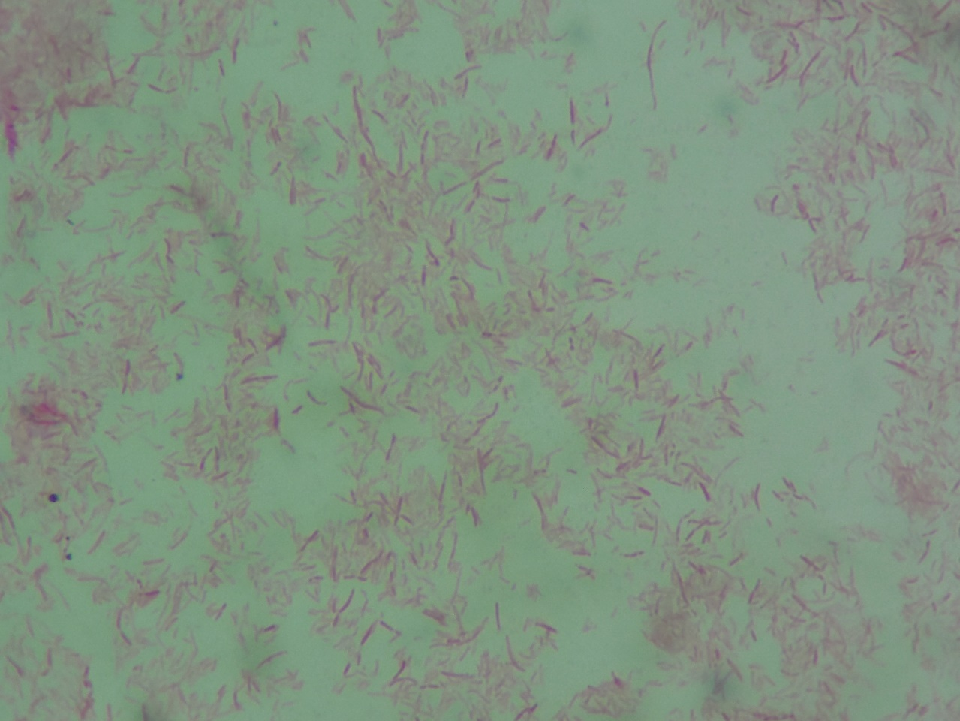
Pseudomonas aeruginosa
Gram-negative rods

