Slide 1
Latin and greek prefixes + suffixes
Based on presentation by E. Dávidová

Slide 2
Decide whether the following statements are true or false:
Statement | answer
1) Dis- is used for “a disorder”, and dys- for “division”, “removal/loss” and “negation”. | T/F
2) The Latin equivalent to the prefix endo- is extra-. | T/F
3) The prefix ana- has two meanings: “division” and “again” (e.g. anatomia, anamnesis). | T/F
4) The prefix af- is a variety of the prefix ab- (e.g. vasa afferentia). | T/F
5) The prefixes ante- and anti- have the same meanings. | T/F
6) The prefix hyper- means “deficient” or “decreased”. | T/F
7) The prefix dia- has three meanings: “division”, “through” and “between” (e.g. diagnosis, diameter, diaphragma). | T/F

Slide 3
Decide whether the following statements are true or false:
Statement | answer
1) It is possible to distinguish noun and adjective suffixes (e.g. obesitas, tonsillaris). | T/F
2) The ending of the suffix determines the declension (e.g. arthrosis, flexura, ligamentum). | T/F
3) The diminutive is a word which relates to an object of the bigger size. | T/F
4) The diminutive always keeps the gender of the word which it comes from (e.g. canalis – canaliculus). | T/F
5) It does not matter whether the suffix –alis or –aris is used to express relation to the noun. | T/F
6) The suffix –or has the meaning of an “agent” and is usually used to name bones. | T/F

Slide 4
MATCH THE PREFIXES WITH THEIR MEANING:
a/an-
peri-
epi-/ep-
post-
super-
para-/par-
cata-
at, near to
from up to down
after, behind
around
at, on, over
negation

Slide 5
MATCH THE SUFFIXES WITH THEIR MEANING:
isease full of
relation (a Latin suffix)
equipped with
Inflammation state
disease/pathological state
relation (a Greek suffix)
tumour
-iasis
-alis
-icus
-atus
-itas
-ia
-oma
-itis
-osus

Slide 6
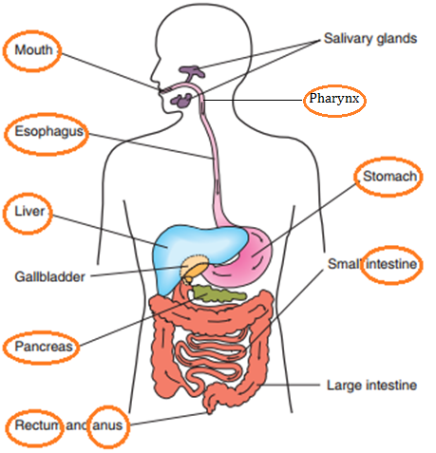
USE THE SUFFIXES TO DERIVE ADJECTIVES FROM NOUNS:
-alis -aris -inus -eus -aneus -icus -arius

Slide 7
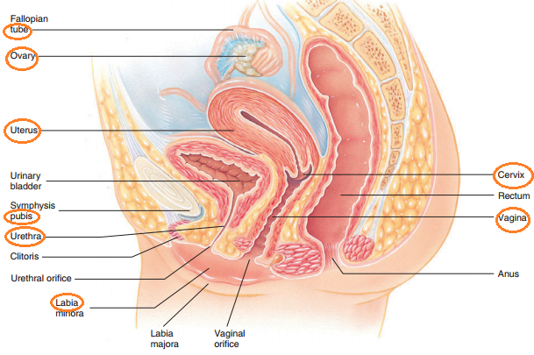
-alis -aris -inus -eus -aneus -icus -arius

Slide 8
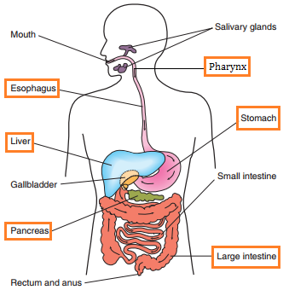
DERIVE TERMS FOR INFLAMMATIONS OF THE FOLLOWING ORGANS:

Slide 9
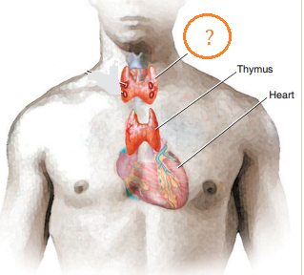
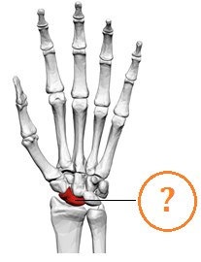
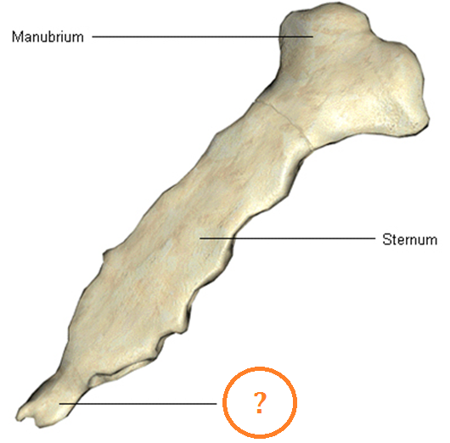
FORM ADJECTIVES WITH MEANING “SIMILAR TO”:
Thyreos (shield):
Glandula thyroidea
Skafe (boat):
Os scaphoideum
Xifos (sword):
Processus xiphoideus

Slide 10
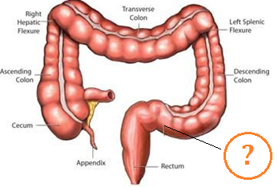
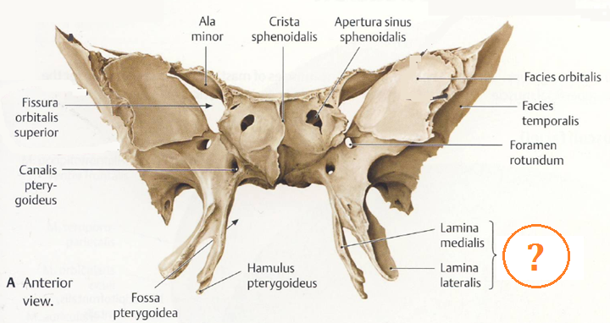
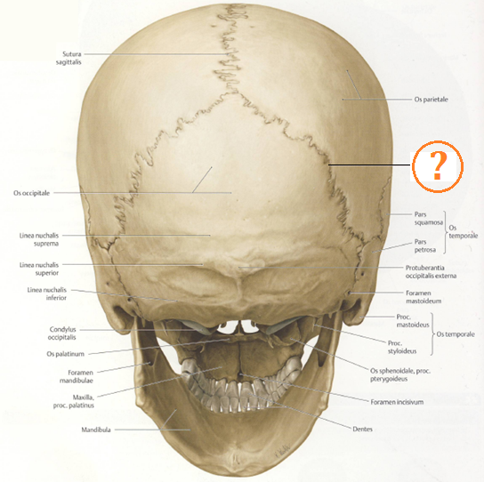
Sigma (Greek letter Σ):
Colon sigmoideum
Pteryx, gen. pterygos (wing):
Processus pterygoideus
Lambda (Greek letter Λ):
Sutura lambdoidea

Slide 11
Divide each term into its components. Write these components into boxes in the table. You may not need all of the boxes provided:
terms | prefix | root 1 | root 2 | suffix 1 | suffix 2
periorbitalis
graviditas
cholelithiasis
posttraumaticus
superficialis
parotis
catarrhalis
epigastricus
anaemia

Slide 12
FORM FIVE TERMS BY COMBINING THE FOLLOWING PREFIXES/ROOTS/SUFFIXES:
IM-
-NEPHR-
DYS-
-MUN-
-CAPIT-
-IA
-CELL-
-ITIS-
-ITAS
INTRA-
-ALIS
-PEPS-
-ARIS
PERI-
-UL-
SUB-

