Slide 1
Word Formation in MT II.

Slide 2
EXPLAIN THE MEANING OF DERIVED WORDS
phlebitis
arteriectomia
phlebotomia
vena
phlebologia
arteriosus
arteria
arteriola
venodilatans
arteriographia
myeloma
myeloides
medulla
myeloneuritis
myelopathia
pisiformis
extensio
forma
cuneiformis
piriformis
extensor
extendere
extensus
vermiformis
extensibilitas

Slide 3
FORM TERMS BASED ON DEFINITIONS
Mys, my-o-/s/-muscle
Benign tumor in a smooth muscle
Inflammation of a muscle
Formation of multiple tumors in a smooth muscle
Middle layer of the wall of the heart formed of heart muscle
Muscular tissue in the uterus
(adj.) Referring to the heart muscle
Recording the degree and strength of a muscle contraction
Record showing how a muscle is functioning
Study of muscles, their associated structures and diseases
Removal of a benign growth from a muscle (esp. on uterus)
Surgical operation to cut a muscle
Plastic surgery to repair a muscle
Notes:
Myoma – myositis – myomatosis – myocardium – myometrium – myocarditicus/myocardialis – myographia – myogramma – myologia – myomectomia – myotomia - myoplastica

Slide 4
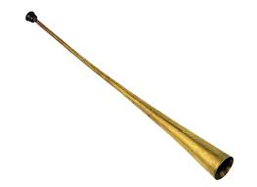
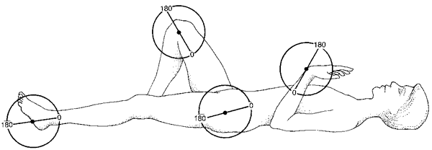
DECIDE WHETHER THE FOLLOWING STATEMENTS ARE
TRUE or FALSE
?
1) Terms colpoplastica, colposcopia and colpotomia refer to the repair of the damaged vagina, to examination of vagina and to its removal respectively.
2) Terms osteitis and ostitis have the same meaning.
4) Musculus omohyoideus originates at the superior border of the shoulder blade (omos) and inserts at the lateral border of the hyoid bone (os hyoideum).
3) The Greek combining element salping-o- (gr. trumpet, tube) refers to: (a) the Fallopian tubes, (b) the auditory meatus.
5) Goniometry is the measurement of angles, particularly those of range of motion of a joint.
Notes:
Gonia – uhol/angle

Slide 5
EXPLAIN THE DIFFERENCE IN MEANING
Poliomyelitis : Polymyositis
Parodontitis : Parotitis
Cheiloplastica : Cheiroplastica
Somatologia : Stomatologia
Spondylitis : Spondylomyelitis
Hysterectomia : Metrectomia
Laryngotomia : Laryngostomia
Perinephritis : Perineuritis

Slide 6

FILL IN MISSING COMPOUND WORDS
Greek combining form for “cure, healing” is __________________. In medical field it is synonymous with word “treatment”. When disease is treated by exposition of the body (part) to the radiation it is __________________, when cancer is treated by specific chemical agents that are selectively destructive to malignant cells and tissues we call it __________________.
The Greek combining element __________________ (mouth, opening) has a specialized usage in medical terminology. In surgical procedures a formation of a passage between any two normally distinct spaces or organs is called ana__________________. Formation of a passage between the colon and the abdominal wall is ___________________, between the bladder and the abdominal wall is ___________________.
Notes:
Therapia – radiotherapia – chemotherapia
Stoma – anastomosis – colostomia – cystostomia

Slide 7
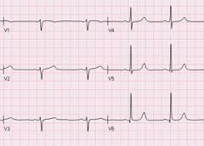
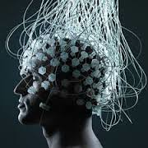
IDENTIFY ABBREVIATION
The recording of the electrical activity of the heart is known also as ECG or EKG, which means ______________________.
The same recording can be also performed on the baby’s heart, it is then called ______________________ and abbreviated as FECG. Together with it cardiotocography (CTG) is performed. These recording methods provide modest help for mothers and babies when continuous monitoring is needed during labour.
The recording of electrical activity along the scalp, which, in clinical contexts, refers to the recording of the brain's spontaneous electrical activity over a short period of time known as EEG means ______________________ .
Notes:
Electrocardiography – fetoelectrocardiography – electroencephalography
Cardiotocography – fetal heartbeat and uterine contractions (tokos = porod)

Slide 8
MATCH DEFINITIONS WITH GREEK COMBINING FORMS
The benign tumor made up of newly formed blood vessels is ?
Py-
The surgical removal of fat beneath the skin is ?
Pyr-
A toxic condition resulting from renal failure in which kidney function is compromised and urea is retained in the blood is ?
Lith-
The burning sensation caused by the return of acidic stomach contents into the oesophagus is called heartburn or ?
Haem-at-
Hydr-
Condition in which excess cerebrospinal fluid accumulates in the ventricles of the brain is ?
Lip-
The surgical removal of a kidney stone through an incision into the kidney is ?
Ur-
An accumulation of pus in the Fallopian tube is ?
Notes:
Haemangioma – pyrosis - hydrocephalus – lipectomy - Pyosalpinx – Nephrolithotomy – Uraemia -

Slide 9
FORM COMPOUND TERMS WITH THE GIVEN GREEK ELEMENT
-ALGIA: “pain, ache, suffering” of the body part or organ
e. g. dorsalgia – back pain
Pain in the JOINT(S)
Arthr-algia
STOMACH pain
Gastr-algia
Pain along the course of NERVE(S)
Neur-algia
TOOTHache
Odont-algia
Pain in the HIP JOINT
Cox-algia
HEADache
Cephal-algia
Pain in the UTERUS
Metr-algia
Pain in the BREAST
Mast-algia/Mamm-algia
Pain in the SMALL INTESTINE
Enter-algia
Notes:
+ ODYNIA je synonymum!!!!

Slide 10
EXPLAIN THE MEANING OF COMPOUND and DERIVED WORDS
-LYSIS : 1) Biochemistry: dissolution, destruction of cells
2) Medicine: gradual subsiding of the symptoms of an acute disease
Pyretolysis
Reduction of fever
Analysis
Separation of a subst. into constituent elements
Haemolysis
Disintegration of red blood cells
Spondylolysis
Defect in the connection between vertebrae
Spasmolysis
Relaxation of muscle spasms
Dialysis
Separation of smaller and larger molecules
Osteolysis
Dissolution or degeneration of bone tissue
Necrolysis
Disintegration and dissolution of dead tissue
Bacteriolysis
Dissolution or destruction of bacteria

Slide 11
EXPLAIN THE MEANING OR DERIVE THE COMPOUND WORD
-PATHIA : disease, disorder
-PTOSIS : dropping, prolapse
Psychopathia
Prolapse of the uterus
Disease of the heart
Gastroptosis
Neuropathia
Prolapse of the Fallopian tube(s)
Disease of the cartilage
Colonoptosis
Angiopathia
Prolapse of the kidney
Disorder of a cell
Blepharoptosis
Rhinopathia
Disease of the tongue
Myopathia

Slide 12
FILL IN MISSING COMPOUND WORDS
Each lung is enclosed within a sac (pleura), which has two layers. Normally there is no space within these two layers except for a thin film of lubricating fluid. In certain lung diseases, however, a space may be forced between these layers by the accumulation of fluid, called: _____________________, of blood, called: _____________________ or of air, called: _____________________.
Abnormalities detected in the analysis of urine are common in clinical practice. Their evaluation can lead to detection of serious underlying diseases. Blood in urine, which is both frightening and well visible is called ___________________ . The presence of excess of serum proteins in urine is _________________, the presence of pus in urine is _____________________, and the excretion of glucose into urine is _____________________.
Notes:
Fluidothorax – haemothorax - pneumothorax
Haematuria – proteinuria – pyuria – glycosuria

Slide 13
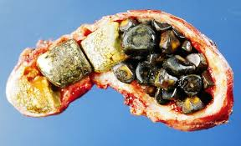
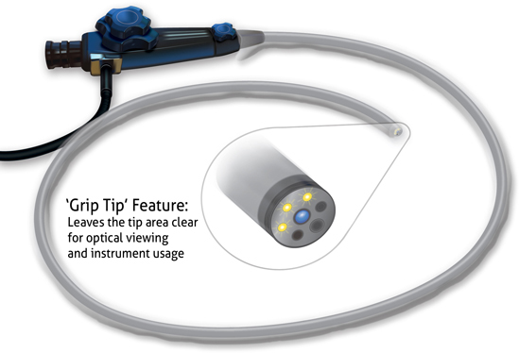
IDENTIFY ABBREVIATIONS
The abbreviation CCE used for common surgical treatment of symptomatic gallstones and other gallbladder conditions stands for ______________________.
Bile components can form crystalline concretions within a gallbladder. It usually results in disease abbreviated as CL, meaning ___________________ .
The endoscopic examination of the large bowel and the distal part of the small bowel with a CCD camera/fiber optic camera on a flexible tube passed through the anus is called ____________________, abbreviated as COL.
Notes:
Cholecystectomia – Cholelithiasis - colonoscopia

Slide 14
READ MEDICAL RECORDS,
MAKE NOTES ABOUT THE DISEASES OF PARTICULAR PATIENTS
1. Osteoporosis. Polymyalgia rheumatica.
2. Cholecystolithiasis. St. p. colicam biliarem
3. Hepatopathia cum trombocytopenia (HTS syndrome v. s.)
4. Hyperplasia prostatae benigna
5. St. post otorrhagiam l. sin.
6. Stp. craniotrauma cum haemorrhagia intracraniali
7. Diarrhoea. Colitis ulcerosa.
8. Insufficientia cordis chronica. Venostasis.

Slide 15
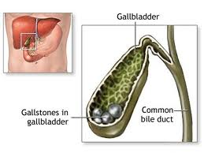
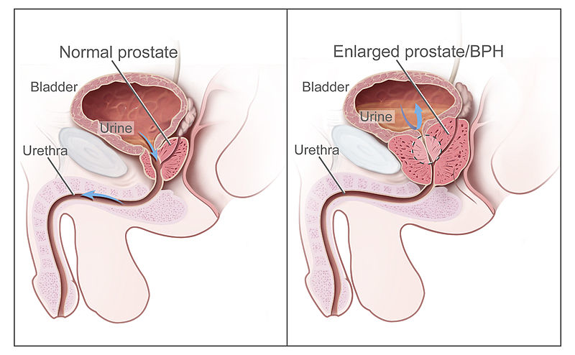
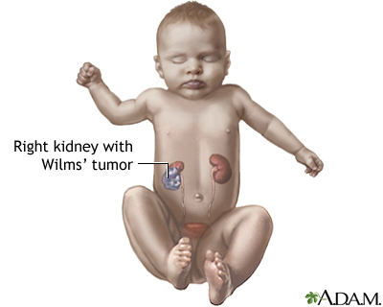
DECIDE WHETHER THE FOLLOWING STATEMENTS ARE
TRUE or FALSE
?
H) Patient ♯5 was admitted to hospital with bleeding from the external auditory canal of the ear.
D) Patient ♯ 3 is a child treated with actinomycin as a therapy for Wilm’s tumor. During the course of therapy the development of severe hepatopathy associated with thrombocytopenia (extremely increased number of platelets) was observed.
E) Like most patients suffering form PMR (Polymyalgia rheumatica) also Patient ♯ 1 wakes up in the morning with pain in her joints in the neck, shoulders, and hips which typically inhibit her activity badly.
G) In patient♯ 6 intracranial bleeding occurred after head injury when his blood vessel within the skull was ruptured.
A) Patient ♯ 4 is a male suffering from abnormal enlargement of the prostate gland.
C) Patient ♯ 8 complains: “Both my legs are badly affected, and doctors say that my condition is some ….. Uhm… strange word they used… phlebostasis, yes, it was phlebostasis.”
B) Patient ♯ 7 suffers from the inflammation of the small intestine. His symptoms include diarrhea, which is common after the ingestion of contaminated substances.
F) Patient ♯2 has several gallstones of the circular shape in his common bile duct.

Slide 16
ANALYSE THE STRUCTURE OF FOLLOWING TERMS
HYPOGLYCAEMIA > HYP-O-GLYC-AEM-IA
Myodystrophia
Claustrophobia
Encephalodysplasia
Hydrorrhoea
Rhinorrhagia
Pancreatolysis
Nephroptosis
Hypopyrexia
Pyodermatitis
Notes:
Claustrum = barrier, fence, enclosure

Slide 17
READ and TRANSLATE:
Peritonitis acuta
Abscessus paranephriticus
Bronchopneumonia periculosa
Cholecystectomia propter cholelithiasim et cholecystitidem
chronicam
Polyneuritis diabetica
Retroflexio uteri
Meningitis purulenta
Graviditas extrauterina primigravidae
Dextropositio cordis
Euthanasia illegalis
Pyoovarium
Urolithiasis ad operationem
Xenophobia
Narcomania

