Slide 1
Word Formation in MT III.

Slide 2
EXPLAIN THE MEANING OF DERIVED WORDS
capitatus
psychiatria
capitulum
CAPUT
capitalis
psychologia
PSYCHE
psychosis
decapitatio
psychosomaticus
infractio
fractura
FRANGERE
fractus
refractio
morbilli
immortalitas
morbosus
MORBUS
morbositas
mortalis
MORS
mortuus
morbilliformis
mortinatalitas

Slide 3
MATCH THE ITEMS IN THE TWO COLUMNS
Chrom-o-, chromat-o-
Blue
Chlor-o-
Color
Cyan-o-
Black, dark
Erythr-o-
Green
Leuc-o-
Grey
Xanth-o-
Red
Poli-o-
White, colorless
Melan-o
Yellow

Slide 4
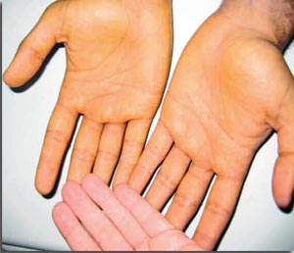
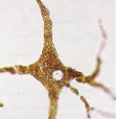
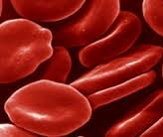
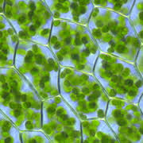
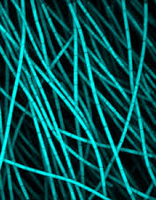
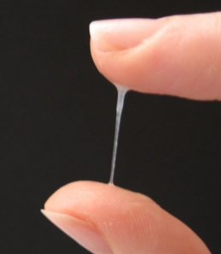
FORM COMPOUND WORDS WITH NAMES OF COLOURS
1. A yellowish discoloration of the skin is known as .…….…….derma
2. A cell producing the dark pigment (…………...) is called ……………………cytus
3. A decreased number of red blood cells is ………………..penia
4. The green pigment of plant leaves and algae is ………………phyllum
5. A group of photosynthetic bacteria containing a blue pigment is ………….bacteria
6. An excessive discharge of white (or sometimes yellowish) mucus from the vagina is ………………..rrhoea
Notes:
Xanthoderma – melanin – melanocytus – erythrocytopenia – chlorophyllum (on) - cyanobcteria - leucorrhoea

Slide 5
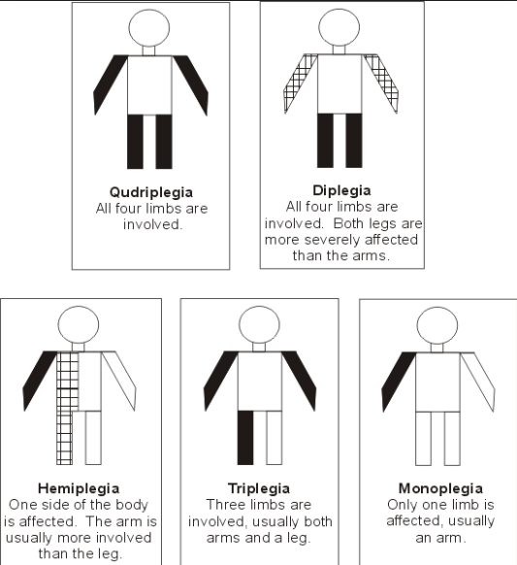
NAME WHAT KIND OF “-PLEGIA” IS ON THE PICTURE
1
2
3
4
5
MONOPLEGIA DIPLEGIA TRIPLEGIA
TETRAPLEGIA HEMIPLEGIA QUADRUPLEGIA
Notes:
Hemiplegia – paraplegia - tetraplegia

Slide 6
BASED ON DEFINITIONS FORM TERMS WITH GREEK ELEMENTS
-PARESIS slight, partial paralysis
-PLEGIA stroke, total paralysis
Partial paralysis of a single limb or one part of the limb
Paralysis of a single extremity
Paralysis of corresponding parts on both sides of the body
Complete paralysis of the lower half of the body including both legs
A slight paralysis or weakness of both legs
Paralysis affecting only one side of the body
Paralysis of an upper and a lower extremity and of the face
Paralysis of all four limbs
Muscular weakness affecting all four extremities
Paralysis of the whole body
Weakness on one side of the body
Notes:
Monoparesis – monoplegia – diplegia – paraplegia – paraparesis –hemiplegia - triplegia – tetraplegia (=quadriplegia, quadruplegia) – tetraparesis – panplegia - hemiparesis

Slide 7
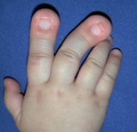
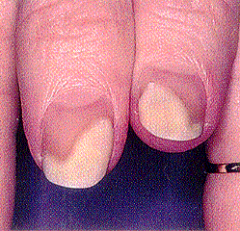
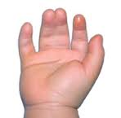
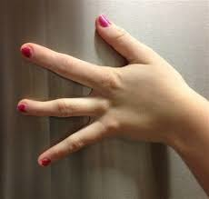
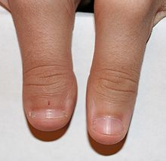
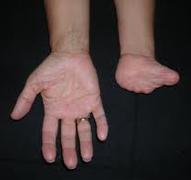
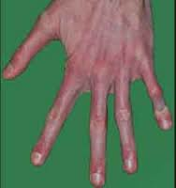
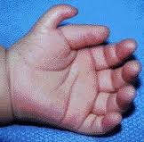
NAME WHAT KIND OF “-DACTYLIA” IS ON THE PICTURE
1
2
3
4
5
6
7
8
SYNDACTYLIA POLYDACTYLIA MACRODACTYLIA ARACHNODACTYLIA ADACTYLIA
BRACHYDACTYLIA ISODACTYLIA OLIGODACTYLIA

Slide 8

FILL IN WHAT IS MISSING
Hyper _ _ _ _ _ _ _
Febris, is, f. / Pyrexia, ae, f.
Sub_ _ _ _ _
Hypo_ _ _ _ _ _ _

Slide 9
FILL IN MISSING COMPOUNDS AND DERIVE THE OPPOSITES.
_________________ which literally means "big body,” is a term used to describe a large newborn (weighting more than 4500 gr). Its opposite is ?
_________________ is a heart rate exceeding the normal range (over 100 BPM). The slow heart beat is ?
_________________amnion is condition in which the pregnant uterus contains more than 2l of amniotic fluid. If there is not enough amniotic fluid, then it is ?
_________________ is a progressive disease of the kidneys that results from hardening of the small blood vessels in the kidneys. On the other side the abnormal softening of the kidney is ?
Notes:
Macro/microsomia – tachy/bradycardia – polyhydramnion/oligohydramnion – nephrosclerosis/nephromalacia

Slide 10
CHOOSE THE CORRRECT ONE
A. The term … describes excessive uterine bleeding at both usual time of menstrual periods and at other irregular intervals
1.DYSMENORRHOEA
2.HYPERMENORRHOEA
3.OLIGOMENORRHOEA
4.MENORRHALGIA
B. The suffix … means surgical fixation.
1. -RRHAGIA
2. -RRHAPHIA
3. -RRHOEA
4. –R(R)HEXIS
C. The term … describes low output of urine (between 100 and 400 ml/day).
1. ANURIA
2. HYPOURESIS
3. OLIGURIA
4. DIURESIS
D. The term … means bleeding from the ear.
1. OTOPYORRHOEA
2. OTOMYCOSIS
3. OTORRHAGIA
4. OTOPEXIS
E. The term … describes condition commonly known as swollen glands.
1. ANGINA
2. ANGIITIS
3. LYMPHANGIOMA
4. LYMPHADENITIS

Slide 11
EXPLAIN THE MEANING OF FOLLOWING COMPOUND WORDS
-IATRIA (gr. iatros healer, physician, treatment
iatrogenes ✪ paediatria ✪ geriatria ✪ psychiatria ✪ iatrophobia
THROMB- (gr. thrombos blood clot
thrombocytos ✪ thrombosis ✪ thrombocytopenia ✪ thrombectomia ✪ thromboendocarditis
MESO- (gr. mesos middle, secondary
mesoderma ✪ mesencephalon ✪ mesogastralgia ✪ mesosomia ✪ mesosternum ✪ mesosyphilis
-GENES/ GEN- (gr. gignesthai come into being, produce, have origin
genetica ✪ cryptogenes ✪ isogenes ✪ pathogenes ✪ carcinogenes ✪ hepatogenes

Slide 12
READ AUTHENTIC MEDICAL RECORDS
1. St.p. hysterectomiam et adnexectomiam propter uterum myomatosum magnum (2007)
2. St.p. hemicolectomiam l. sin. propter Ca sigmoid., st.p. CHT
3. Cholecystolithiasis - microlithiasis. Haemangioma lob. sin. hepatis.
4. Encephalopathia. St. post ictum cerebri tempore remoto. Hemiparesis l. dx.
5. St.p. CHCE, APPE, HYE et AE bilat.
6. Paraplegia extremitatum infer. bilat., st.p. fr. C6
7. Haemopneumotorax l. sin. traumaticus. Fractura costarum VII.- X. l. sin.
8. Carcinoma mammae dx. STP. mastectomiam cum lymphadenectomia et therapia hormonali curatam

Slide 13
READ AUTHENTIC MEDICAL RECORDS
1. Dystopia int. caeci. Abdomen ad observandum
2. St.p. CHCE, hernia in cicatrice libera. Obstipatio. Operatio gynaecologica ante annos VII (septem)
3. St. post panhysterectomiam et hernioplasticam in cicatrice post laparotomiam
4. TU ventriculi magnum, ad mesocolon transversum crescens, dolores mesogastrii lat. utq.
5. Thrombosis a. brachialis susp., fr. colli chirurgici humeri l. sin.
6. Polycystosis hepatis, Cholecystitis, pericholecystitis. Morbus hypertonicus. Hypothyreosis. St. p. thyreodectomiam propter M. Basedov, nicotinismus

