Slide 1
Basic medical terminology 6
IIIrd declension : Consonant stems

Slide 2
Specific features of the 3rd declension
All 3 genders are included (cortex m., radix f., femur n.)
Genitive ending: -is
Nom. Sg. – various endings (sanguis, excisio, abductor, rete, latus, femur, abdomen, cavitas)
  !NOMINATIVE form is NOT interconnected with the GENDER! Words must be carefully memorized!
Two main groups:
  nominative and genitive stem differs (genitive is longer than nominative) Consonant stems
  nominative and genitive stem remains unchanged (genitive has same number of syllables as nominative)
  I- stems + exceptions

Slide 3
Specific features of the 3rd declension
-Consonant stems
Stem in gen. sg. and nom sg. usually differs
  pulm-o//pulmon-is
  fem-ur//femor-is
  rad-ix//radic-is
For the proper inflection the GENITIVE form is NECESSARY to know
1. pulm-o
2. pulmon-is
4. pulmon-em
6. pulmon-e

Slide 4
Declension paradigms
Consonant |  | I-stems |  | EXCEPTIONS
DOLOR | CORPUS | PELVIS | RETE | DOSIS, FEBRIS
M. + F. | N. | M. + F. | N. | F.

Slide 5
DOLOR
 | Sg. | Pl.
nom. | dolor | dolor-es
gen. | dolor-is | dolor-um
ak. | dolor-em | dolor-es
abl. | dolor-e | dolor-ibus

Slide 6
CORPUS
 | Sg. | Pl.
nom. | corpus | corpor-a
gen. | corpor-is | corpor-um
ak. | corpus | corpor-a
abl. | corpor-e | corpor-ibus

Slide 7
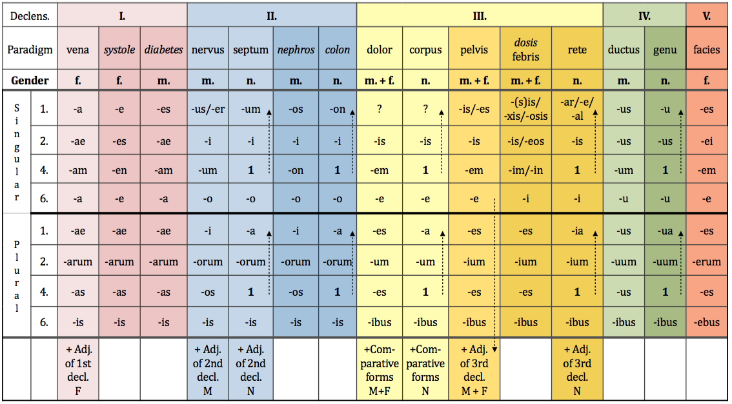
Latin and Greek declensions

Slide 8
EXCEPTIONS
os, ossis n. bone → gen. pl.–ium
vas, vasis, n. vessel
  In sg. follows paradigm CORPUS vas-vasis-vas-vase
  In pl. follows paradigm CEREBRUM vasa-vasorum-vasa-vasis
GREEK NOUNS typical endings
  -itis//-itidis → inflammation
  -(o)ma//-(o)matis → tumour diseases/swellings

Slide 9
Connection with the adjective
F M N
SG.
1. cavitas magna dolor magnus foramen magnum
2. cavitatis magnae doloris magni foraminis magni
4. (in) cavitatem magnam dolorem magnum foramen magnum
6. (in) cavitate magna dolore magno foramine magno
PL.
1. cavitates magnae dolores magni foramina magna
2. cavitatum magnarum dolorum magnorum foraminum magnorum
4. (in) cavitates magnas dolores magnos foramina magna
6. (in) cavitatibus magnis doloribus magnis foraminibus magnis

Slide 10
Write down stems
Nom. Sg. Gen. sg. Stem
Abdomen
Dolor
Latus
Abductor
Encephalitis
Lien
Amputatio
Excisio
Luxatio
Apex
Extensor
Margo
Abdominis
Abdomin-
Doloris
Dolor-
Lateris
Later-
Abductoris
Abductor-
Encephalitidis
Encephalitid-
Lienis
Lien-
Amputationis
Amputation-
Excisionis
Excision-
Luxationis
Luxation-
Apicis
Apic-
Extensoris
Extensor-
Marginis
Margin-

Slide 11
Assign nouns to paradimgs
vena
nervus
dolor
systole
septum
corpus
• musculus • vulnus • ulcus • digitus • albus •
• cavitas • vas • arterias • diarrhoas •
• ligamenta • aqua • crura • symptoma
• tumor • ren • abdomen • systolen • apex • cortex
• luxatio • ostio • os • radios • cor

Slide 12
What is a nominative form of these nouns?
Ex.: Injectionis > Injectio, feminine, DOLOR
Cervicis
Solutionis
Tumoris
Femoris
Vertebrae
Sacchari
Systoles
Oculi
Cancri
Phalangis
Ossis
Oris
Coli
Colli
Extremitatis
Capitis
Ganglii
Cervix
Solutio
Tumor
Femur
Vertebra
Saccharum
Systole
Oculus
Cancer
Phalangx
Os
Os
Colon
Collum
Extremitas
Caput
Ganglion

Slide 13
Change into nominative plural:
Femur
Mater
Flos
Foramen
Oedema
Apex
Caput
Melanoma
Cartilago
Injectio
Femora
Matres
Flores
Foramina
Oedemata
Apices
Capita
Melanomata
Cartilagines
Injectiones

Slide 14
Connect nouns to name structures:
Cranii
Thoracis
Abdominis
Laryngis
Nasi
Oris
Pharyngis
Uteri
Linguae
Phalangis
Sterni
Tali
Tibiae
Uteri
Ossis metacarpi
Ossis metatarsi
Coccygis
Cavitas
Corpus
Brachii
Capitis
Carpi
Cervicis
Coxae
Cruris
Dorsi
Femoris
Pedis
Costae
Femoris
Fibulae
Humeri
Mandibulae
Phalangis
Radii
Ulnae
Regio
Caput
Cervix
Uteri
Vesicae
urinariae

Slide 15
Assign adjectives to nouns
tumor• corpus• medicamentum•pes • os• foramen• diameter• vulnus
Benignus
Malignus
Novus
Novum
Bonum
Longum
sacrum
Obliqua
Humanum
Osseum
Adiposum
Alienum
Humanus
Sinister
dexter
Nutricium
Medium
Scissum
Sclopetarium
Contusum
Sectum
Punctum

Slide 16
Find Greek and Latin synonyms
English Latin Greek
_____________ ___________ soma
_____________ os, oris _____________
kidney _____________ _____________
_____________ _____________ colon
brain _____________ _____________
_____________ organum _____________
_____________ _____________ hepar
stitch _____________ _____________
_____________ vulnus __________
body
corpus
mouth
stoma
ren
nephros
large intestine
intestinum crassum
cerebrum
encephalon
organ
organon
liver
iecur
sutura
r(h)aphe
injury, wound
trauma

Slide 17
Add loose attributes, TASK 5
Cavitas + septum nasi
Operatio + cervix uteri
Corpus + vertebra thoracica
Fractura + os sacrum
Luxatio + crus
Morbus infectiosus + abdomen
Dolor acutus + caput
Cavitas septi nasi
Operatio cervicis uteri
Corpus vertebrae thoracicae
Fractura ossis sacri
Luxatio cruris
Morbus infectiosus abdominis
Dolor acutus capitis

Slide 18
Change for nominative plural, TASK 7
sphincter
foramen nutricium
dolor chronicus
vas longum
musculus adductor
femur fractum
cartilago thyreoidea
vulnus punctum
sphincteres
foramina nutricia
dolores chronici
vasa longa
musculi adductores
femora fracta
cartilagines thyreoideae
vulnera puncta

Slide 19
Connect with the preposition to form the phrase, TASK 6
inter
post
sub (position)
propter
ad
pro
per
cum
contra
phalanges digitorum
operationem carcinomatis
lobo dextro pulmonis
dolorem acutum cordis
cavitatem nasi
injectione subcutanea
os
vulnere secto
ulcus ventriculi

Slide 20
Fill in the missing ending, TASK 9
Vitium acquisit_____ ren_____
Operatio tumor_____ benign_____ in cavitat_____ or_____
Fractura complicat_____ femor_____ sinistr_____
Luxatio articulation_____
Injectio contra dolor_____ acut_____
Periculum carcinomat_____ cervic_____ uter_____
Oculus post operation_____ irid_____
Medicamentum bon_____ contra encephalitid_____ adult_____
Excisio tumor_____ benign_____
Medicamentum bon_____ contra colitid____ acut_____
um
is
is
i
e
is
a
is
i
is
em
um
is
is
i
em
is
um
em
orum
is
i
um
em
am

Slide 21
Form phrases with different types of injuries
Vulnus + sclopetarius, a, um + dorsum
Sutura + vulnus + lacer, a, um + caput
Oedema + propter + vulnus + contusus, a, um + femur
Infectio + in + vulnus + scissus, a, um + digitus + II
Vulnus (pl.) + sectus, a, um + antebrachium
Sepsis + post + vulnus (pl.) + morsus, a, um + caput
Corpus (pl.) + alienus, a, um + in + vulnus (pl.) + punctus, a, um + abdomen
Vulnus sclopetarium dorsi
Sutura vulneris laceri capitis
Oedema propter vulnus contusum femoris
Infectio in vulnere scisso digiti secundi
Vulnera secta antebrachii
Sepsis post vulnera morsa capitis
Corpora aliena in vulneribus punctis abdominis

Slide 22
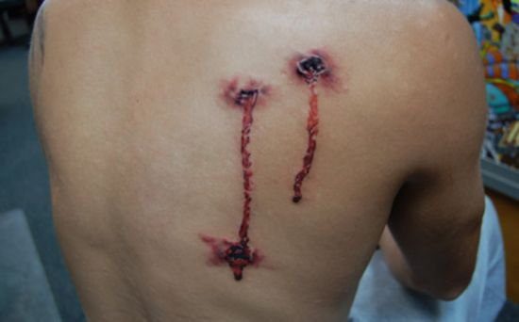
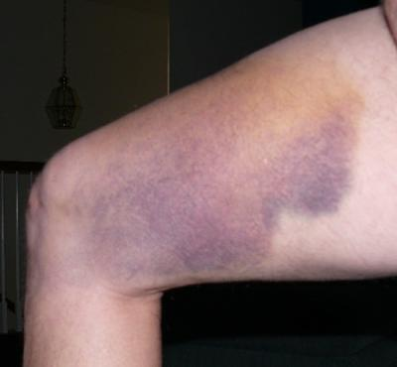
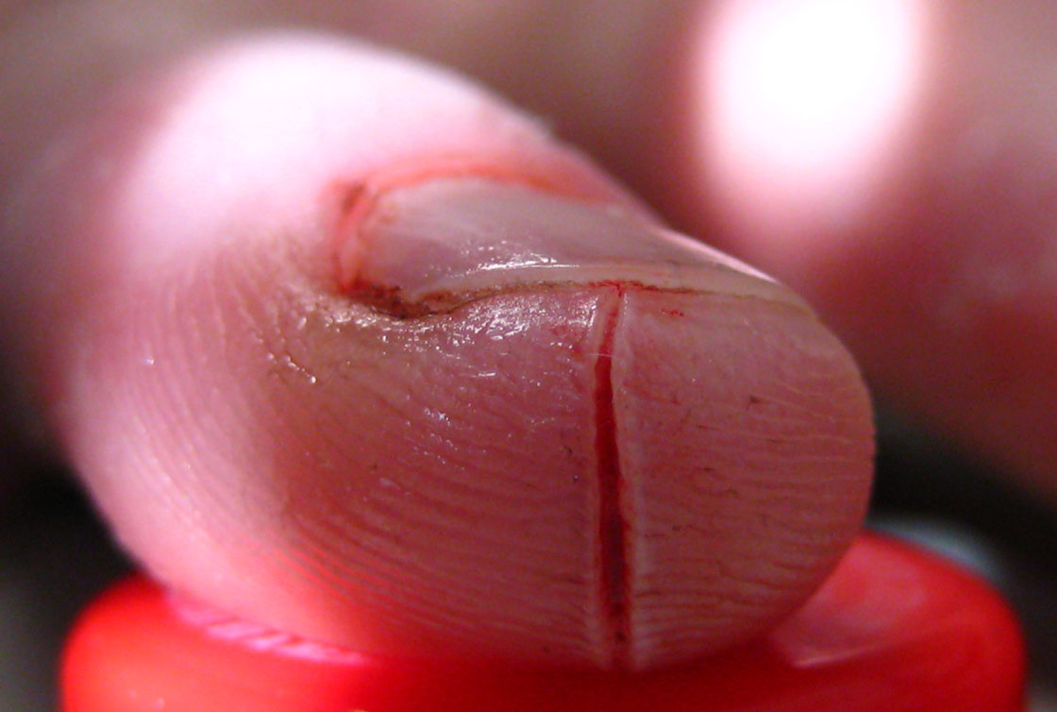
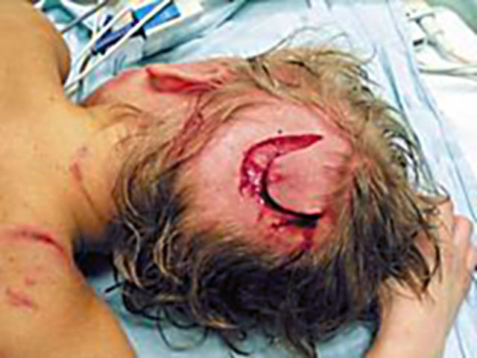
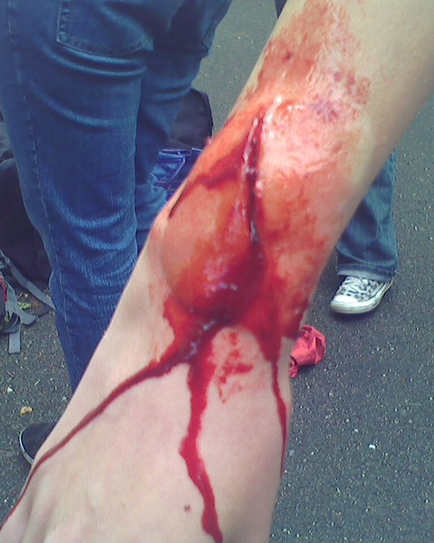
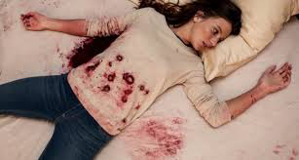
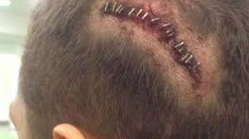
A
C
F
B
D
G
E
Notes:
A vulnus sclopetarium dorsi/ B vulnera secta antebrachii, (vidno len jednu ranu!)/ C oedema propter vulnus contusum femoris/ D corpora aliena in vulneribus punctis abdominis (často sa dostanu do rany kúsky látky z odevu) /E sutura vulneris laceri capitis / F Infectio in vulnere scisso digiti secundi / G sepsis post vulnera morsa capitis (vidno len jednu ranu!)

Slide 23
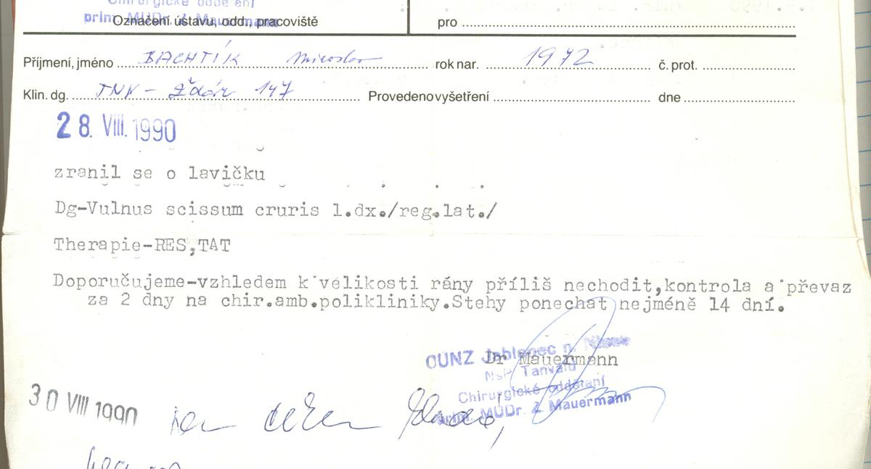
Reading authentic records 2
- read and translate the diagnosis, re-write it without abbreviations

Slide 24
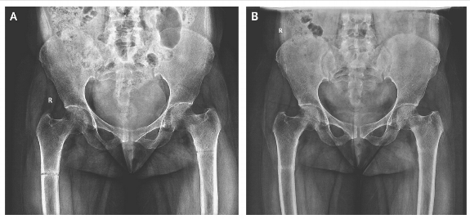
2
A 45-year-old woman presented with a 3-month history of generalized body pains nonresponsive to analgesics. Along with a low back pain, she had progressive difficulty in getting up from sitting and supine positions and in walking. There was no history of trauma or any medication intake. She is an orthodox believer who wears a black veil outdoors and is completely covered, with little exposure to the sun. An anteroposterior radio-graph of the pelvis showed an undisplaced transverse fracture of the shaft of both femurs. The patient was treated with therapeutic doses of calcium and vitamin D supplements.

Slide 25
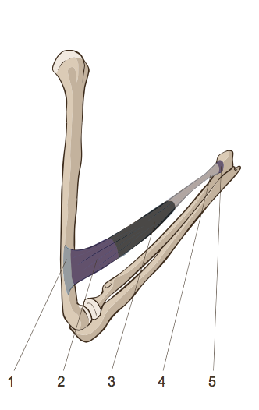
Fill in what is missing
venter |  | f.
 | caudae |  |  | 4
 | originis |  |  | 1
 |  | n. | head
 | insertionis |  | insertion
ventris
muscle belly
3
cauda
f.
tail
origo
f.
origin
caput
capitis
2
insertio
f.
5

Slide 26
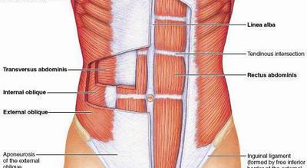
Names of muscles by fiber direction
1
4
2
3
m. rectus abdominis
m. transversus abdominis
m. externus obliquus abdominis
m. internus obliquus abdominis

Slide 27
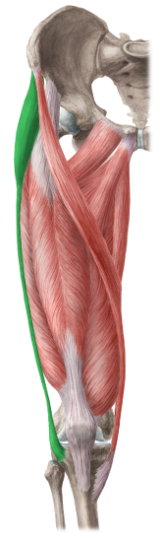
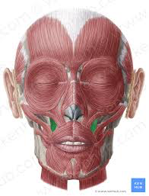
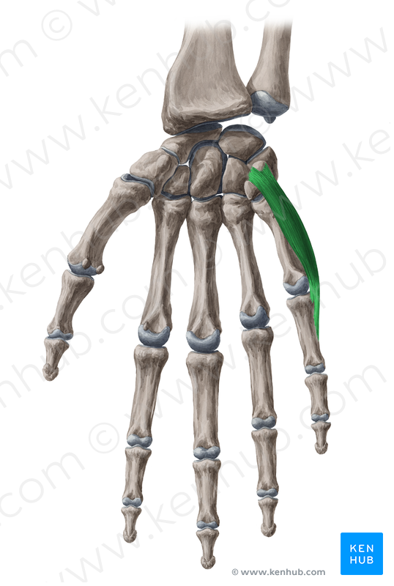
The muscle(s) that…
…moves the little finger away from other fingers is…
…helps the face to form a smile because it elevates the angles of the mouth at each corner is…
…stretches the wide band that encloses the thigh muscles is…
Notes:
Musculus abductor digiti minimi
Musculus levator anguli oris
Musculus tensor fasciae latae

Slide 28
Name the action performed by the given muscle
Musculus abductor pollicis longus >> abductio, onis, f.
Adductio, onis, f.
Musculus adductor hallucis longus
Musculus compressor urethrae
Musculus constrictor pharyngis medius
Musculus depressor anguli oris
Musculus dilatator pupillae
Musculus extensor carpi
Musculus flexor digitorum profundus
Musculus levator glandulae thyr(e)oideae
Musculi rotatores thoracis
Musculus tensor fasciae latae
Compressio, onis, f.
Constrictio, onis, f.
Depressio, onis, f.
Dilatatio, onis, f.
Extensio, onis, f.
Flexio, onis, f.
Levatio, onis, f.
Rotatio, onis, f.
Tensio, onis, f.

Slide 29
Specific features of the 3rd declension
-Latin I-stems
Masculine and feminine nouns
  have the same numbers of syllables in the nominative and the genitive singular:
    ca-na-lis, ca-na-lis
    pel-vis, pel-vis
    pu-bes, pu-bis
  a group of consonants is preceding the genitive ending -is
  (i.e. the stem ends in a group of consonants)
    pars, part-is
    dens, dent-is
Neutral nouns
  words ending in nom. sg. in -e, -al or –ar
  only few words: animal, alis, n., calcar, aris, n., cochlear, aris, n., rete, is, n.

Slide 30
Declension paradigms
Consonant |  | I-stems |  | EXCEPTIONS
DOLOR | CORPUS | PELVIS | RETE | DOSIS, FEBRIS
M. + F. | N. | M. + F. | N. | F.

Slide 31
PELVIS
I-STEM MASCULINE AND FEMININE GENDER NOUNS
 | Sg. | Pl.
nom. | pelvis | pelv-es
gen. | pelv-is | pelv-ium
ak. | pelv-em | pelv-es
abl. | pelv-e | pelv-ibus

Slide 32
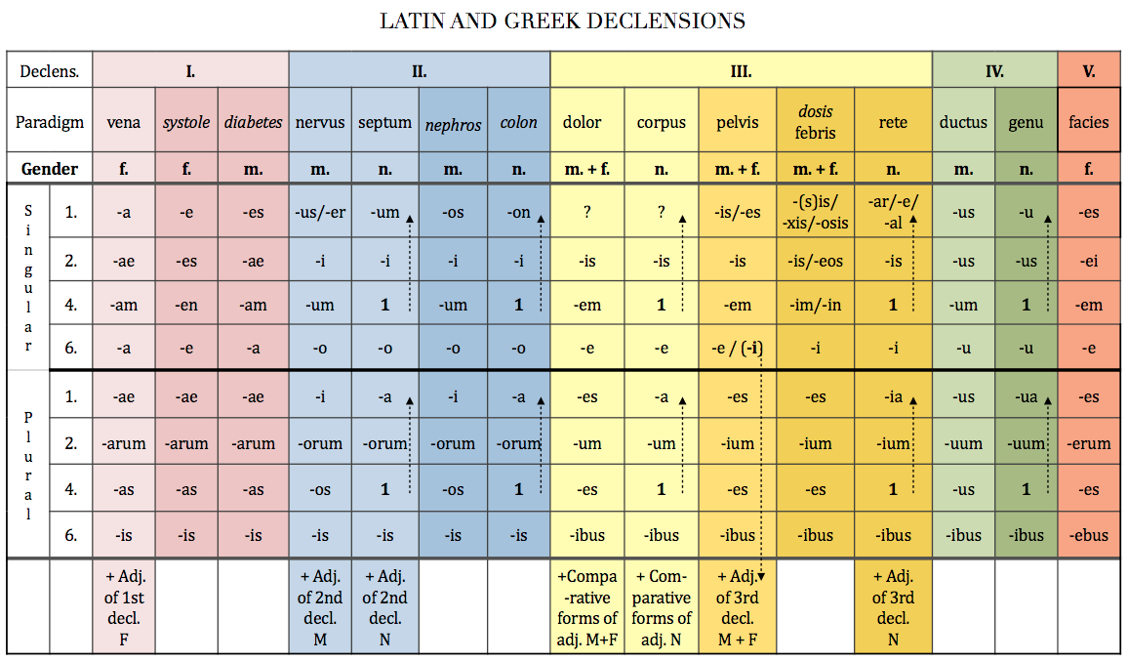

Slide 33
The difference between paradigms
PELVIS and DOLOR

Slide 34
The difference between paradigms
PELVIS and DOLOR
 | Sg. | Pl.
nom. | dolor | dolor-es
gen. | dolor-is | dolor-um
ak. | dolor-em | dolor-es
abl. | dolor-e | dolor-ibus
 | Sg. | Pl.
nom. | pelvis | pelv-es
gen. | pelv-is | pelv-ium
ak. | pelv-em | pelv-es
abl. | pelv-e | pelv-ibus
CONSONANT-STEM MASCULINE AND FEMININE GENDER NOUNS
I-STEM MASCULINE AND FEMININE GENDER NOUNS

Slide 35
RETE
I-STEM NEUTRAL GENDER NOUNS
 | Sg. | Pl.
nom. | rete | ret-ia
gen. | ret-is | ret-ium
ak. | rete | ret-ia
abl. | ret-i | ret-ibus

Slide 36
NEUTRAL GENDER NOUNS

Slide 37
DOSIS
Only feminine nouns decline according to paradigm dosis
These words are mostly of Greek origin
  in nominative singular they end in -sis, -xis, -osis
  and the genitive singular is the same
 | Sg. | Pl.
nom. | dosis | dos-es
gen. | dos-is / -eos | dos-ium
ak. | dos-im / -in | dos-es
abl. | dos-i | dos-ibus
Some Latin words are declined according to dosis, but they do not have Greek endings:
febris, is, f, tussis, is, f., pertussis, is, f., sitis, is, f., tuberculosis, is, f.

Slide 38
EXCEPTIONS
hepar, hepatis, n. is declined like CORPUS
axis, is, m. is inflected like PELVIS
Nouns DENS, FONS, FRONS, LENS, MENS, MONS, MORS, PARS and PONS, are inflected like PELVIS (= gen. pl. –ium) even if they do not have equal number of syllables
Words inflected like DOSIS have very frequently irregular ending in genitive sg. -eos and in accusative sg. -in.
Nouns FEBRIS, TUSSIS, PERTUSSIS, SITIS, TUBERCULOSIS are inflected like DOSIS
Greek nouns typical ending
  -osis > non-inflammatory degenerative disease
  e. g. arthrosis, nephrosis, spondylosis…

Slide 39
Write down the stem and guess the paradigm word
os, ossis, n.
cutis, is, f.
mors, tis, f.
pulmo, onis, f.
trauma, atis, n.
basis, is /eos, f.
animal, alis, n.
latus, eris, n.
tussis, is, f.
pubes, is, f.
oss-
cut-
mort-
pulmon-
traumat-
bas-
animal-
later-
tuss-
pub-
corpus
pelvis
pelvis
dolor
corpus
dosis
rete
corpus
dosis
auris

