Slide 1
Basic medical terminology

Slide 2
Fill in all forms
Gen. sg. | Gender | Paradigm | Nom. Pl. | Gen. pl.
margo
pars
regio
extremitas
foramen
canalis
phalanx
tendo
marginis
M
dolor
margines
marginum
partis
F
pelvis
partes
partium
regionis
F
dolor
regiones
regionum
extremitatis
F
dolor
ex-at-es
ex-at-um
foraminis
N
corpus
foramina
foraminum
canalis
M
pelvis
canales
canalium
phalangis
F
dolor
phalanges
phalangum
tendinis
M
dolor
tendines
tendinum

Slide 3
Fill in all forms
Gen. sg. | Gender | Paradigm | Nom. Pl. | Gen. pl.
abdomen
extensor
tuber
os
basis
dens
unguis
vas
abdominis
N
corpus
abdomina
abdominum
extensoris
M
dolor
extensores
extensorum
tuberis
N
corpus
tubera
tuberum
ossis/oris
N
corpus
ossa/ora
ossium/orum
basis
F
pelvis
bases
basium
dentis
M
pelvis
dentes
dentium
unguis
M
pelvis
ungues
unguium
vasis
N
corpus/
septum
vasa
vasorum

Slide 4
Form phrases
Cortex + ren, lien, cerebellum, ovarium
Carcinoma + ureter, uterus, urethra, tuba uterina, vesica urinaria
Fractura + occiput, femur dextrum, caput femoris, thorax, costae verae
Apex + cor, pulmo, prostata, vesica urinaria, lingua
Basis + cor, pulmo dexter, cranium, phalanges digitorum
Caput + femur sinistrum, costa spuria, humerus, pancreas, fibula dextra, os metacarpi

Slide 5
Form phrases
Basis + os + sacer, a, um
Pars + apex + dens
Sclerosis + arteriae (pl.) + coronarius, a, um
Calculosis + vesica + urinarius, a, um
Stenosis + ostium + venosus, a, um
Canalis + cervix + uterus
Therapia + nephrosis + chronica
Basis ossis sacri
Pars apicis dentis
Sclerosis arteriarum coronariarum
Calculosis vesicae urinariae
Stenosis ostii venosi
Canalis cervicis uteri
Therapia nephrosis/nephroseos chronicae

Slide 6
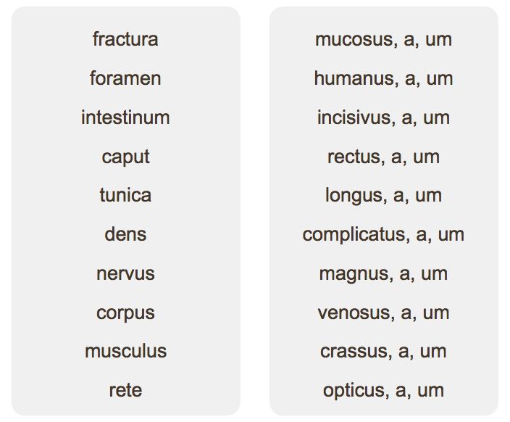
Match and form phrases

Slide 7
1. Find correct form of adjective, 2. Change phrases into nom. pl.
margo (dexter, a, um)
pars (uterinus, a, um)
femur (sinister, a, um)
regio (thoracicus, a, um)
os (longus, a, um)
cirrhosis (chronicus, a, um)
pelvis (masculinus, a, um)
canalis (nutricius, a, um)
rete (venosus, a, um)
marginis dextri
partis uterinae
femoris sinistri
regionis thoracicae
ossis longi
cirrhosis chronicae
pelvis masculinae
canalis nutricii
retis venosi

Slide 8
Fill in the missing endings
is/eos
Partes hypophys
Symptomata tuberculos
Resectio radic dent
Sub calcar av
Amputatio ped dextr cum narcos
Febris cum tuss
Aether pro anaesthes
Fractura pelv cum haemorrhagi in cavitat abdomin
Cochlear plen mell pro tuss chronic
Cystis benign corpor uter
Myomat (pl.) cum prognos bon
Haemodialysis propter function ren (pl.) laes
Metastas (pl.) carcinomatos in stomach
is
is
is
i
is
is
i
i
i
ia
is
a
e
is
um
is
i
a
a
is
i
a
i
a
em
um
am
es
ae
o

Slide 9
Translate
Death on the operating table
Profound part of the parotid gland
Symptoms of tuberculosis
With narcosis
Lobes and parts of the hypophysis
Antibiotics against the whooping cough
Mors in tabula
Pars profunda (glandulae) parotidis
Symptomata tuberculosis
Cum narcosi
Lobi et partes hypophysis/hypophyseos
(Remedia) antibiotica contra pertussim

Slide 10
Translate
Internal ear
Network of carpus
In acute fever
Canine teeth
Venous network of the eyeball
Symptoms of organic psychosis
Symptoms of synarthrosis
Auris interna
Rete carpi
In febri acuta
Dens caninus
Rete venosum bulbi oculi
Symptomata psychosis/eos organicae
Symptomata synarthrosis/eos

Slide 11
Fill in what is missing
Nom.sg. | Gen.sg. | Gen. | Meaning
distensio |  | f.
 | osteosynthesis |  | Surgical procedure to fix broken bones
 |  | f. | lesion, injury
dysfunctio |  | f.
 | spasmi | n.
 | structurae
innervatio |  | f.
distensionis
abnormal
stretching
osteosynthesis
f.
laesio
laesionis
dysfunctionis
dysfunction
spasmus
spasm
structura
f.
structure
inervationis
innervation

Slide 12
Form phrases
Laesio + musculi (pl.) + glutaeus, a, um
Structura + musculus + masseter
Distensio + musculus + obliquus, a, um + externus, a, um + abdomen
Spasmus + musculus + rectus, a, um + abdomen
Status post + osteosynthesis + os (pl.)
Dysfunctio + musculus (pl.) + carpus

Slide 13
Give the full form of abbreviated words
Vulnus reg. coxae l. sin.
Varices extremitatum l. utr.
Ulcus chron. cruris l. dx. Posttraumaticum
Vv. lacera reg. pedis
V. contusum regionis femoris l. dx.
Oedema pedis et cruris l. utr. post vulnus morsum
Amputatio phalangis digiti III. et IV. pedis l. sin.
Status post luxationem colli femoris l. dx.
Fractura baseos phalangis digiti V.

Slide 14
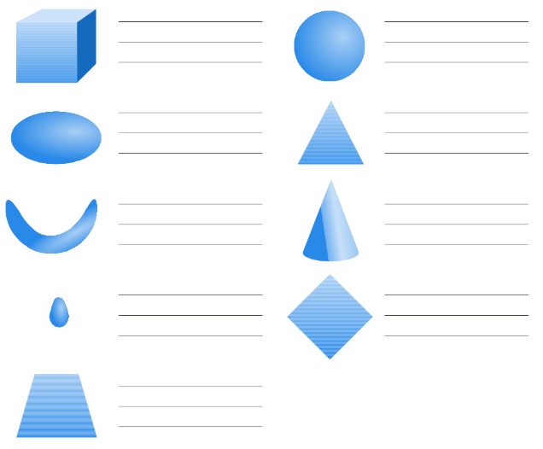

Slide 15
Latin 4th and 5th declension
4th declension
Gender: masculine + neuter (only genu, us n. knee, cornu, us, n. horn)
Nom. sg. -us / -u
Gen. sg. -us / -us
Female gender exception (manus, us, f. hand)
5th declension
Gender: feminine, no neuter
Nom. Sg. -es
Gen. sg. -ei
Masculine gender exception (dies, ei, m. day)

Slide 16
Endings

Slide 17
Connection with adjective
Ductus (lymphaticus, a, um)
Genu (dexter, a, um)
Facies (pelvicus, a, um)
Sg.
Ductus lymphaticus Genu dextrum Facies palatina
Ductus lymphatici Genus dextri Faciei palatinae
Ductum lymphaticum Genu dextrum Faciem palatinam
Ductu lymphatico Genu dextro Facie palatina
Pl.
Ductus lymphatici Genua dextra Facies palatinae
Ductuum lymphaticorum Genuum dextrorum Facierum palatinarum
Ductus lymphaticos Genua dextra Facies palatinae
Ductibus lymphaticis Genibus dextris Faciebus palatinis

