Slide 2
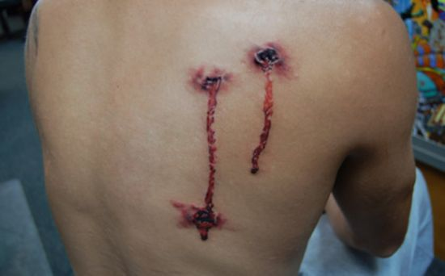
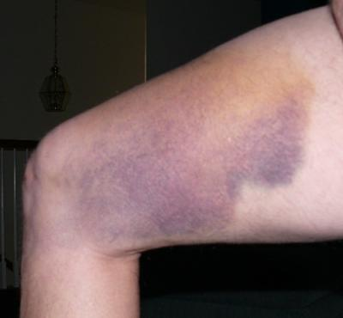
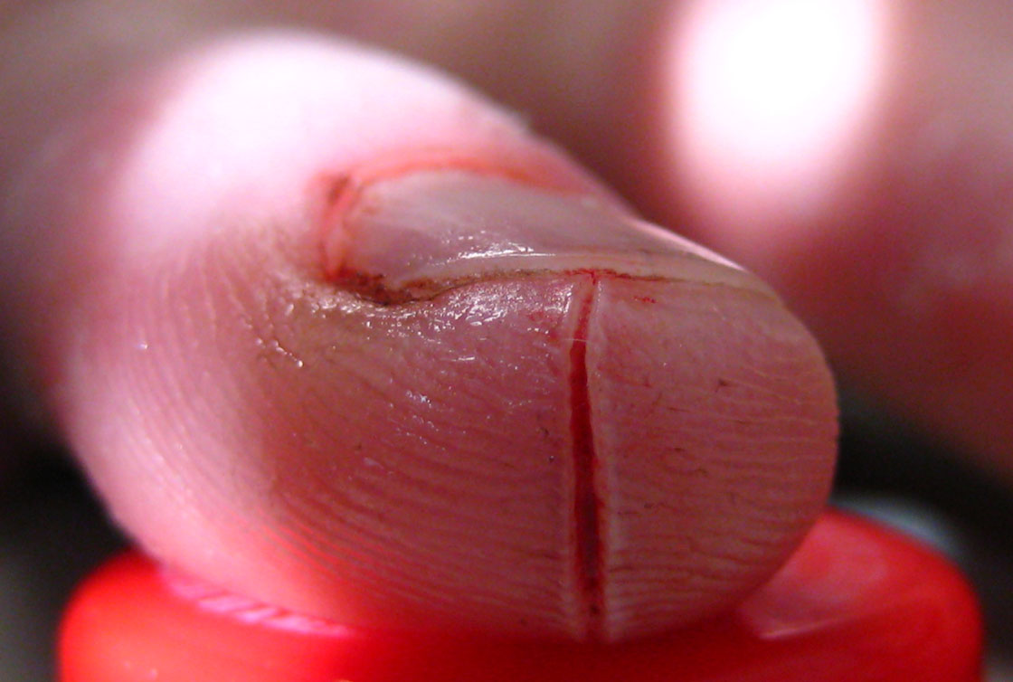
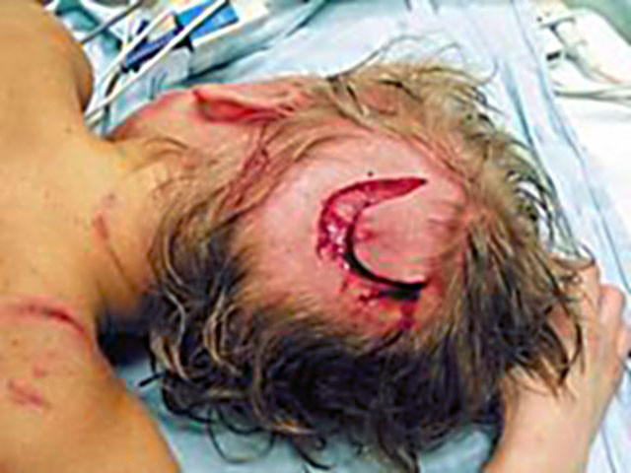
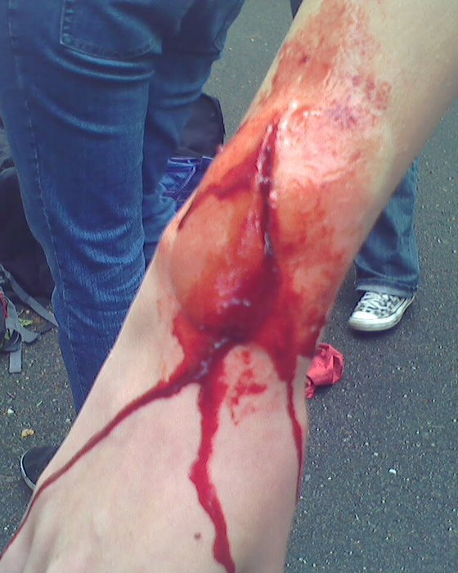
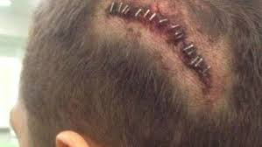
A
C
F
B
D
G
E
Notes:
A vulnus sclopetarium dorsi/ B vulnera secta antebrachii, (vidno len jednu ranu!)/ C oedema propter vulnus contusum femoris/ D corpora aliena in vulneribus punctis abdominis (často sa dostanu do rany kúsky látky z odevu) /E sutura vulneris laceri capitis / F Infectio in vulnere scisso digiti secundi / G sepsis post vulnera morsa capitis (vidno len jednu ranu!)

Slide 3
Decide what is correct
✗
Patient 1 has shot wound in his left lower leg
Patient 2 tore her upper lip
Patient 2 suffered brain concussion
Patient 3 has open fracture of his left forearm with contusion and tear wound on the lower leg
Patient 4 broke her heel bone
Patient 4 had simple fracture of the third thoracic vertebra
Patient 4 has cut wound in the region of the left elbow bone
✔
✗
✗
✔
✗
✗
Notes:
K tomuto cvičeniu majú extra Handout (7a), pracuje sa v skupine

Slide 4
Names of muscles by fiber direction
1
4
2
3
m. rectus abdominis
m. transversus abdominis
m. externus obliquus abdominis
m. internus obliquus abdominis

Slide 5
Latin nouns of the 4th and 5th declension
-U- and -E- stems

Slide 6
4th declension
genitive singular ending -ūs
mostly of masculine gender: -us/-ūs
paradigm word: ductus = duct
There are 2 nouns that have ablative plural ending -ubus:
arcus, us, m. = bow
artus, us, m. = member, joint
 | singular | plural
nom. | duct-us | duct-ūs
gen. | duct-ūs | duct-uum
ak. | duct-um | duct-ūs
abl. | duct-ū | duct-ibus
There are only few exceptions of feminine gender:
manus, ūs, f. -hand

Slide 7
Decide on the declension of the nouns
tractus, us, m.
musculus, i, m.
corpus, corporis, n.
ulcus, eris, n.
manus, us, f.
visus, us, m.
nervus, i, m.
methodus, i, f.
crus, cruris, n.

Slide 8
4th declension - neuters
genitive singular ending -ūs
paradigm word: genū = knee
In the 4th declension there are only two neuters:
genu, us, n = knee
cornu, us, n. = horn
 | singular | plural
nom. | gen-ū | gen-ua
gen. | gen-ūs | gen-uum
ak. | gen-ū | gen-ua
abl. | gen-ū | gen-ibus

Slide 9
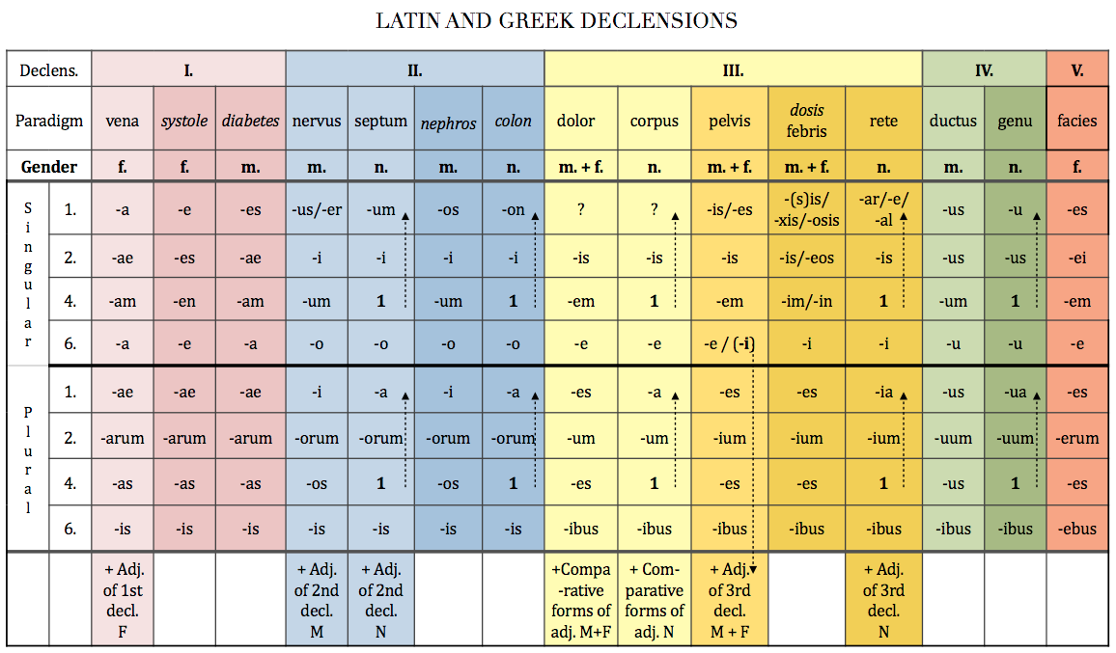

Slide 10
5th declension
genitive singular ending -ei
paradigm word: faciēs = face, front part
all the nouns of the 5th declension are of feminine gender
 | singular | plural
nom. | faci-ēs | faci-ēs
gen. | faci-ēī | faci-ērum
ak. | faci-em | faci-ēs
abl. | faci-ē | faci-ēbus

