Slide 1
Basic medical terminology
2nd seminar

Slide 2
Read aloud
Infarctus myocardii recens
Fractura comminutiva colli femoris lateris dextri
Commotio cerebri
Vulnus punctum thoracis ad pulmonem lateris sinistri penetrans
Aethylismus chronicus
Appendicitis acuta
Intoxicatio carboneo hydroxydato (CO) gradus maioris

Slide 3
Read aloud
Typhus reccurens
Tonsillitis purulenta recidivans
Diabetes mellitus stabilis
Dermatitis allergica protrahens
Vitium cordis acquisitum
Infarctus haemispherii sinistri cerebri, Hemiparesis
Nephrolithiasis, colica renalis subsequens
Tumor ventriculi ad investigationem et observationem

Slide 4
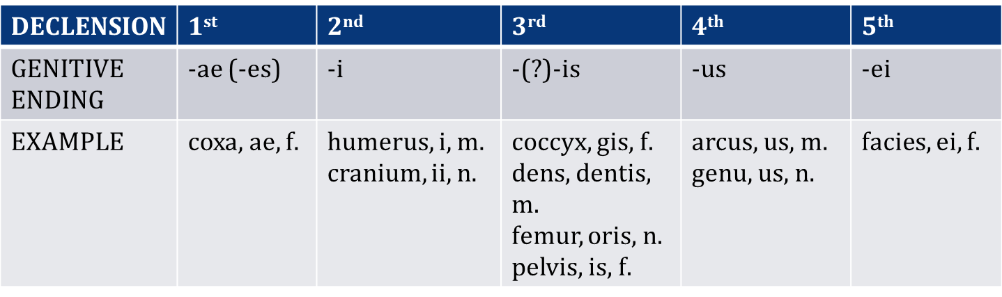
Questions
How do I decide to what declension the word belongs?
  I need to know the genitive ending
What are the genitive endings of Latin declensions?

Slide 5
Questions
What is a stem?
  a stem is a form to which affixes can be attached
How can we identify the stem of a Latin noun?
  we take genitive form and we remove the genitive ending
    vena, ven-ae
    musculus, muscul-i; diameter, diametr-i
    auris, aur-is; corpus, corpor-is
    arcus, arc-us; genu, gen-us
    facies, faci-ei

Slide 6

Gender
The grammatical gender of a noun affects the form of other words related to it.
In Latin, adjectives (and pronouns) change their form depending on the noun to which they refer.
ENGLISH has 3 genders:
  HE – refers to male humans and animals
  SHE – refers to female humans and animals
  IT – inanimate objects or animals
LATIN has 3 genders:
  not only humans and animals, but also other objects are thought of as being:
    masculine -> discipulus (he-student), musculus (muscle)
    feminine -> discipula (she-student), vena (vein)
    neuter -> corpus (body)

Slide 7
Latin – inflectional language
In many languages, Latin and Greek among them, nouns inflect (change their form) for number and for case.
  Inflection for number involves singular (sg.) : plural (pl.) forms (eg. forearm : forearms, antebrachium : antebrachia) and is present in English as well.
  Inflection for case involves changing the form of the noun according to its syntactic function/meaning. Latin has extensive case system in which a special form is used for every specific meaning. In medical terminology we use 4 out of 6 Latin cases to express the following meanings:

Slide 8
Cases and their meanings
LATIN
system of specific case endings + prepositions
1. NOMINATIVE – subject (ending)
2. GENITIVE – dependency of two nouns, possession (ending)
4. ACCUSATIVE – object, movement (preposition + ending)
6. ABLATIVE – place, location, instrument, cause (preposition + ending)
ENGLISH
prepositions or word order
subject of the sentence
of
object of the sentence
by, with, to, because of...
In medical terminology accusative and ablative cases are used only after the preposition.
In books, cases are labelled with numbers 1, 2, 4, and 6 or with corresponding abbreviations
- nom., gen., acc., abl. - for practical reasons.

Slide 9
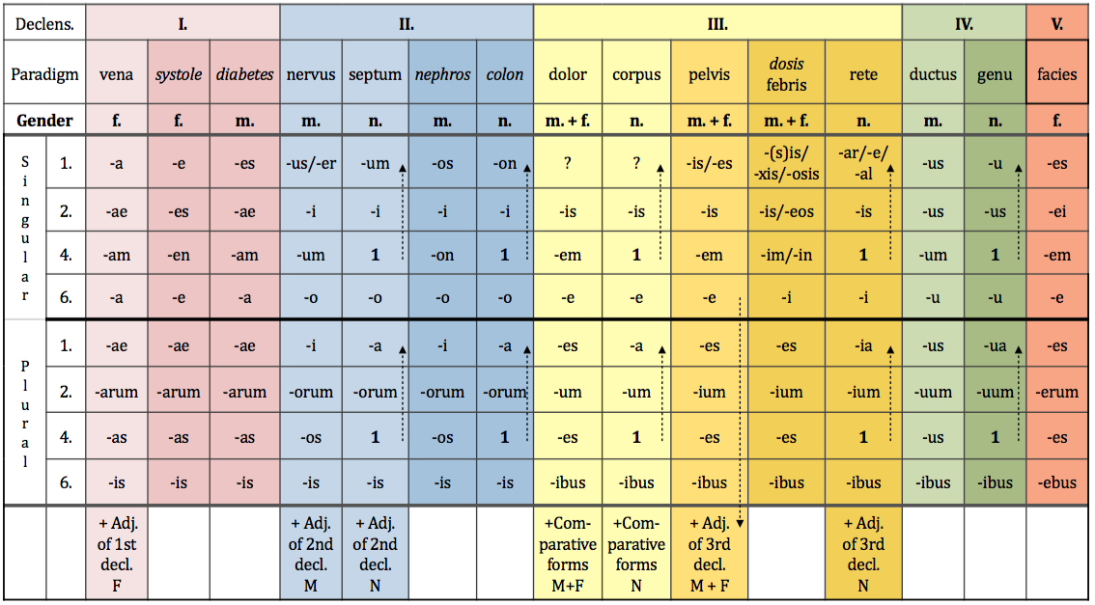
Nominative –singular and plural
Nominative singular is the first form listed in the dictionary.

Slide 10
Use the chart with endings to change the following words into plural
coxae
cervicis
coxa_ _ _ _ _ _ _ _ cervix_ _ _ _ _ _ _ _
_ _ _ _ _ _ _ _ _ _ _ _ _ _ _ _ _ _ _ _ _
_ _ _ _ _ _ _ _ _ _ _ _ _ _ _ _ _ _ _ _ _
mentum_ _ _ _ _ _ arcus _ _ _ _ _ _ _ _
_ _ _ _ _ _ _ _ _ _ _ _ _ _ _ _ _ _ _ _ _
_ _ _ _ _ _ _ _ _ _ _ _ _ _ _ _ _ _ _ _ _
I
cox-
III
cervic-
coxae
cervices
menti
arcus
II
ment-
IV
arc-
menta
arcus

Slide 11
Introduction to syntax
NOUN IN APPOSITION I.
noun + noun < GENITIVE
  Translated: using of
  Meaning: state of dependency, possession
EX: Fractura costae //fractura costarum
        Fracture of rib Fracture of ribs
        ! = rib fracture = rib fractures

Slide 12
Genitive –singular and plural
Genitive singular ending is the second form listed in the dictionary.

Slide 13
Connect two nouns
ex: caput + costa > caput costae head of rib
caput + femur ->
caput + fibula ->
caput + humerus ->
caput + phalanx ->
caput + radius ->
caput + talus ->
caput + ulna ->
caput femoris
caput fibulae
caput humeri
caput phalangis
caput radii
caput tali
caput ulnae

Slide 14
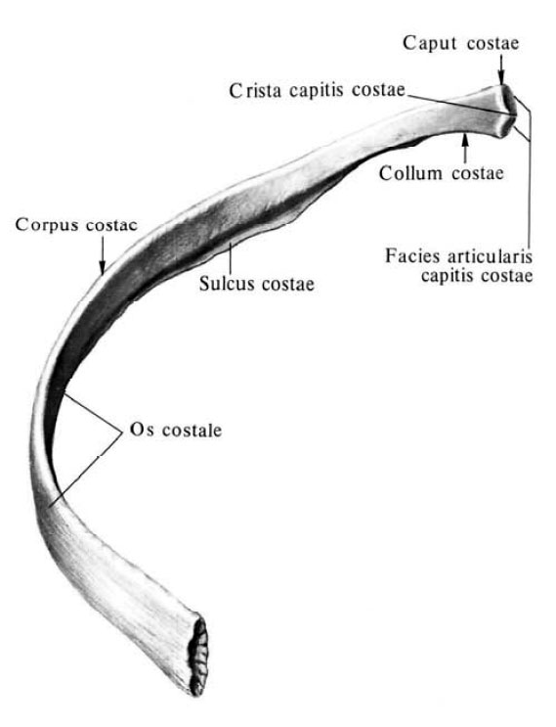
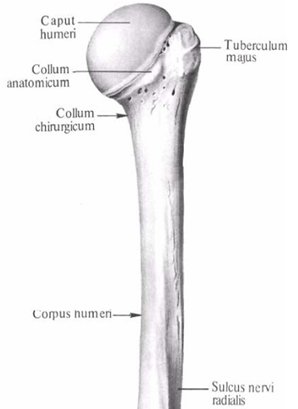

Slide 15
Prepositions and prepositional phrases
Denote:
  Spatial relations sub, infra, post
  Temporal relations post, ante
  Causal relations propter, e/ex
Can be connected with:
  Accusative case
  Ablative case
  Both Accusative and Ablative case
The dictionary entry will tell you what case to put after the preposition.

Slide 16
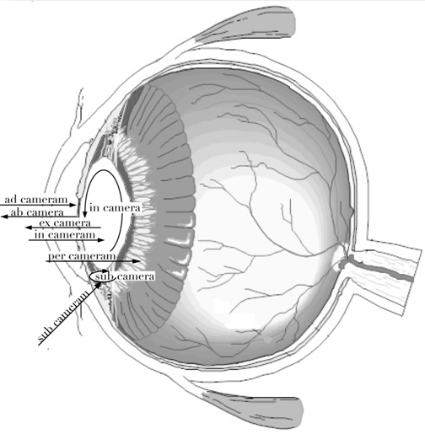

Slide 17
Accusative and ablative singular and plural

Slide 18
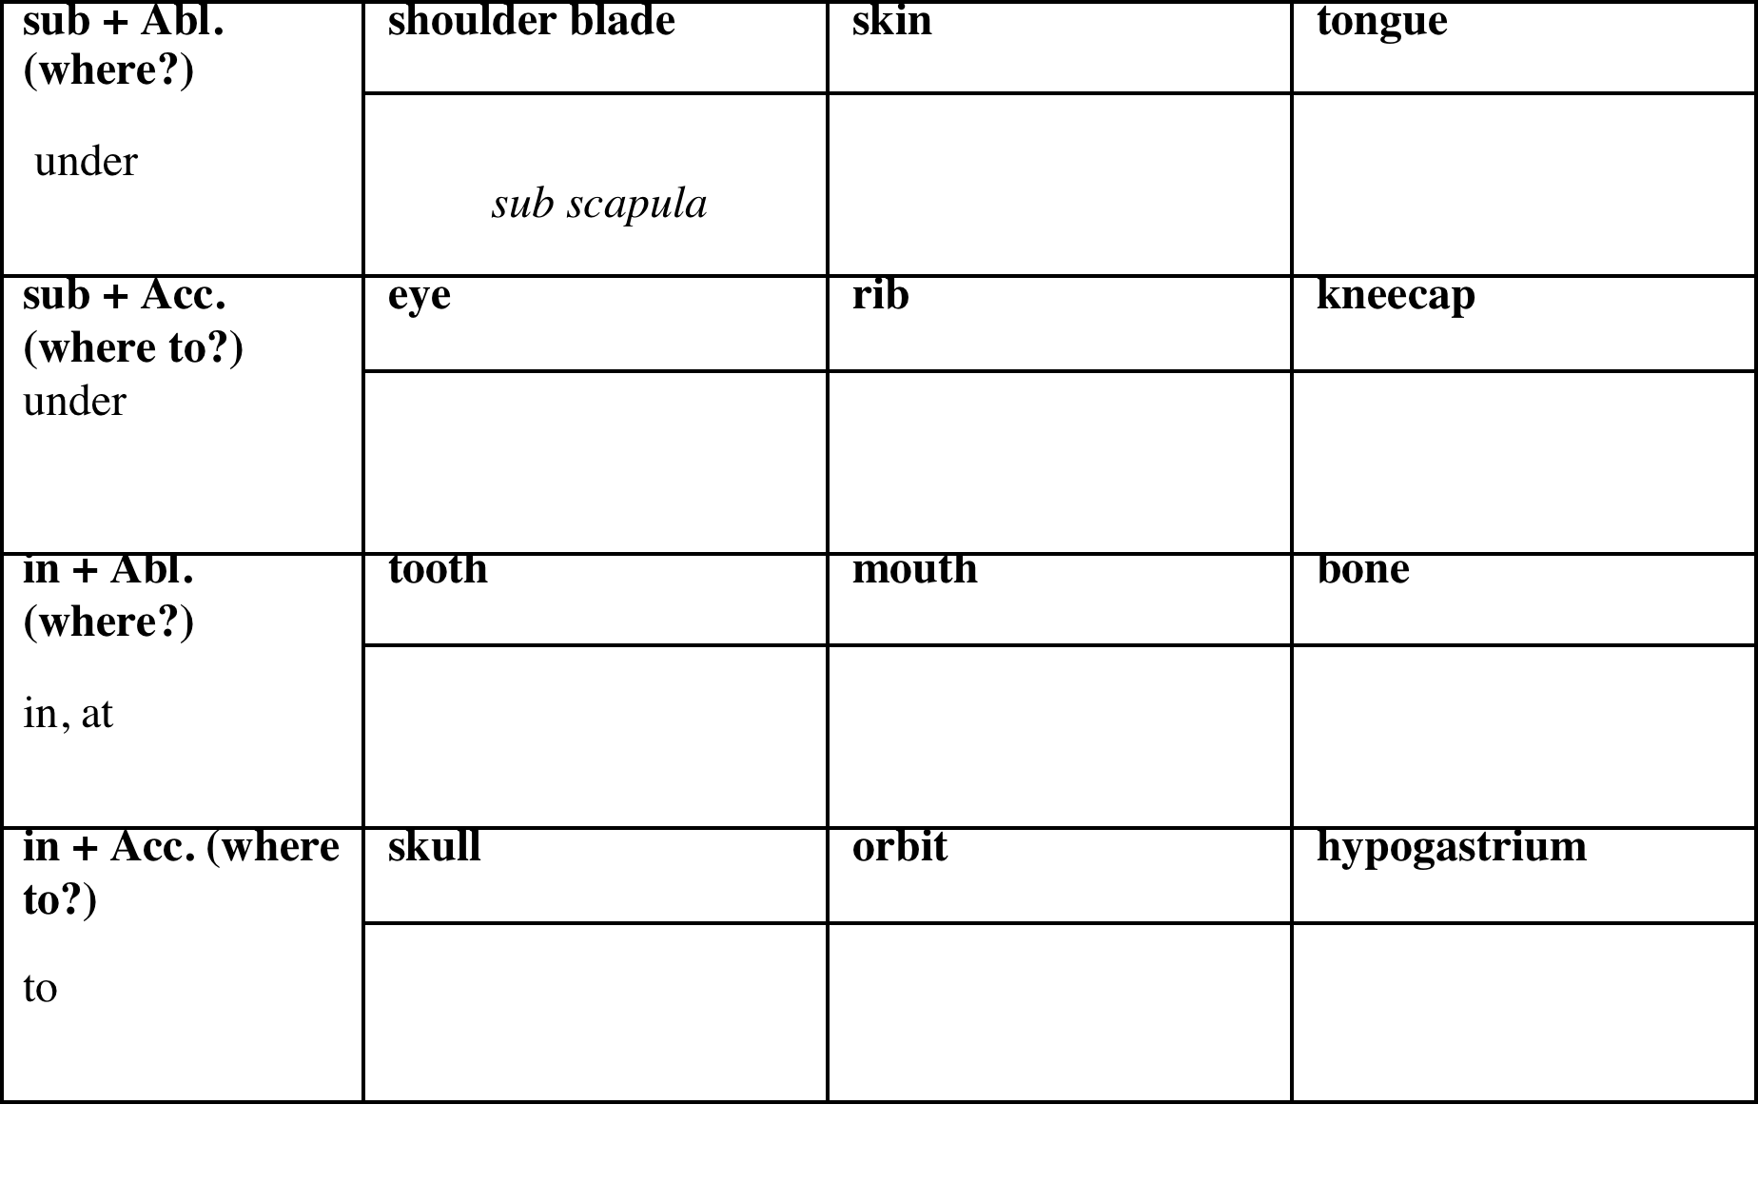
Connect nouns with prepositions
sub scapula
sub cute
sub lingua
sub oculum
sub costam
sub patellam
in dente
in ore
in osse
in cranium
in orbitam
in hypogastrium

Slide 19
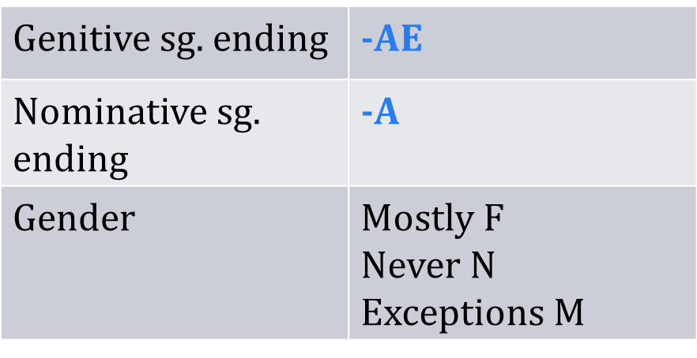
1st Latin declension
In the 1st declension we decline nouns that have:
NOUNS OF THE 1st Declension that are of masculine gender are:
  Names of specialists – Dentista, ae, m.
  Names of muscles – Agonista, ae, m.

Slide 20
1st Latin declension

Slide 21
1st Latin declension
Example word: vēna, ae, f.
case | singular | plural
nom. | vēna | vēnae
gen. | vēnae | vēnarum
ak. | vēnam | vēnas
abl. | vēnā | vēnis

Slide 22
1st Greek declension
In the first declension we decline nouns that have:
Genitive sg. ending | -ES | -AE
Nominative sg. ending | -E | -ES
Gender | F | M

Slide 23
1st Greek declension

Slide 24
1st Greek declension
 | systole, es, f | diabetes, ae, m.
nom. sg. | systole | diabetes
gen. sg. | systoles | diabetae
ak. sg. | systolen | diabetam
abl. sg. | systole | diabeta
All nouns infleced like systole, es, f. are of feminine gender.
All nouns inflectted like diabetes, ae, m. are of masculine gender.
Paradigms vena, systole and diabetes have identical endings in plural.

Slide 25
1st Greek declension

