Slide 1
Comparison of Adjectives

Slide 2
1. SUPERIOR OR SUPERIUS?
MAIOR OR MAIUS?
ANTERIOR OR ANTERIUS?
Vena cava
superior
Cornu
maius
Arteria
anterior
Membrum
superius
Ductus
maior
Ductus
anterior
Extremitas
superior
Ala
maior
Segmentum
anterius
Palpebra
superior
Musculus
maior
Margo
anterior
Labium
superius
Curvatura
maior
Bronchus
anterior
Facies
superior
Flexura
maior
Nucleus
anterior
Meatus
superior
Fossa
maior
Cornu
anterius
Arteria
superior
Foramen
maius
Nodus
anterior
Plexus
superior
Tuberculum
maius
Tuberculum
anterius
Segmentum
superius
Circulatio
maior
Radix
anterior
Regio
superior
Pelvis
maior
Crus
anterius

Slide 3
2. FORM PHRASES WITH COMPARATIVES/GIVE THE OPPOSITE
/TRANSFORM INTO ABLATIVE WITH PREPOSITION IN
Labium (superior) ___________ ___________
Membra (inferior) ___________ ___________
Tubercula (minor) ___________ ___________
Circulatio (maior) ___________ ___________
Dosis (maximus) ___________ ___________
Partes (posterior) ___________ ___________
Parietes (anterior) ___________ ___________
Foramen (maior) ___________ ___________

Slide 4
GIVE COMPARATIVES AND SUPERLATIVES:
Laesio recens
Laesio recentior
Laesio recentissima
Musculus longus
Musculus longior
Musculus longissimus
Dosis parva
Dosis minor
Dosis minima
Os longum
Os longius
Os longissimum
Musculus magnus
Musculus major
Musculus maximus
Operatio simplex
Operatio simplicior
Operatio simplicissima

Slide 5
3. GIVE COMPARATIVES AND SUPERLATIVES
Cavitas parva
c. minor
c. minima
Radix lata
r. latior
r. latissima
Defectus magnus
d. major
d. maximus
Gradus parvus
g. minor
g. minimus
Operatio acuta
o. acutior
o. acutissima
Foramen parvum
f. minus
f. minimum
Pulsus frequens
p. frequentior
p. frequentissimus
Os breve
o. brevius
s. brevissimum
Pars mollis
p. mollior
p. mollissima
Therapia longa
t. longior
t. longissima
Infarctus recens
i. recentior
i. recentissimus

Slide 6
4. PUT COMPARATIVES AND SUPERLATIVES INTO THE PLURAL
Musculi longi
longiores
longissimi
Cavitates parvae
minores
minimae
Radices latae
latiores
latissimae
Defectus magni
majores
maximi
Gradus parvi
minores
minimi
O-tiones acutae
acutiores
acutissimae
Foramina parva
minora
minima
Infarctus recentes
recentiores
recentissimi
Ossa brevia
breviora
brevissima
Partes molles
molliores
mollissimae
Therapiae longae
longiores
longissimae

Slide 7
5. GIVE THE OPPOSITE
Meatus superior
inferior
Gradus minor
major
Phalanx proximalis
distalis
Segmentum anterius
posterius
Arteria suprema
infima/ima
Anomalia minima
maxima
Pars externa
interna
Pulsus durus
mollis

Slide 8
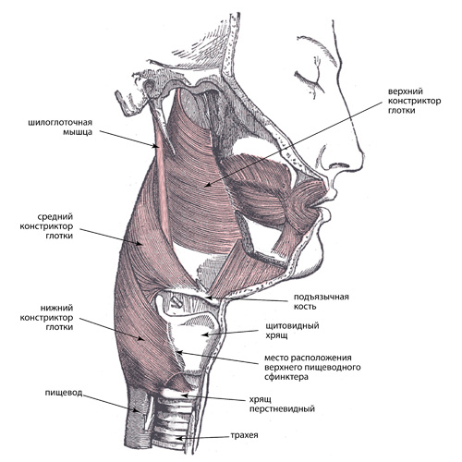
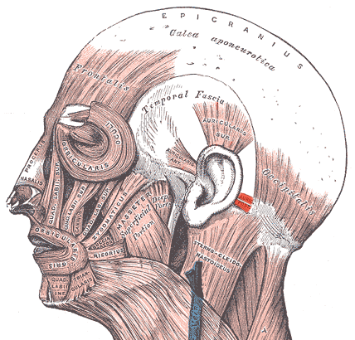
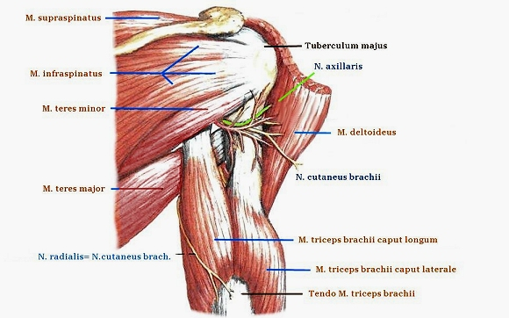
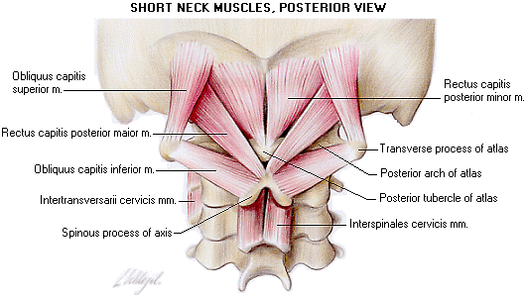
6. ADD WHAT IS MISSING
Musculus adductor minim_____
Musculus auricularis posterior, ______ et superior
Musculus constrictor pharyngis ________, medius et _________
Musculus gluteus ________, _________ et minimus
Musculi intercostales externi, ________ et ________
Musculus longitudinalis inferior et _________
Musculus rectus capitis posterior minor et ________
Musculus teres ________ et major

Slide 9
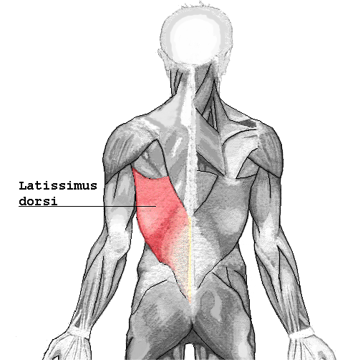
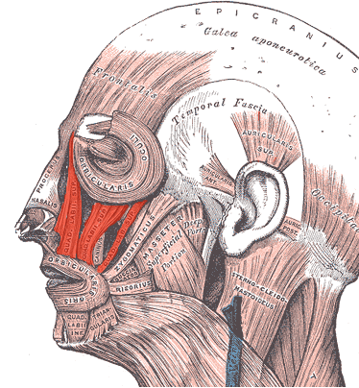
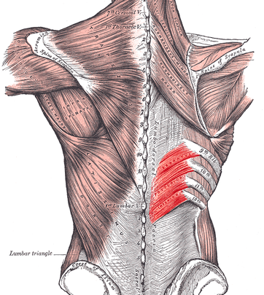
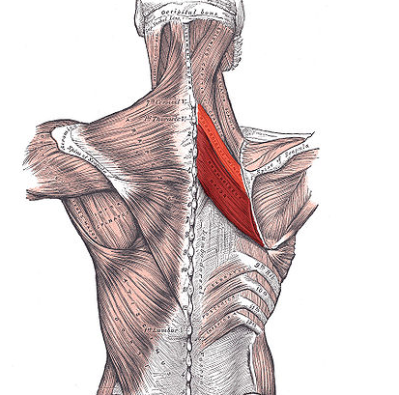
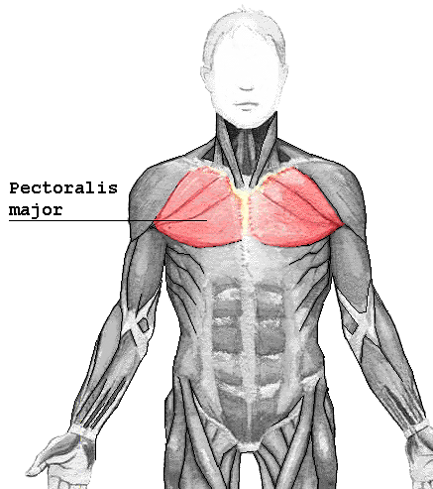
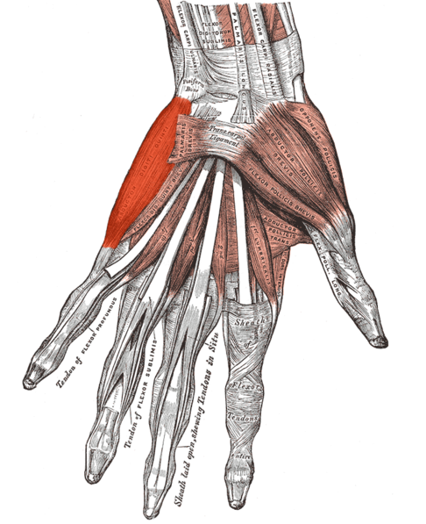
B
C
A
D
F
E
Notes:
M. latissimus dorsi
M. levator labii superioris
M. serratus posterior inferior
M. rhomboideus major
M. pectoralis major
M. abductor digiti minimi

Slide 10
FILL IN WHAT IS MISSING
superioris
Fractura membri ………………………………. /superior/
Post contusionem labii………………………./inferior/
Infarctus parietis……………………………….../anterior/ ventriculi cordis
Ramus ………………………../inferior/ arteriae
Segmenta …………………………/posterior/
Cum oedemate ……………………../maius/
In nephritide……………………………/gravior/
Tuberculum ........................... /major/ et ............................./minor/
humeri
inferioris
anterioris
inferior
posteriora
maiore
graviore
majus
minus

Slide 11
GIVE THE OPPOSITE TO THE UNDERLINED TERM
musculi membrorum inferiorum
foramen palatinum majus
pollex lateris dextri
musculus gluteus minimus
palatum molle
tunica externa arteriae
articulatio composita
arteria temporalis anterior
m. transversus perinei profundus
organa genitalia feminina
fascia superior diaphragmatis pelvis
commissura labiorum anterior
incisura ischiadica minor
spina iliaca posterior superior
pelvis major
pars proximalis urethrae masculinae
superiorum
minus
sinistri
maximus
durum
intima
simplex
posterior
superficialis
masculina
inferior
posterior
major
anterior
minor
distalis

Slide 12
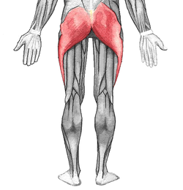
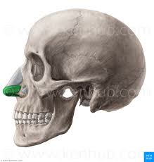
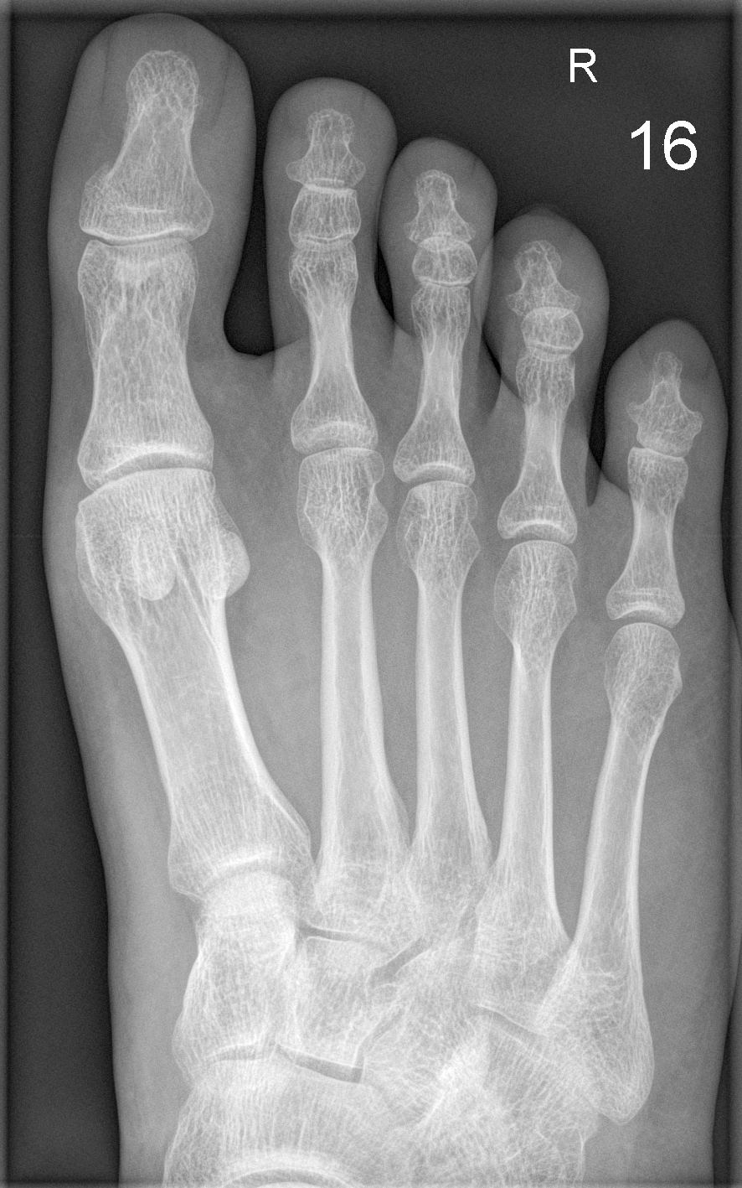
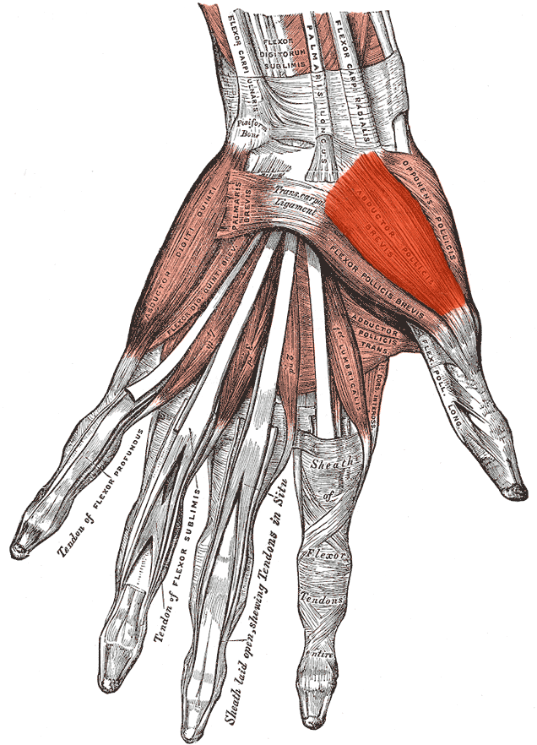
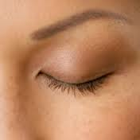
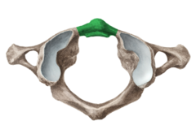
NAME COLORED/HIGHLIGHTED STRUCTURES
Notes:
Musculus gluteus maximus // Cartilago alaris major // Digitus minimus pedis // palpebra superior // musculus abductor pollicis brevis // Arcus anterior atlantis

Slide 13
READ MEDICAL RECORDS CONTAINING NUMERALS
ICD code | DIAGNOSIS
S2230 | Fractura traumatica costae VI.- IX. l. dx
S2200 | Fractura pathologica vertebrae Th7, Th9, Th10 et processus transversi L3
S2200 | Fractura compressiva corporis vertebrae Th 5, Th9, Th11 et Th12
S6261 | Fractura phalangis proximalis digiti III. manus l. sin. comminutiva aperta
S6230 | Fractura ossis metacarpalis V. manus l. dx.
S9230 | Fractura ossis metatarsalis II. et III. pedis l. dx. sine dislocatione
L030 | Defectus chronicus cum phlegmone digiti IV. pedis l. sin.
D6919 | Gangraena diabetica hallucis et digiti II. pedis l. dx.
Phlegmone, es, f. : phlegmon (purulent inflammation of the cellular
or areolar tissue)

Slide 14
CHANGE THE WORD ORDED TO GET THE AUTHENTIC RECORD
pedis excoriationes dx. et ablatio digiti II. multiplices unguis pedis I.
seu manus quinti luxatio digiti l. sin. minimi
Excoriationes pedis I. dx. multiplices et ablatio unguis digiti II. pedis
Luxatio digiti quinti seu minimi manus l. sin.
digiti vulnus III. manus contusolacerum l. sin.
digiti pollicis status II. post traumaticam et manus l. dx. amputationem
Vulnus contusolacerum digiti III. manus l. sin.
Status post amputationem traumaticam pollicis et digiti II. manus l. dx.

Slide 15
FILL IN THE MISSING ENDINGS, TRANSLATE AUTHENTIC RECORDS
1: Distorsio gen_ _ l. dx. cum excoriation_ _ _ _ multiplic_ _ _ _et laesion_ muscul_ _ _ _ l. dx. suspect_
2: Laceratio lob_ superior_ _ pulmon_ _ l. sin et contusio pulmon_ _ l. dx lev_ _
3: Fractura oss_ _ _ nasal_ _ _ sine dislocation_. Contusio faci_ _
cum haematomat_ region_ _ orbital_ _ l. sin.
4: Contusio cox_ _ l. sin. cum distension_ muscul_ _ _ _ region_ _
glute_ _ l. sin.

Slide 16
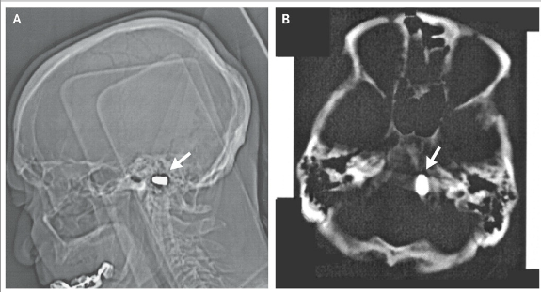
Cranial computed tomographic imaging revealed a metal foreign body, 1.2×0.7 cm, at the left edge of the foramen magnum in 85-year-old man. There was no clinical or radiographic evidence of neural damage. The patient revealed that at the age of 3 years he had been accidentally shot with a pistol by his older brother. The bullet had struck him just inferior to the nose, and he had lost consciousness for several hours, recovering without any specific therapy.

Slide 17
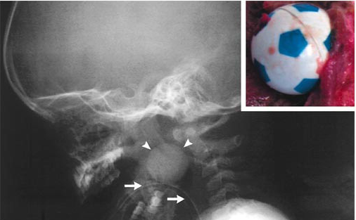
A three-year-old boy was playing with a plastic ball while in the backseat of a car. The father heard a gasp, saw that the child was unconscious, and suspected the child to aspirate the toy ball. Emergency personnel intubated the child, no foreign body was visualized then. The child was dead on arrival at the hospital. During the postmortem examination, a radiograph of the head and neck showed a spherical foreign body located in the oropharynx. The oropharynx contained a toy soccer ball 2.5 cm in diameter.
Notes:
Corpus alienum sphaeroideum oropharyngis
Sphaeroideus, a, um - význam koncovky –oideus, + iné príklady geometr. tvarov (rhomboideus, conoideus, deltoideus, cuboideus, ellipsoideus)
Oropharynx, gis, m. - požiadať ich, aby sa pokúsili vysvetliť, ako je slovo vytvorené (os, oris, n. + pharynx, gis, m.)

