Slide 1
Fractures

Slide 2
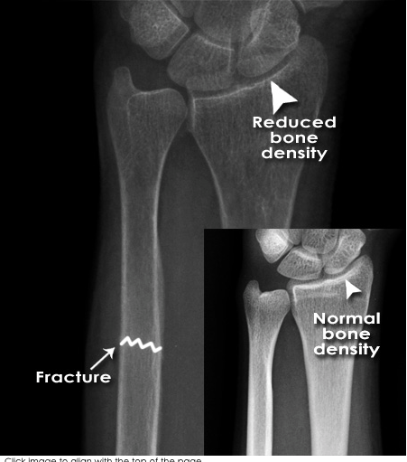
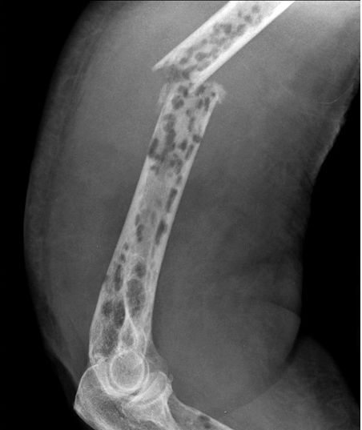
Fractura pathologica
Myeloma -The plasma membrane of a muscle fiber

Slide 3
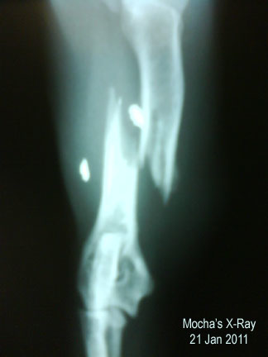
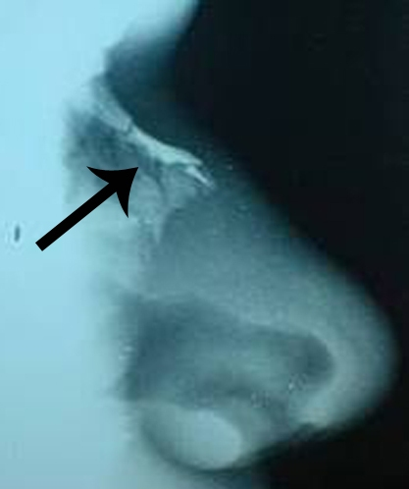
Fractura traumatica

Slide 4
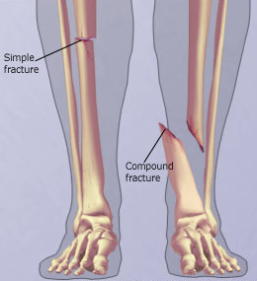
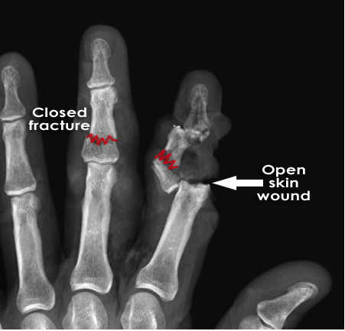
Fractura aperta/clausa

Slide 5
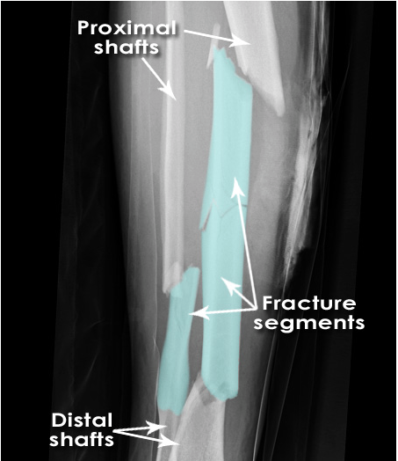
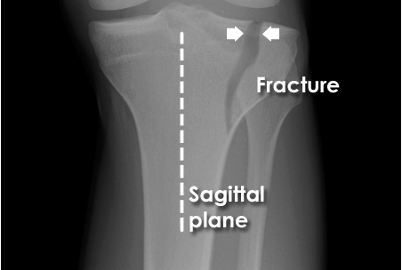
Fractura simplex/multiplex

Slide 6
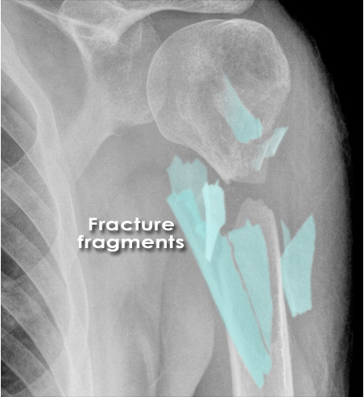
Fractura comminutiva

Slide 7
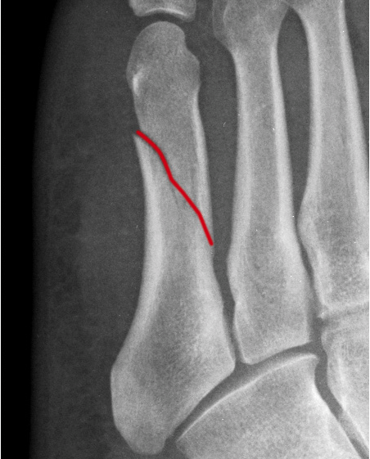
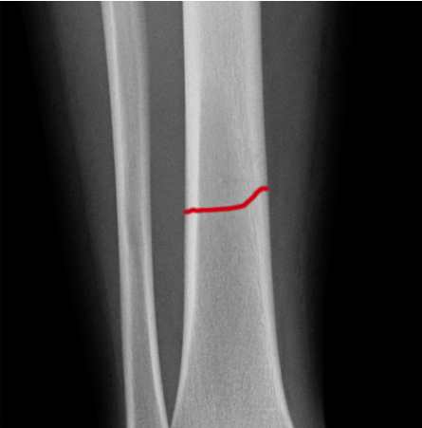
Fractura transversa/obliqua

Slide 8
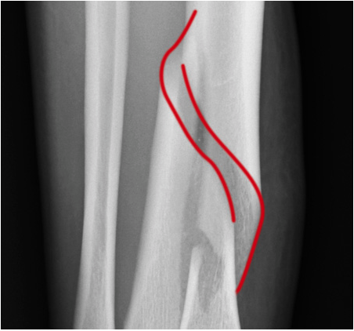
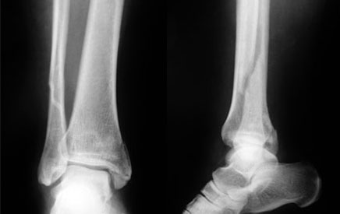
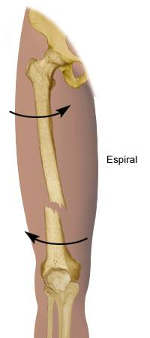
Fractura spiralis / longitudinalis

Slide 9
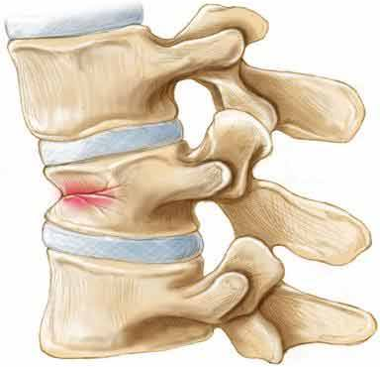
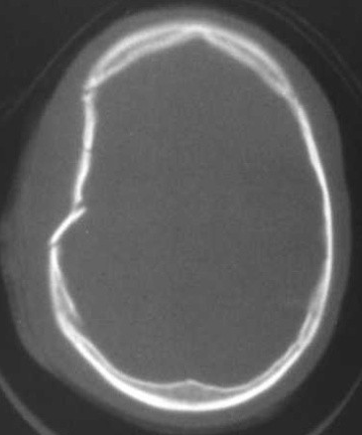
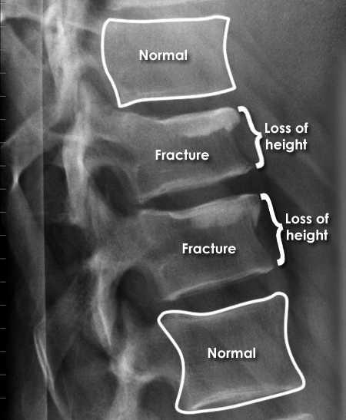
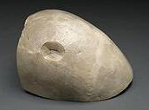
Fractura compressiva / impressiva

Slide 10
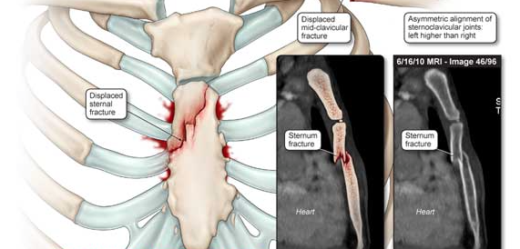
Fractura incuneata
Notes:
Toto by snáď mohlo byť ok?

Slide 11
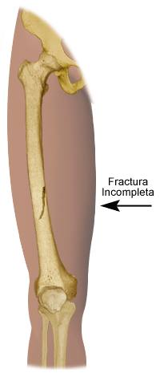
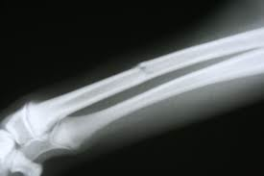
Infractio = f. partialis = f. incompleta

Slide 12
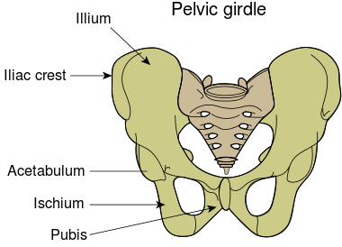
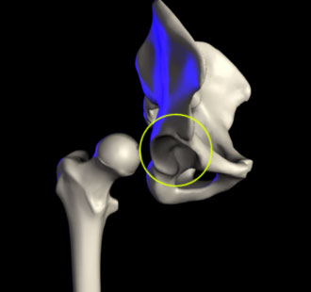
The acetabulum (cotyloid cavity) is a concave surface of the pelvis. The head of the femur meets with the pelvis at the acetabulum, forming the hip joint.

Slide 13
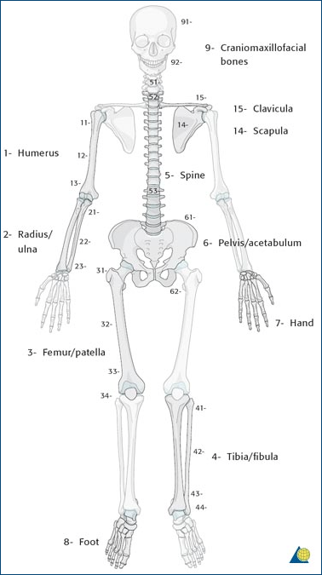
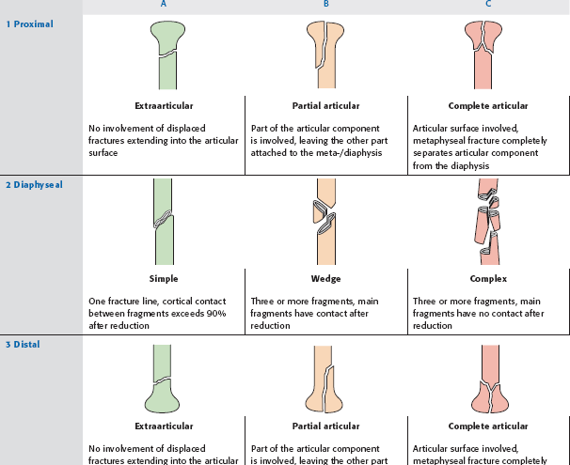
AO Classification of fractures
S 4220 Fractura colli chirurgici humeri l. dx. comminutiva AO 11-C3
Notes:
první číslo – vyjadřuje postiženou kost (1 humerus, 2 předloketní kosti, 3 femur, 4 bérec, 5 páteř, 6 pánev, 7 ruka 8 noha)
druhý údaj – určuje segment kosti (u dlouhých kostí – 1 prox.epimetafýza, 2 diafýza, 3 distální epimetafýza)
- třetí údaj ukazuje typ zlomeniny – A-C, u každé části je konkrétní

Slide 14
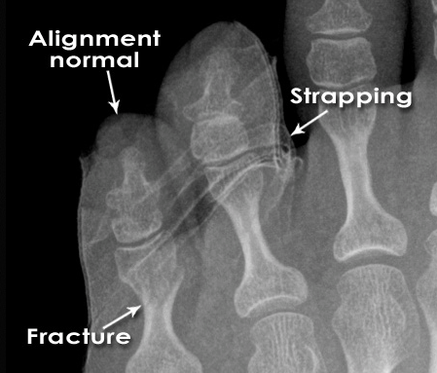
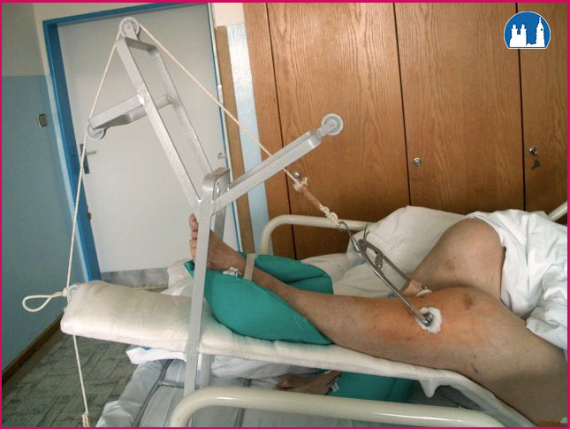
Fracture Healing:
1: REPOSITIO = REDUCTIO fragmentorum
  CLOSED (short /long term)
Notes:
is a medical procedure to restore fracture or dislocation to the correct alignment. This sense of the term "reduction" does not imply any sort of removal or quantitative decrease but rather implies a restoration: re ("back [to normal]") + ducere ("lead"/"bring"), i.e., "bringing back to normal."
Use of plates, screws, and wires was first documented in the 1880s and 1890s. Early surgical fixation initially was complicated by many obstacles, such as infection, poorly conceived implants and techniques, metal allergy, and a limited understanding of the biology and mechanics of fracture healing.[1] During the 1950s, Danis and Muller began to define the principles and techniques of internal fixation.

Slide 15
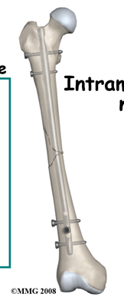
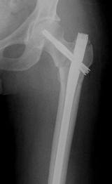
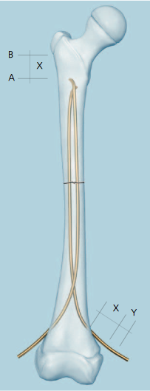
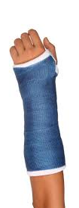
Fracture Healing:
2: FIXATIO = STABILISATIO fragmentorum
  PLASTER CAST
  INTERNAL FIXATION
Notes:
(mechanical stability)
intramedullar rods/ Internal plates and screws
ESIN

Slide 16
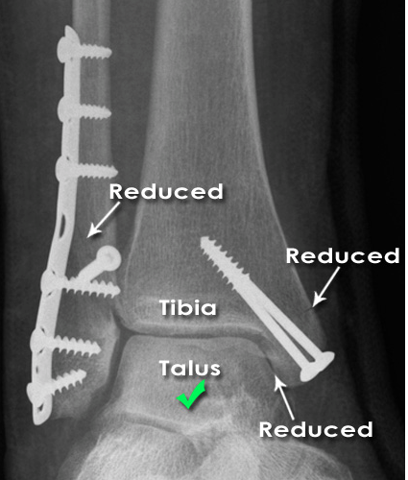
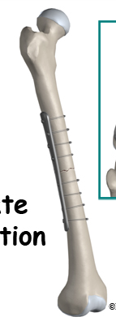
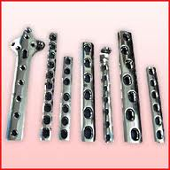
Fracture Healing:
2: FIXATIO = STABILISATIO fragmentorum
INTERNAL FIXATION

Slide 17
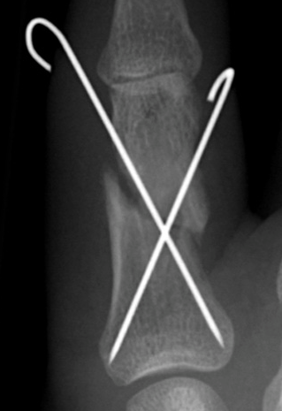
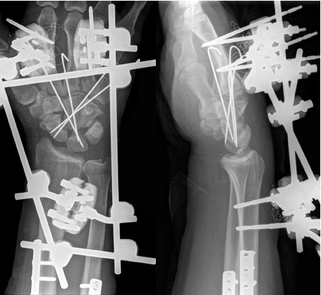
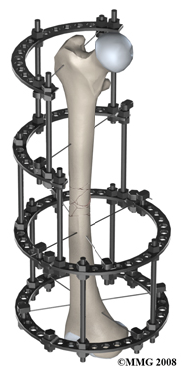
Fracture Healing:
2: FIXATIO = STABILISATIO fragmentorum
Notes:
Kirschner

Slide 18
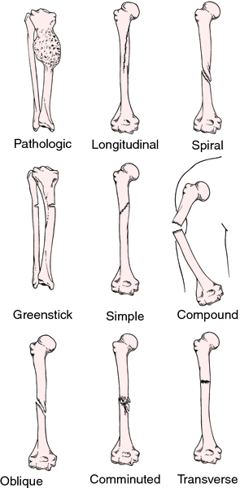
Name the type of fracture
A
B
C
D
E
F
Notes:
A, pathologica
B, spiralis
C, infractio, incompleta
D, obliqua
E, aperta/complicata
F, comminutiva

Slide 19
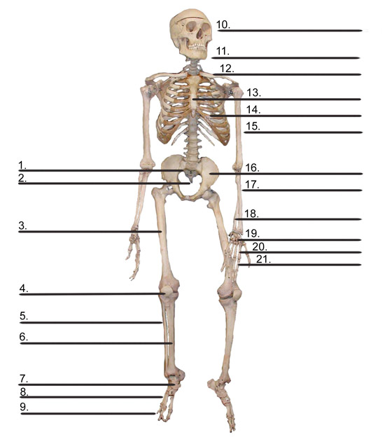
A) Name different bones of the human body
B) Write down different types of fractures of named bones
Notes:
Cvičení primárně slouží jako opakování názvú kostí lidského těla, (kosti pojmenovat, zařadit do deklinace, určit gen. základ slova, případně odvodit adj.
Sekundárně jej možno použít jako cvičení pro zopakování typu zlomenin, student si vybere, kterou kost a jak “zlomí” a pokusí se to zapsat

Slide 20
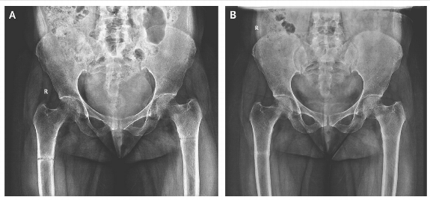
1
A 45-year-old woman presented with a 3-month history of generalized body pains nonresponsive to analgesic agents. Along with low back pain, she had progressive difficulty in getting up from sitting and supine positions and in walking. There was no history of trauma or any medication intake. She is an orthodox believer who wears a black veil outdoors and is completely covered, with little exposure to the sun. An anteroposterior radio-graph of the pelvis showed an undisplaced transverse fracture of the shaft of both femurs. The patient was treated with therapeutic doses of calcium and vitamin D supplements.

Slide 21
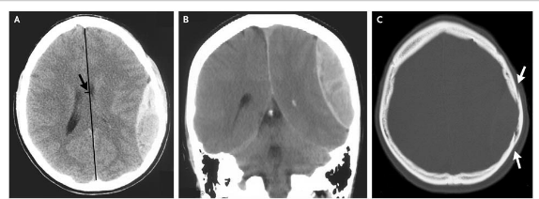
2
An 18-year-old slightly intoxicated man was assaulted with a glass bottle on the left parietal region of his head and had a 5-minute loss of consciousness. Two hours after the injury he was presented to a local emergency with severe headache, nausea, and repeated vomiting. Computed tomography of the head revealed a 2.5-cm epidural hematoma in the left parietal region (Panels A and B) underlying a linear nondisplaced skull fracture (Panel C, arrows).

Slide 22
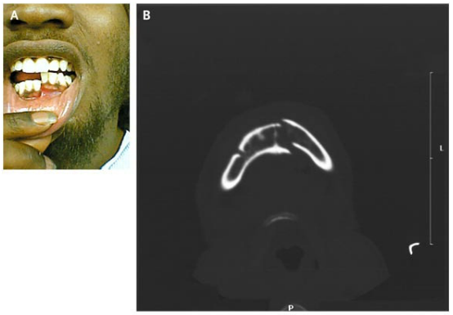
3
A 21-year-old man
presented after being
struck with a gun on
his right lower jaw.
Examination revealed
displacement of the
left half of his mandible with malocclusion on biting (Panel A). Computed tomography showed a fracture of the left mandible and a fracture of the right mandibular body and angle (Panel B). Given the U shape of the mandible, it is common for contralateral fractures to result from major injury. Intravenous analgesics and antibiotics were given; the patient underwent open reduction with internal fixation of his fractures.

Slide 23
Literature
Mazánek, J.: Traumatologie orofaciální oblasti. Praha : Grada, p. 24
http://radiologymasterclass.co.uk
http://anthropology.si.edu
http://nejm.org (The New England Journal of Medicine)

